Slide 1

Covid-19 US States Dashboard
Author: Eric Junkins
Systems Software Engineer (1740)

Slide 2
Motivation
Goal:
Help answer the question “are state governments taking appropriate lockdown action in response to COVID-19?”
Approach:
Design an interactive tool to explore COVID-19 data from each state
Both relative to all other states, and absolute scales
Monitor individual states responses (ie. Lockdown orders)
Allow sorting/filtering to view trends between states

Slide 3
Technology Used
Dashboard
Built in D3
Datasets
CovidTrackingProject - API
Johnhopkins University - API
US States lockdown orders - Manually gathered
Other relevant state datasets (population, political affiliation etc.)

Slide 4
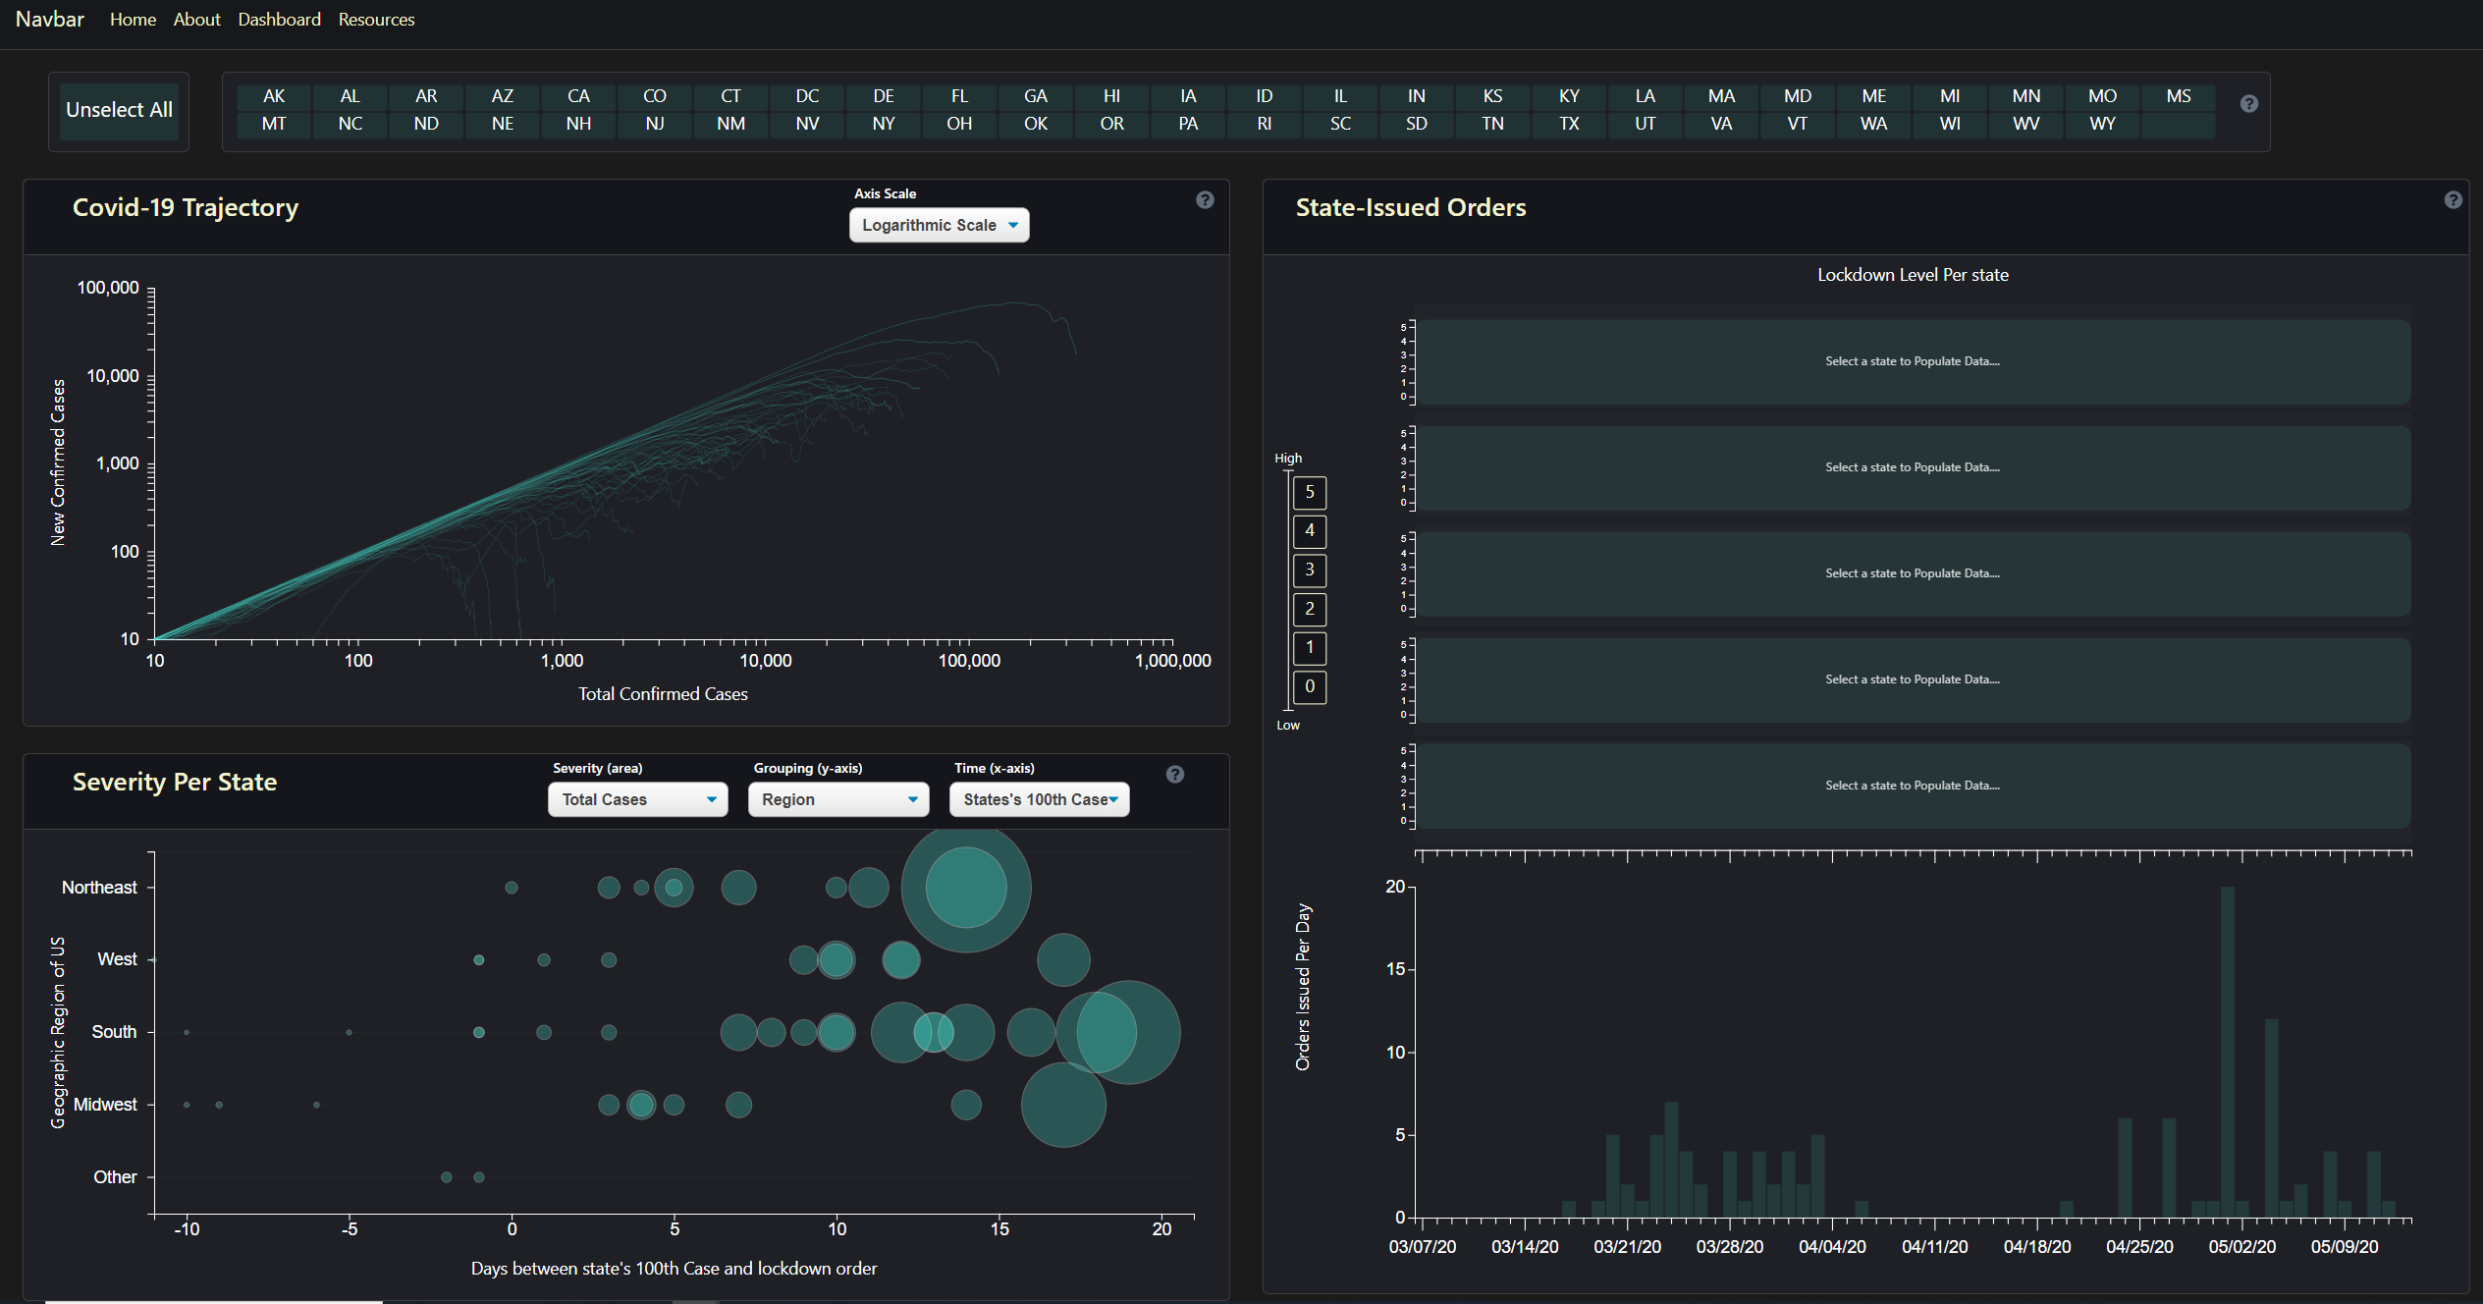
Dashboard
Represent all states where possible
Highlight states when selected for comparison
Interactive for user, most objects clickable to select/more information

Slide 5
Dashboard Components
Selection Tool:
Used for Selecting and unselecting states
Functions as Color Legend

Slide 6
Dashboard Components
State Issued Orders:
Issues ordered per day
Individual state’s lockdown level over time

Slide 7
Dashboard Components
Severity Bubbles:
Comparison of states “severity” when lockdown happened locally
Selection criteria to find trends between states

Slide 8
Dashboard Components
Covid-19 Trajectory Chart:
Different than standard Log Cases vs Time
Instead is Log new cases vs Log total cases
Easily highlights “flattening curve”
Marks orders for each state

Slide 9
Demo
https://ericjunkins.github.io/covid-19-us-states/

Slide 10
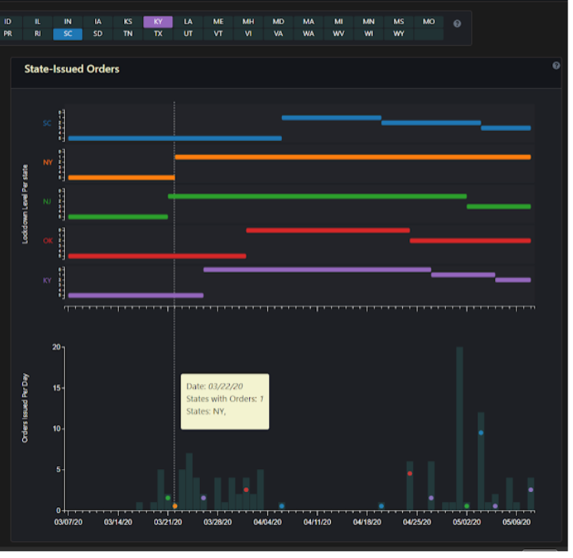
Examples/Conclusions
Compare what states released orders on what day
See each state’s lockdown level as a function of time

Slide 11
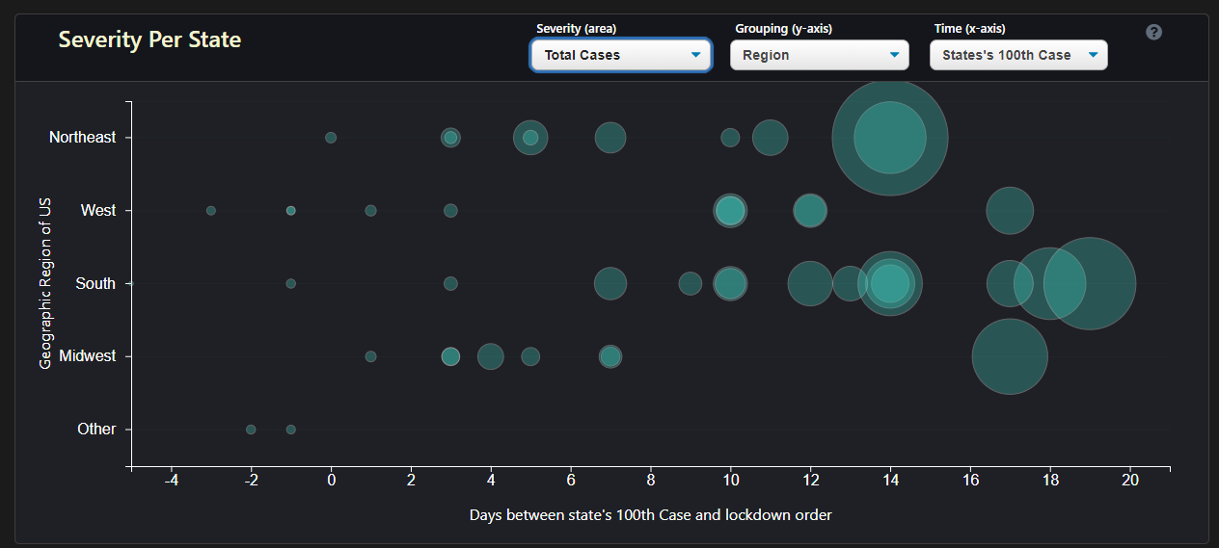
Examples/Conclusions
Southern states tended to wait longer, and get more severe before issues a lockdown order
Midwest states tended to respond quicker and didn’t get as severe

Slide 12
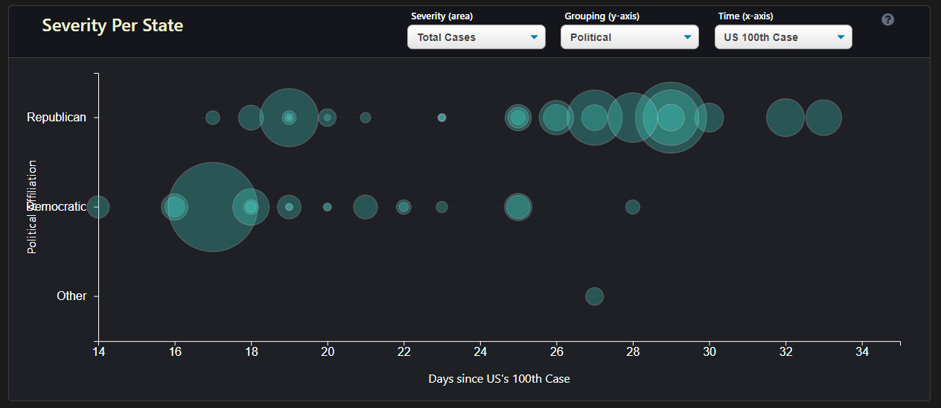
Examples/Conclusions
Democratic states responded quicker on average and didn’t get as severe (NY as outlier)

Slide 13
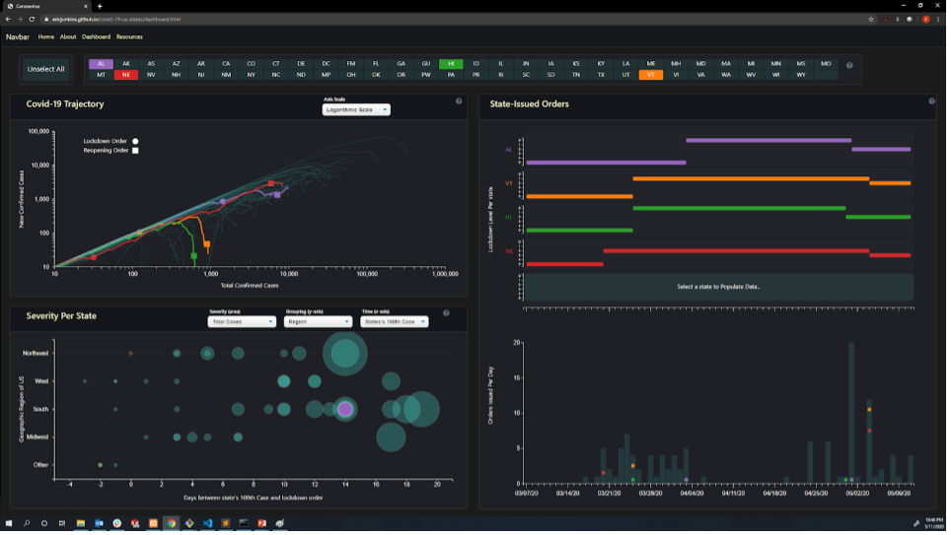
Examples/Conclusions
NE, AL are still increasing or spike after reopening order
VT and NE released reopening order to level “3” on the same day, despite drastic different conditions
HI, VT have done a great job “flattening curve”, downward curve after reopening order

Slide 14
Future Work
Modifications on current visualizations
Additional filtration criteria of displays
Better filtration, grouping, and selection to focus on trends between groups of states
Splash page information more clear, demo on how to use/understand dashboard
General clarity updates of charts, legends etc.
Additional visualizations
New tab of “current/up-to-date” data
US state map colored by selectable criteria (lockdown level, cases in last week, cases per capita etc.)
US State ranking based on selectable criteria

