Slide 1
Suduku game
C++ OOP Version

Slide 2
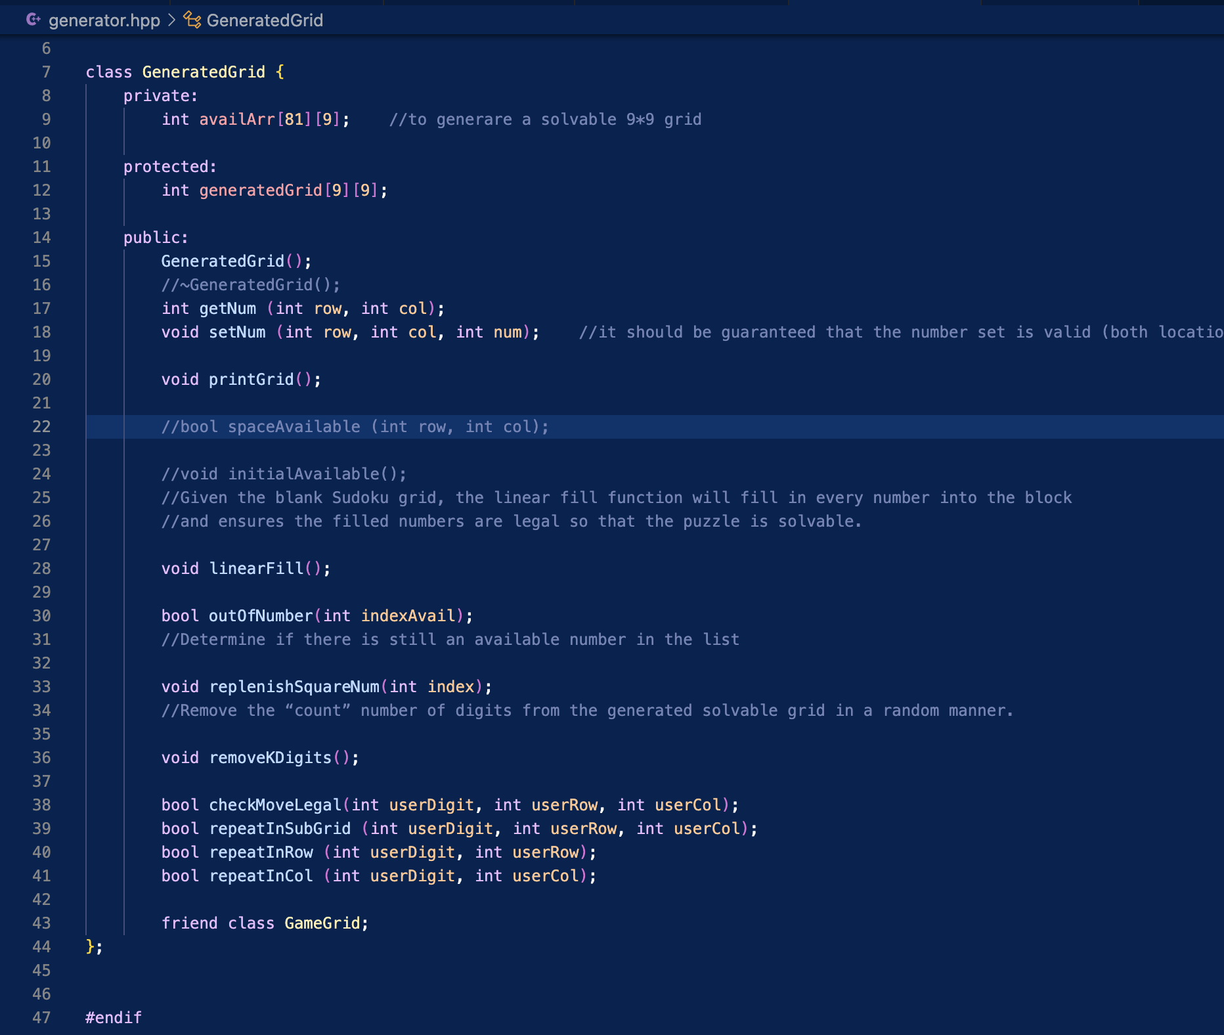
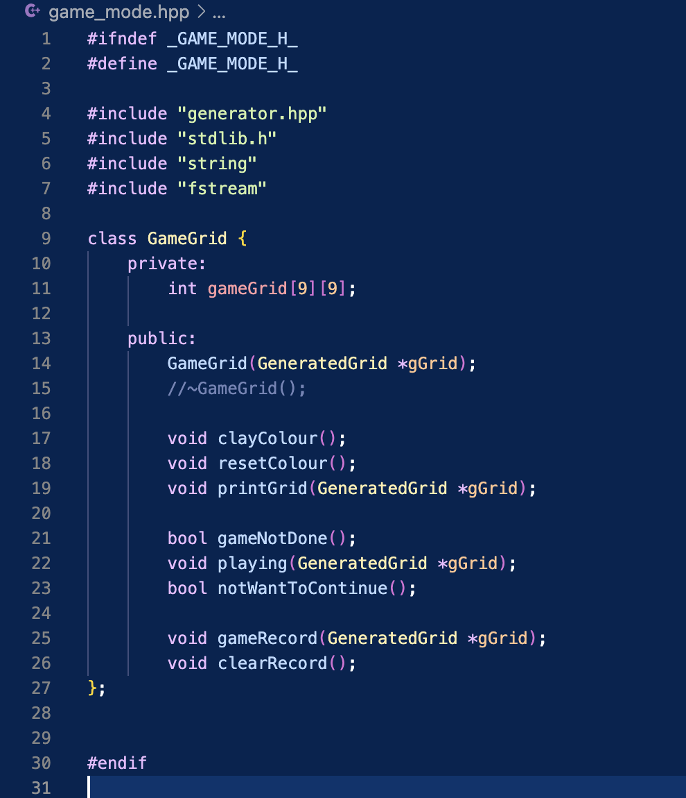
Updates:
OOP implementation
Two classes implemented (one friend class)

Slide 3
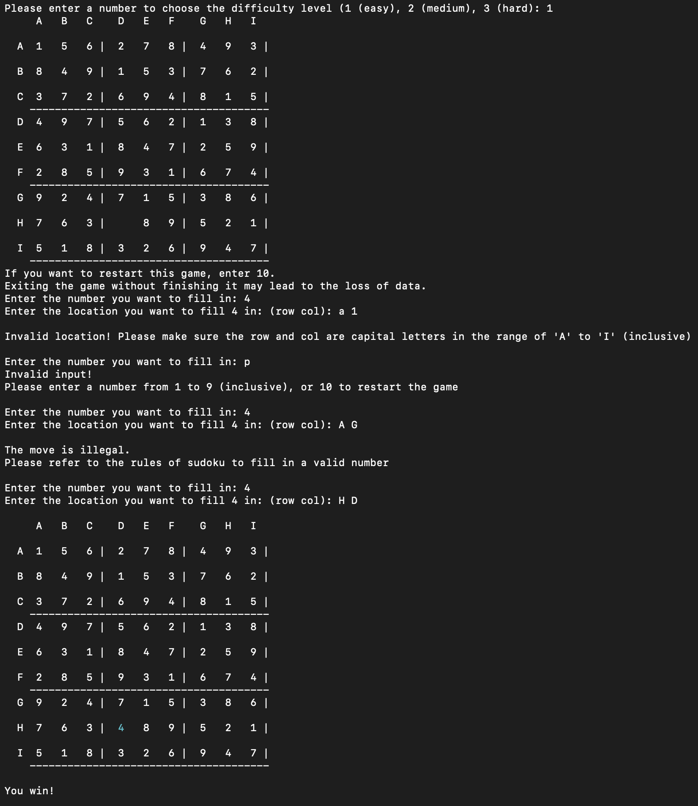
First Run
Different difficulty levels result in different number of digits removed
(for simplicity of demo only one digit is removed)
Problematic inputs will be caught. The program will tell the user what is wrong with the input
User inputs have different color to be distinguished.
Once the board is filled, the single game ends.

Slide 4
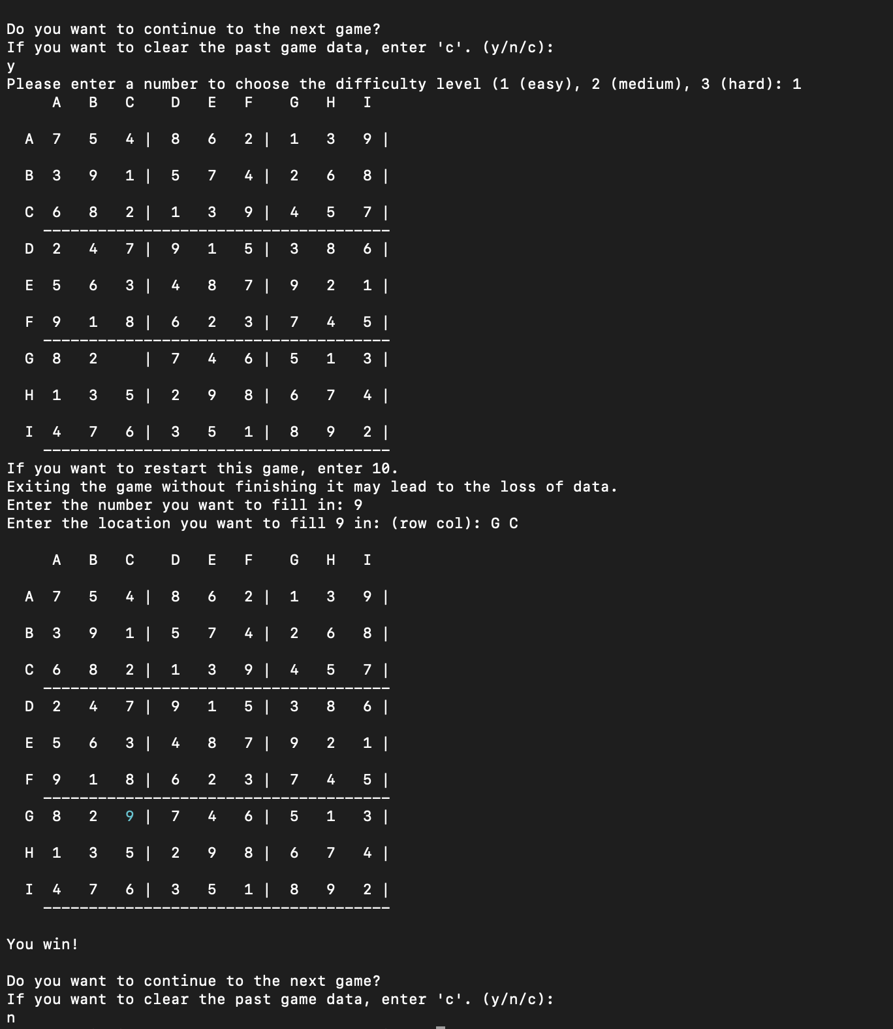
Second Run
After one game, the program asks if the user wants to continue.
Three options are provided, respectively yes/no/clear.
If y is entered, a new game is generated.
If n is entered, the program stops.

Slide 5
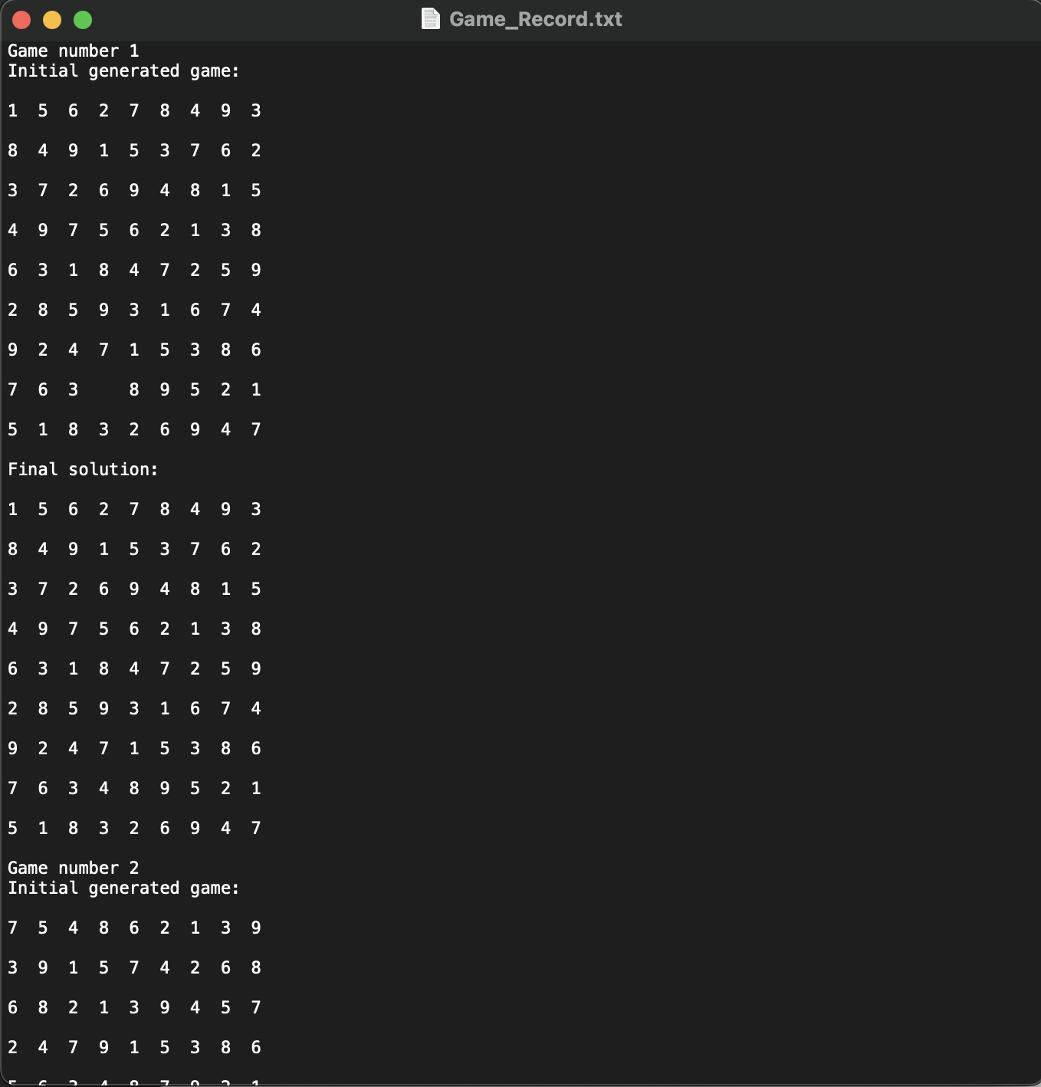

Game Record File
At this point, the Game_Record.txt file saves the previous games played with game number recorded so that the user can keep track of the previous games.
Even when the program restarts, the game number is still saved in another text file for the program to read and update.

Slide 6
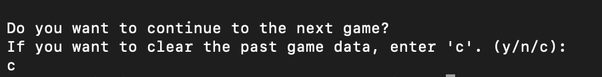
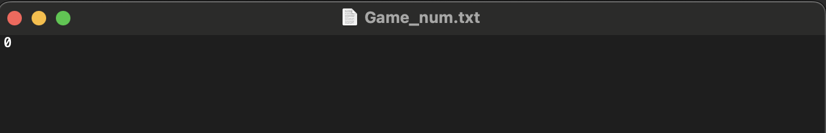
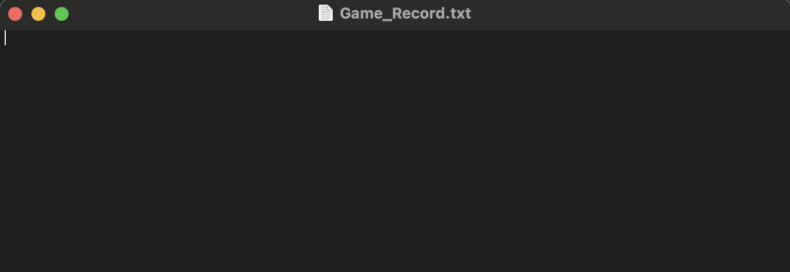
Clear record
When the user enters ‘c’ to clear the record:
Game_num resets to 0
Game_Record resets to nothing

