Slide 1
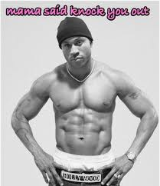
Knockout
Erick Thompson
erick.thompson@gmail.com
datatoknowledge.com

Slide 2
What is knockout
JavaScript library that provides a framework for rich data binding
Focuses on the client side of an application
Fits best with applications that use the MVVM pattern

Slide 3
What it isn’t
UI library
Collection of utilities

Slide 4
Model
The shape of the data on the server
Generally domain objects
View
Defines the user facing part of the application
HTML (or jade, MVC, etc.)
View Model
Data representation of the UI
Container for all state in the application

