Slide 1
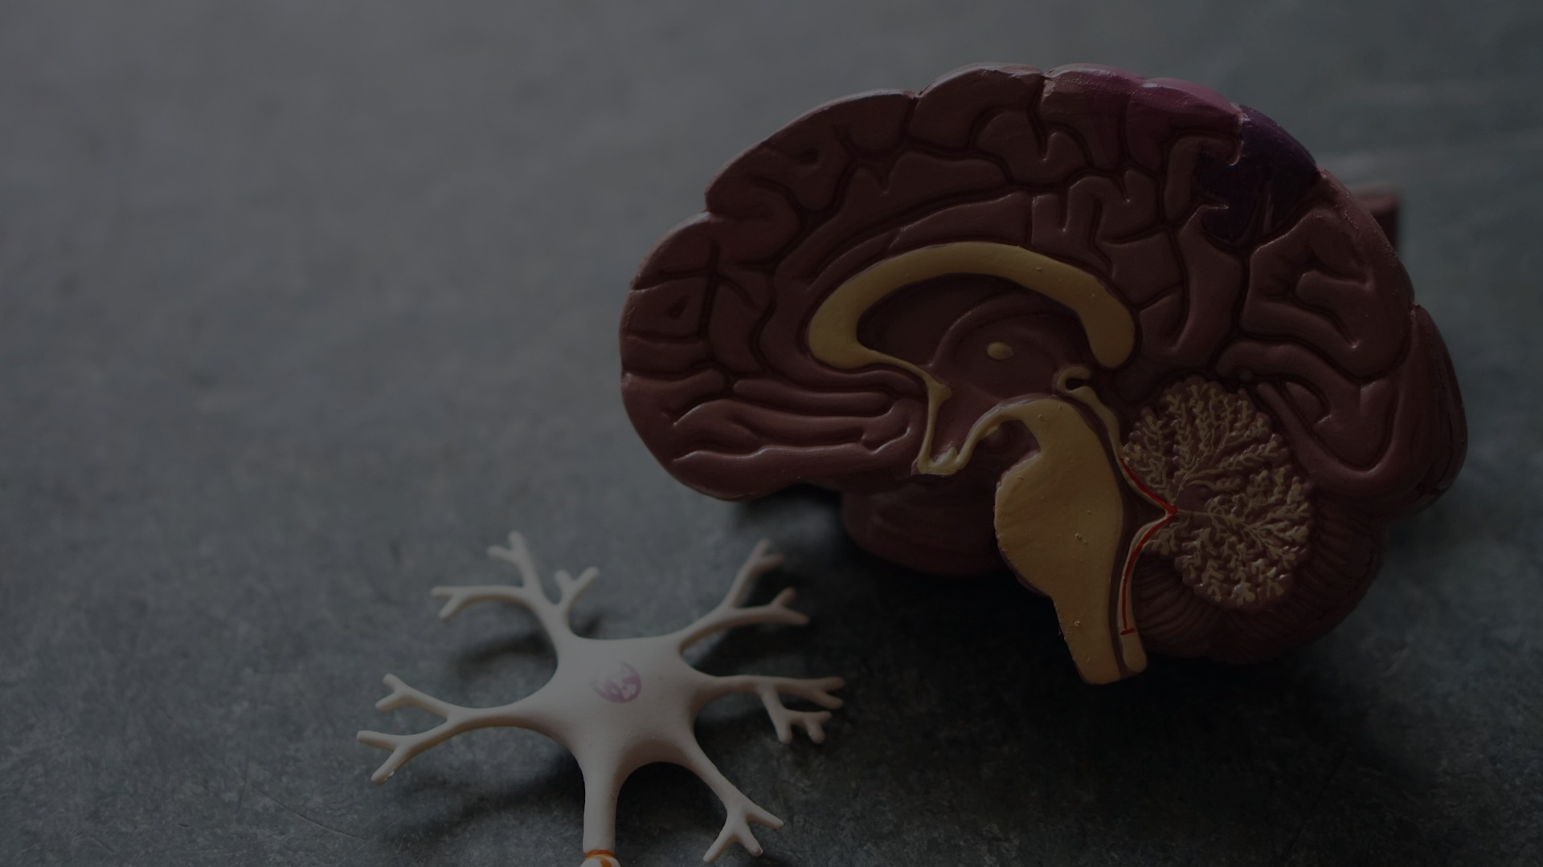
HULT PRIZE 2026 INTERNATIONAL PITCH
Solving the Unseen.
Scaling the Impact.
Pioneering Dual AI Architecture for Global Healthcare (Alzheimer's) and Food Security (Banana Plagues) powered by DeepMind & USC LONI.

Slide 2
Two Planetary Crises.
One Root Cause: Late Detection.
1. Healthcare: Neurological Collapse
• $1.3T Global economic cost of dementia. Structural brain damage is irreversible by the time symptoms appear.
• 20% Misdiagnosis rate in standard health systems due to fragmented human analysis of MRIs.
2. Food Security: Agricultural Collapse
• 400M+ People rely on bananas as their staple food. TR4 Fusarium Wilt destroys entire plantations.
• 100% Crop loss occurs because farmers lack access to laboratory-grade phytopathology tools in the field.

Slide 3
The Unified AI Brain
Perdix Origin Platform
Different problems, identical underlying mathematical challenge: Pattern Recognition at early stages. Our platform orchestrates two specialized engines.
🧠 Cloud AI
Deep Tensor Extraction & Healthcare Multi-modal Fusion
<===>
📱 Edge AI
Agrotech Computer Vision engineered for Mobile Offline Inferencing

Slide 4
Global Data Foundation
USC LONI & The IDEAS Project
Our AI models aren't trained on synthetic or standard data. We leverage the Image Data Archive (IDA) from the Laboratory of Neuro Imaging (LONI) at the University of Southern California (USC).
■ The IDEAS Study Validation
We base our architecture on findings correlated with the IDEAS (Imaging Dementia—Evidence for Amyloid Scanning) project, enhancing PET scan analytical correlations with NIfTI MRI.
■ ADNI Standardization
Strict adherence to Alzheimer's Disease Neuroimaging Initiative standardizations, parsing thousands of multi-country subjects ensuring zero bias clinical reliability.
145,000+
SIGNATURES ANALYZED BY IDA GLOBALLY

Slide 5
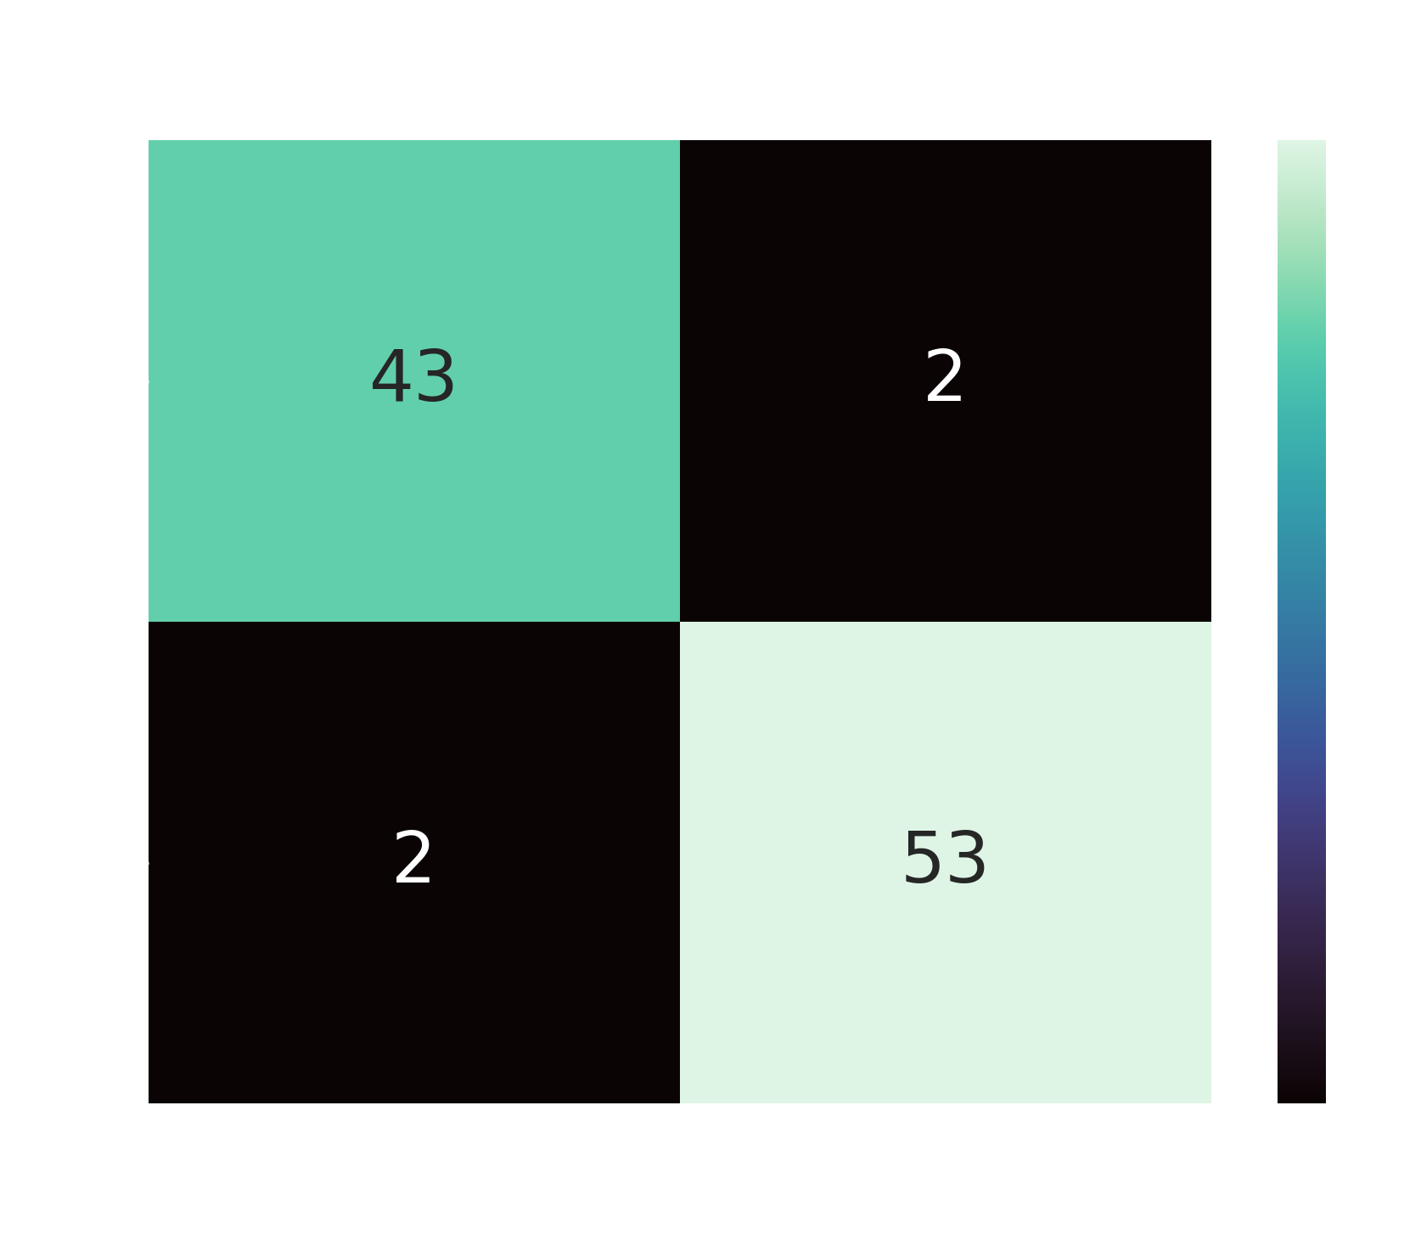
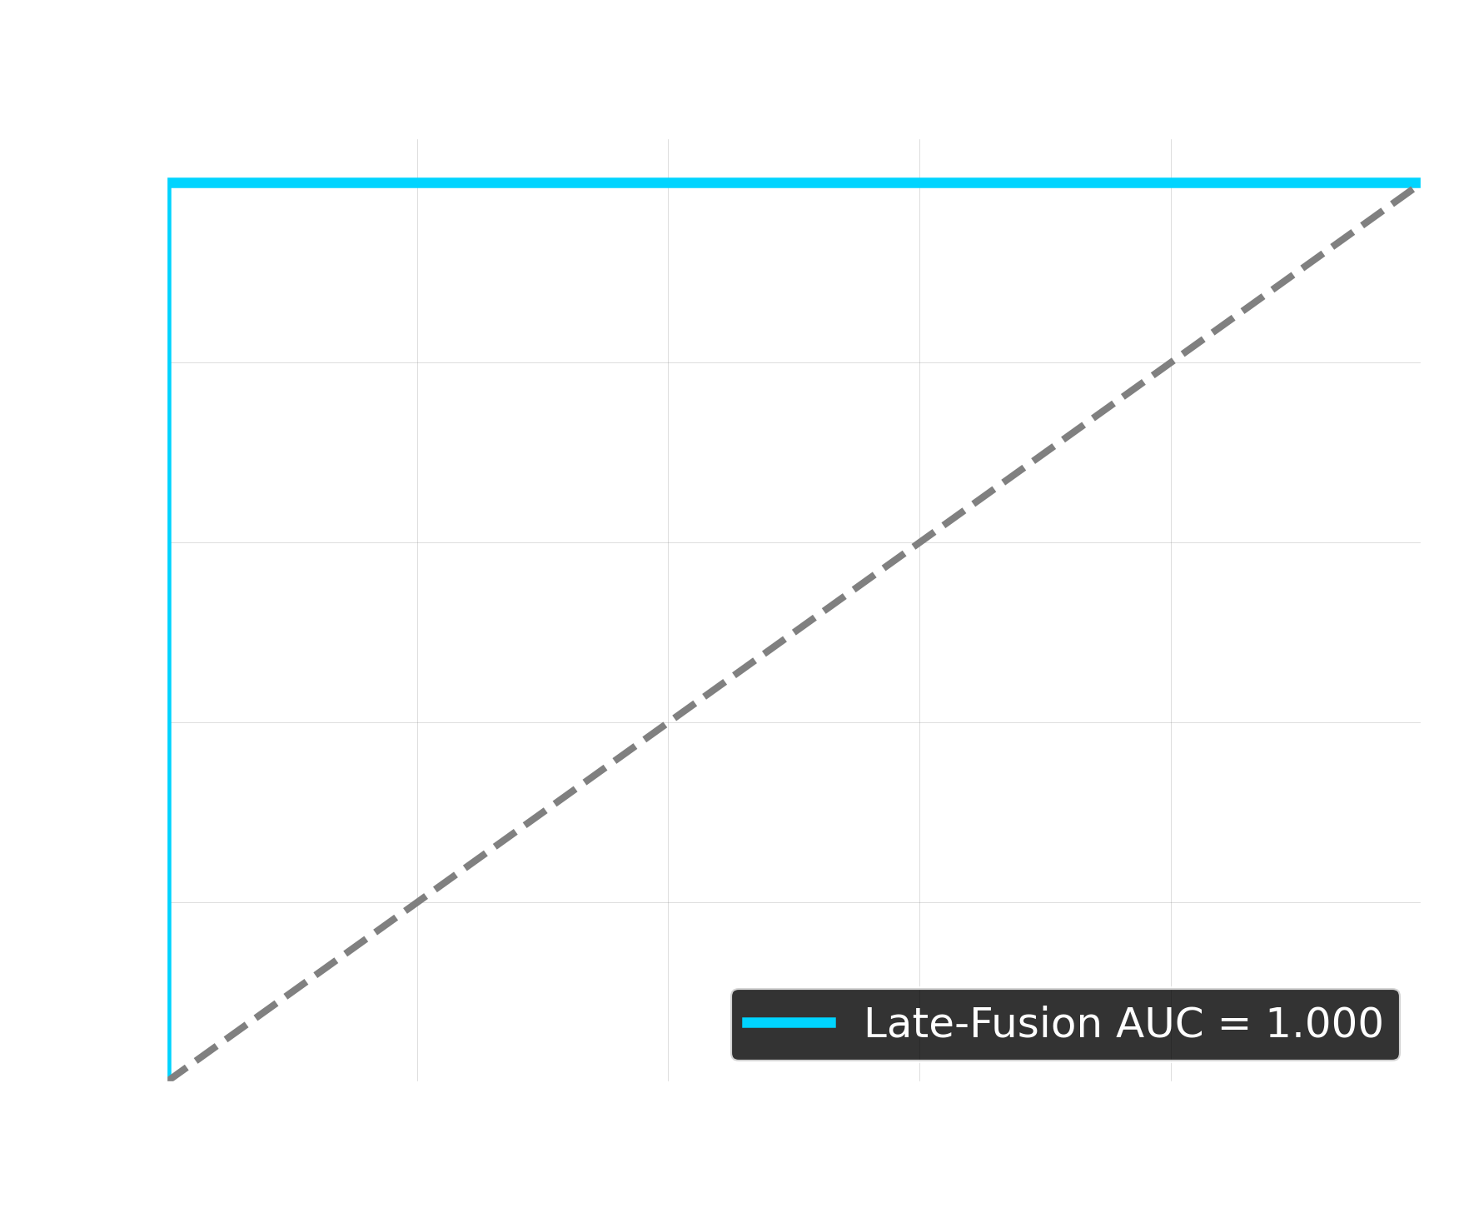
Technological Moat 1
Healthcare: MedGemma & Late-Fusion
Google DeepMind Integration
MedGemma-4B-IT Ecosystem
We process dense clinical data and EHR using Google's pioneering medical LLM, bridging the gap between raw data and digestible medical insights.
Proprietary Architecture
Late-Fusion Multivariate AI
Our clinical AI organically fuses 128 deep Keras parameters perfectly intertwined with Patient Age, MMSE, and clinical history through an XGBoost logic tree.

Slide 6

Technological Moat 2
Banana Disease Edge AI
99% TARGET ACCURACY | EDGE OFFLINE EXECUTION < 1s INFERENCE TIME
Built specifically for remote LATAM/African rural regions without internet. We utilize heavily quantized Convolutional Neural Networks on mobile devices to detect microscopic symptomatic patterns on banana leaves, halting TR4 outbreaks instantly.

Slide 7
Global Scale
The Market Opportunity
$180B+
TAM
Combined AI Health & Agro Market
$150M
SOM (Year 3)
Penetration in Key Farming & Clinic Hubs
$15B
SAM
LATAM & Developing Nations Needs

Slide 8
Financial Sustainability
B2B & B2G Revenue Models
🏥 Healthcare SaaS
B2B Licensing / Pay-per-Inference
Clinics pay a monthly license or API-call fee to access our ADNI-Standard orchestrator, circumventing the need for million-dollar proprietary software setups locally.
🌾 Agriculture Tech
B2G & Conglomerate Contracts
Targeting Ministries of Agriculture and Multinational Exporters (like Dole/Chiquita). High-value preventative defense contracts to protect national GDP.

Slide 9
Execution Plan
Global Roadmap (2026+)
1. Validation
Present - Late 2026
• Hult Prize Regional/Global Finals.
• Final training loop with USC LONI / ADNI datasets.
• Agro-Edge deployed in pilot farms.
2. Pilot Entry
2027
• First B2B medical clinics integrated in LatAm natively.
• Government lobbying for TR4 prevention.
• Seed Round funding ($1M+ Target).
3. Deep Scaling
2028+
• Enterprise partnerships with cloud providers.
• Drone-automated inferencing for Agro.
• Massive clinical expansions via APIs.

Slide 10
The Engineering Team
Perdix Origin Core
Erick Flores Zambrano
Head of AI Architecture
Perdix Team
Medical & Agrotech Deep Research
LIVE PRODUCTION ENGINE:
https://ingenieria-platform.vercel.app/
Detector de Enfermedades del Banano | Deep Learning
Powered by: Google DeepMind | USC LONI (IDEAS / ADNI) | Vercel

