Slide 1
HULT PRIZE 2026 PITCH
Solving the Unseen.
Scaling the Impact.
Dual AI Architecture for Global Healthcare (Alzheimer's) and Food Security (Banana Plagues).

Slide 2
Two Planetary Crises.
One Root Cause: Late Detection.
1. Healthcare (Alzheimer's)
• 55M+ Global dementia patients. Structural brain damage is irreversible by the time symptoms appear.
• 20% Misdiagnosis rate in standard health systems due to fragmented human analysis.
2. Food Security (Agro)
• TR4 Fusarium Wilt ravages global crops, destroying the livelihoods of developing nations.
• 100% Plantation loss occurs because farmers lack access to laboratory-grade phytopathology tools.

Slide 3
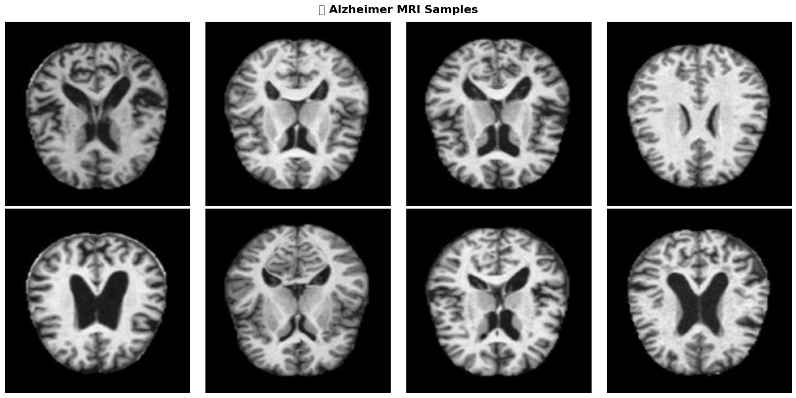
Healthcare Solution
Perdix Vision AI
We engineered a Multimodal Diagnostic Orchestrator that fuses deep anatomy with clinical reality, matching the exact protocols of top-tier US laboratories (USC / Harvard).
1. The ADNI Pre-Processing Standard
Trained under the strict paradigms of the ADNI (IDA LONI). We utilize mathematically rigorous 3D tensor extraction directly from NIfTI MRI.
2. Late-Fusion Multivariate Architecture
Our AI organically fuses 128 deep Keras parameters perfectly intertwined with Patient Age, MMSE, and BMI through an XGBoost logic tree.

Slide 4
AgroTech Solution
Banana Disease Core
99% TARGET ACCURACY | EDGE OFFLINE EXECUTION | < 1s INFERENCE TIME
Utilizing Convolutional Neural Networks to detect microscopic symptomatic patterns on banana leaves, stopping plagues like TR4 before they spread across borders and ensuring farmer sovereignty.

Slide 5
Impact & Business Viability
Sustainable B2B & B2G Models
⚕️ Healthcare SaaS
Licensing the ADNI-Standard API directly to regional hospitals, clinics, and health-tech startups. Monetized per API-inference or via enterprise yearly licenses.
🌾 Agriculture B2G
Selling the Agronomic Edge Model to Ministries of Agriculture and large-scale farming conglomerates under preventative strategic contracts.
Both engines are unified mathematically under the Perdix Origin Platform infrastructure, maximizing server efficiency and reducing OPEX.

Slide 6
The Engineering Team
Perdix Origin Core
Erick Zambrano
Head of AI Architecture
Perdix Team
Medical & Agrotech Ops
LIVE PRODUCTION ENGINE:
https://ingenieria-platform.vercel.app/

