Slide 1
COVID-19 Cases in King County, WA
Ericka Smith
Dec. 3, 2020
Notes:
Hi Everyone! Today I’m going to tell you a little bit about my project,
COVID-19 Cases in King County, WA

Slide 2
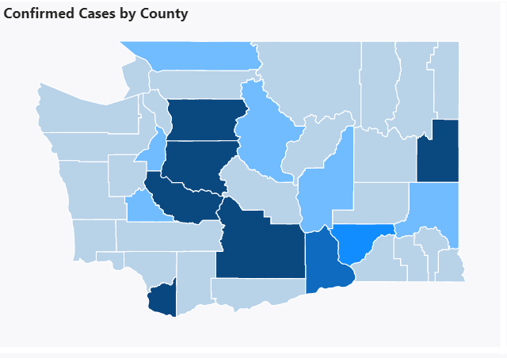
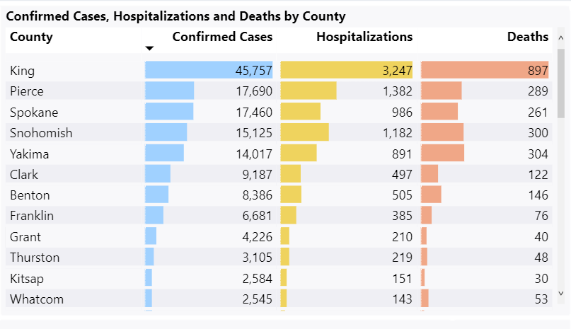
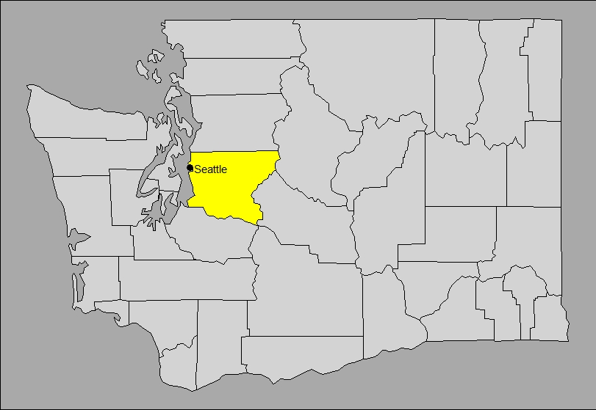
Introduction
https://www.doh.wa.gov/Emergencies/COVID19/DataDashboard
Notes:
First, a little background.
I’m not going to go into what COVID-19 is or how much it’s affected the world this year, that’s not news to anyone.
What I do want to talk a little about why I was interested in King County, Washington in particular.
I have to admit, part of my motivation was just a preference for the area. As many of you know I’m originally from Washington State and I love it there.
But what’s actually of general interest is that it’s where the virus originated in the U.S. The first confirmed case was in Snohomish County, Washington, which is part of the Seattle metro area.
Now I’d like to orient you a little bit.
If you look at the map in the top right you’ll see the counties of Washington state with darker shading indicating more total confirmed cases. The plot on the left is total numbers of confirmed cases by county. If you look at these counties in the center, (use mouse) there’s Snohomish, king, and pierce all grouped together. This is the seattle metro area.
Then these other dark counties are Yakima, Spokane, and Clark.
And then in bottom right map you can see that seattle itself is marked and it is within the highlighted king county.
Now to a point, we’re just seeing population centers, since we’re looking at total confirmed cases. But I don’t think that detracts at all from the fact that there still are a LOT of cases in King County and that the Seattle area was an early epicenter of the outbreak, which made me think the progression of the data might be more interesting in this space.
Speaking of the data, lets talk about it a little.

Slide 3
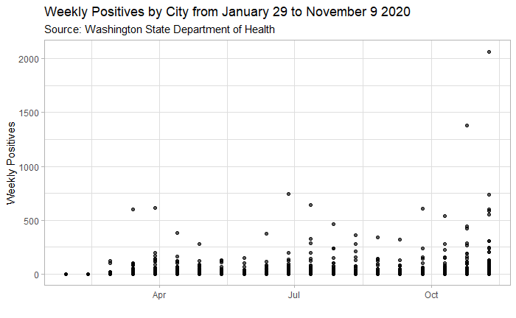
The Data
12/3/2020
COVID-19 Cases in King County, WA
3
Notes:
I combined two datasets from King County’s covid data site, which hosts data collected by the Washington State department of health
One dataset included my variable of interested, number of positive cases by week. This variable had the benefit of being a count over a discrete and specific measure of time.
This first dataset also included the rate of people tested.
The second data set, also from King County’s covid data site, included population sizes for age demographics by city.
Originally I was interested in city itself as a variable, but king county has 59 unique cities in it and many of them bleed into one another throughout the suburbs so I quickly found it to not be practically very useful for a model itself. It was still necessary as a matching variable to combine the two datasets, and I think it’s interesting to look at the numbers split up that way, which is why I’ve depicted them for you in the scatter plot on this slide.
You’ll immediately notice that this data looks to be zero-inflated. I did not dig very far into zero-inflated regression because I wanted to stay relevant with what we had learned in class, and that is a limitation of this analysis.
Another limitation that you’ll notice as we move forward is that I did not delve into the time series aspect of the model. Partially because the research I did on this issue indicated that it’s not appropriate to go through any of our typical “fixes”. For example, you can’t just add a lagged dependent variable like you might in other models, as the exponentiated coefficient on the lagged variable is no longer an autocorrelation coefficient (it’s a growth rate).
But also because, again, I want to stay relevant to this course and this is not time series. So try to keep that in mind moving forward, and let’s get into the models that I DID fit.

Slide 4
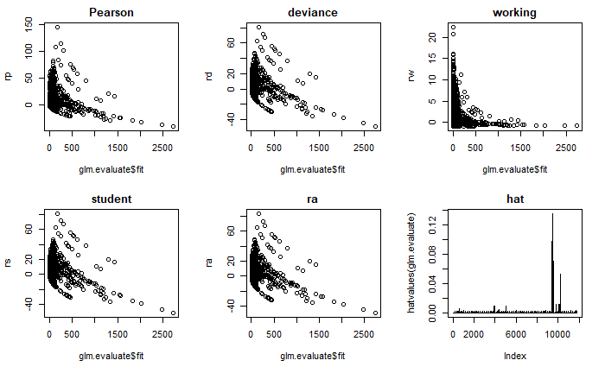
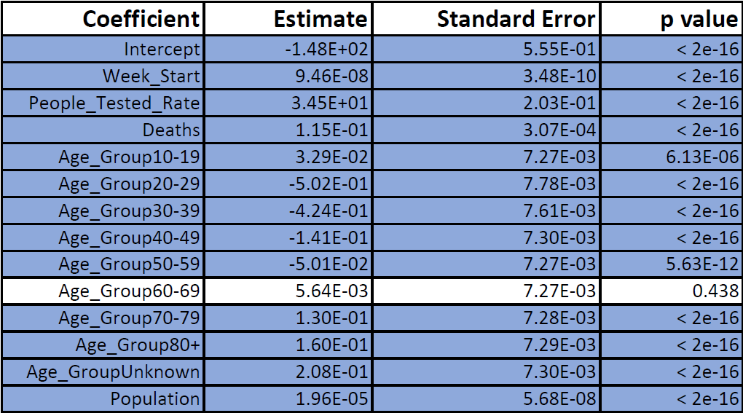
Poisson
Notes:
First, since we’re looking at count data, I fit a Poisson Regression.
You can see the residuals on the right and some of the output on the left.
I had anticipated that the data probably did not meet assumptions, and I was correct in that. The data are over-dispersed.
(degrees of freedom = 11,786 < residual deviance=580,131)
This led me to my next model….

Slide 5
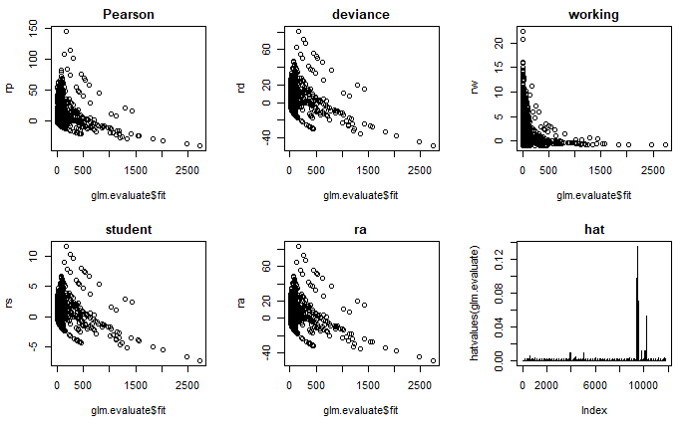
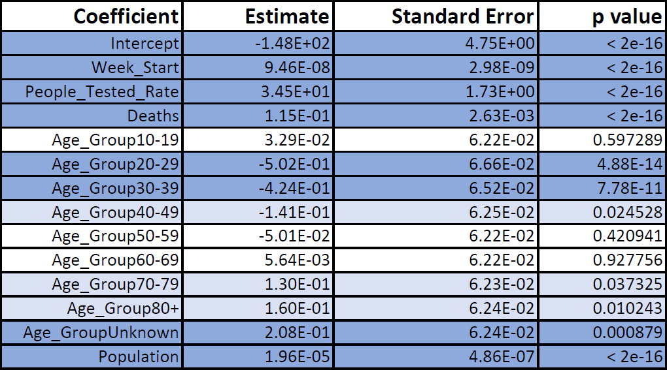
Quasi-Poisson
Notes:
The quasi-poisson model.
I think for this model we can be somewhat comfortable with the mean and variance relationship. However, the concern is an excess number of zeroes, as we discussed earlier.
You’ll note that our residuals look similar.
Also take a second to notice some of the output.

Slide 6
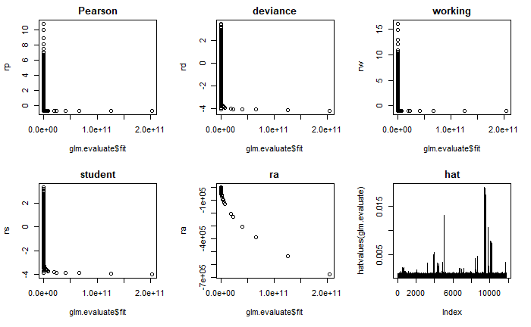
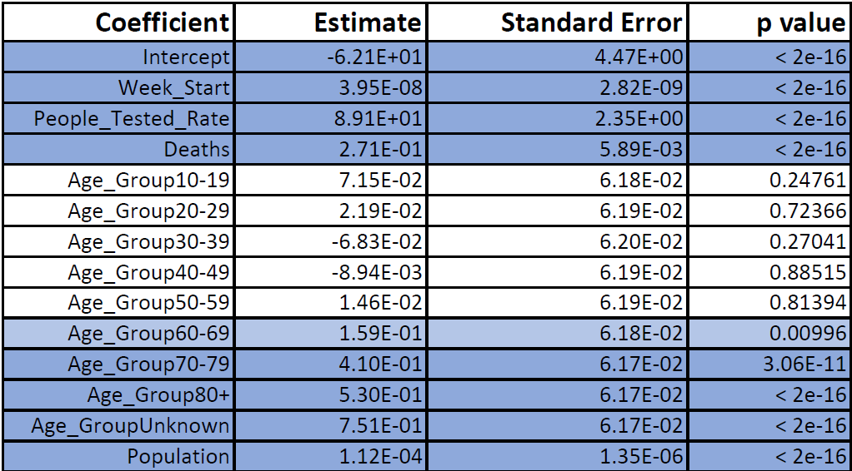
Negative Binomial
Notes:
Finally, Negative Binomial Regression.
I fit this model since the quasipoisson assumes a linear relationship between mean and variance, whereas the negative binomial allows for a quadratic relationship between the two, which can give more flexibility and allow for better fitting.
You’ll note that the residuals look very different.
See the output to the left.

Slide 7
Conclusion
Notes:
The analysis of deviance table is the same for each model, which is why I didn’t discuss it.
Negative binomial aic is 81,800
Which IS lower than poisson (aic = 617,768), but that doesn’t say much.
Quasipoisson of course can’t have aic
Poisson:
Null deviance: 1189783 on 11799 degrees of freedom
Residual deviance: 580131 on 11786 degrees of freedom
Quasi Poisson: SAME AS POISSON
Null deviance: 1189783 on 11799 degrees of freedom
Residual deviance: 580131 on 11786 degrees of freedom
Negative binomial ALL MUCH LOWER
Null deviance: 23739 on 11799 degrees of freedom
Residual deviance: 13156 on 11786 degrees of freedom
Our negative binomial model is the best fit, but I’d still caution against using it over a zero-inflated model.
Population, Rate of people tested, Number of Deaths and week start date were all consistently significant predictors.
Age group overall was, but it seems that there are certain age groups where this was more true than it was for other age groups., specifically in those 70 and above.

Slide 8
Questions?
Ericka B. Smith
Notes:
And that’s it.
Thank you all so much for listening.
Does anyone have any questions?

