Slide 1
Case-cohort and nested case-control designs
Michelle M. Nuño
Department of Preventive Medicine
University of Southern California
November 2, 2020

Slide 2
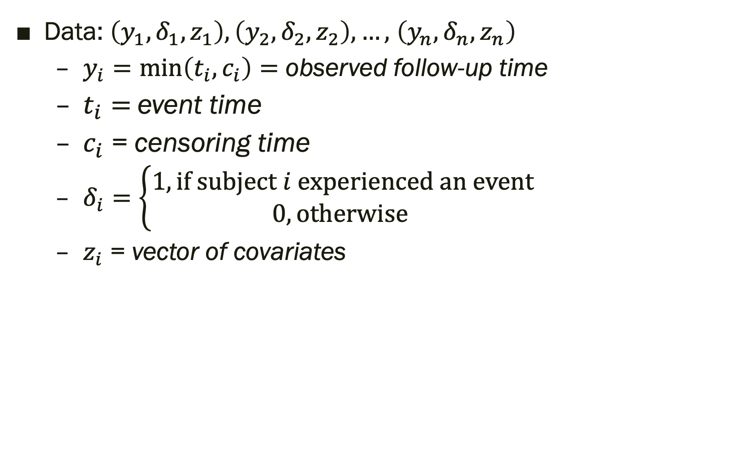
Time-to-Event Data
Data: $\left(y_{1},δ_{1}, z_{1}\right), \left(y_{2},δ_{2},z_{2}\right), …,$ $\left(y_{n}, δ_{n}, z_{n}\right)$
$y_{i}=\min\left(t_{i}, c_{i}\right)=$ observed follow-up time
$t_{i}=$event time
$c_{i}$ = censoring time
$δ_{i}=\left\{\begin{aligned}1, if subject i experienced an event \\ 0, otherwise \end{aligned}\right.$
$z_{i}$ = vector of covariates

Slide 3
Censoring
7
6
5
Subject ID
4
3
2
1
0
1
2
3
4
5
6
8
7
Years

Slide 4
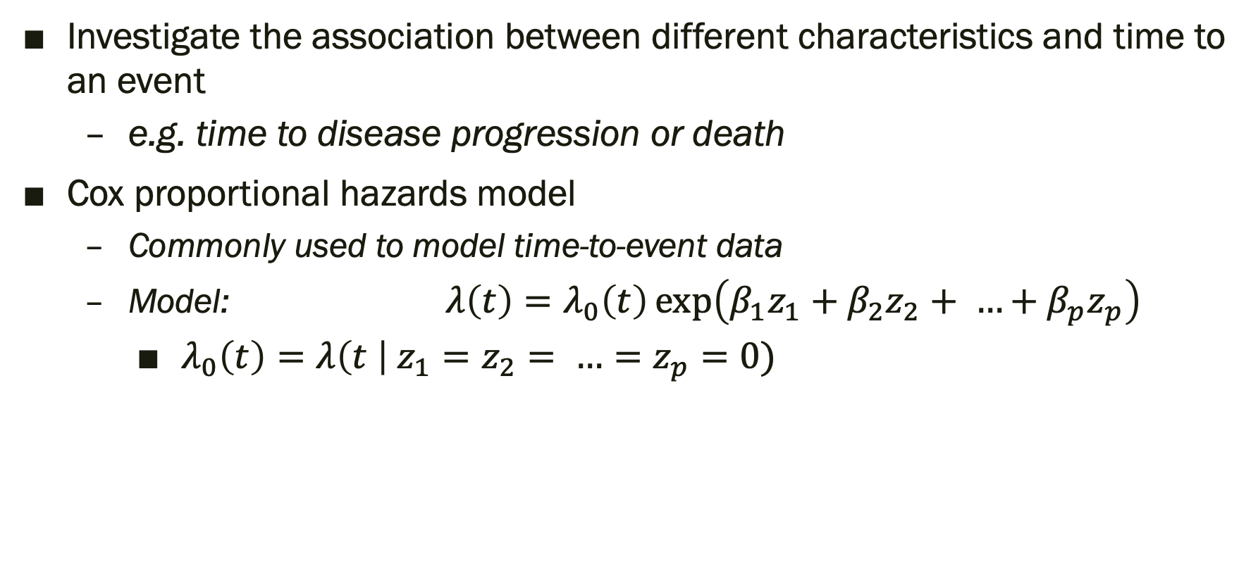
Cox Proportional Hazards Model
Investigate the association between different characteristics and time to an event
e.g. time to disease progression or death
Cox proportional hazards model
Commonly used to model time-to-event data
Model: $λ\left(t\right)=λ_{0}\left(t\right)\exp\left(β_{1}z_{1}+β_{2}z_{2}+ …+β_{p}z_{p}\right)$
$λ_{0}\left(t\right)=λ\left(t \right| z_{1}=z_{2}= …=z_{p}=0)$

Slide 5
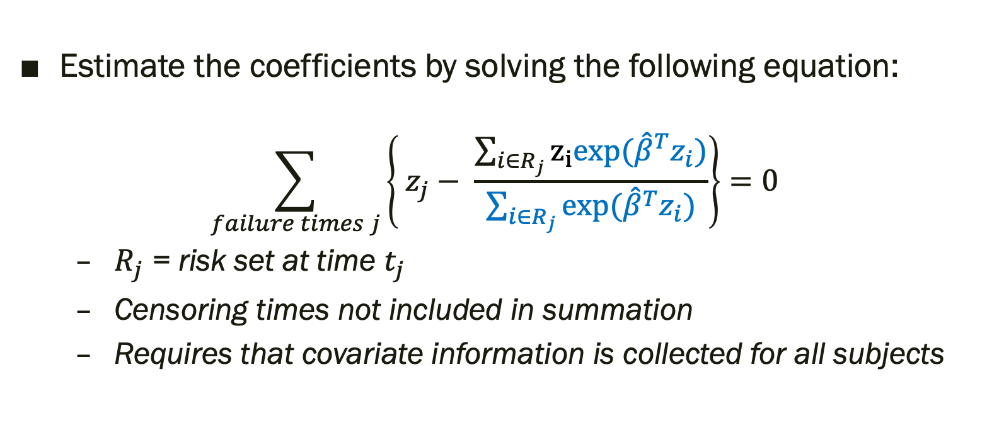
Cox Proportional Hazards Model
Estimate the coefficients by solving the following equation:
$$\sum_{failure times j}{\left\{ z_{j}− \frac{\sum_{i∈R_{j}}{z_{i}exp{({\hat{β}}^{T}z_{i})}}}{\sum_{i∈R_{j}}{\exp{({\hat{β}}^{T}z_{i})}}}\right\}=0}$$
$R_{j}$ = risk set at time $t_{j}$
Censoring times not included in summation
Requires that covariate information is collected for all subjects

Slide 6
Difficulties Collecting Data
It may be difficult and/or expensive to collect covariate information for all study participants
For rare diseases, would need to collect information on A LOT of people to observe enough events

Slide 7
Difficulties in collecting data for Alzheimer’s Disease studies
Participants are often unwilling to undergo certain procedures
Less willing to participate in trials requiring lumbar punctures (Nuño et al., 2017)

Slide 8
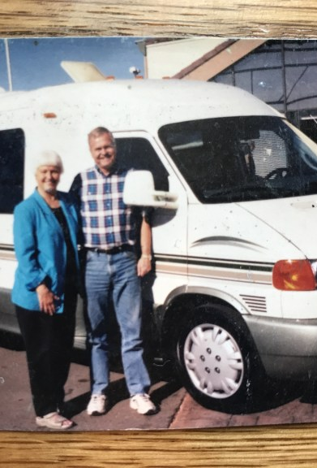
Difficulties in collecting data for Alzheimer’s Disease studies
UCI Alzheimer’s Disease Research Center
Participants are asked whether they are willing to undergo a lumbar puncture
CSF samples are collected and stored
Only processed if needed
Want to use these samples efficiently

Slide 9
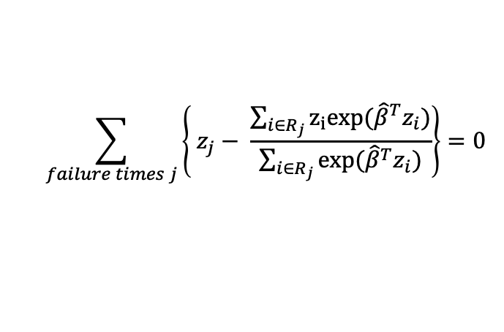
$$\sum_{failure times j}{\left\{ z_{j}− \frac{\sum_{i∈R_{j}}{z_{i}exp{({\hat{β}}^{T}z_{i})}}}{\sum_{i∈R_{j}}{\exp{({\hat{β}}^{T}z_{i})}}}\right\}=0}$$

Slide 10
Efficient Sampling Designs
Oversample events?
Case-cohort design
Nested case-control design

Slide 11
Case-Cohort Design

Slide 12
Case-Cohort Design
Randomly sample a subcohort from the full cohort
Collect covariate information from
Cases (subjects who experience an event)
Subcohort members
Do not need to collect covariate information for subjects who are not in the subcohort and who do not experience an event

Slide 13
Cox Proportional Hazards Model
Estimate the coefficients by solving the following equation:
$$\sum_{failure times j}{\left\{ z_{j}− \frac{\sum_{i∈R_{j}}{z_{i}exp{({\hat{β}}^{T}z_{i})}}}{\sum_{i∈R_{j}}{\exp{({\hat{β}}^{T}z_{i})}}}\right\}=0}$$
$R_{j}$ = risk set at time $t_{j}$
Censoring times not included in summation
Requires that covariate information is collected for all subjects

Slide 14
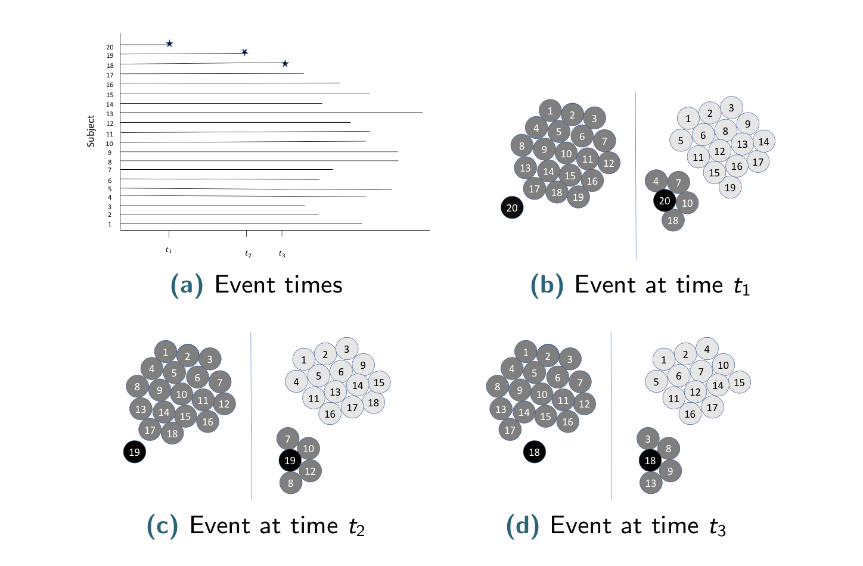



Full Cohort
20
19
18
17
16
15
14
13
12
11
10
9
8
7
6
5
4
3
2
1
Subject
$$t_{1}$$
$$t_{3}$$
$t_{1}$ ${ t}_{2} t_{1}$

Slide 15
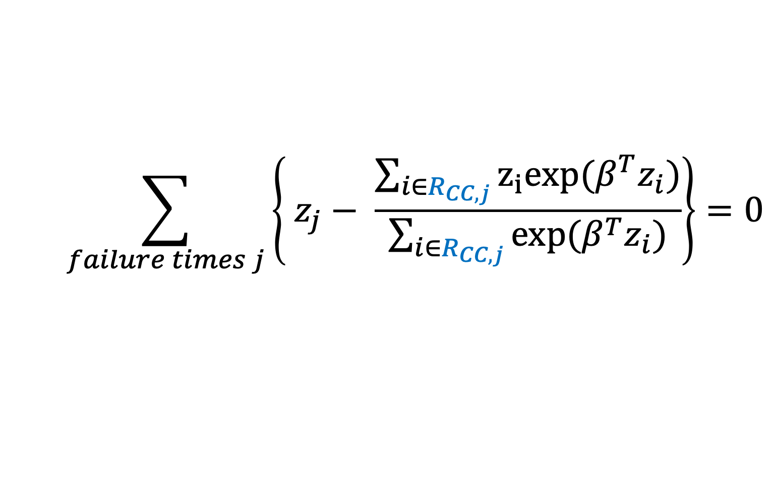

Cox Proportional Hazards model: Case-Cohort Design
$R_{CC, j}$= risk set at time $t_{j}$ under the case-cohort design
Includes the cases and subcohort controls
$$\sum_{failure times j}{\left\{ z_{j}− \frac{\sum_{i∈R_{CC, j}}{z_{i}exp{(β^{T}z_{i})}}}{\sum_{i∈R_{CC, j}}{\exp{(β^{T}z_{i})}}}\right\}=0}$$

Slide 16
Case-Cohort Design (Prentice, 1986)
20
19
18
17
16
15
14
13
12
11
10
9
8
7
6
5
4
3
2
1
Subject
18 16 3 7 13 20 9
$$t_{1}$$
$$t_{3}$$
$t_{1}$ ${ t}_{2} t_{1}$
(Nuño and Gillen, 2017)

Slide 17
Case-Cohort Design
Outcome and time | Prentice (1986) | Self and Prentice (1988) | Barlow (1994)
Non-subcohort case before failure | 0 | 0 | 0
Non-subcohort case at failure | 1 | 0 | 1
Subcohort case before failure | 1 | 1 | 1/⍺
Subcohort case at failure | 1 | 1 | 1
Subcohort control | 1 | 1 | 1/⍺
⍺ = proportion of subjects sampled from the full cohort into the subcohort
*Table adopted from Barlow (1999)

Slide 18
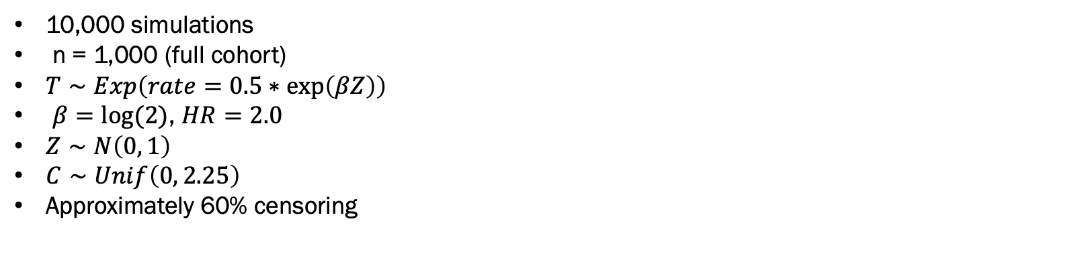
Case-Cohort Design
10,000 simulations
n = 1,000 (full cohort)
$T∼Exp\left(rate=0.5∗\exp\left(βZ\right)\right)$
$β=log⁡(2)$, $HR=2.0$
$Z∼N\left(0, 1\right)$
$C∼Unif\left(0, 2.25\right)$
Approximately 60% censoring
(Nuño and Gillen, 2017)

Slide 19
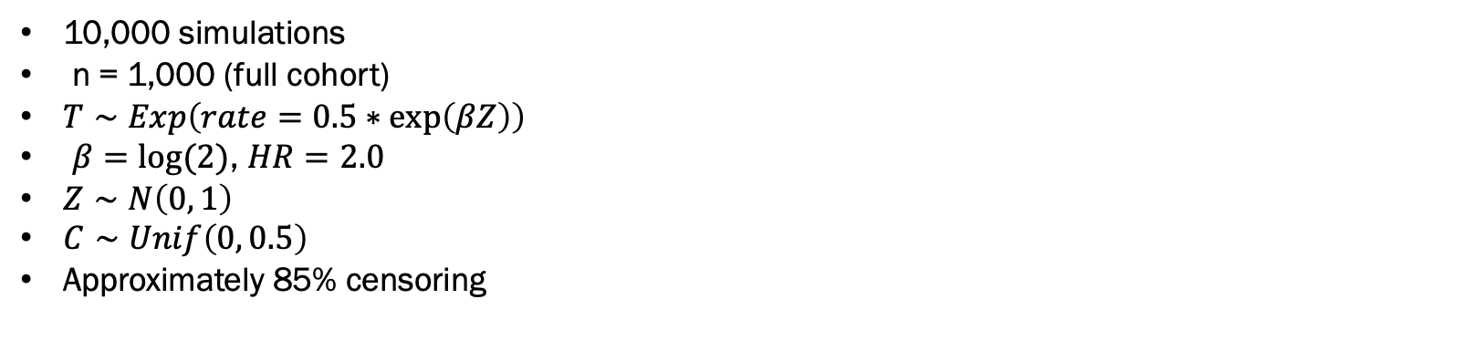
Case-Cohort Design
10,000 simulations
n = 1,000 (full cohort)
$T∼Exp\left(rate=0.5∗\exp\left(βZ\right)\right)$
$β=log⁡(2)$, $HR=2.0$
$Z∼N\left(0, 1\right)$
$C∼Unif\left(0, 0.5\right)$
Approximately 85% censoring
(Nuño and Gillen, 2017)

Slide 20
Nested Case-Control Design

Slide 21
Nested Case-Control Design
At each event time, randomly sample M controls
The risk set at each event time is made up of
The case at that time
Sampled controls for that event time

Slide 22
Cox Proportional Hazards Model
Estimate the coefficients by solving the following equation:
$$\sum_{failure times j}{\left\{ z_{j}− \frac{\sum_{i∈R_{j}}{z_{i}exp{({\hat{β}}^{T}z_{i})}}}{\sum_{i∈R_{j}}{\exp{({\hat{β}}^{T}z_{i})}}}\right\}=0}$$
$R_{j}$ = risk set at time $t_{j}$
Censoring times not included in summation
Requires that covariate information is collected for all subjects

Slide 23
Full Cohort
20
19
18
17
16
15
14
13
12
11
10
9
8
7
6
5
4
3
2
1
Subject
$$t_{1}$$
$$t_{3}$$
$t_{1}$ ${ t}_{2} t_{1}$

Slide 24
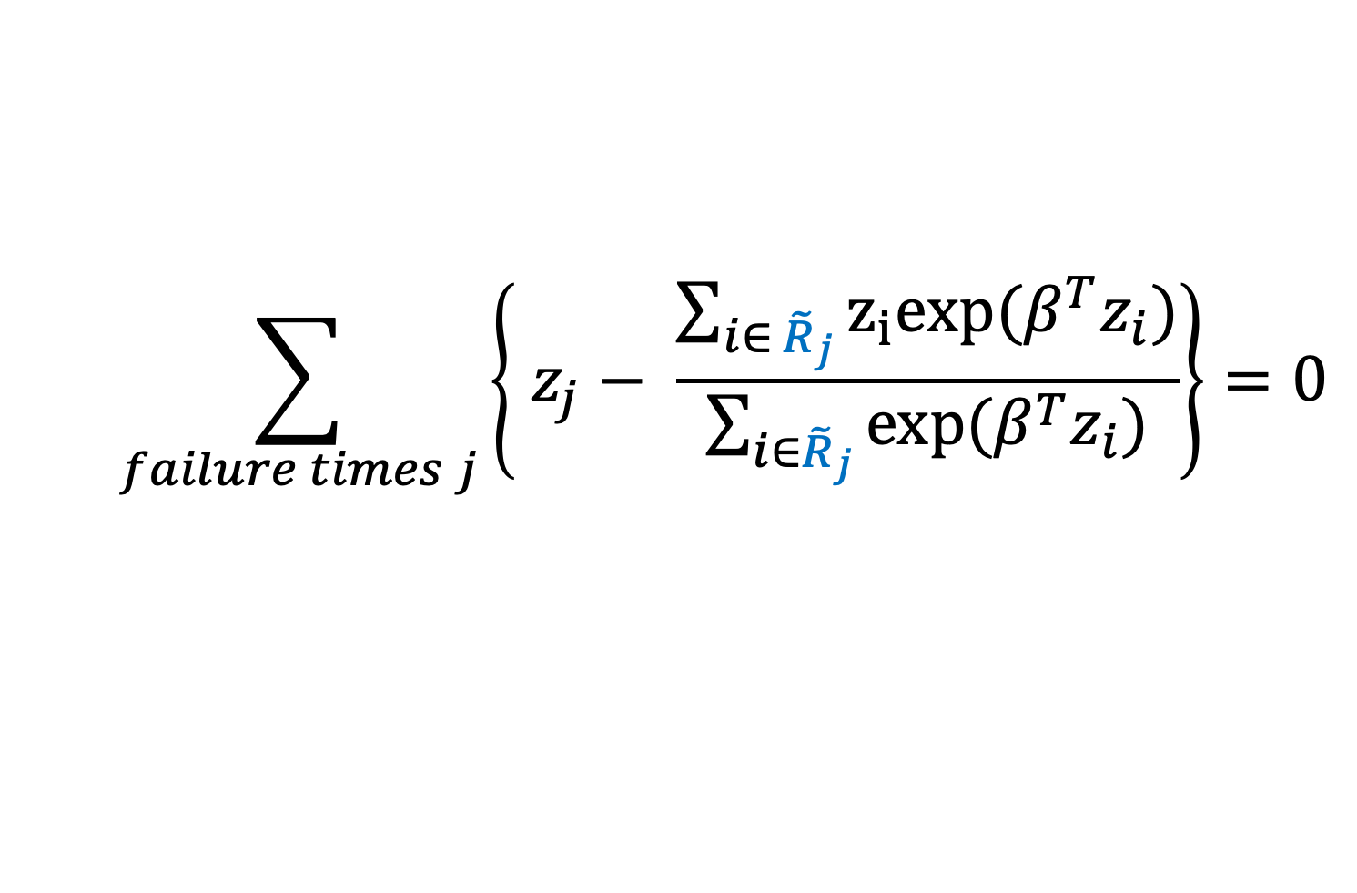

Cox Proportional Hazards model: Nested case-control design
${\tilde{R}}_{j}$ = risk set at time $t_{j}$ under the NCC design
Includes the case and sampled controls
$$\sum_{failure times j}{\left\{ z_{j}− \frac{\sum_{i∈{ \tilde{R}}_{j}}{z_{i}exp{(β^{T}z_{i})}}}{\sum_{i∈{\tilde{R}}_{j}}{\exp{(β^{T}z_{i})}}}\right\}=0}$$

Slide 25



Nested Case-Control Design
20
19
18
17
16
15
14
13
12
11
10
9
8
7
6
5
4
3
2
1
Subject
$$t_{1}$$
$$t_{3}$$
$t_{1}$ ${ t}_{2} t_{1}$
(Thomas, 1977)
(Nuño and Gillen, 2017)

Slide 26
Nested Case-Control Design
10,000 simulations
n = 1,000 (full cohort)
$T∼Exp\left(rate=0.5∗\exp\left(βZ\right)\right)$
$β=log⁡(2)$, $HR=2.0$
$Z∼N\left(0, 1\right)$
$C∼Unif\left(0, 2.25\right)$
Approximately 60% censoring
(Nuño and Gillen, 2017)

Slide 27
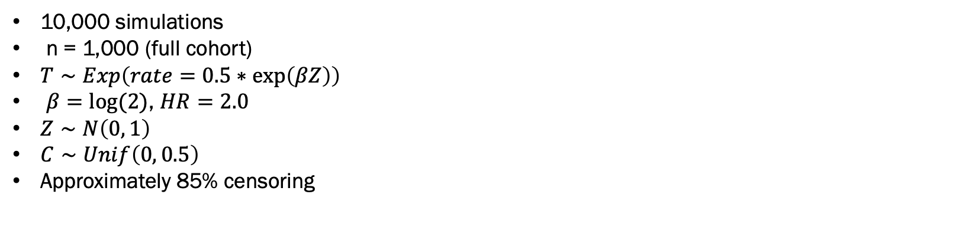
Nested Case-Control Design
10,000 simulations
n = 1,000 (full cohort)
$T∼Exp\left(rate=0.5∗\exp\left(βZ\right)\right)$
$β=log⁡(2)$, $HR=2.0$
$Z∼N\left(0, 1\right)$
$C∼Unif\left(0, 0.5\right)$
Approximately 85% censoring
(Nuño and Gillen, 2017)

Slide 28
Variations of the Nested Case-Control Design
Matching (Keogh and Cox, 2014)
Counter-matching (Langholz and Clayton, 1994)

Slide 29
Nested Case-Control and Case-Cohort Designs
Reduce study costs when considering rare events
Efficient
Nested case-control design
Controls are sampled at each event time
Case-Cohort design
Controls are sampled before knowing when event times occur

Slide 30
Nested Case-Control or Case-Cohort Design?
Case-Cohort Design
Control Depletion
Bias
Under case-cohort design may induce bias due to closer follow-up of subcohort members
Nested Case-Control Design
Multiple outcomes
Follow-up after the end of the study
Need to wait for events to occur to select controls
(Wacholder, 1991)

Slide 31
Current/Future Work
Nested case-control design
Model misspecification
Estimating AUC
Joint longitudinal survival models

Slide 32
References
Barlow, William E. "Robust variance estimation for the case-cohort design." Biometrics (1994): 1064-1072.
Barlow, William E., et al. "Analysis of case-cohort designs." Journal of clinical epidemiology 52.12 (1999): 1165-1172.
Keogh, Ruth H., and David Roxbee Cox. Case-control studies. Vol. 4. Cambridge University Press, 2014.
Langholz, Bryan, and David Clayton. "Sampling strategies in nested case-control studies." Environmental Health Perspectives 102.suppl 8 (1994): 47-51.
Nuño, Michelle M., and Daniel L. Gillen. "Alternative Sampling Designs for Time-to-Event Data With Applications to Biomarker Discovery in Alzheimer's Disease." Handbook of statistics. Vol. 36. Elsevier, 2017. 105-166.
Nuño, Michelle M., et al. "Attitudes toward clinical trials across the Alzheimer’s disease spectrum." Alzheimer's research & therapy 9.1 (2017): 81.
Prentice, Ross L. "A case-cohort design for epidemiologic cohort studies and disease prevention trials." Biometrika 73.1 (1986): 1-11.
Self, Steven G., and Ross L. Prentice. "Asymptotic distribution theory and efficiency results for case-cohort studies." The Annals of Statistics (1988): 64-81.
Thomas, Duncan C. "Addendum." Journal of the Royal Statistical Society: Series A (General) 140.4 (1977): 483-485.
Wacholder, Sholom. "Practical considerations in choosing between the case-cohort and nested case-control designs." Epidemiology (1991): 155-158.

