Slide 1

Notes:
Hello, my name is Erick Cestari. I will talk about differential fuzzing on the Lightning Network. A technique to find bugs between different Lightning implementations.

Slide 2
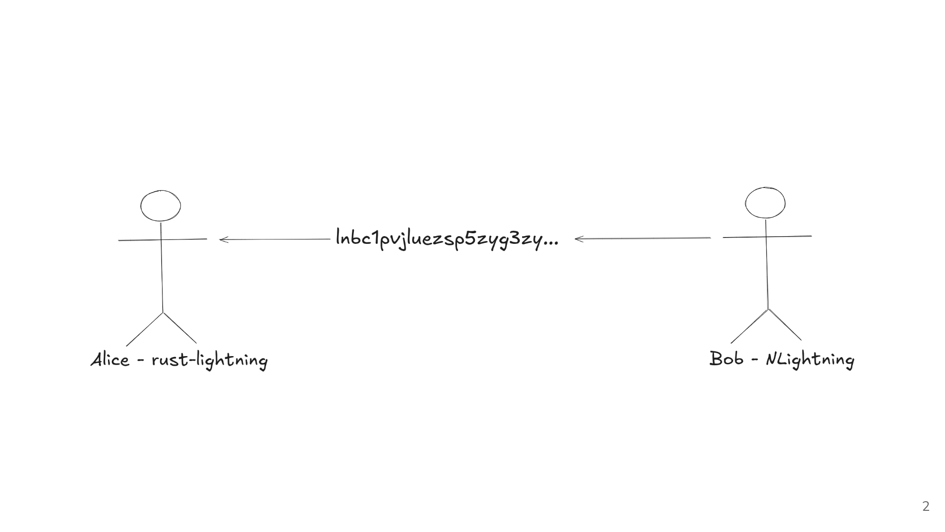
Notes:
So imagine this scenario: Bob is trying to sell coffee to Alice. Bob is using NLightning to generate the invoice, and Alice is using Rust-Lightning to make the payment. Bob generates and sends the invoice to Alice.

Slide 3
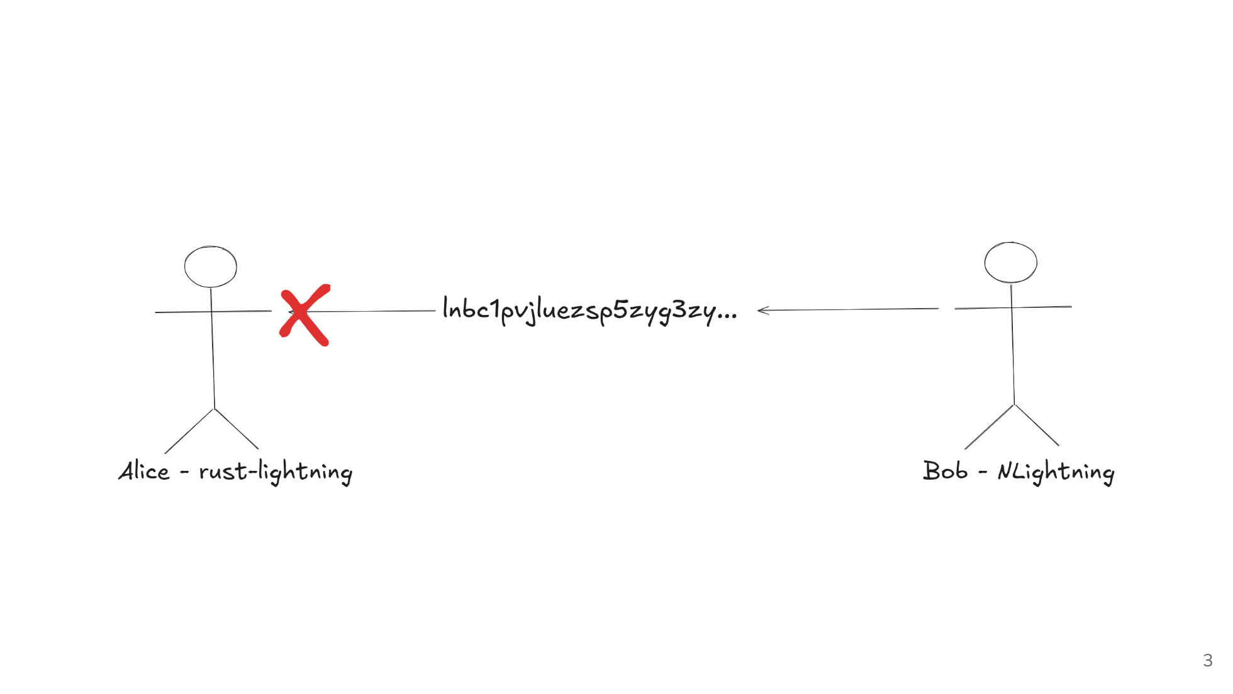
Notes:
Alice tries to pay the invoice using Rust-Lightning, but it fails to decode the invoice. She gets an error and can't complete the payment.

Slide 4
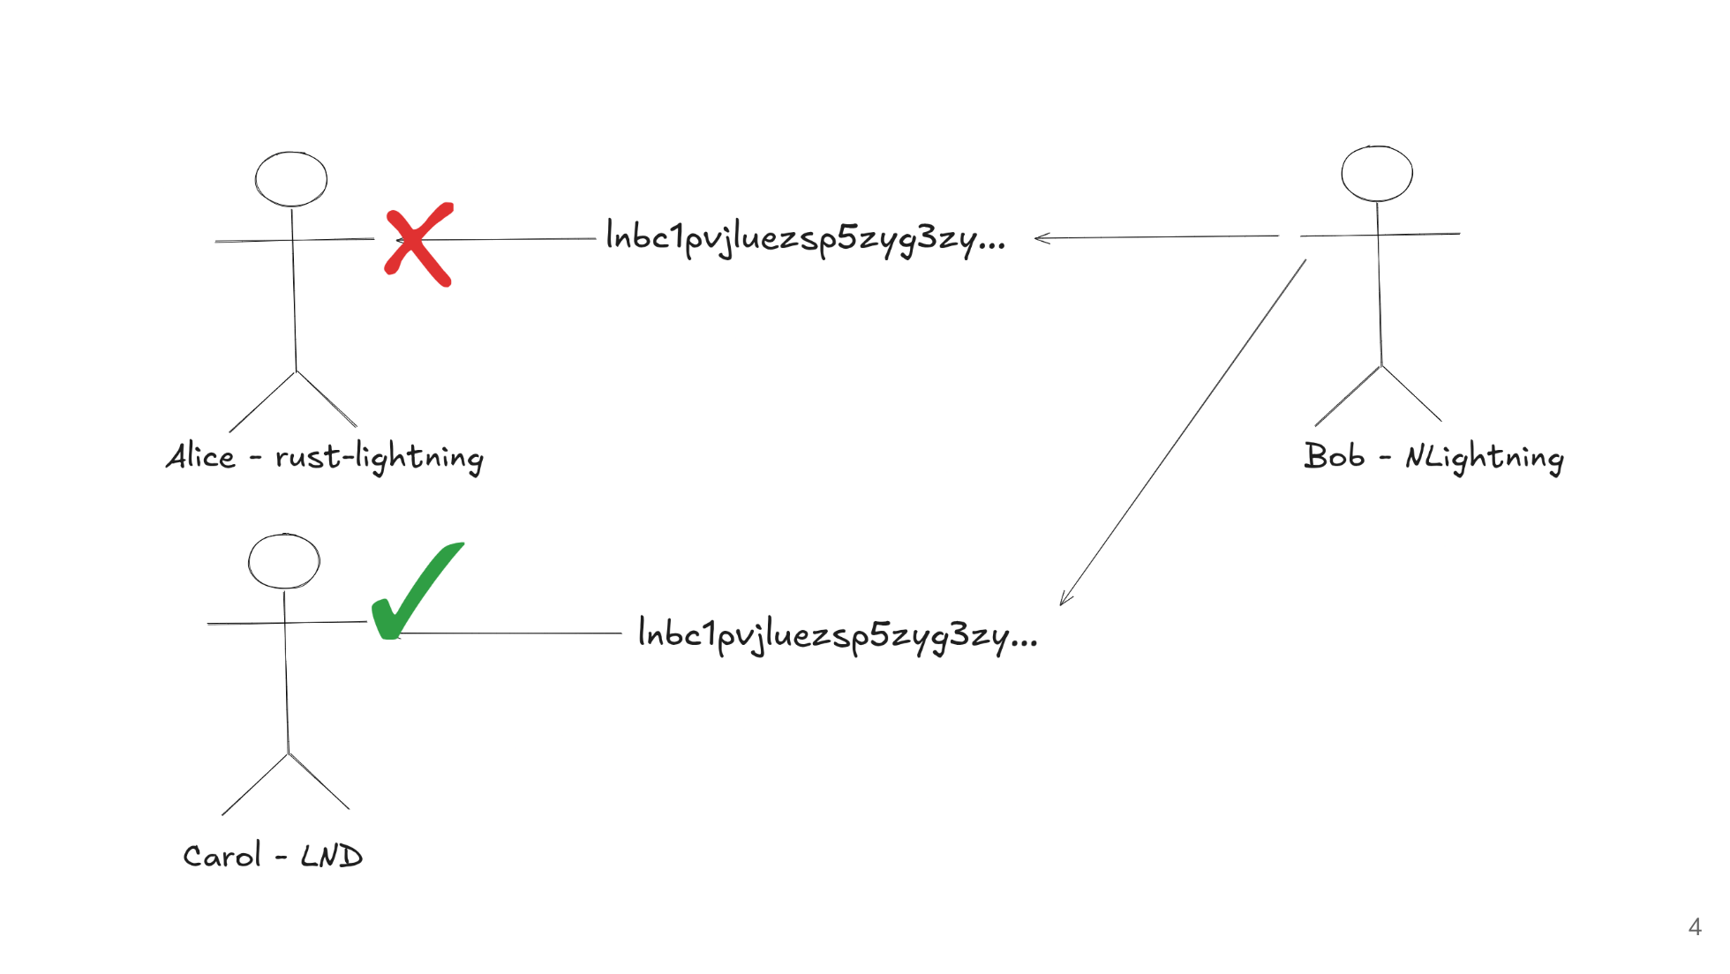
Notes:
Frustrated, Alice asks her friend Carol for help. Carol tries to pay the same invoice using her LND node, and this time it succeeds! Same invoice, different implementation, different result.

Slide 5
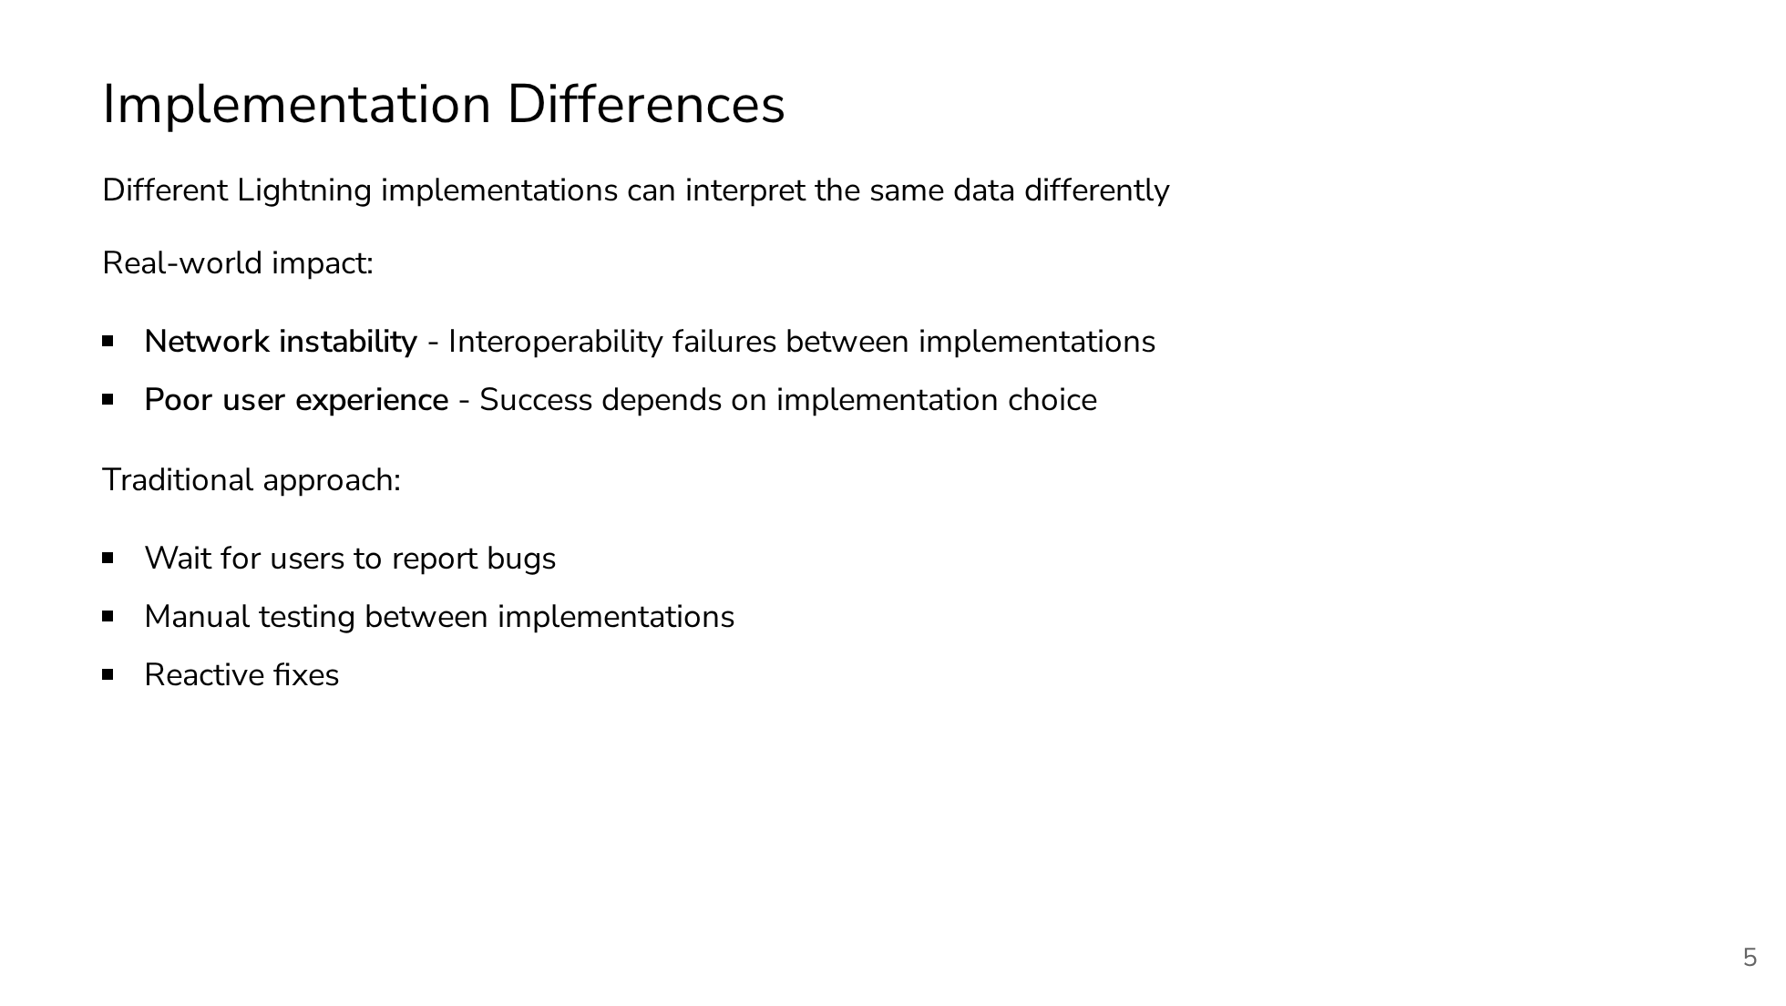
Notes:
Different Lightning implementations can interpret the same data differently. Real-world impact: Poor user experience where success depends on which implementation you're using. Traditional approach: Wait for users to report bugs, manual testing between implementations, reactive fixes.

Slide 6
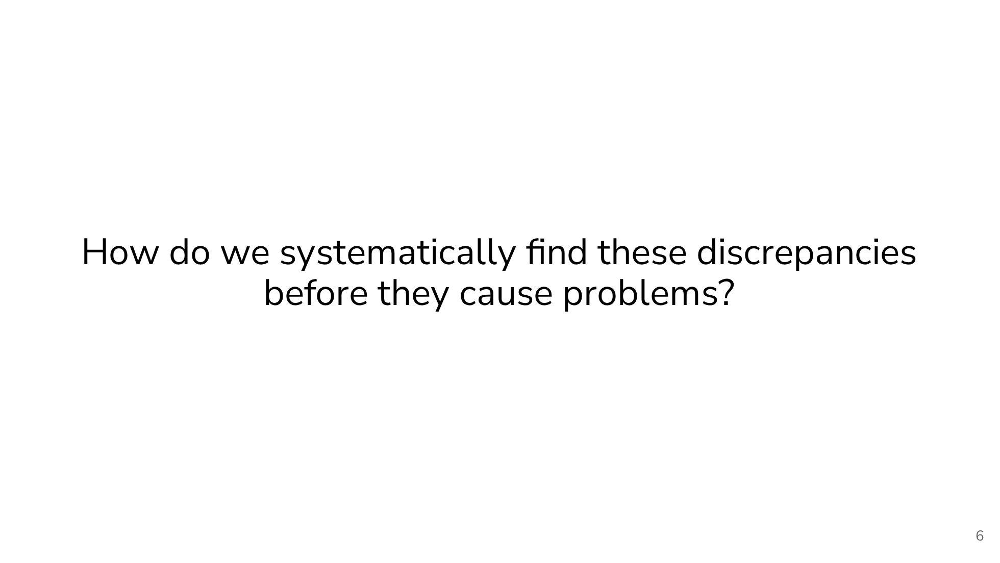
Notes:
How do we systematically find these discrepancies before they cause problems?

Slide 7
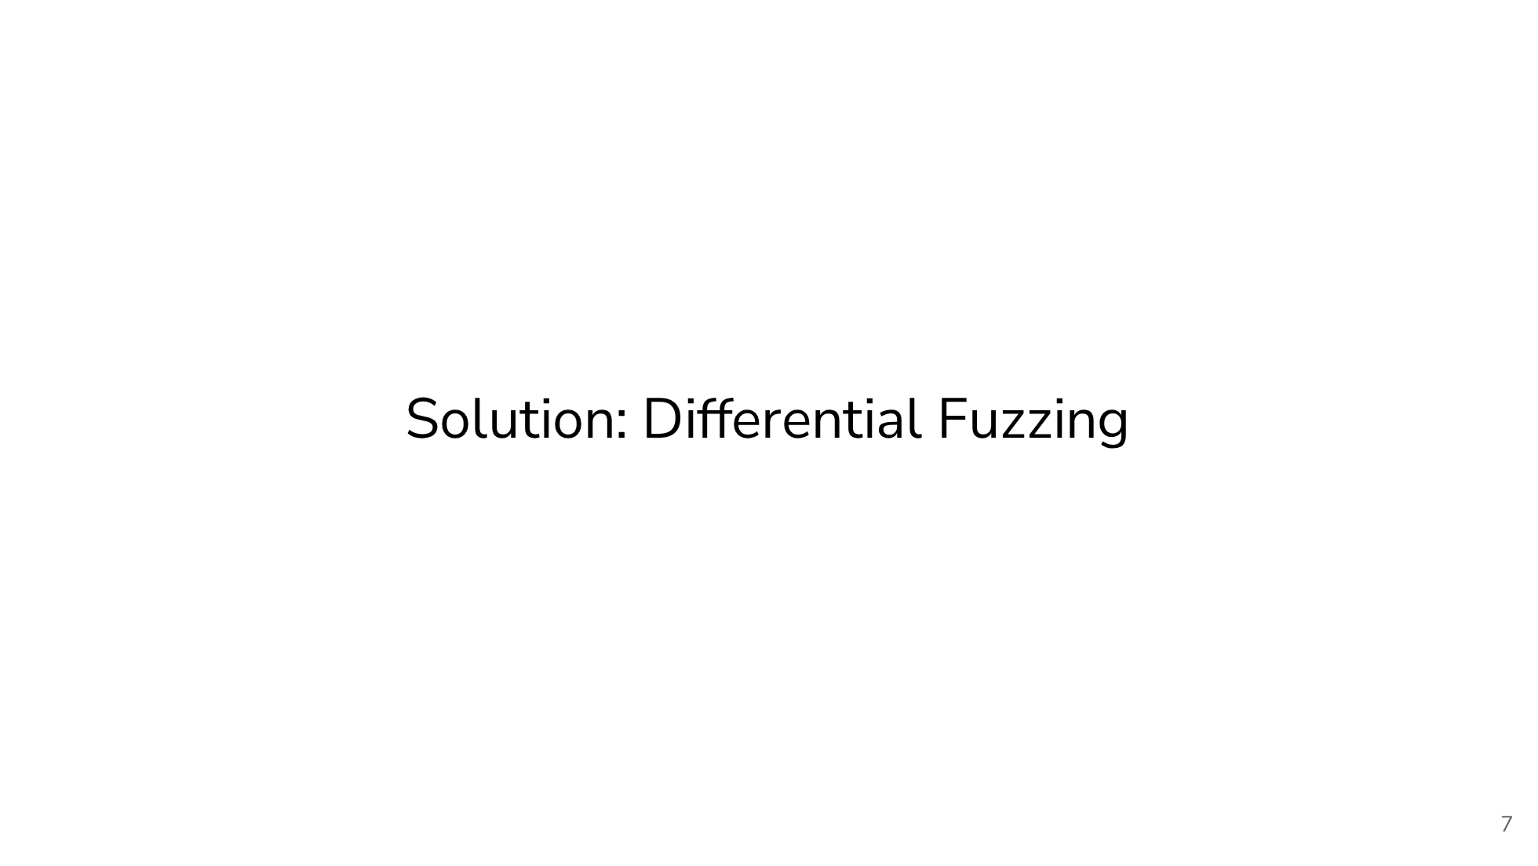
Notes:
So the solution is by doing differential fuzzing. The theme of this presentation :)

Slide 8
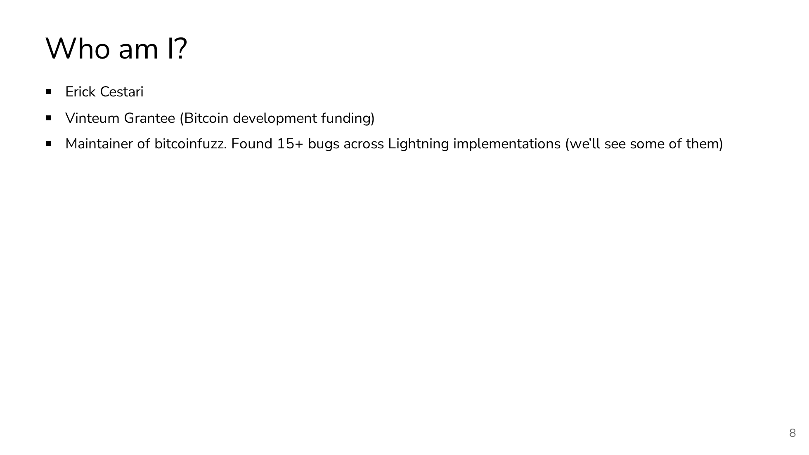
Notes:
But first, Who am I? My name is Erick Cestari. I am a Vinteum grantee. That's Bitcoin development funding for those who aren't familiar. I'm the maintainer of bitcoinfuzz, where I've found over 15 bugs across various Lightning implementations and reported some security disclosures.

Slide 9
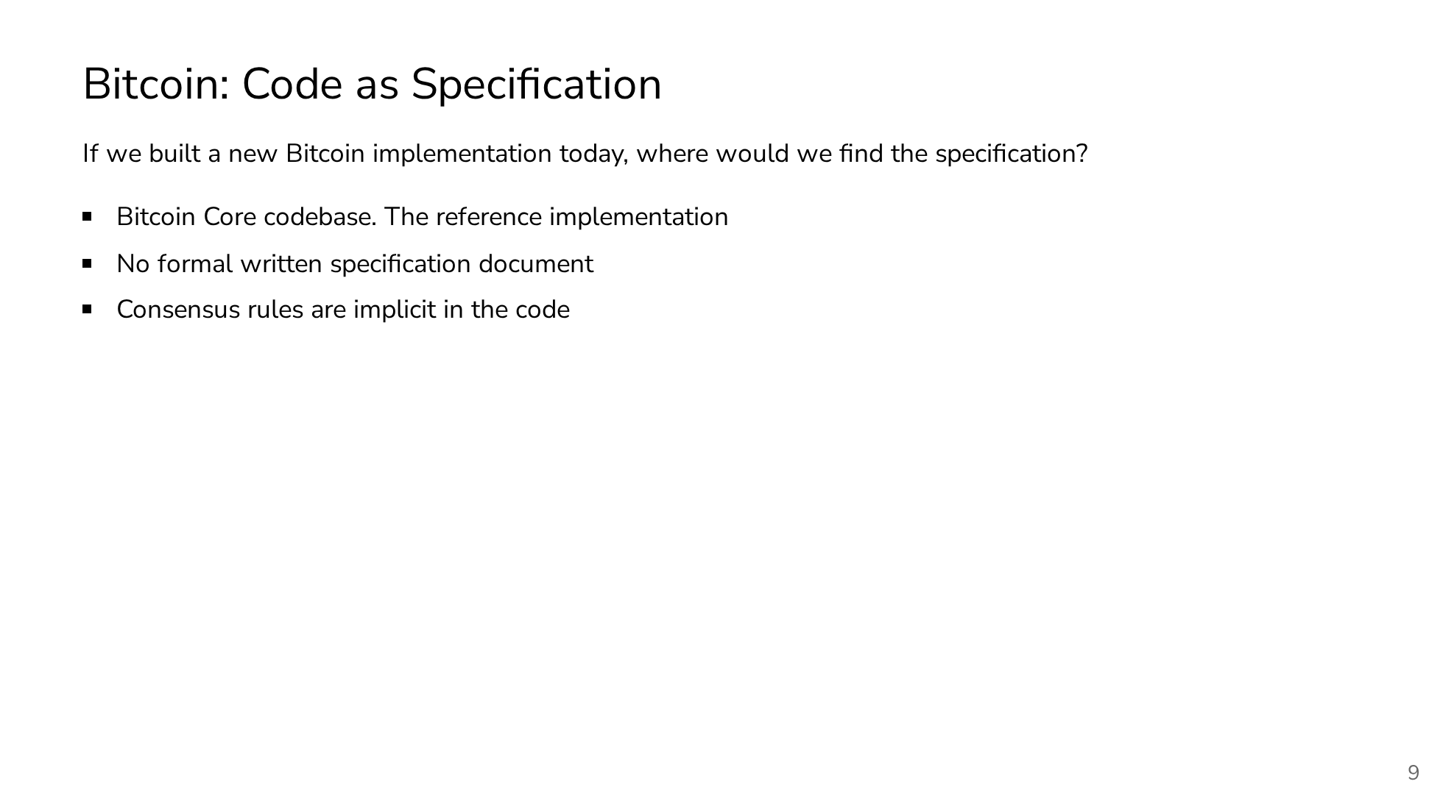
Notes:
Bitcoin has an interesting characteristic. There's no formal specification document. If you want to build a new Bitcoin implementation today, you essentially have to reverse-engineer Bitcoin Core. The consensus rules are implicit in the code, which means implementation differences can be catastrophic.

Slide 10
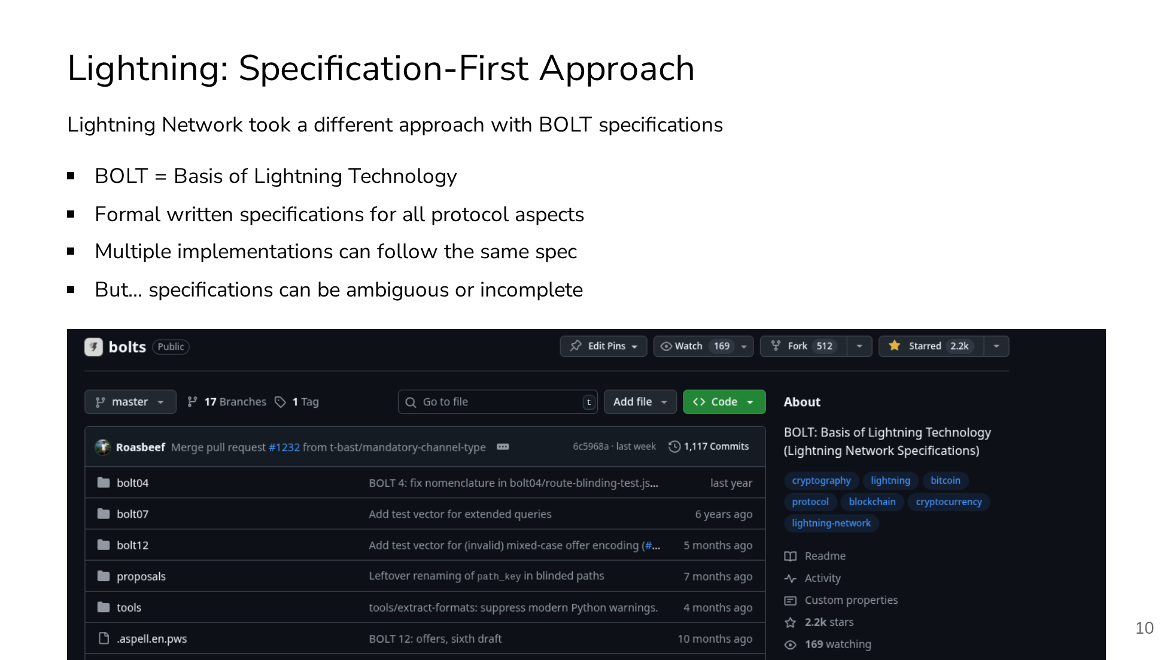
Notes:
Lightning Network learned from Bitcoin's approach and took a specification-first approach. BOLT stands for Basis of Lightning Technology. These are formal written specifications that cover all aspects of the Lightning protocol. This allows multiple implementations to follow the same spec and theoretically be compatible. But here's the catch. Specifications can be ambiguous or incomplete. Even with a formal spec, different teams can interpret the same requirements differently. This is where our differential fuzzing comes in. To find these interpretation differences systematically.

Slide 11
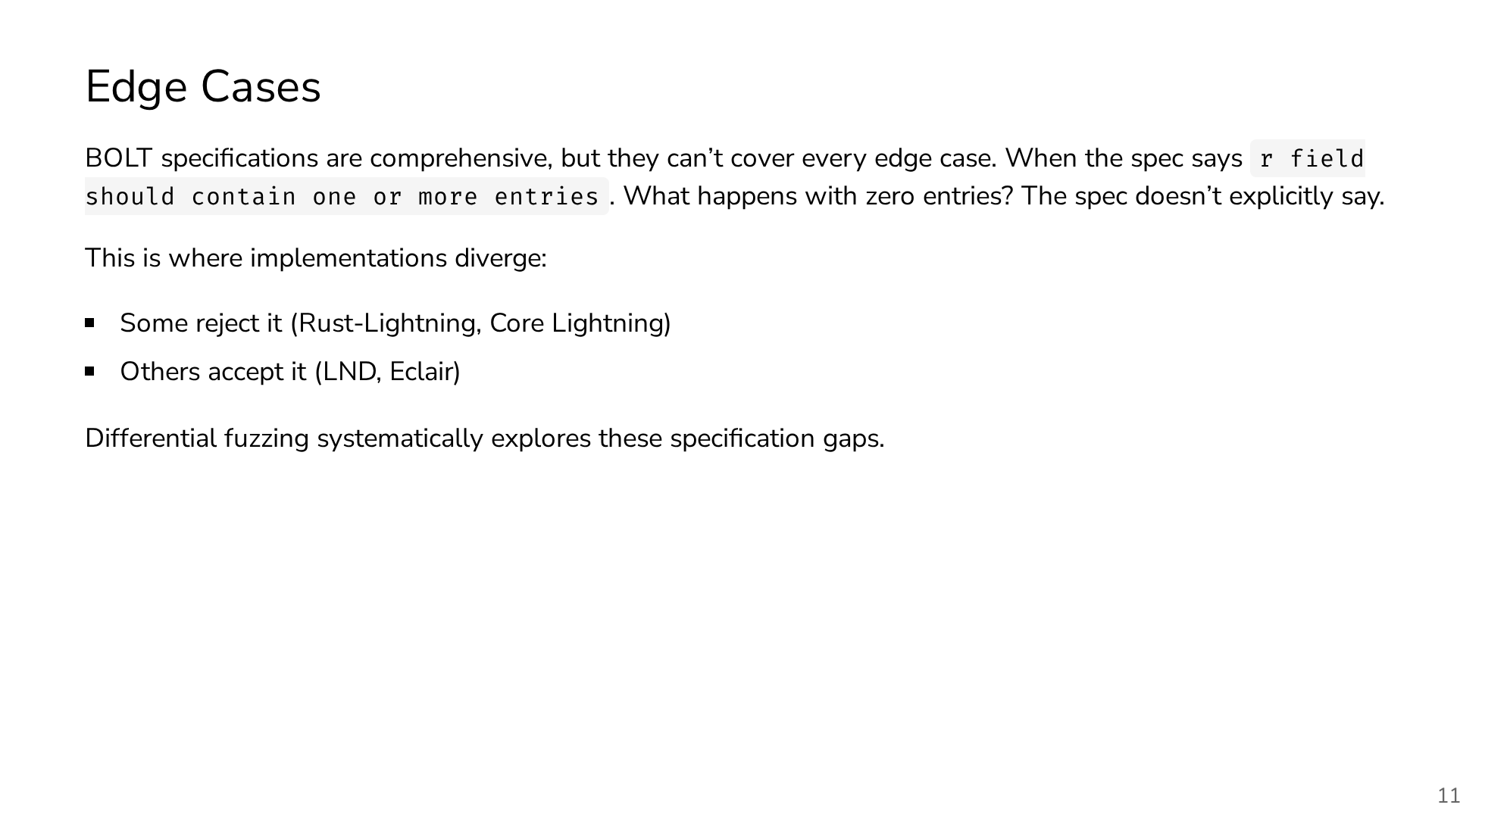
Notes:
So here's the core challenge with specifications. Even when they're comprehensive like BOLT, they can't anticipate every possible edge case. Take this real example from our fuzzing results: The BOLT11 specification says the 'r' field should contain "one or more entries" for routing information. Sounds clear, right? But what happens when you encounter an 'r' field that exists but contains zero entries? The specification doesn't explicitly address this scenario. And this is exactly where we see implementations diverge. Rust-Lightning and Core Lightning take a strict interpretation. They reject invoices with empty 'r' fields. Meanwhile, LND and Eclair are more permissive. They accept these invoices. Neither approach is necessarily wrong. They're just different interpretations of an ambiguous specification. This is the perfect example of why differential fuzzing is so valuable. Instead of waiting for users to discover these incompatibilities in production, we can systematically generate edge cases like this and find where implementations behave differently. This helps us identify specification gaps before they cause real-world payment failures.

Slide 12
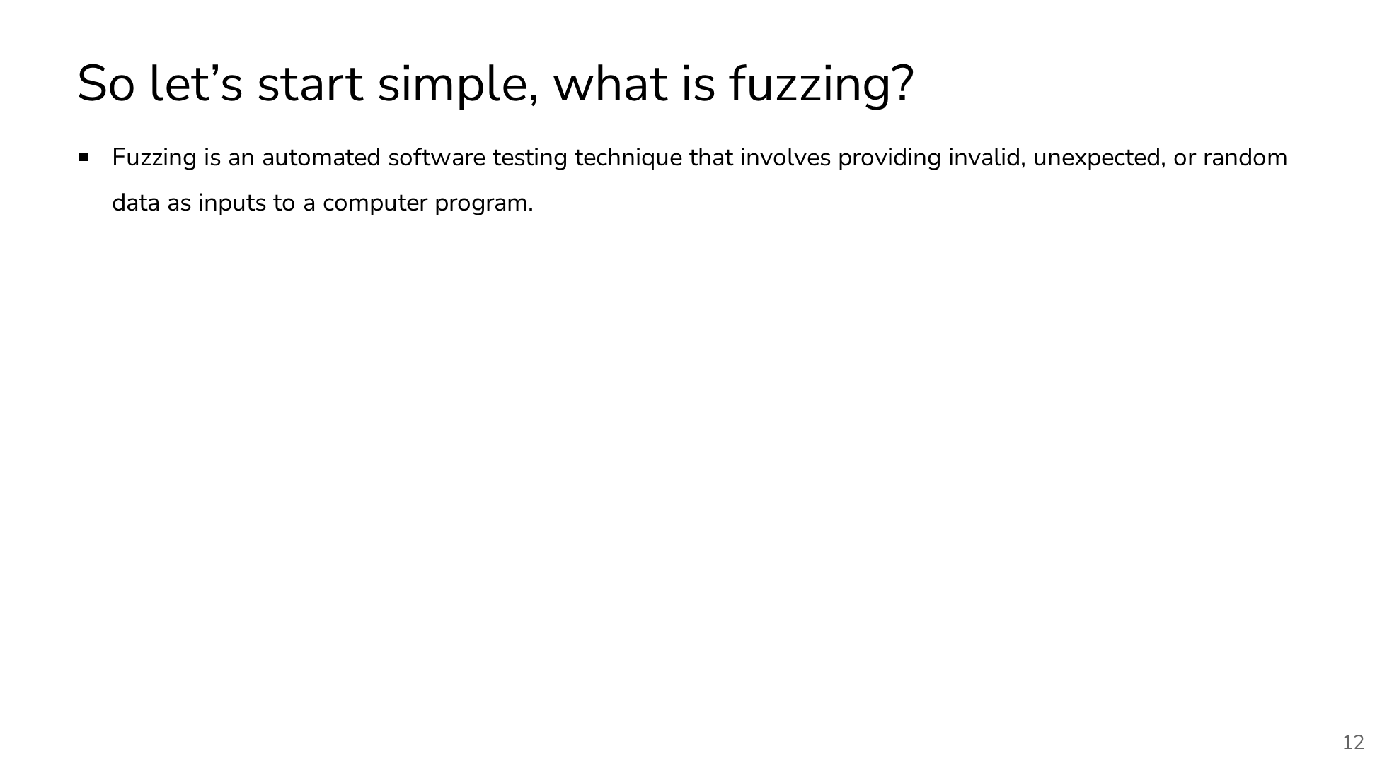
Notes:
So let's start by fuzzing testing technique. So it's an automated software testing technique that involves providing invalid, unexpected or random data as inputs to a program.

Slide 13
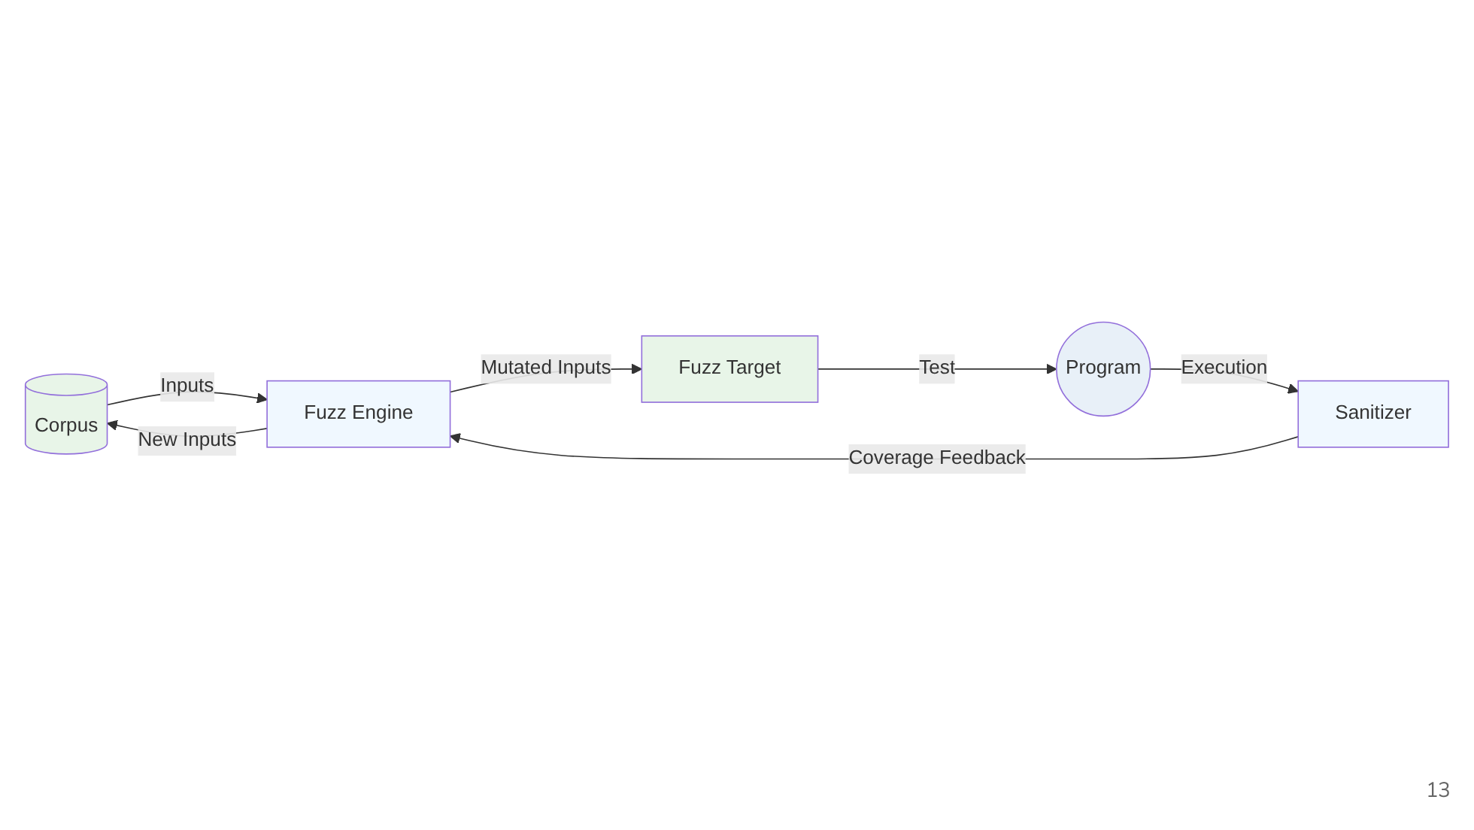
Notes:
This diagram illustrates the basic workflow of fuzzing. The corpus contains the initial set of inputs, which are mutated by the fuzzing engine. These mutated inputs are passed to the fuzz target. The specific part of the program being tested. When executed, the program runs with sanitizers that monitor for issues like crashes or memory errors. The sanitizers then provide coverage feedback to the fuzzer engine, which uses this information to decide whether to keep the new input in the corpus for further mutation.

Slide 14
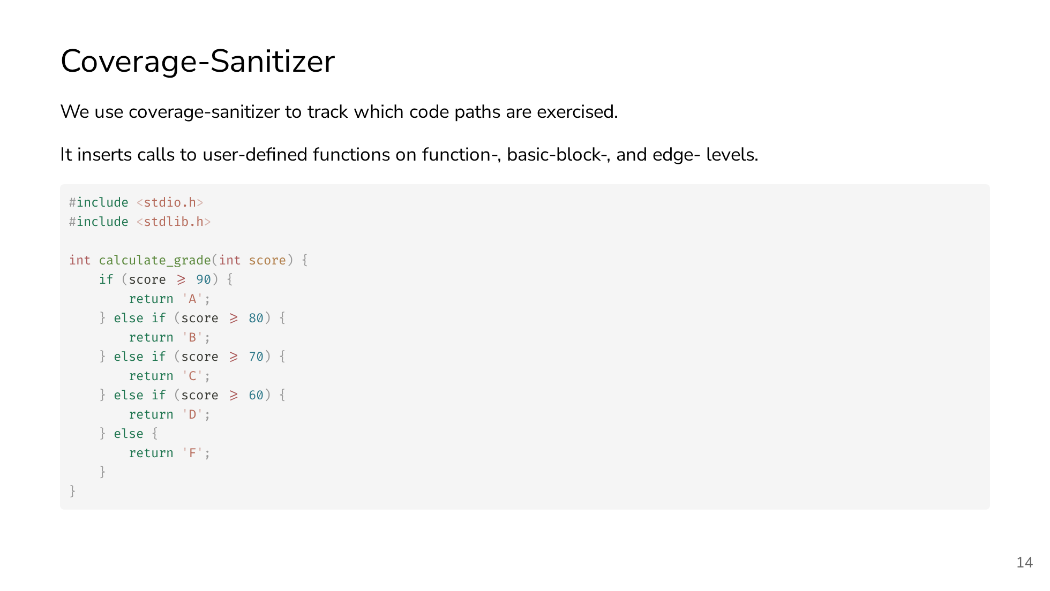
Notes:
Coverage sanitizers provide feedback to the fuzzer by tracking which parts of the code are executed. During compilation, they insert instrumentation calls at various code levels (e.g., functions, basic blocks, edges) to report execution paths. The fuzzer uses this feedback to decide whether a given input explores new behavior and should be retained in the corpus. Below is a simple example function that calculates a grade from a score. We'll use this to compare builds with and without coverage sanitization.

Slide 15
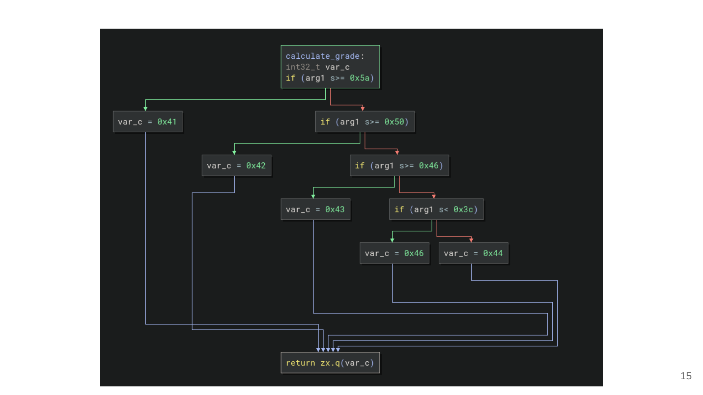
Notes:
This a High Level view of the C code compiled to machine code without Coverage Sanitizers.

Slide 16
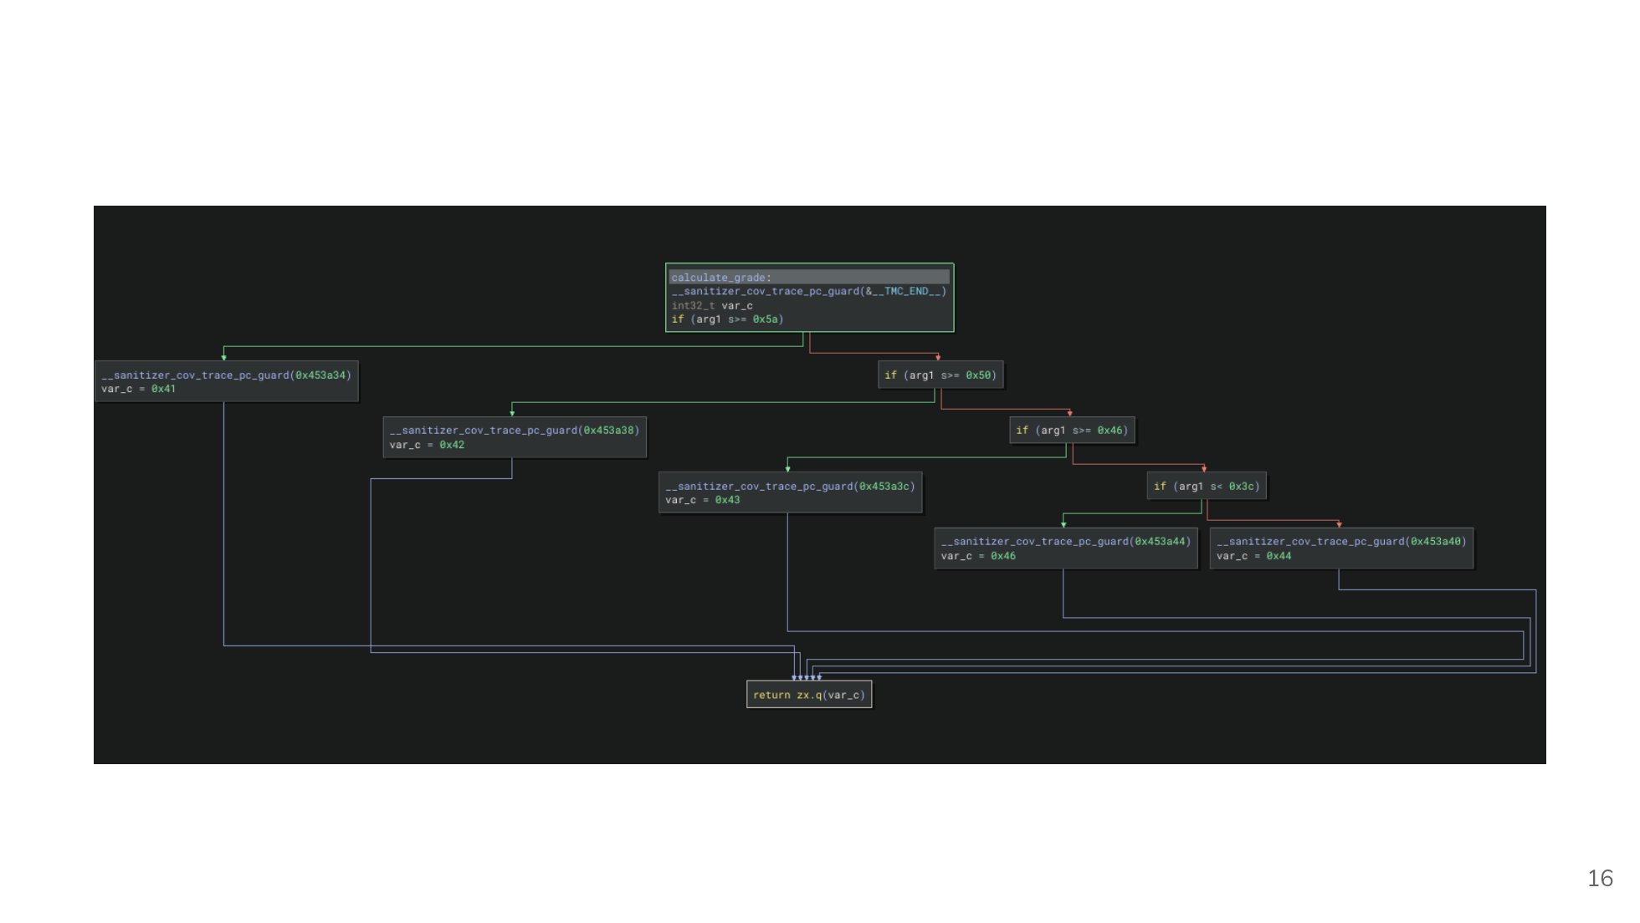
Notes:
This a High Level view of the C code compiled to machine code with Coverage Sanitizers. We can see that it adds function calls to send coverage information to the fuzzer.

Slide 17
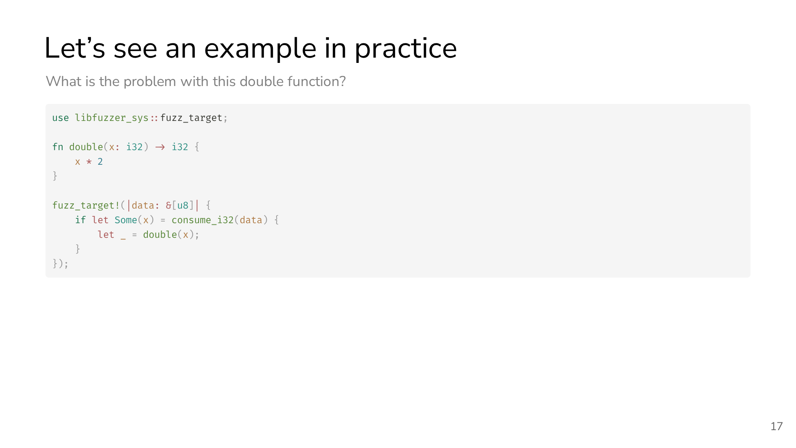
Notes:
This is an example of a bug that fuzzing can find. We have this double function that receives a signed integer 32 bits that then will be multiplied by 2. In this example we can see that the double function doesn't handle overflow, so running the fuzzer we will see that it will crash by overflow.

Slide 18
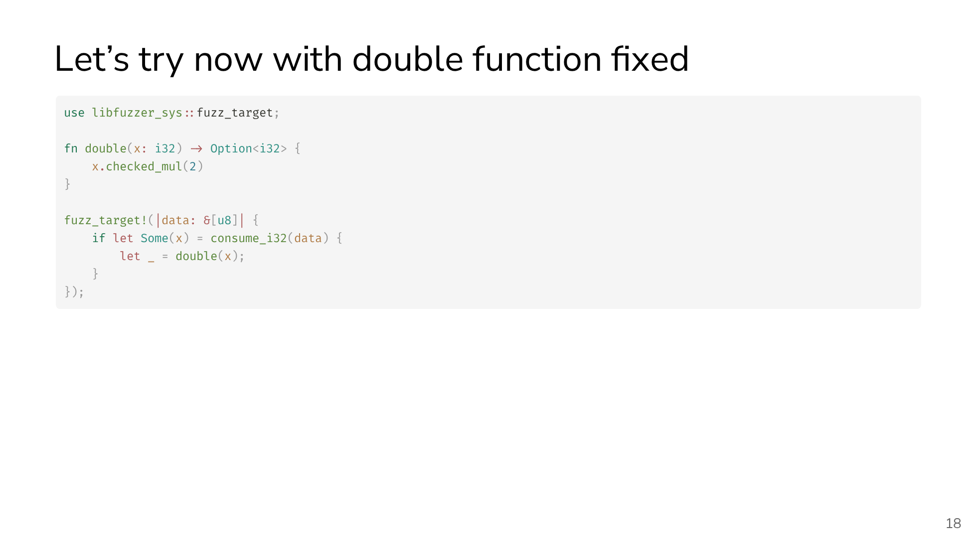
Notes:
Now let's try with the function fixed to see what happens. We can see that the fuzzer get stuck because it explored all the code and maximized the coverage and didn't find any crashes.

Slide 19
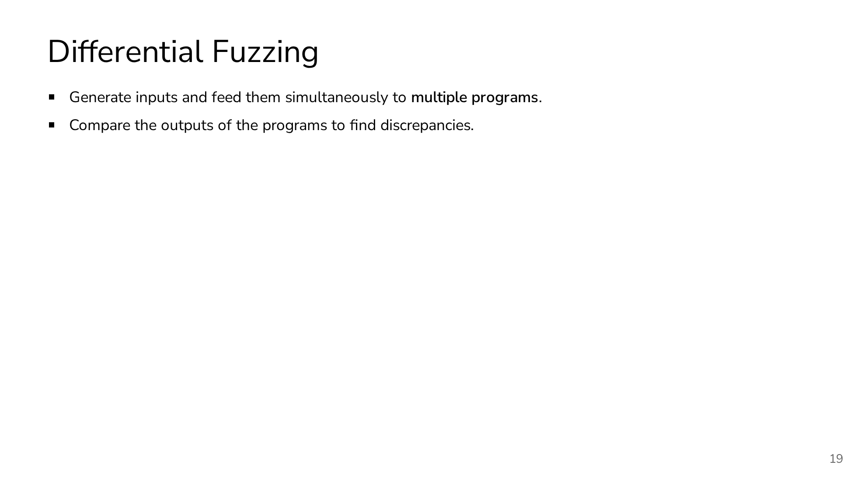
Notes:
Differential fuzzing will feed two or more programs with the same input and compare those outputs. If they are different outputs the program will crash and save the possible bug.

Slide 20
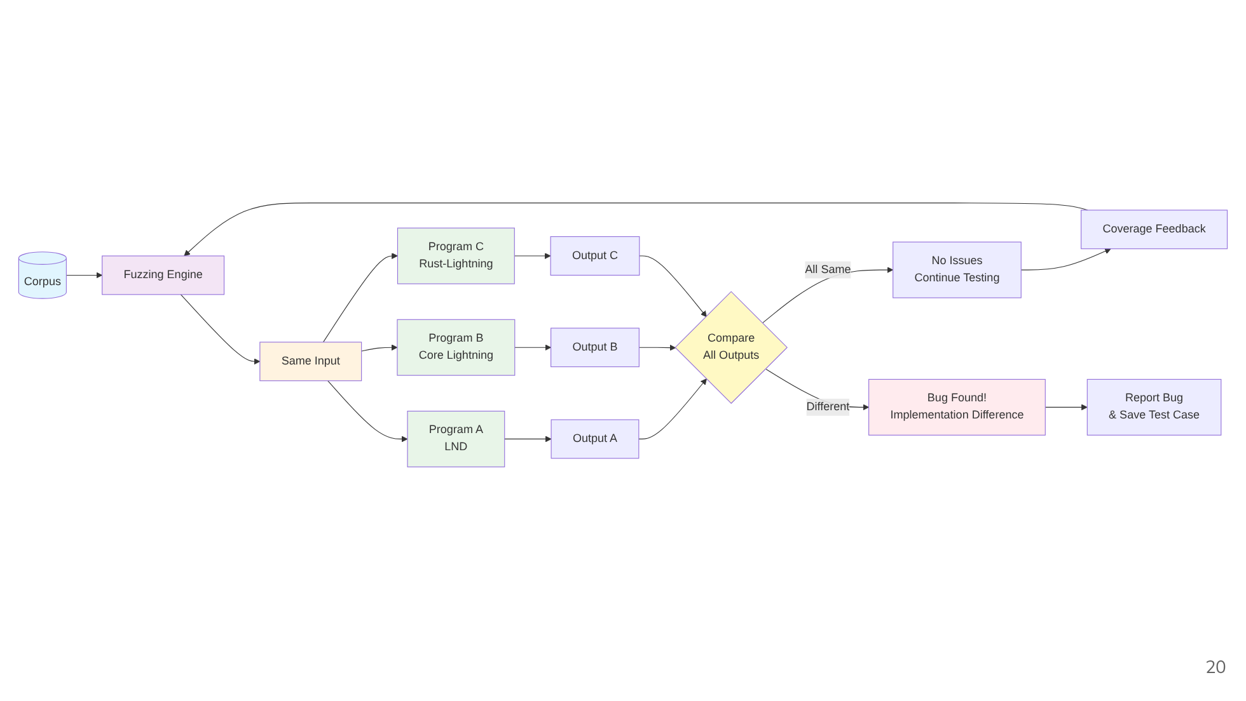
Notes:
This is an overview diagram of differential fuzzing. The outputs can be structured in many different ways. So it could be a boolean type, integer, string, structured formats, etc. It’s important to return the max information possible in the outputs to then be able to catch most/all the discrepancies.

Slide 21
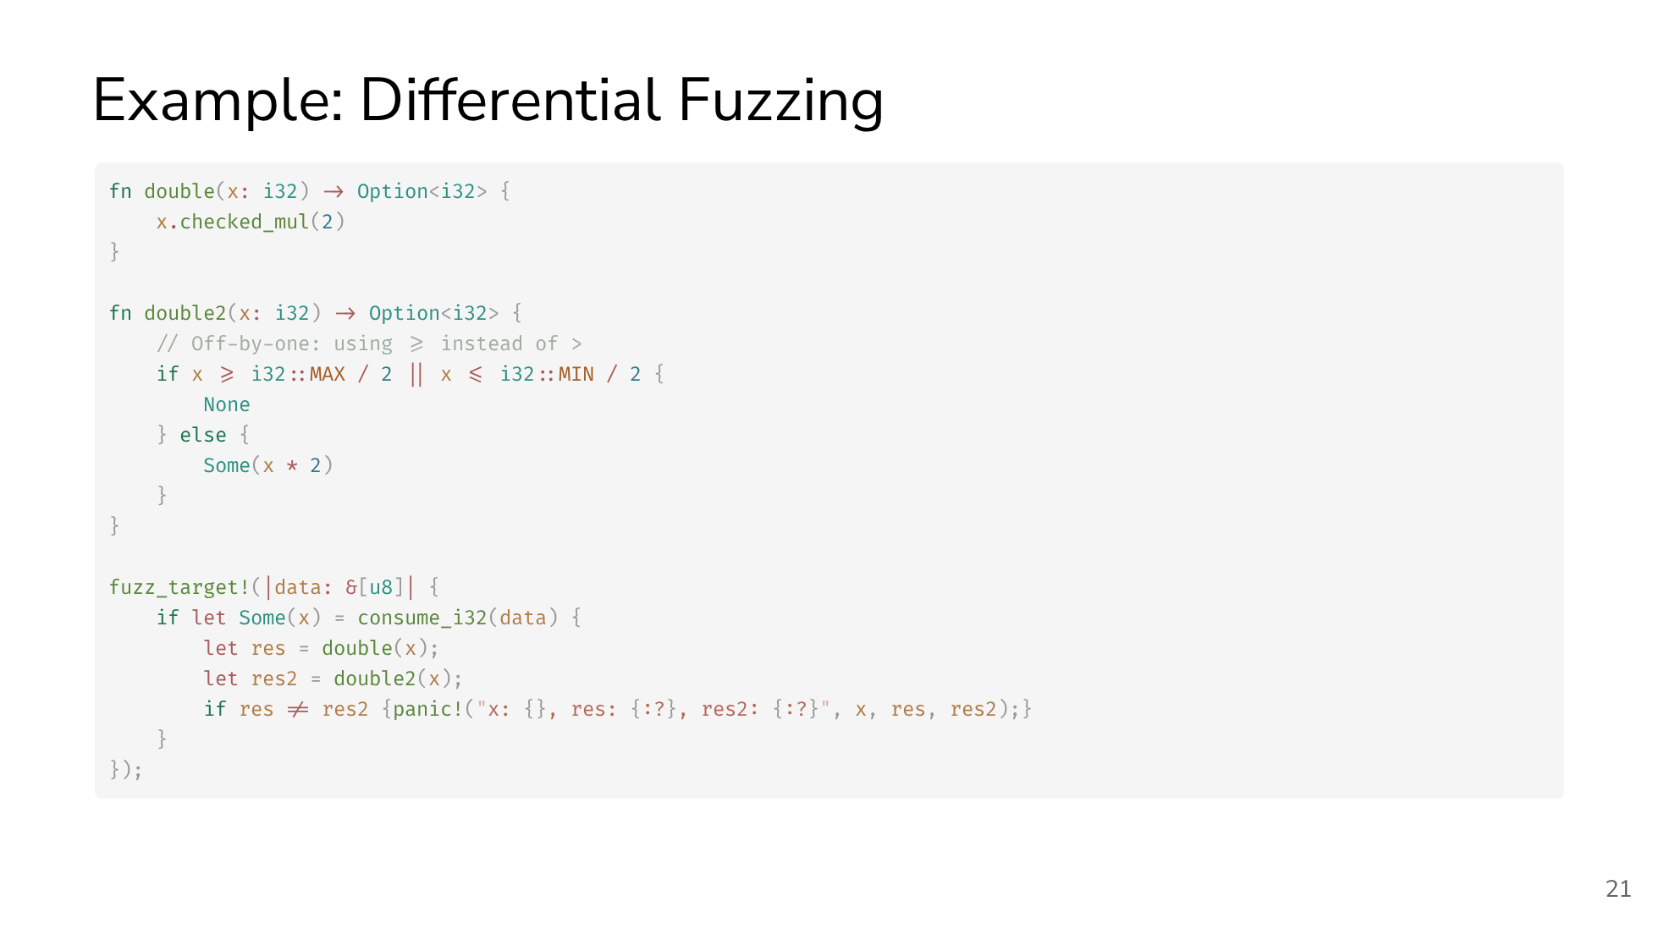

Slide 22
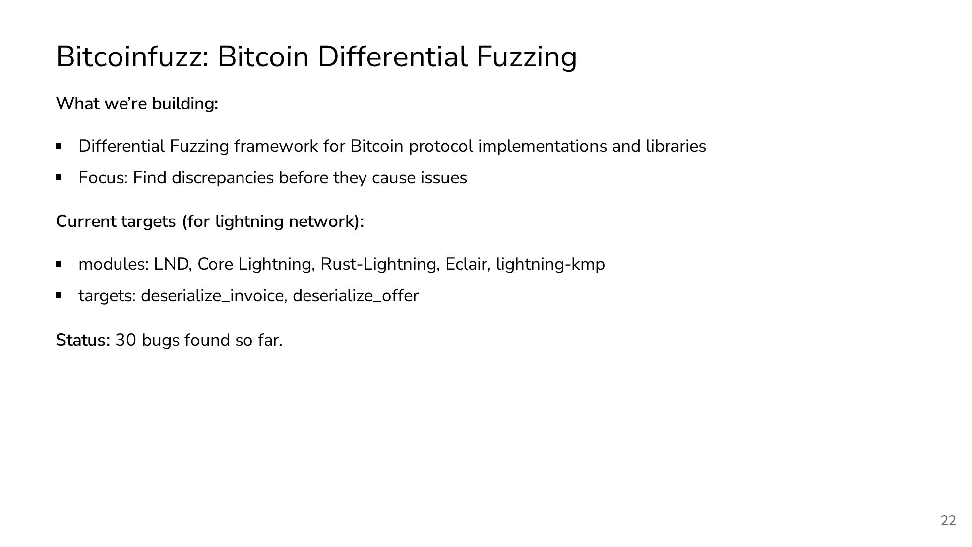

Slide 23
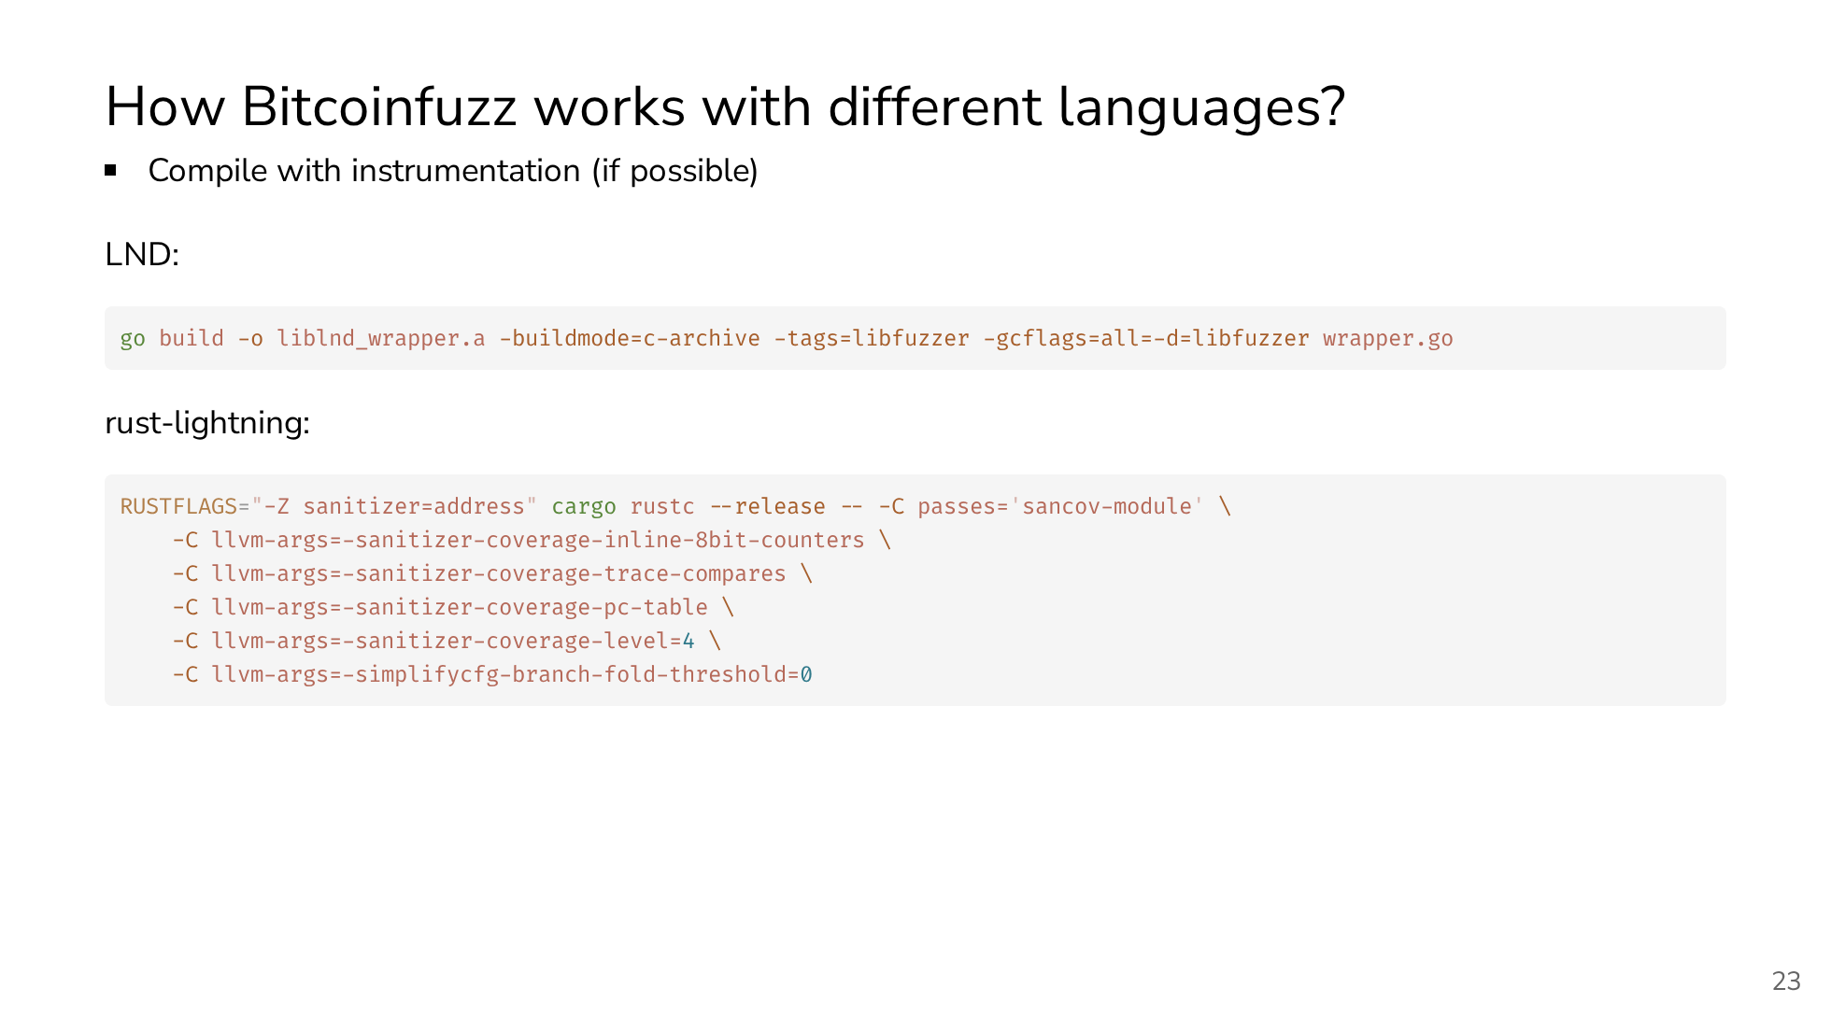

Slide 24
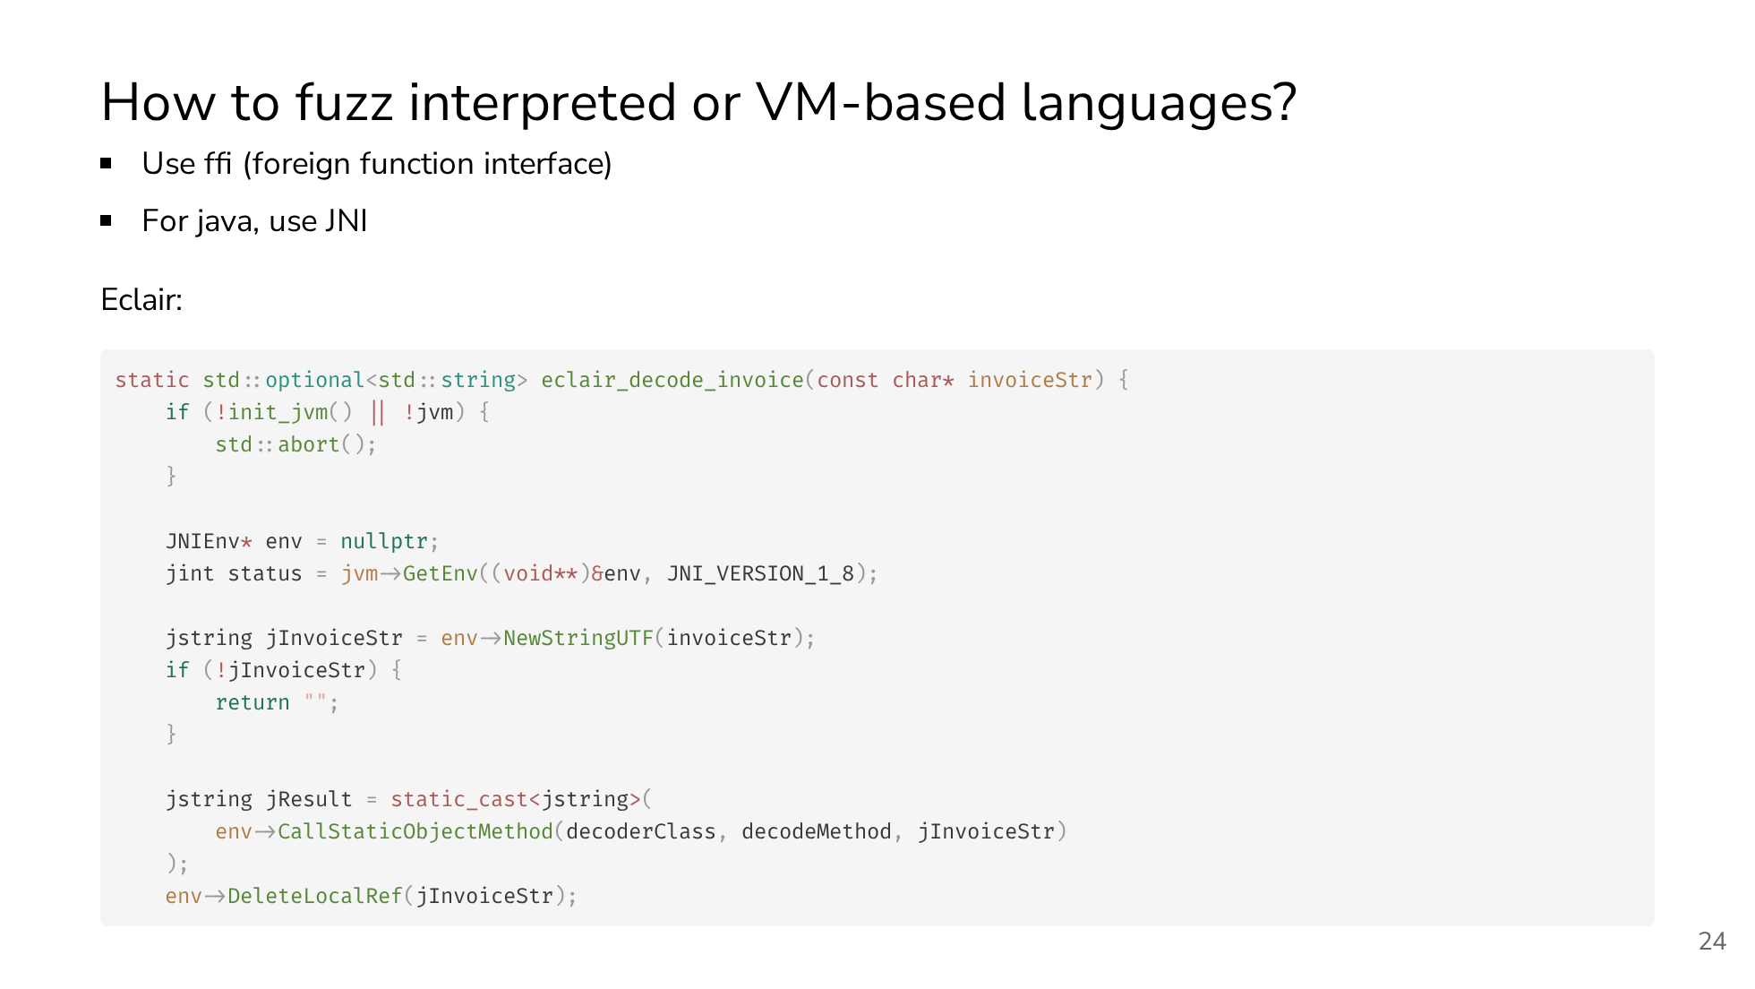

Slide 25
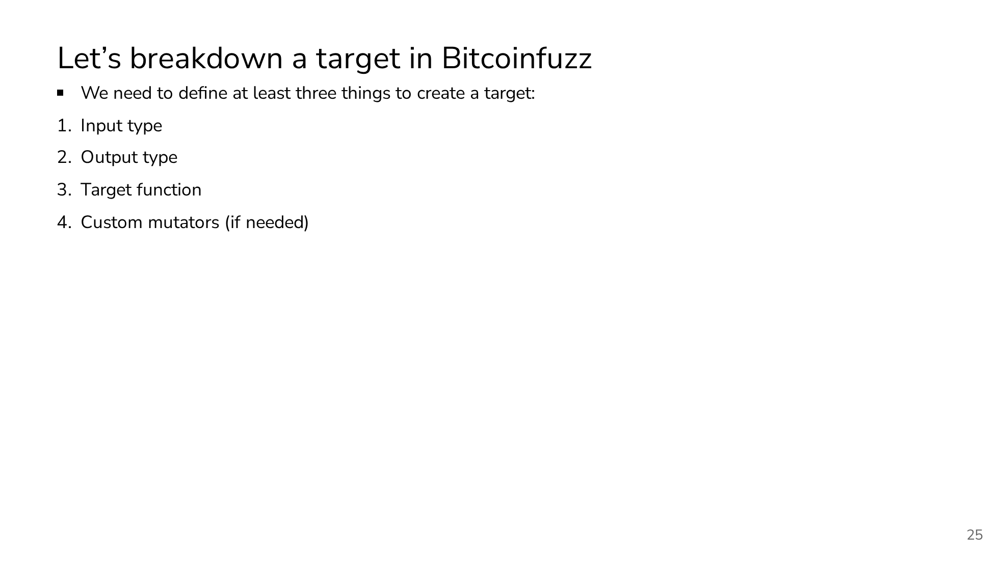

Slide 26
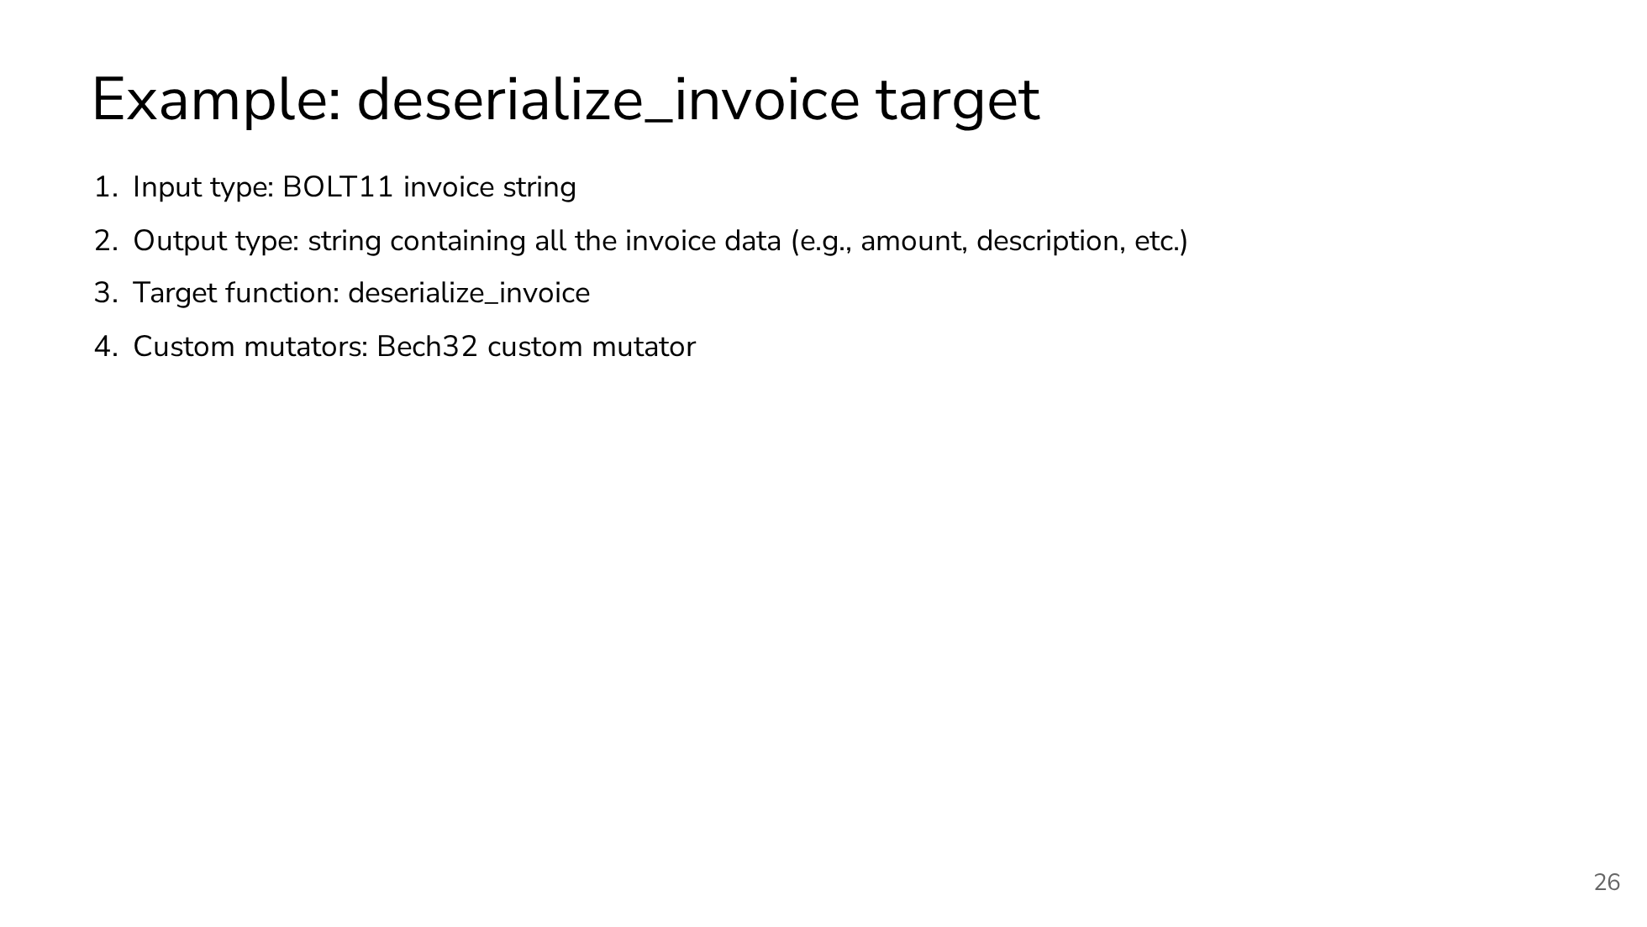

Slide 27
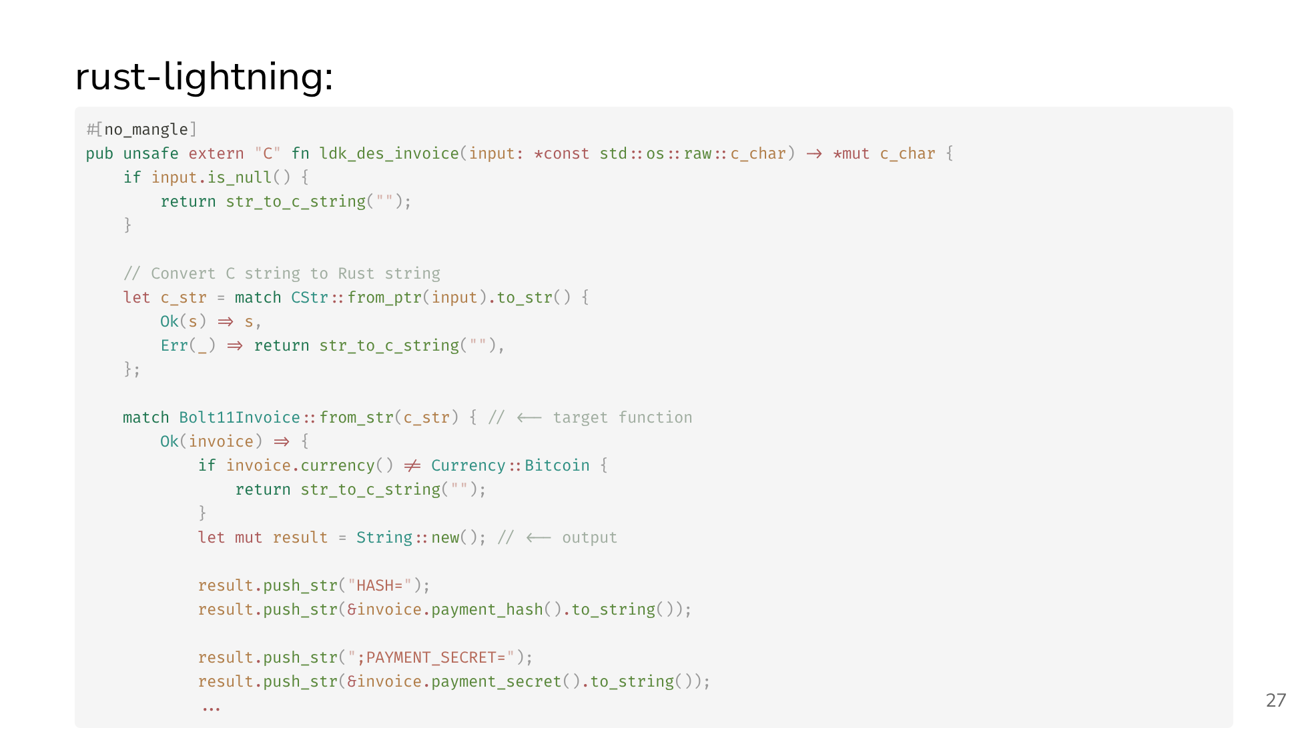

Slide 28
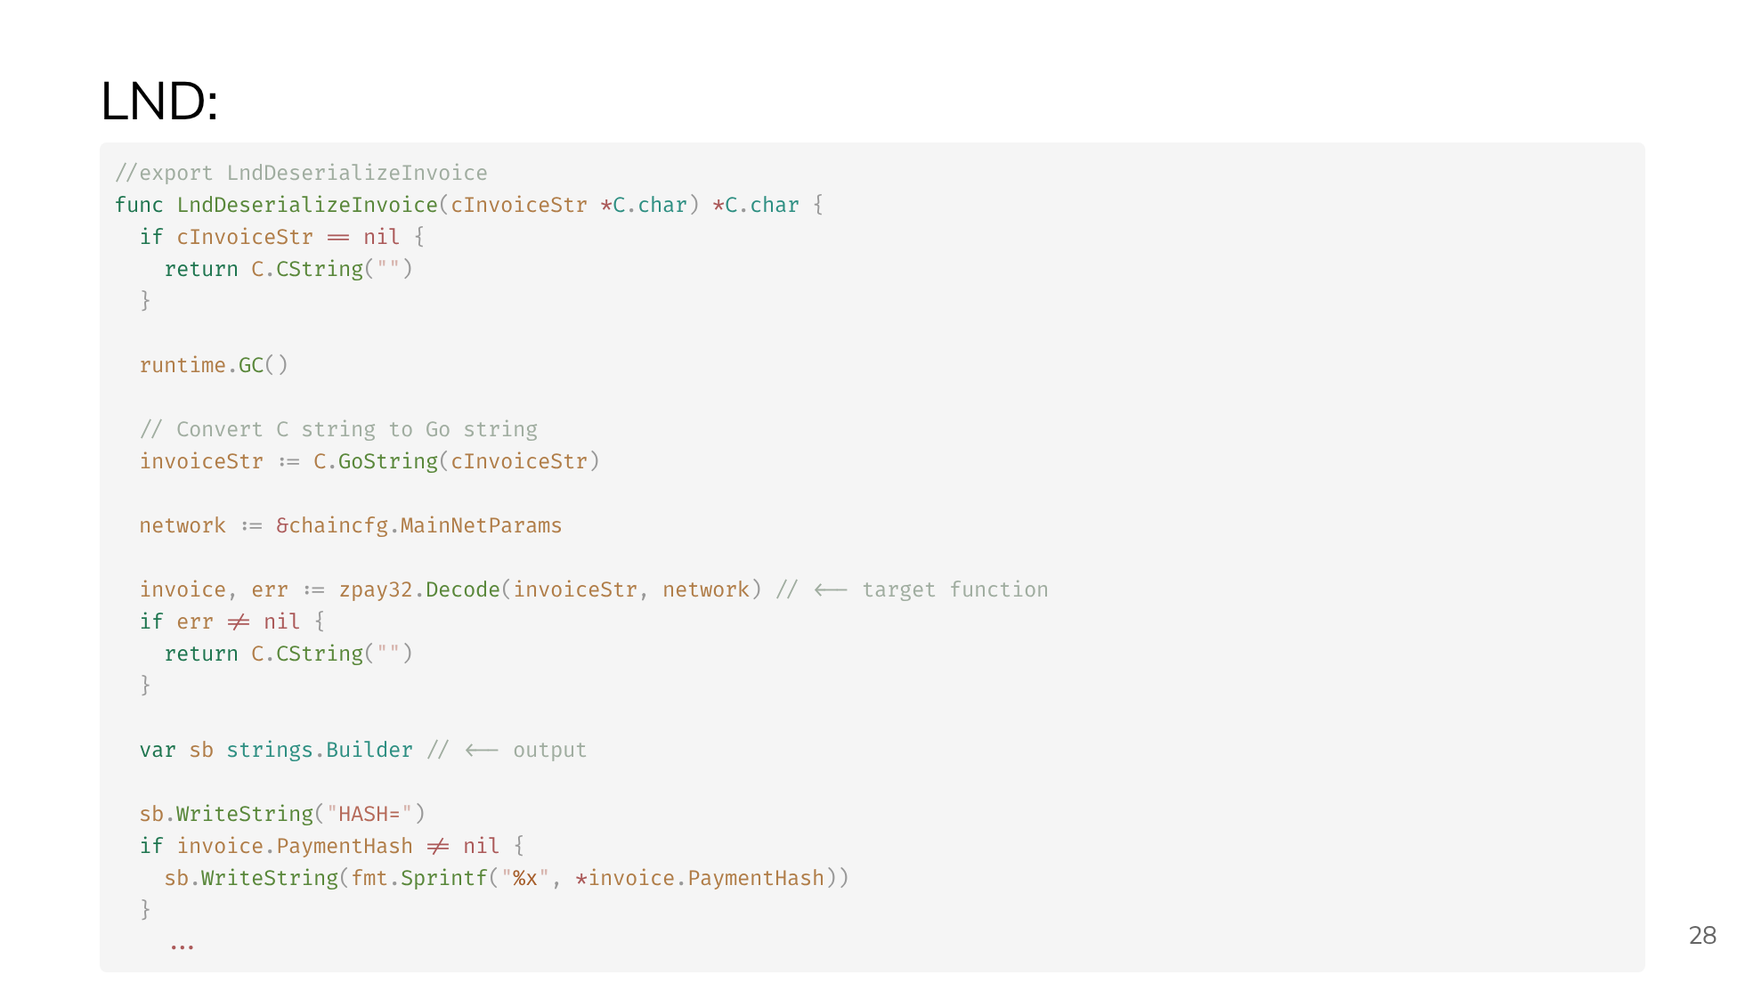

Slide 29
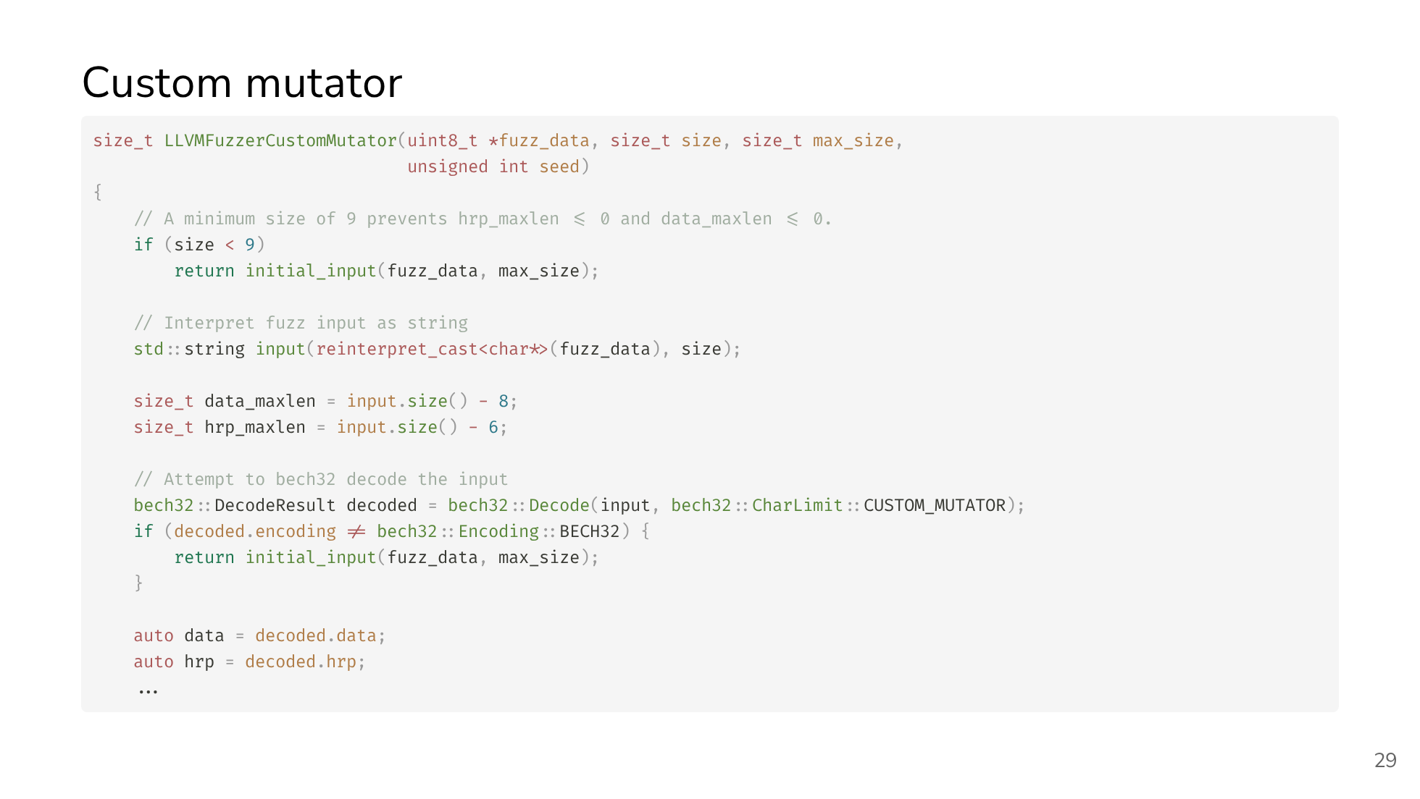

Slide 30
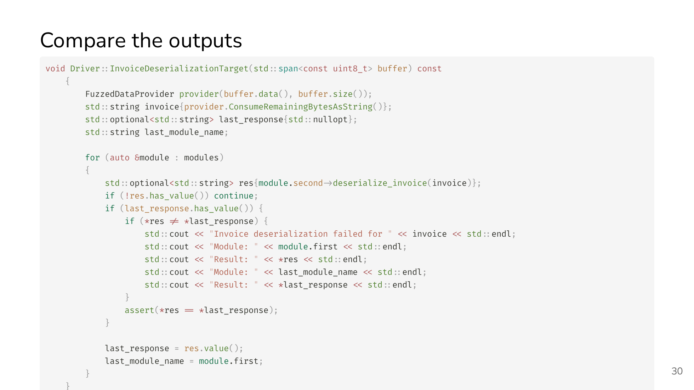

Slide 31
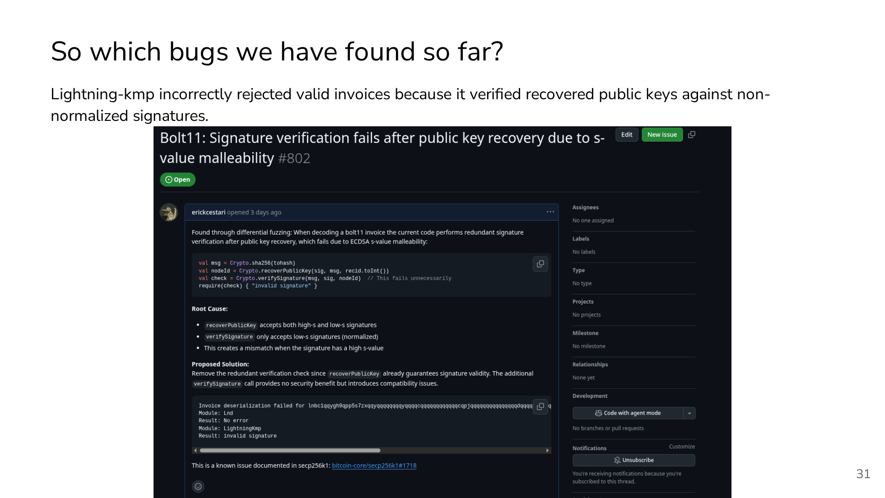
Notes:
TODO: Display with more details the bugs we found

Slide 32
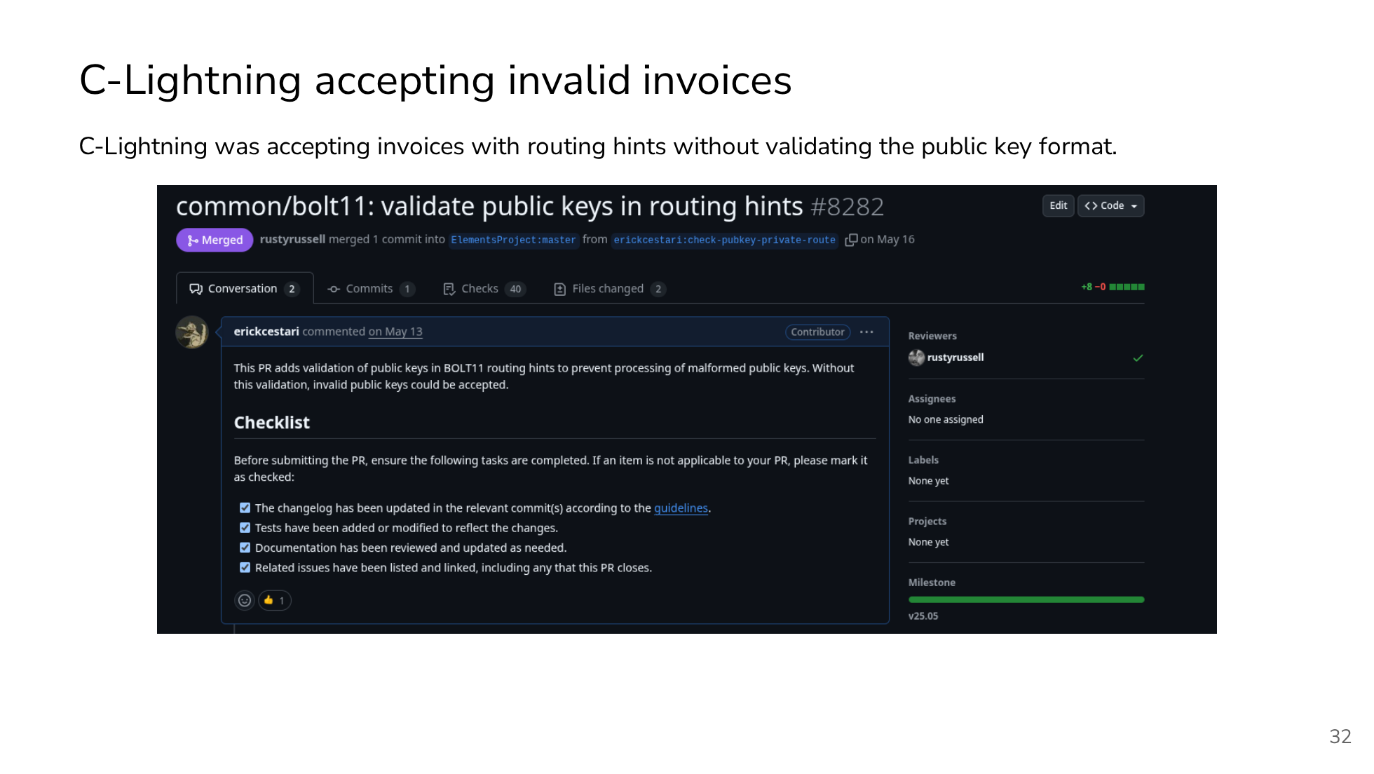

Slide 33
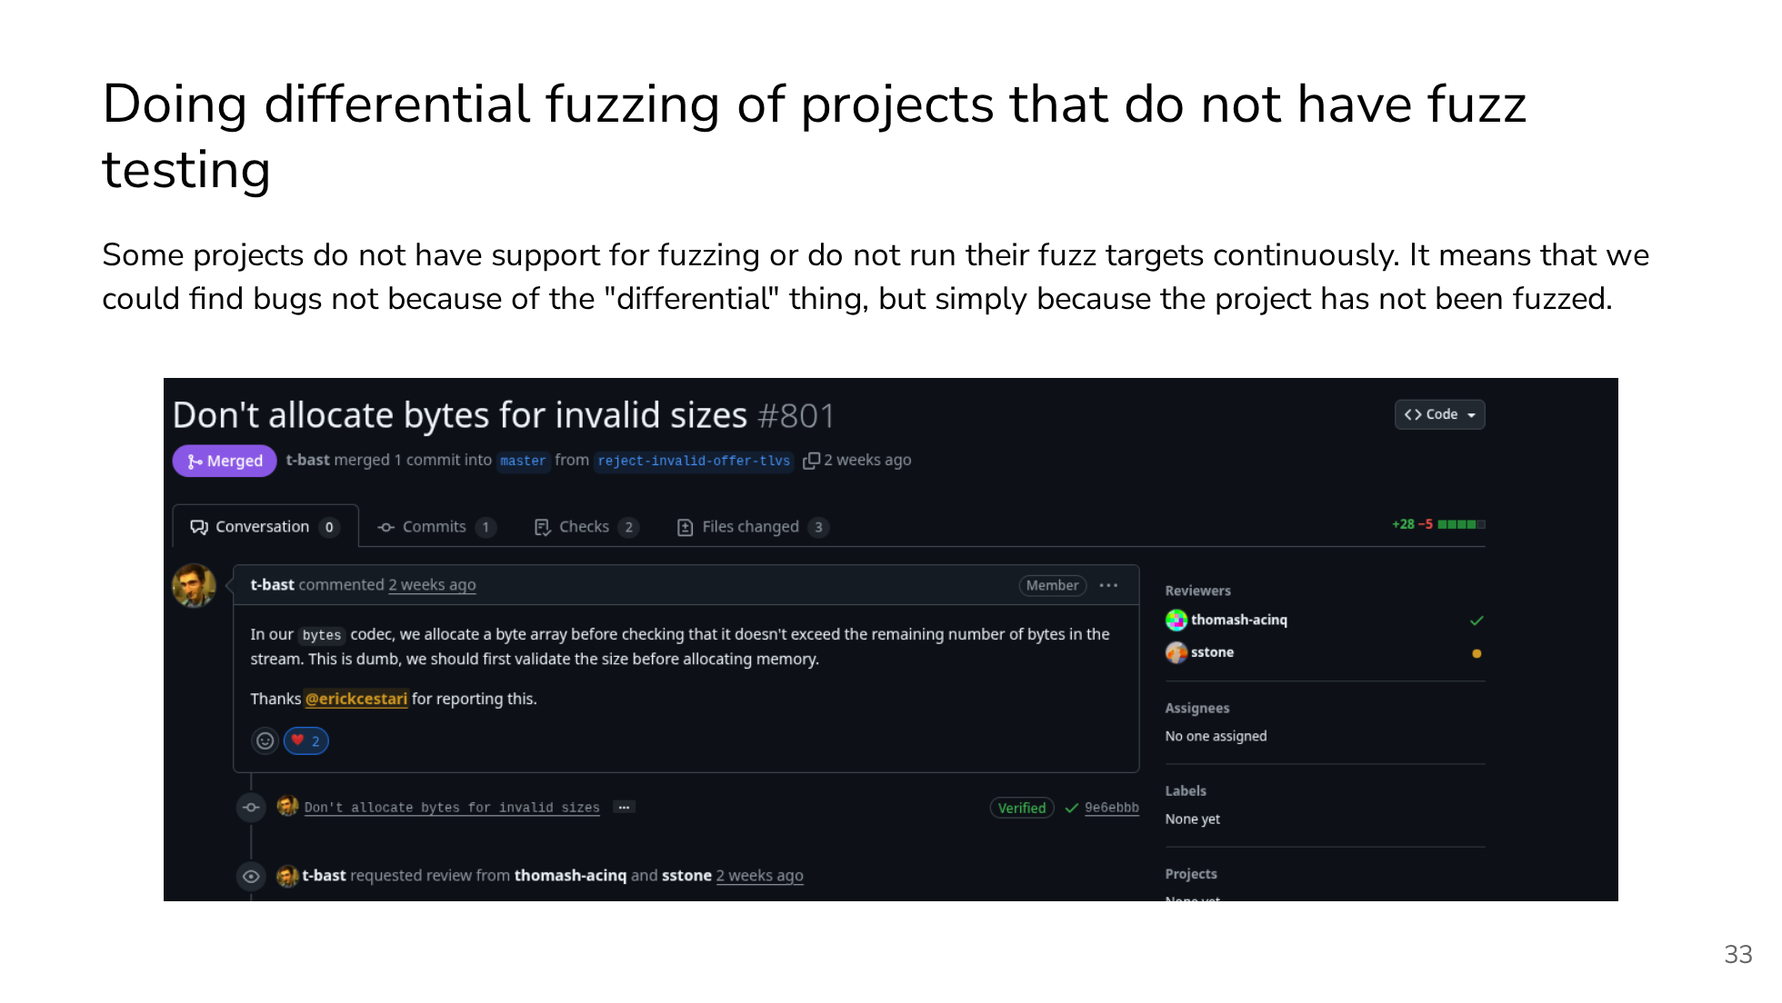

Slide 34


