Slide 1

Group Erick Calzadilla Molly Stewart Catherine Abelido

Slide 2

E(xtract)
We gathered our data from Kaggle for March Madness data
Our data had season results and tournament results data from 2003 – 2015(16 *tourney)
The data was formatted in csv
We used data that was an expanded box score and not the basic score data set it included

Slide 3
T(ransform)
For our transformations we changed the names of the columns to be understandable
We also combined some columns to become either percentages and a total
We dropped columns we did not see as valuable moving forward in information we wanted
We changed the names of the winning and losing team rows to know the team names
Then we saved our transformation data in new csv’s

Slide 4
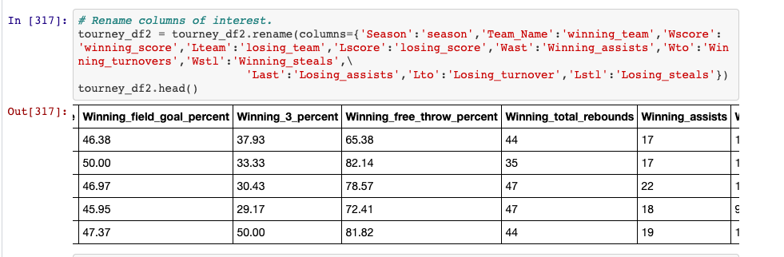
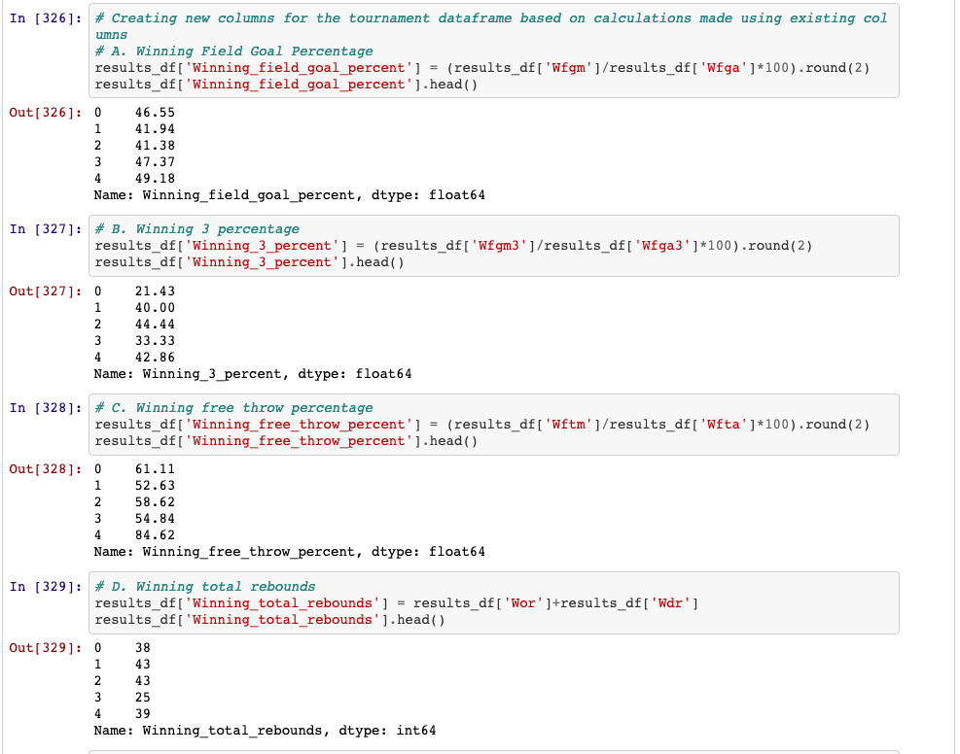

Slide 5
L(oad)
To load the data we created a database called MarchMadness2.0
Uploaded our transformed results and tourney data into tables in Postgres
Unioned the tables to combine season and tourney data in one table to show a teams whole season record
We created two final tables to contain 2015 data for both Duke and Wisconsin season records since both team reached the final

Slide 6
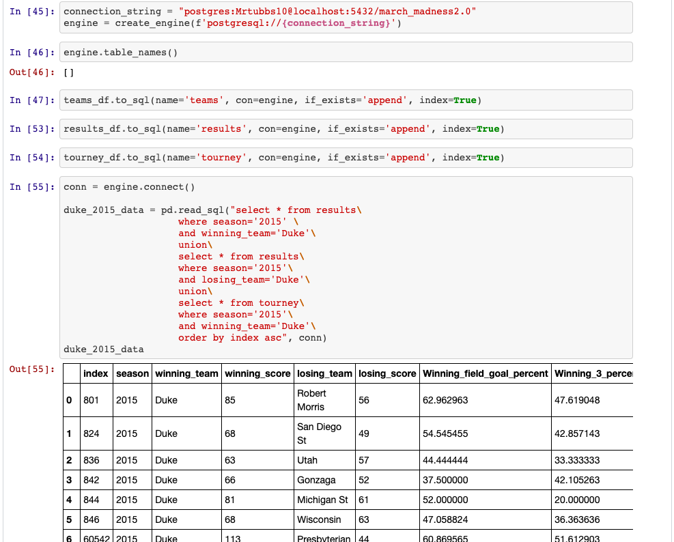

Slide 7
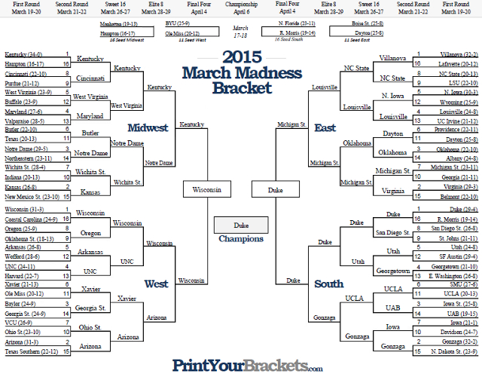

Slide 8

No Questions…. Thank you

