Slide 1

Group Erick Calzadilla Clayton Ragsdale

Slide 2
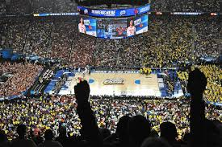
What is March Madness
March Madness- the “holy grail” of basketball tournaments
68 teams competing , single game elimination
Fans and Analysts around the country decide to compete in their own way.
Scientific formulas, dumb luck, favorite teams, and historical data

Slide 3
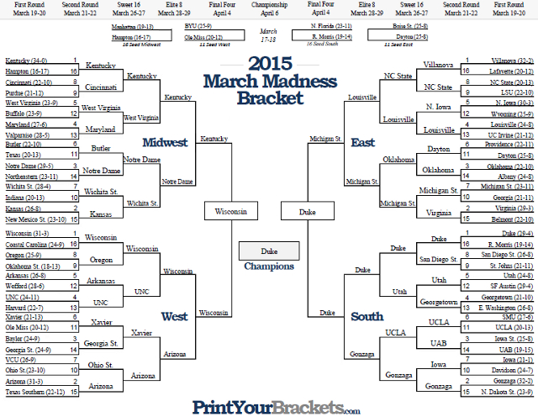

Slide 4
Objective
Out of 67 games try to create a model using historical data
From that model we will try to predict as many games possible correct
To be able to predict the 2015 champion Duke University Blue Devils
In order to establish a highly successful model using Random Forrest algorithm for classification
1 = Win, 0= Loss

Slide 5

DATA
Gathered data from Kaggle
Regular season data from 2003-2016
Created Model from half of data, and tested
-on other half
Post season data from 2015 tested on
71242 observations
Started with 33 variables
Ended with 23 variables

Slide 6
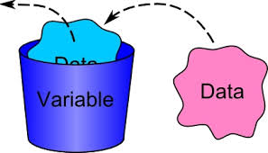
Dependent Variable & Independent Variables
Dependent Variables
Win
Independent Variables
ftm
fta
or
dr
ast
to
stl
blk
pf
Oftm
Ofta
Oor
Odr
Oast
Oto
Ostl
Oblk
Opf
FGP
OFGP
FGP3
OFGP3

Slide 7
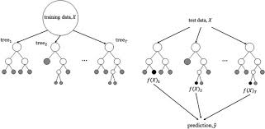
Random Forrest
It develops lots of decision tree based on randomly selecting random variables from a random selection of data
Two principles
- most of the trees are predicting correctly
-Trees are making mistakes at different nodes
Majority Rules

Slide 8
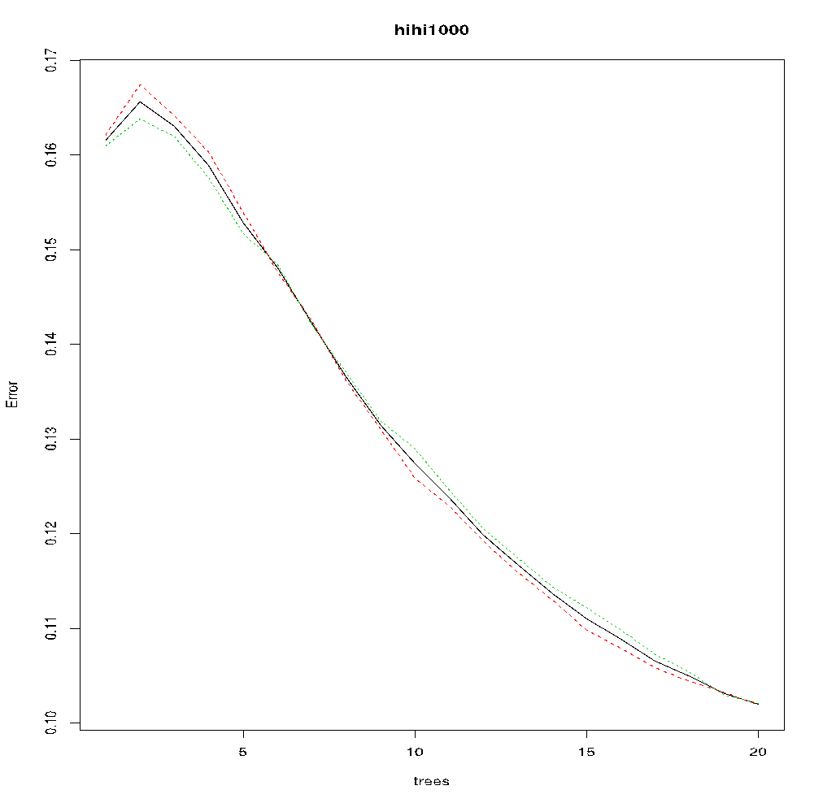
Error Rate

Slide 9
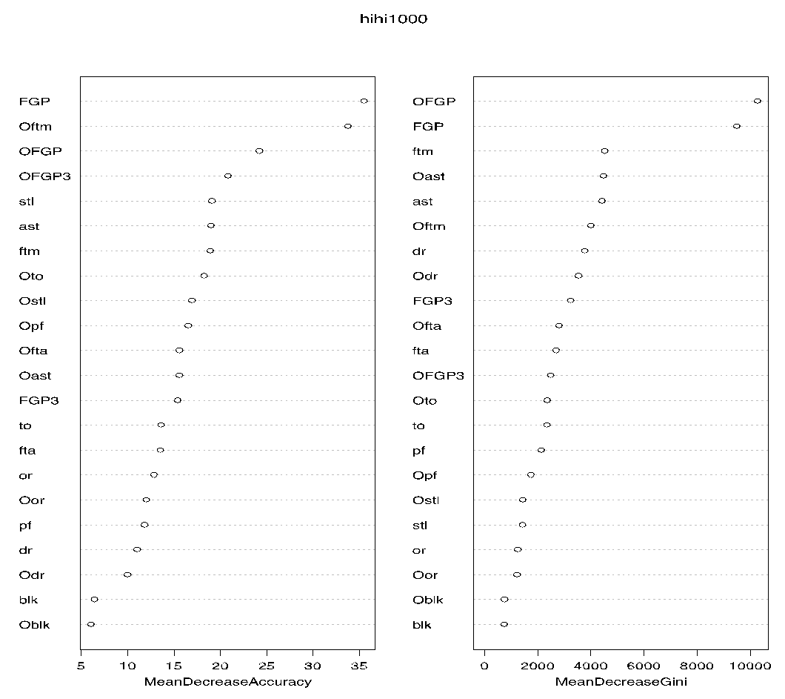
VIP

Slide 10
Training and Testing
Split the random sample half and half
The error rate was 10.2% on the training data
The error rate on the testing data was 8.53%
Next goal to test on 2015 tournament teams based on their averages

Slide 11
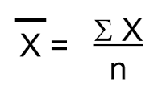
Explaining Averages
From the tournament we now use season averages of 2015, instead of post game data to predict outcome
By doing so we expect a higher error rate since we are now feeding the model average season data instead of post game data
We took the Average of the 2015 Season

Slide 12
By Round Model
Each round was run separately, and does not include wins from previous rounds.
Even if game in previous round is incorrect, the next round is reset with all correct winners.
This allows model to perform better than it would on the traditional bracket

Slide 13
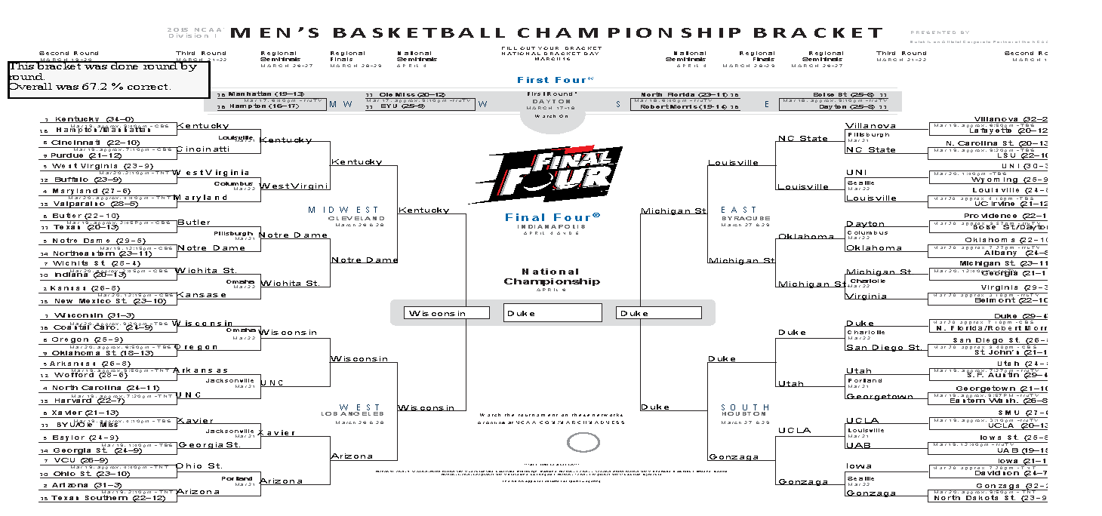
Bracket by Round
65.67% Correct
Br

Slide 14
Results by Round
Winner Duke Blue Devils
¼ - play in round
22/32– first round
11/16- second round
6/8- Sweet Sixteen
¾- Elite Eight
½-Final Four
Winner predicted correctly

Slide 15
Traditional Tournament
Single game elimination
Fill out bracket entirely even if previous winners are incorrect
Assumption: error rate will be greater than by Round bracket since games are conditional upon previous rounds

Slide 16
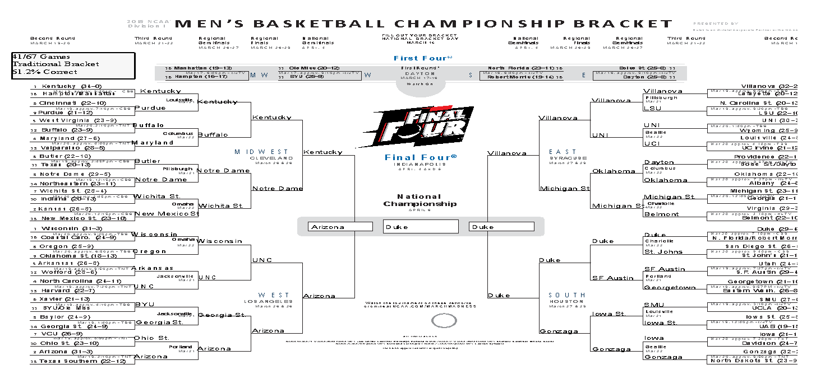
Traditional Bracket

Slide 17

Results by Traditional
Winner Duke Blue Devils
¼ - play in round
21/32– first round
10/16- second round
6/8- Sweet Sixteen
2/4- Elite Eight
½-Final Four
Winner predicted correctly

Slide 18



How to improve model ?
For loop can be ran in order to calculate averages that are updated every game per team.
Model would now resemble more of our test data format
Create a model in which in can do team by team comparisons.
- or create model where it compares different conferences
-assumption: conferences has specific style
Each team has their own model would then predict winner off of predicted independent variables .

Slide 19
What to take away
Winners heavily dependent upon shooting percentage and there opponents overall shooting percentage.
Though some predictions were incorrect since teams with a lower strength of schedule had higher shooting percentages for playing weaker teams
Ex-New Mexico State beats Kansas
Overall Random Forest algorithm provides exceptional results considering lack of data and descriptive independent variables.
Shows us the power of many decision trees

Slide 20

Questions?

