Slide 1
Quick Sort
eRICK dOMINGUEZ MARQUEZ

Slide 2
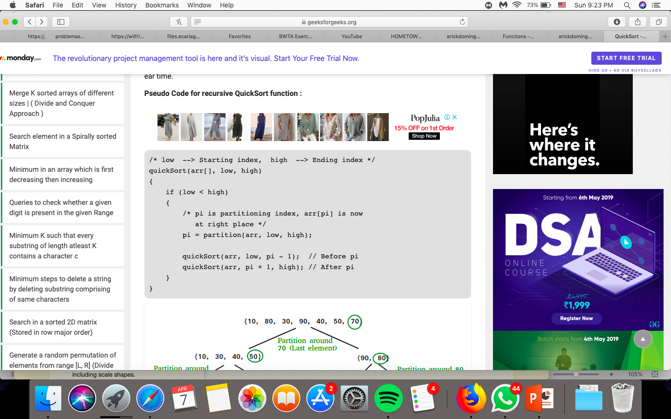

Slide 3
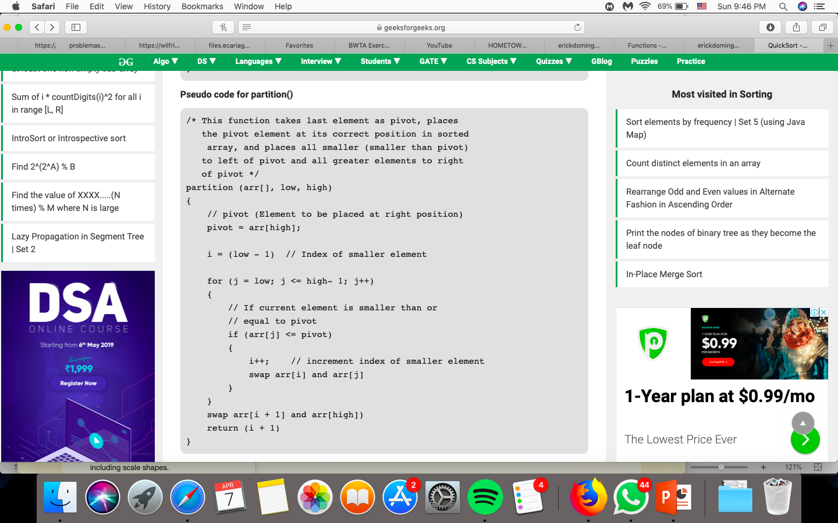

Slide 4
6
7
3
9
2
1
5
4
quickSort(a, 0, 7)
Low= 0
High=7
Llamamos la función de partition con los
siguientes parametros
Low= 0
High=7

Slide 5
6
<=
4
7
<=
4
El pivote es el elemento que
Acomodaremos en este caso:
3
<=
4
9
<=
4
4
i=-1
j=0
2
<=
4
1
<=
4
5
<=
4

Slide 6
6
<=
4
7
<=
4
3
<=
4
3
2
1
9
<=
4
2
<=
4
6
7
9
5
1
<=
4
5
<=
4

Slide 7
6
<=
5
3
<=
1
7
<=
5
2
<=
1
<=
9
5
3
2
6
7
9

Slide 8
6
<=
9
3
<=
2
7
<=
9
3
6
7

Slide 9
6
<=
7
6

