Slide 1

INCOME CLASSIFICATION
A Machine learning based EDA & Sklearn Pipeline building project.

Slide 2
ABOUT PROJECT

Slide 3
ABOUT PROJECT
OBJECTIVE
We are going to take a deep dive into the data of income of various persons and going to build a Sklearn Pipeline for finding the best classification model using hyperparameter tuning.

Slide 4
ABOUT DATASET

Slide 5
Dataset
The sample Dataset consist of around 32.6k records of users having income either greater than 50k or less than 50k
ABOUT DATASET
Variables of Dataset
Age
WorkClass
Fnlwgt
Education Num
Marital Status
Occupation
Relationship
Race
Sex
Capital Gain
Capital Loss
Hours Per Week
Nativee Country
Income

Slide 6
TOOLKIT AND ALGORITHMS

Slide 7



MARKET SEGMENTATION
TECH TOOLKITS USED
Python
SK-Learn
Python is the programming language which is used to code the project. Various algorithms used are coded in Python
.
Scikit-learn is a free software machine learning library for the Python programming language. It features various classification, regression and clustering algorithms
Jupyter Notebook
Jupyter notebook is the effective IDE used for coding in Python. It is very easy to use and widely used over the industry.

Slide 8
Algorithms used in the project
Logistic Regression
Random Forest
Decision Tree
XGboost

Slide 9
STEPS AND PROCESS

Slide 10
1
Research and business understanding
The first thing you have to do before you solve a problem is to define exactly what it is. You need to be able to translate data questions into something actionable.
PROJECT PROCESS
2
Data pre-processing
Data preprocessing can refer to manipulation or dropping of data before it is used in order to ensure or enhance performance, and is an important step in the data mining process.
3
Exploratory Data analysis
Exploratory data analysis is an approach of analyzing data sets to summarize their main characteristics, often using statistical graphics and other data visualization methods.
4
Model Building
Model building process where different machine learning algorithms are used to make different machine learning models for various applications.
5
Sklearn Pipeline
Building a sklearn pipeline for preventing the data leakage. Hyperparameter tuning using the pipeline

Slide 11
INSIGHTS GENERATED

Slide 12
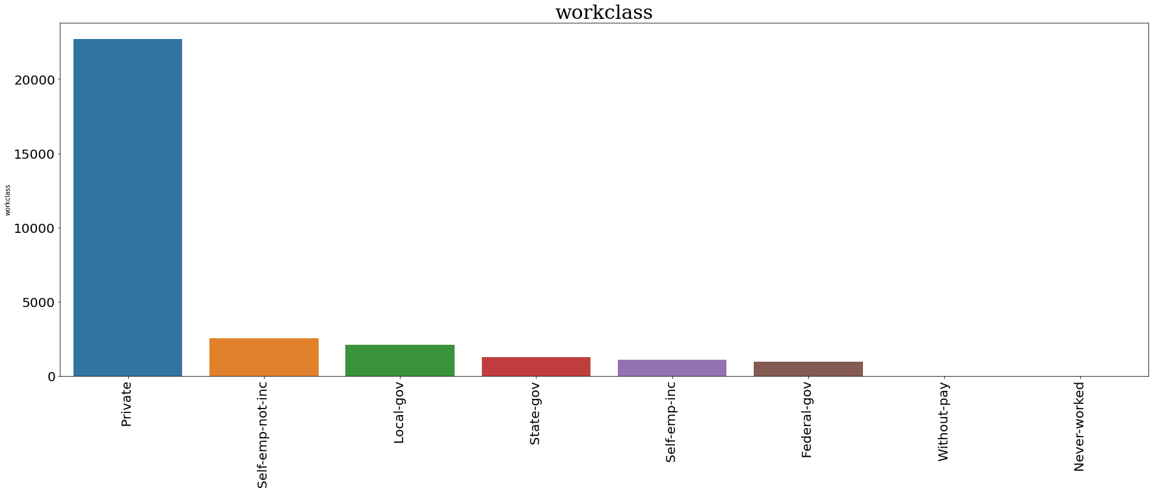
OVERALL ANALYSIS

Slide 13
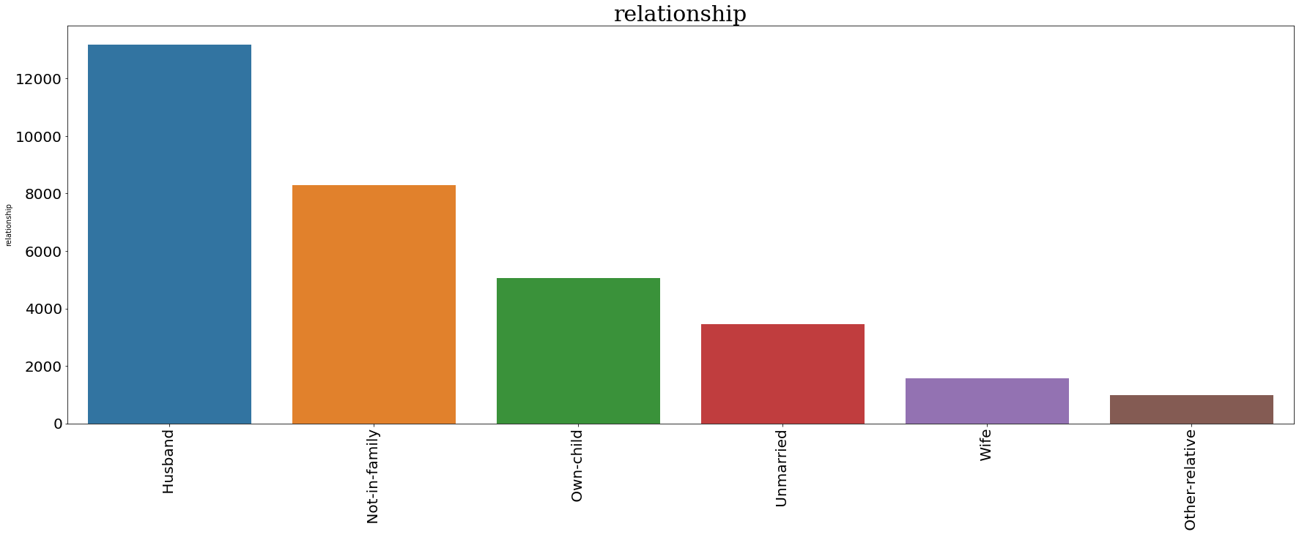
OVERALL ANALYSIS

Slide 14
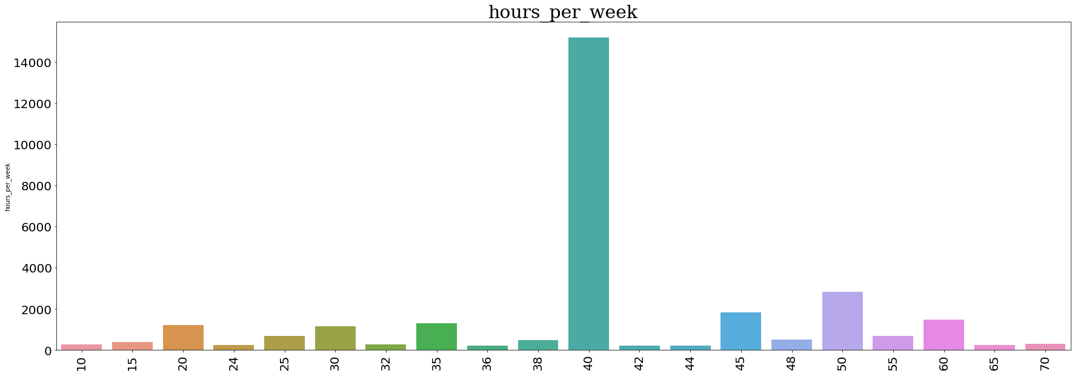
OVERALL ANALYSIS

Slide 15
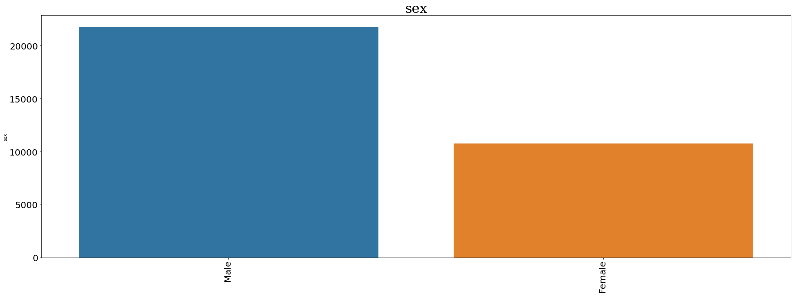
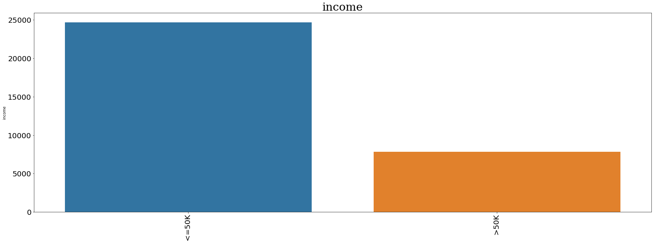
OVERALL ANALYSIS

Slide 16
OVERALL ANALYSIS
Main occupation of People are Prof-specialty, Craft repair, exec-managerial, Adm-clerical, Sales
Mostly people's Native country is from United States
3. People having income less than 50K is more
4. AVG Working hours per week is 40
5. Capital Loss having 31018 number of rows zero which is large in number so other values are treated as outliers
6. Capital Gain having 29825 number of rows zero which is large in number so other values are treated as outliers
7. In the dataframe percentage of Male's are approximately double of Female's
8. Half of the male's are married
9. Mostly Race of the people is White
10. Approxmately 10K people are not married
11. Mostly people are high school graduate or in some college or completed bachelors
12. Workclass of majority of people's is Private.

Slide 17
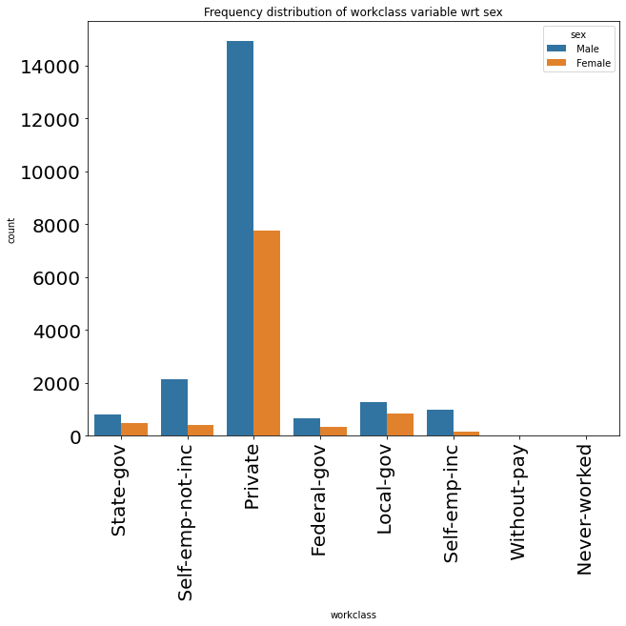
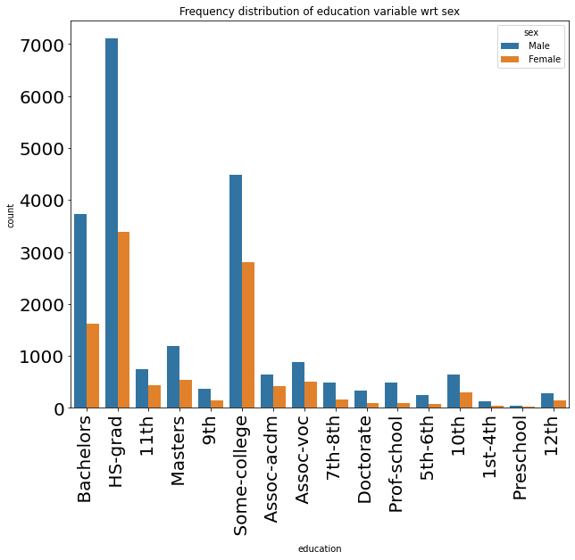
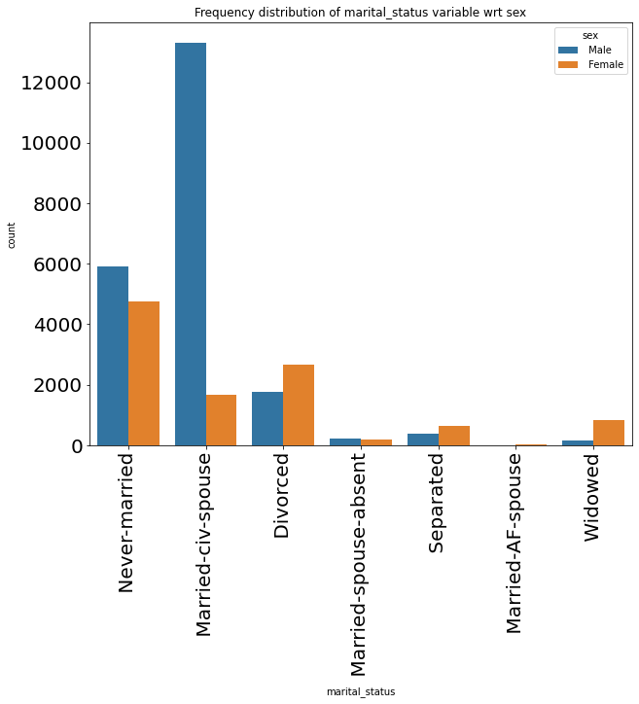
OVERALL ANALYSIS

Slide 18
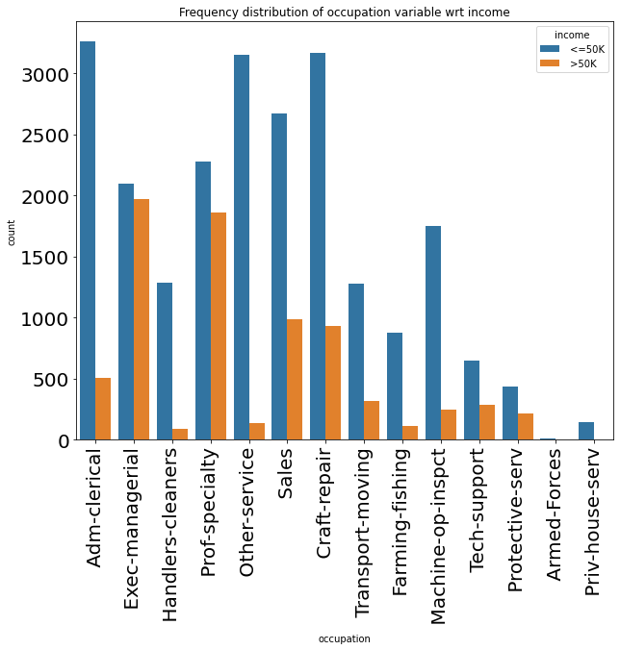
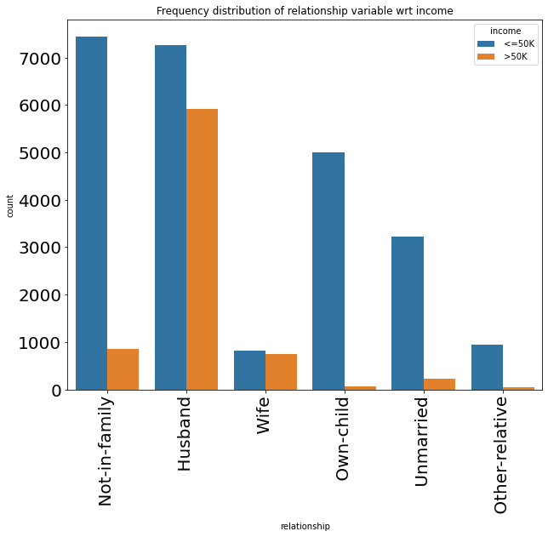
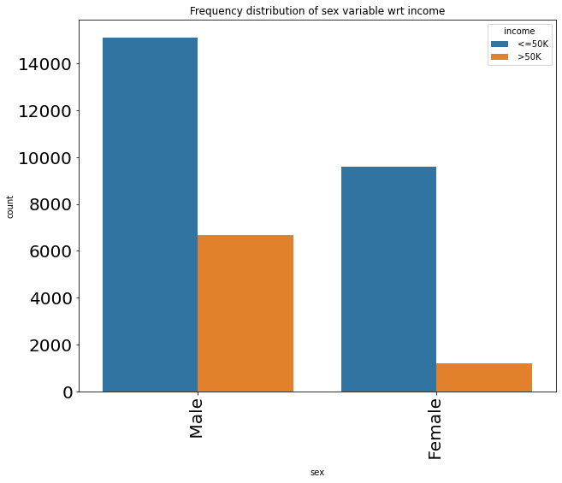
OVERALL ANALYSIS

Slide 19
OVERALL ANALYSIS
1. If the person workclass is private then there is high probability that income of the person is less than 50k
2. If the person's education is HS-grad or some college then there is high probability that income of the person is less than 50k
3. If the person's education is masters, doctorat or prof-school then there is high probability that income of the person is more than 50k
4. probability of income of never-married, divoreced, separated or widowed persons is less than 50k
5. People having occupation Adam-clerical, other services, Handlers-cleaners,sales, Transport moving, farming-fishing or machine-op-inspct have high probability that there will be income less than 50k
6. People haing relationship status as not-in-familty, own-child, unmarried or relatives have high probability that there will be income less than 50k
7. More than 50k is the income of the person that persons gender might be male.

Slide 20

INCOME CLASSIFICATION
A Machine learning based EDA & SKLearn Pipeline building Project

