Slide 1

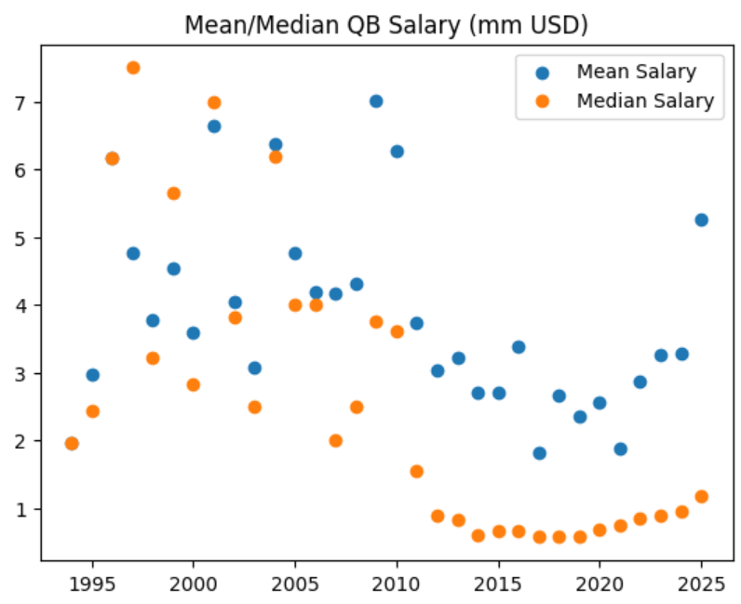
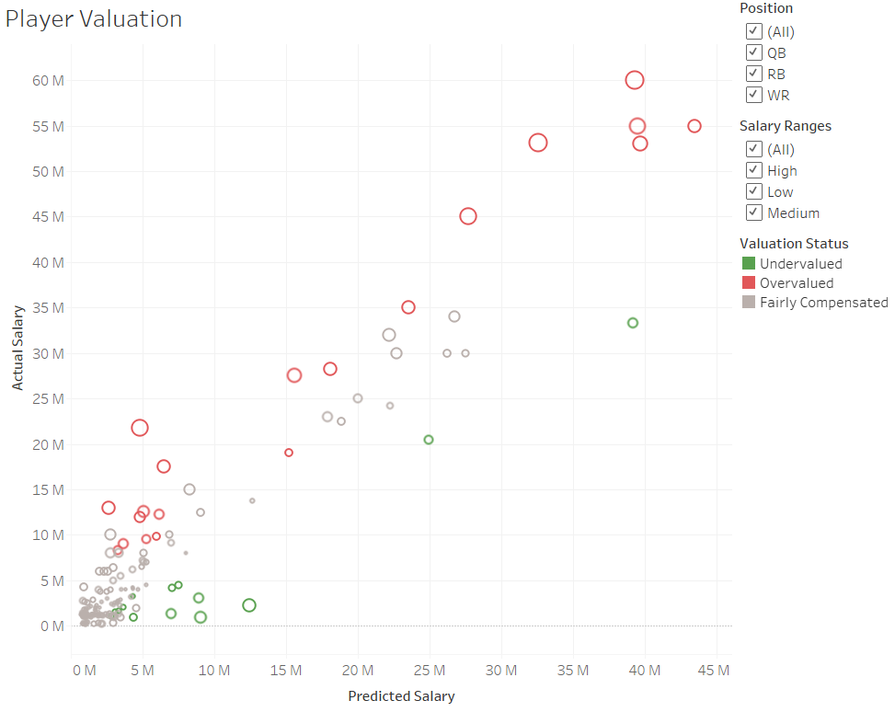
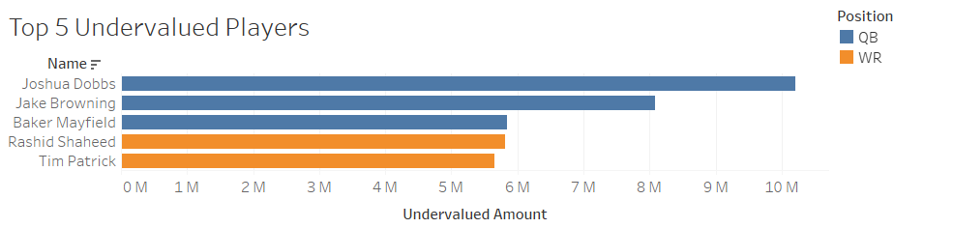
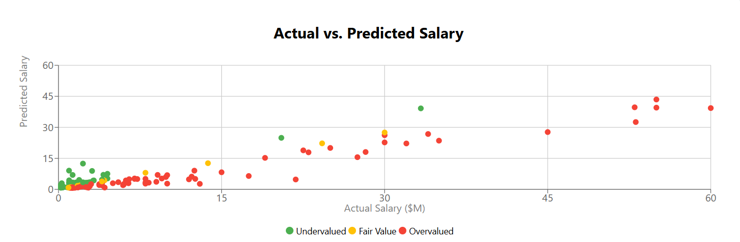
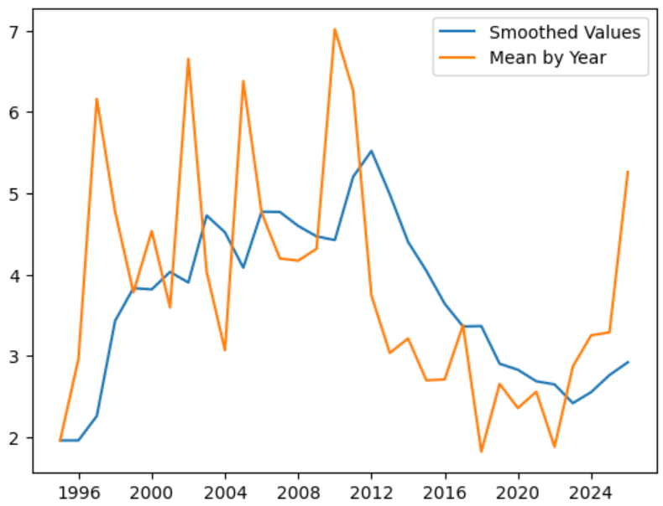
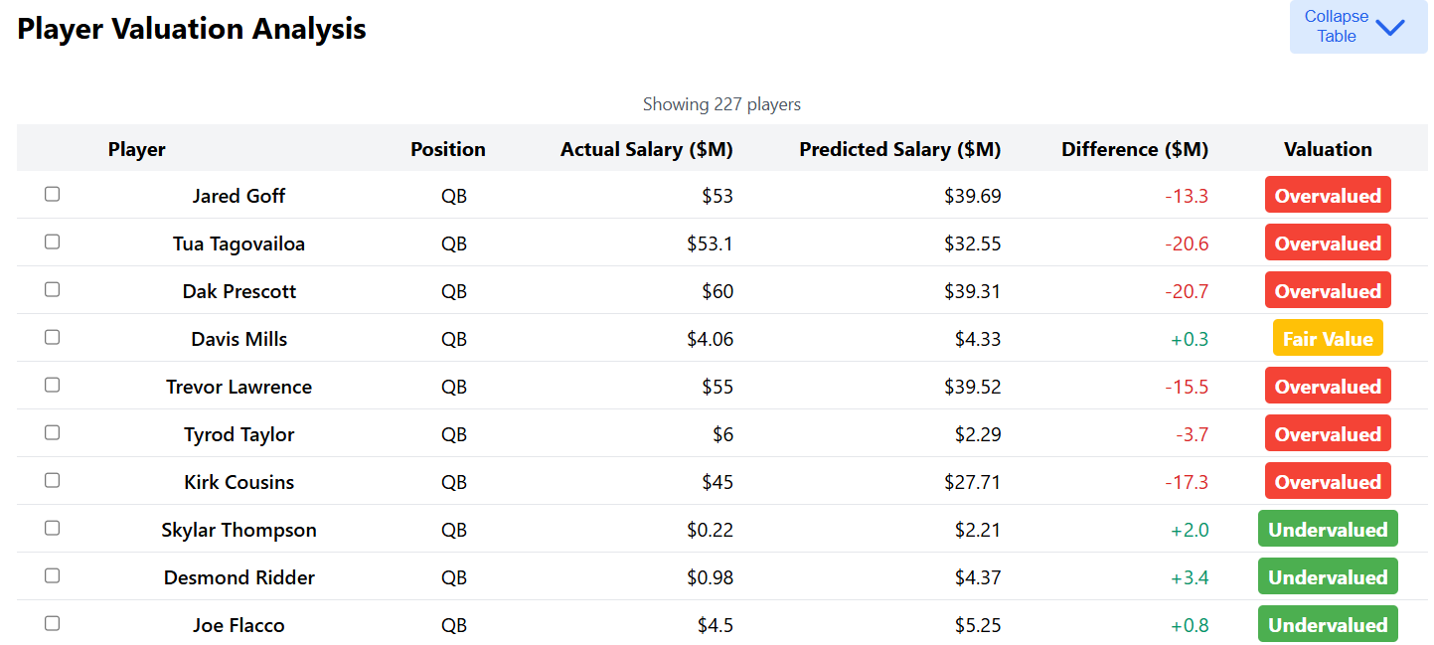
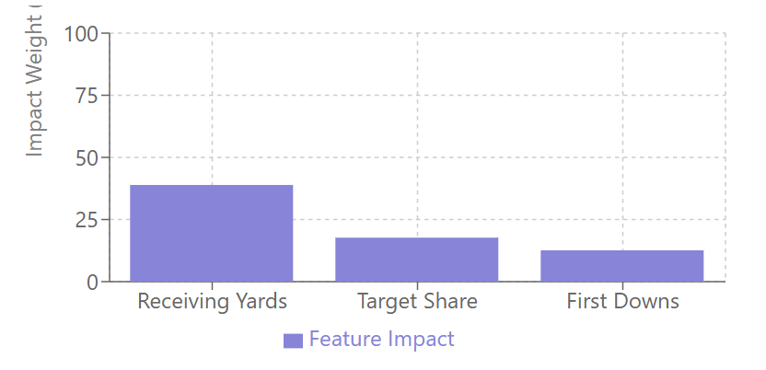
Predicting and Visualizing NFL Player Salaries
Ivan Eduardo Del Valle, Walker Harrison Butin, Roman Erick Emde, Faiza Mehboob Jamani
Motivation & Introduction
NFL player salary is highly volatile and therefore subject to disparity. Utilizing historical NFL salaries and player performance statistics, we applied various normalization methods and trained regression models with the goal of predicting a player’s true market value, as measured by the average annual value of their contracts. Using this valuation, teams could then identify which players are undervalued by the market and pursue them in free agency.
Data
Player performance statistics, team performance, and contract data was collected from the open-source nflverse GitHub page. The most widely available performance data were for quarterbacks, running backs, and wide receivers.
Our Approach
Visualization
Results were visualized using the following methods:
A heatmap to convey player valuation status by comparing actual and model-predicted salary, as well as the degree of over/undervaluation with interactive filters for Position, Salary Range, and Valuation Status.
An interactive dashboard that visualizes the difference between players' actual and predicted salaries, using scatter plots and radar charts to identify undervalued and overvalued NFL players based on position-specific performance metrics.
Data Normalization
With the volatility year-to-year of NFL salary data, we tested mean centering, median centering, and exponentially smoothed average centering (novel approach developed by team). We found the best results with this third method.
Models
Centered data was then fed into a various regression models, with results evaluated using R-squared and Mean Squared Error to select the best model. These models included Linear Regression with LASSO used for feature selection, and Gradient Boosting Machines.
Using exponential smoothing, we were able to capture market trends without the extreme volatility of using annual mean salary values
Experiments and Results
Feature importance metrics were gathered to ensure models had an intuitive method of predicting player salary
Conclusion
Using our most performant centering methodology and regression model, we can capture a fair valuation of a player’s salary recommendation based on past performance. This can then be used by NFL teams to better negotiate with or target players.
Models and centering methods were evaluated using R-squared values and MSE.
 | Quarterback | Running Back | Wide Receiver
Mean- centered | R²: 0.83 MSE: 1.27 | R²: 0.66 MSE: 1.62 | R²: 0.82 MSE: 1.73
Median-center | R²: 0.81 MSE: 191.29 | R²: 0.76 MSE: 16.02 | R²: 0.76 MSE: 83.36
Smoothed-centered | R²: 0.84 MSE: 3.64 | R²: 0.75 MSE: 5.84 | R²: 0.9 MSE: 1.21

