Slide 1
a statistical primer on gambling
eric kim + susa cx
11/7/17

Slide 2
my goals today:
speak minimally and have you guys play games

Slide 3
warnings
the purpose of this talk is to introduce some statistical methodology from probability and game theory to the theory of gambling followed by playing games and having a fun time with no risk to actual capital
you should in no way shape or form take the contents of these slides or the theory in any of the references as legitimate gambling advice
tldr: gambling is bad for you and you shouldn’t do it because you’ll lose all your money

Slide 4
1) six
we consider the game of `six` as a motivation for `blackjack`
we have a deck with three 3’s and three 1’s
two players (A and B) both get two cards
both have the opportunity to “hit” or “stay”
the winner is the player who gets the closest to six without going over

Slide 5
solving `six`
there are only four cases to consider
A has 6 (3,3) B has 4 (3,1) or 2 (1,1)
A has 4 (3,1) B has 2 (1,1)
A has 2 (1,1) B has 4 (3,1)
A has 4 (3,1) B has 4 (3,1)

Slide 6
A has (3,3) B has (3,1) or (1,1)
A should not hit, B can tie at best

Slide 7
A has (3,1) B has (1,1)
there are only {3,3} left so A should not hit since she will bust
B should hit so he ends with 5 and wins

Slide 8
A has (1,1) B has (3,1)
by symmetry, A should hit B should stay, A wins

Slide 9
A has (3,1) B has (3,1)
here, the remaining deck is {3,1} so we have some randomness to consider. let’s suppose that we have payoffs as follows: V(A wins) = 2x, V(B wins) = x, V(A loses) = -x, V(B loses) = -2x (so a bit unfair for B, but this replicates a casino setting where A would be the house)

Slide 10
A has (3,1) B has (3,1)
A stays
if B stays, then tie
if B hits, payoff is .5(x) - .5(2x) = -.5x < 0, so B wants to stay.
hence if A stays, then B will stay and there will be a tie (no payout to either)

Slide 11
A has (3,1) B has (3,1)
A hits
if A hits, her expected payoff is .5(2x) -.5(x) = .5x > 0 so she will prefer to hit rather than stay
suppose A hits and busts (drew a 3), B wins from staying (did nothing)
suppose A hits and does not bust (drew a 1), B loses from staying (did nothing)
in either case, B ends up just staying so the optimal moves are (hit, stay)

Slide 12
1.1) blackjack
see chapter 21 in `the doctrine of chance` by ethier
consider a relatively simplified version of blackjack as follows: n players and a dealer with a couple standard 52 card decks
everyone gets two cards face up and the dealer receives one card face up and one card face down. goal is to get close to 21 without busting. after everyone is done deciding to hit or stay, dealer hits until they bust or has 17 or higher
2,...,10 worth their face value, J, Q, K worth 10, A worth 1 or 11

Slide 13
solving blackjack
we can approach via the tree method as in the last case of `six`, but that would take forever
instead, we can cheat a little via counting cards: if we could tabulate what cards had been shown, we could give a reasonable guess of what’s left in the deck and decide to hit or stay more optimally

Slide 14
counting cards
see chapter 21.3 in `the doctrine of chance` by ethier
consider a very basic up-down model:
initialize count = 0
if low cards (2,3,4,5,6): count += 1
if mid cards (7,8,9): count += 0
if high cards (10,J,Q,K,A): count -= 1

Slide 15
counting cards (intuition)
if the count is sufficiently high, the game favors the player: the player stays and the dealer must hit, but the deck has many high cards so the likelihood that the dealer busts is higher
if the count is sufficiently low, the game favors the dealer: the dealer can inch his way up to 21. in this case, the player should hit and try to get up to 21 which increasing the count

Slide 16
refinement to the up-down model
do the same thing but keep track of 5’s, 10’s, and A’s as well
(ideally, we just remember every card that had showed up)

Slide 17
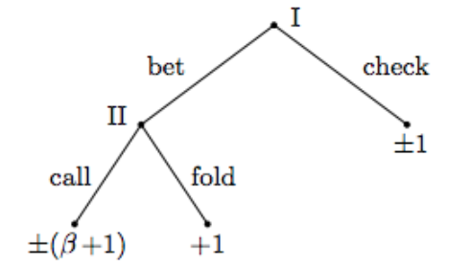
2) von neumann poker
two players, each player pays $1 and assume PI goes before PII
and we have a payoff tree as follows

Slide 18
von neumann poker (cont)
suppose both players pick a number from an iid ~Uniform(0,1)
PI wins if x > y and PII wins if x < y (we don’t care about x=y since the prob is 0)
PI has optimal strategy see `Theory of Games and Economic Behavior` by von Neumann and Morgenstern (1944)

Slide 19
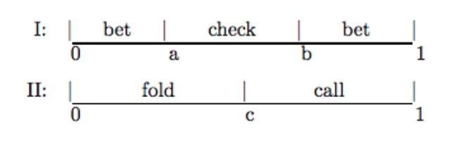
von neumann poker (cont)
optimal strategy:
PI - bet if x < a (hope PII folds) or x > b (high enough value); check otherwise
PII - call if y > c (high enough value) fold if y < a (too low)

Slide 20
2.1) poker (texas hold em)
see chapter 22 in `the doctrine of chance` by ethier
each player dealt two cards face down with a round of check, bet, or fold
(can also have blinds or ante)
after first round comes the flop: three cards laid out in the middle followed by another round of check, bet, or fold
then the turn: one more card laid out followed by check, bet, or fold
then the river: one last card laid out followed by check, bet, or fold

Slide 21
solving poker
idk
research area for [deep] reinforcement learning
take CS 188 + 189 + 294-112

Slide 22
3) kelly systems (single wager)
see chapter 10 in `the doctrine of chance` by ethier
consider a game that is super fair. let X (a [-1,infinity) discrete RV) represent the gambler’s profit per unit bet (the gamber gets X=-1 aka losing his bet with positive probability).
let Xi represent the profit at coup and suppose the gamber bets Bi where Bi is a function of the previous profits (Bi = b(X1,...,Xi-1) and B1 = b1 a constant).
the fortune can be defined as Fn = F0 + (B1X1+...+BnXn) where F0 is the initial fortune.

Slide 23
horse race betting
suppose we choose to bet on a horse
if the horse wins, it pays a to 1 P(X = a) = p
if the horse ties with another winning horse, you get your dollar back P(X = 0) = r
if the horse loses, you lose a dollar P(X = -1) = q

Slide 24
horse race betting
to determine the optimal betting proportion f, consider the expected log profit
u(f) = E[log(1+fX)] = p*log(1 + af) + r*log(1 + 0f) + q*log(1 - f) = p*log(1 + af) + q*log(1-f)
take the derivative and set equal to 0 to solve
f* = (ap-q)/(a(p+q)) = E[X|X ≠ 0]/a !!! this doesn’t depend on ties !!!

Slide 25
horse race betting
if we had data on how a horse performed in the past, we could estimate p and q from the proportions of their wins and losses and bet f* of our fortune on that horse

Slide 26
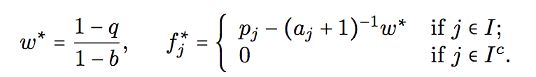

3.1) simultaneous wagers kelly systems
what if we wanted to bet on more than one horse (hedging our bets)?
let I be the set of horses we bet on, w the withheld capital, and fj the proportion of our fortune we bet on horses. using a lot of math, the optimal allocation can be solved to be (1) for withheld capital: (2) for full capital bet:

Slide 27
simulations
code available at: https://github.com/erickim/kellyCriterion
you can also `git clone https://github.com/erickim/kellyCriterion.git`

Slide 28
thank you for coming!
now we get to play games

