Slide 1

Import
Product Tax System
Problem Definition
Import tax management system is often handled manually, leading to frequent errors, delays, and compliance issues. Businesses struggle to accurately calculate duties, apply exemptions, and meet tax deadlines.

Slide 2
Customs agencies, Import/export businesses, and Tax authorities
Customs Officers
Business Owner
Tax Authorities
Automate tax calculations for imported and exported goods.
Ensure compliance with country-specific trade regulations.
Generate reports for tax audits and customs clearance.
Context
Target Users
Project Goals

Slide 3
IMPORT PRODUCT TAX MANAGEMENT SYSTEM:
Help us to manage and track taxes on imported products, ensuring compliance, transparency, and accurate reporting.
Objectives
  Automate the tax calculation process.
  Track importer records and transaction history.
  Support timely tax payments and clearance authorization.
  Importers/International sellers.
  Customer Officers
  Tax System Database
  Payment Gateway
  Audit Department
Entities

Slide 4
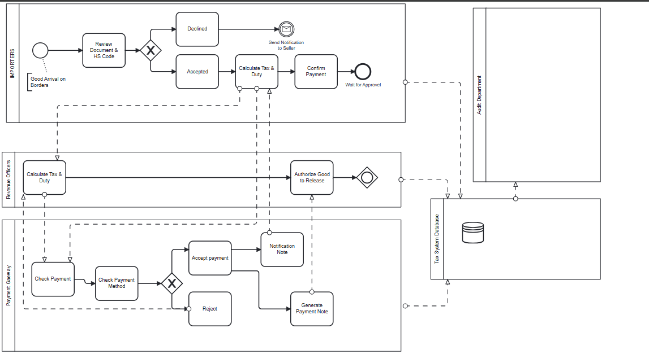

Slide 5
Entities
Importer
    Invoice id (PK)
    Transaction id (FK)
    Payment Date
    Payment Method
    Status
    Importer Id
    Name
    Contact Info
    Country
Invoices
    Product id (PK)
    Name
    Category
    Value
    Quantity
Payments
Product
    Payment id (PK)
    Invoice id (FK)
    Payment Date
    Payment Method
    Status
    Tax Id (PK)
    Category
    Rate Percentage
Tax Rate
Audit Log
    Log id (PK)
    User ID
    Action
    Timestamp
    Table Affected
Import Transaction
    Transaction id (PK)
    Importer id (FK)
    Product id (FK)
    Tax id (FK)
    Transaction Date
    Status
Holday
    Holiday Id (Pk)
    Date
    Description

Slide 6
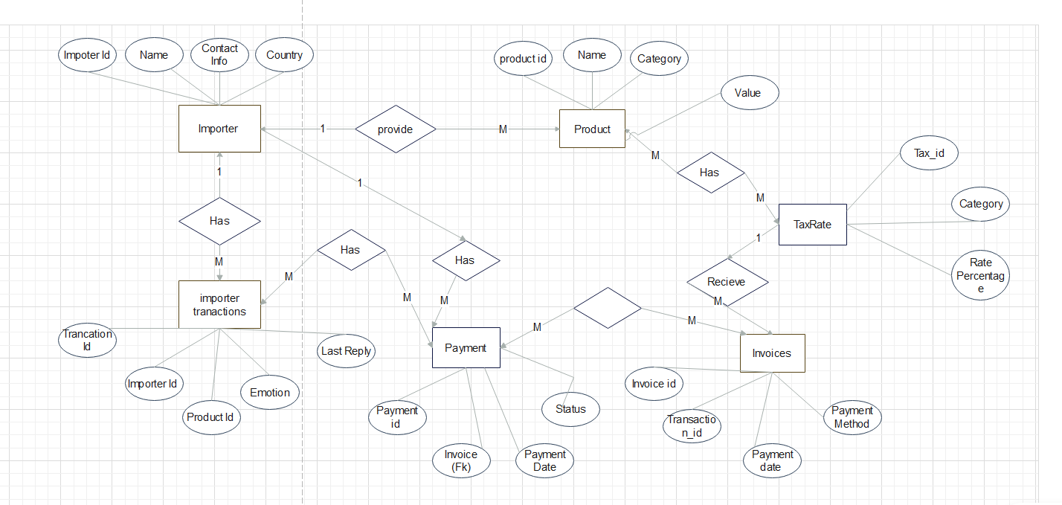

Slide 7
One importer can make many import transaction
Each Product is linked to a Tax Rate based on category
Each Import Transaction generates one invoice
Each invoice is linked to many payment
Audit Log tracks actions performed by system users.
Holyday stores restricted dates used un trigger logic
One Importer transaction has many Payment

