Slide 1
Movie Industry Exploratory Analysis
Data-Driven Insights from IMDb (2010–2019)
Eric Kisu Nzuma
2026

Slide 2
Initial Exploration Findings
Key Insight 1: Genre Performance. (e.g., "Documentary and History films consistently outperform other genres in average user ratings.")
Key Insight 2: Runtime Trends. (e.g., "Most highly-rated films fall between 90–120 minutes, though runtime alone is not a guarantee of quality.")
Key Insight 3: The dataset focuses on movies released between 2010 and 2019, ensuring a modern perspective on the industry.

Slide 3
The Business Question (With Visualization)
The Question: "Which combinations of genres and directors consistently produce movies with ratings above 8.0, and what is the optimal runtime for these high-rated films to maximize audience engagement?"
Why it matters: Explain that identifying "winning formulas" (Genre + Director + Runtime) allows the studio to allocate budgets more effectively and reduce the risk of low-rated releases.

Slide 4
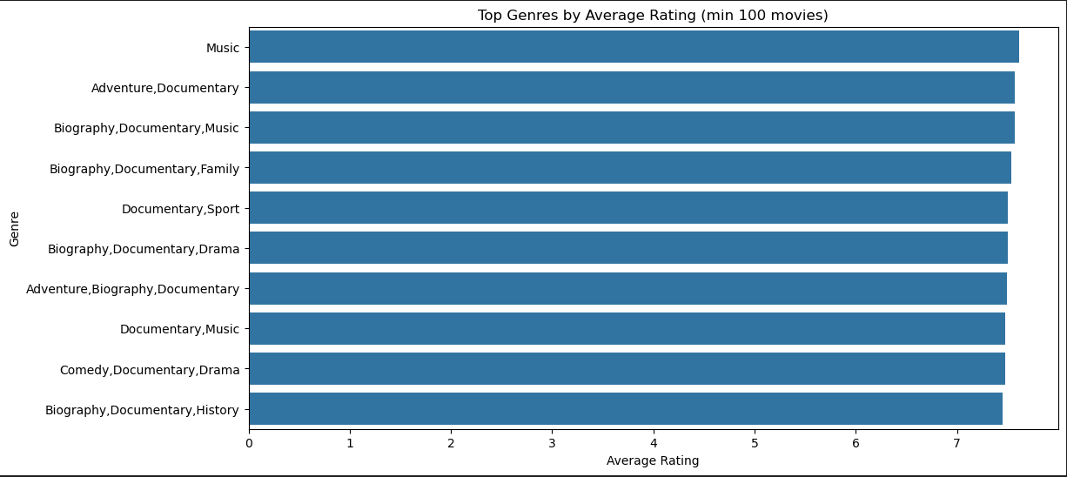
Top Genres by Average Rating

Slide 5
Data Quality & Cleaning Strategy
The Problem: Raw IMDb data is "messy."
Identified Tasks:
1. Genre Normalization: Splitting the comma-separated strings (e.g., "Action, Sci-Fi") into individual records to analyze true genre impact.
2. Outlier Removal: Removing extreme runtime outliers (films listed at 1 minute or 10+ hours) that skew averages.
3. Deduplication: Standardizing personnel names in the persons table to ensure directors with multiple entries are counted correctly.

Slide 6
Conclusion & Next Steps
Summary: The data suggests a strong preference for specific niche genres.
Next Step: Perform a deeper "Deep Dive" into the identified "8.0+ Rating" directors to see if their success is consistent across different genres.

Slide 7
End of Presentation

