Slide 1


SALES & RETENTION ANALYSIS
DATA ANALYTICS PORTFOLIO
ERICK KHOSASI
EXECUTIVE SUMMARY

Slide 2
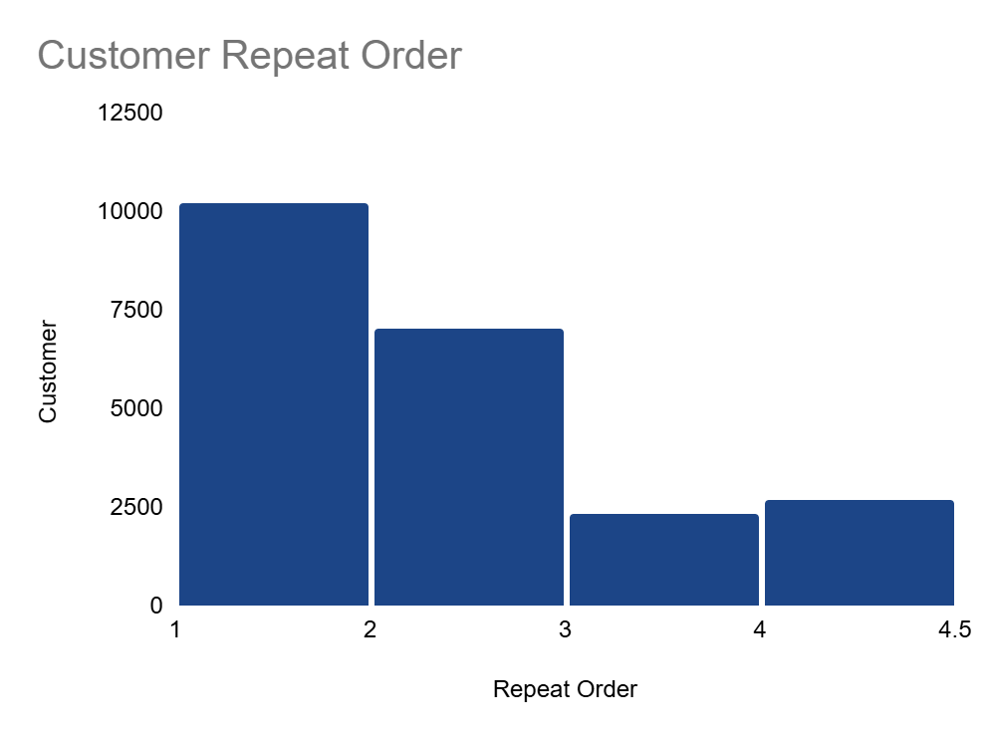
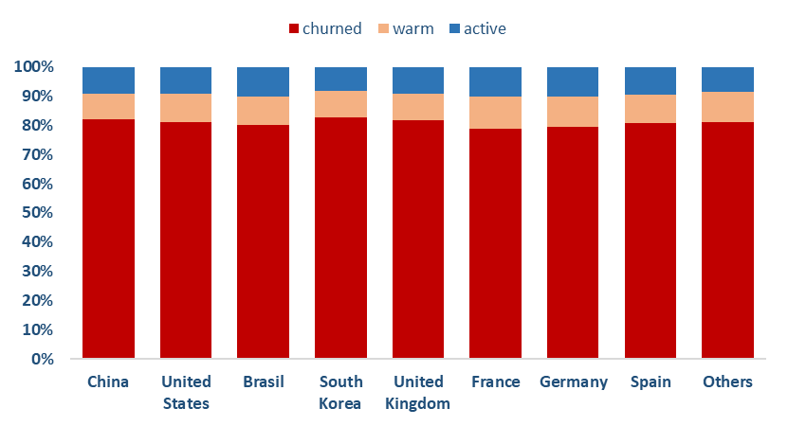
CUSTOMER CHURN IS NOT HEALTHY
EXECUTIVE SUMMARY
1
Customer churn is unhealthy and consistent across geography and demographics, ranging from 79-82%.
2
46% of churned customers are one-time-order buyers, and another 31% churn after just 2 orders.
Together, 77% buyers churn by their 2nd order.
BUSINESS OBJECTIVES
Notes:
Executive Summary

Slide 3
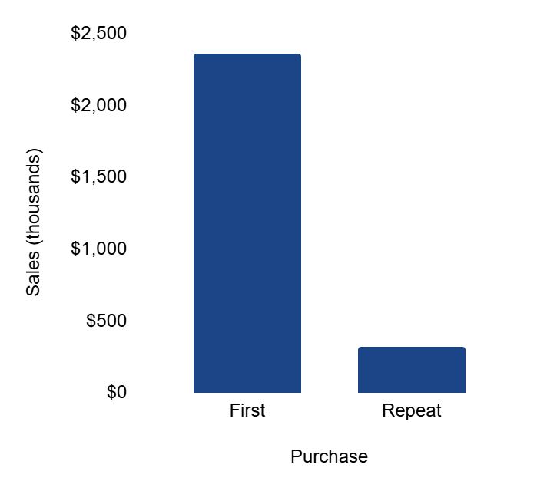
REVENUE LOST DUE TO HIGH CHURN
BUSINESS OBJECTIVES
CURRENT OBJECTIVES
1
Conduct operational/quality audits
Churn is consistently high (~80%) across all countries, age groups, and categories, suggesting the root cause is not market-specific but systemic.
~$2,000K
LOST
2
Launch engagement campaigns
Repeat orders only contribute 12% of total sales. Launching post-purchase engagement campaigns can improve retention and increase customer lifetime value (CLV).
OBJECTIVE 1: LOGISTIC INVESTIGATION
Notes:
Executive Summary

Slide 4
LOGISTICS & SHIPPING IS EFFICIENT
OBJECTIVE 1: LOGISTIC INVESTIGATION
AVERAGE
PROCESSING TIME
INDUSTRY BENCHMARKS
Processing time: 1-2 days
Lead time:
Domestic orders: 2-5 days
International: 7-14 days
1 DAY
The Look’s 1-day processing is faster than average and its 3-days delivery is within the top tier either for domestic and international e-commerce.
Logistics and shipping do not appear to be the cause of high churn.
This suggests the churn problem likely originates from product quality, customer experience, or post-purchase engagement.
AVERAGE
LEAD TIME
3 DAYS
OBJECTIVE 1: PRODUCT QUALITY INVESTIGATION
Notes:
Executive Summary

Slide 5
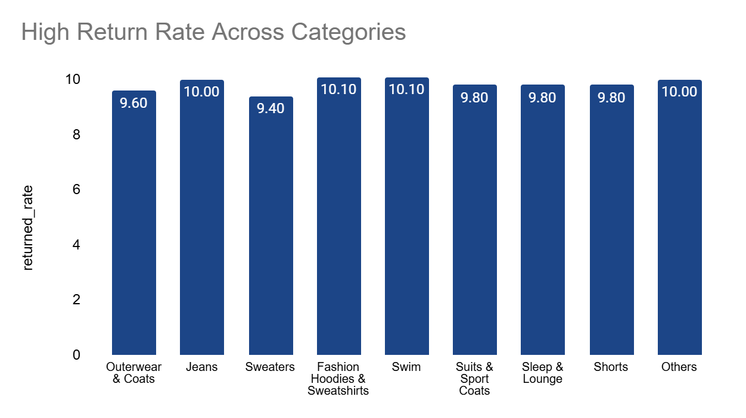
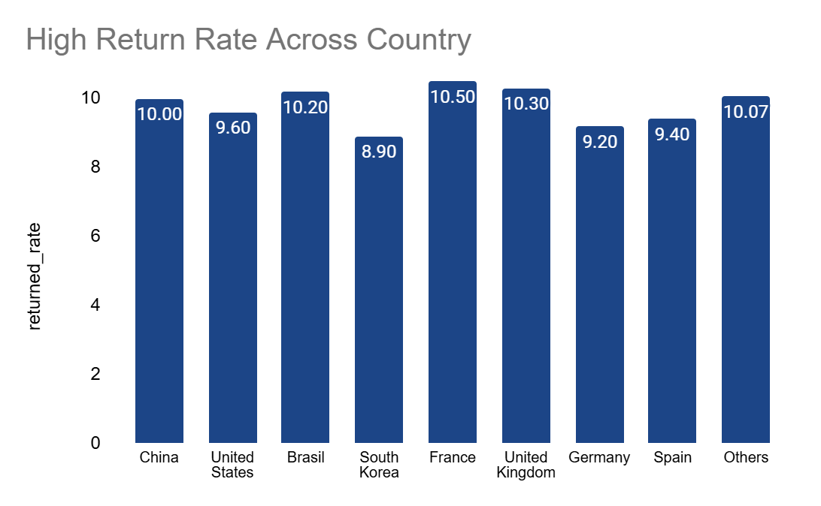
CONSISTENT HIGH RETURN RATE
OBJECTIVE 1: PRODUCT QUALITY INVESTIGATION
Consistent Product Quality Issue
High return rate across all categories & regions signals a systemic issue.
Possible causes: size inconsistencies, material quality, or product descriptions mismatch.
Packaging / Logistics Issue
Weak or non-standardized packaging could cause products delivered in damaged or wrinkled condition.
Poor handling in logistics chain may also cause uniform return rates.
OBJECTIVE 1: RECOMMENDATIONS
Notes:
Executive Summary

Slide 6


NEED FURTHER AUDITS AND DATA
OBJECTIVE 1: RECOMMENDATIONS
1
Current data is INSUFFICIENT
Return rates are consistent across all categories and regions → doesn’t isolate the root cause.
Missing insights from customer feedback and reviews.
Current evidence rules out shipping delays, but not quality or expectation mismatch.
2
Conduct Audits and Gather Data
Perform operational audits: product quality control, sizing standards, material checks.
Assess logistics partners and packaging processes for handling or damage risks.
Collect customer feedback: surveys, reviews, product ratings, return reason.
OBJECTIVE 2: USER SEGMENTATION
Notes:
Executive Summary

Slide 7
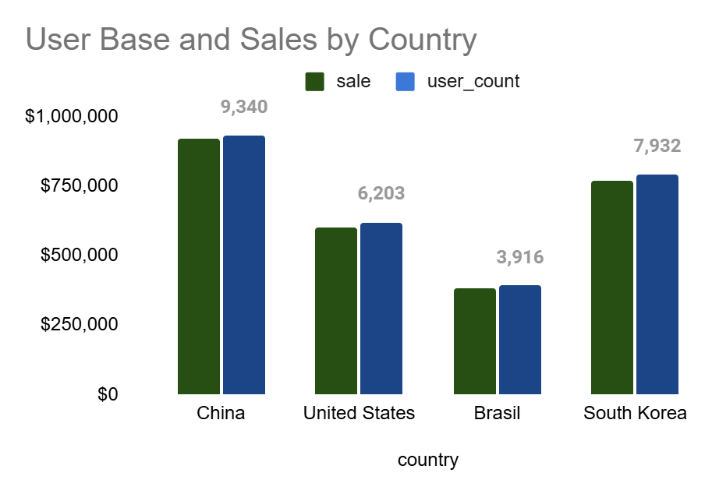
THREE COUNTRIES DOMINATE SALES
OBJECTIVE 2: USER SEGMENTATION
70% of both user base and total revenue comes from just three countries: China, USA, and Brazil. The graph distribution highlights that The Look’s sales are primarily driven by user volume, rather than higher spending per customer.
The Average Order Value (AOV) is consistent (~$85) across all countries, reinforcing that growth relies heavily on attracting and retaining users.
This makes churn reduction critical for sustaining growth in these key markets.
OBJECTIVE 2: REPEAT ORDERS
Notes:
Executive Summary

Slide 8
REPEAT-ORDERS CONTRIBUTE 12% OF SALES
OBJECTIVE 2: REPEAT ORDERS
FIRST-TIME
ORDERS
88% of total revenue comes from first-time orders, while repeat-orders contribute only 12%. Despite this imbalance, the AOV remains consistent ($85) for both customers.
The heavy reliance on first-time orders creates a significant revenue loss potential.
Furthermore, since customer acquisition is costly, depending on first-time orders is not a sustainable strategy. Company must take urgent action to improve retention and increase CLV.
$2,357,198
27,391
USERS
REPEAT
ORDERS
$317,654
3,349
USERS
OBJECTIVE 2: RECOMMENDATIONS
Notes:
Executive Summary

Slide 9



FOCUS CAMPAIGN IN TOP MARKETS
OBJECTIVE 2: RECOMMENDATIONS
Given that 70% of The Look’s users and revenue are concentrated in China, USA, and Brazil, engagement efforts should be prioritized in these top markets.
1
Post-Purchase Engagement Campaigns
Personalized emails, loyalty rewards, and time-limited second order promotions.
2
Localized Engagement
Tailor campaigns to cultural and market-specific behaviors.
3
Affiliate Programs
Partner with local influencers to drive trust and repeat purchases.
KEY TAKEAWAYS
Notes:
Executive Summary

Slide 10
KEY TAKEAWAYS
KEY TAKEAWAY
1
Customer Retention = Untapped Growth
2
Data Gaps Must be Addressed
Currently contributing only 12% of sales, retention presents a major opportunity to drive sustainable revenue growth
Insufficient or incomplete data limits decision-making; prioritizing better data collection and analysis will strengthen future strategies
3
Focus Campaigns in Top Markets
4
High Return Rate Limits Profit
China, USA, and Brazil remain priority markets where tailored campaigns and affiliate programs can significantly boost engagement.
A significant volume of returned orders erodes margins and implies possible issues in product quality or customer experience. Addressing this is crucial for sustainable growth
CLOSING
Notes:
Executive Summary

