Slide 1
CS50 SQL
FINAL PROJECT
Erick Khosasi
Github: erickkhosasi
edX: erickkhosasi98
Location: Medan, Indonesia
Date: 27 May 2025
Notes:
Hi, I’m Erick from Indonesia and I’m here to present my final project for the CS50 SQL course

Slide 2
FITNESS TRACKER DATABASE
A relational database designed to help users track their workouts, meals, and physical progress efficiently.
Notes:
My project is a Fitness Tracker Database that allows users to track their workout routines, dietary intake, and body metrics like weight, body fat, and muscle mass. This database supports raw data logging and meaningful data analysis.

Slide 3
What Does This Database Cover?
User Profiles
Workout sessions & exercise details
Food consumption (calorie and macronutrient intake)
Physical progress
Purpose: Fitness self-monitoring/tracking
Notes:
The database covers:
1. User profiles
2. Workout sessions & the exercise breakdown
3. Calorie and macronutrient intake
4. Physical progress
Its main purpose it to support user’s fitness self monitoring.

Slide 4
Schema Overview
Users
Workouts
Workout Details
Exercises
Meals
Foods
Progress
Notes:
The database includes 7 main tables and the relationship of each table is represented with the following ER diagram

Slide 5
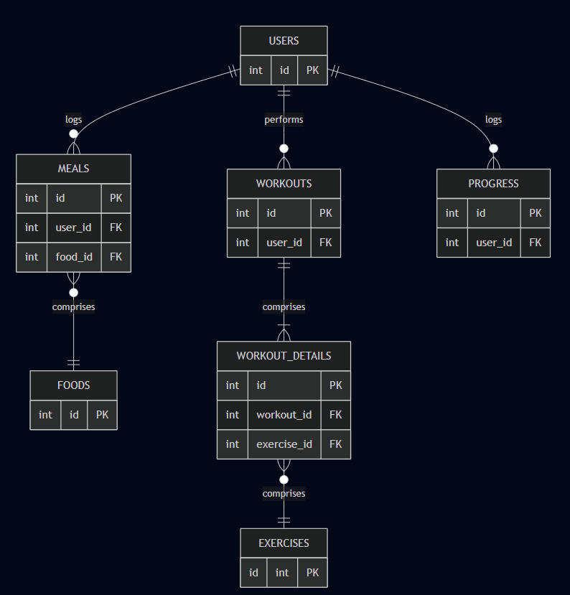
Notes:
At the center is the users table, which connects to three key activity logs:
Workouts, which tracks workout sessions performed by users
Meals, which logs the food users eat each day
Progress, which tracks physical metrics like weight, body fat, and muscle mass.
Each workout can include multiple workout_details, which records individual exercises performed during that session. These details reference the exercise table.
Each meal can include one food item, referenced from the foods table. If a meal consist of multiple food items, then user need to logged in multiple records for each food item.
All relationships are clearly defined using foreign keys, ensuring data consistency.

Slide 6
CREATE Views
workout_list
JOIN “users”, “workouts”, “workout_details”, and “exercises”
meal_nutrients
JOIN “users”, “meals”, and “foods”
user_progress
JOIN “users” and “progress”
Purpose: Simplify query logic by joining table and improving reusability
Notes:
To simplify the queries, I created 3 main views to join different tables
workout_list which join users, workouts, workout details, and exercises
Meal_nutrients which join users, meals, and foods
User_progress which join users and progress
These views make reporting easier and queries more reusable

Slide 7
Performance Optimization
CREATE INDEX:
“username” in “users”
“user_id” in “workouts”, “meals”, “progress”
“date” in “workouts”
“workout_id” in “workout_details”
Result: Common queries are upgraded from SCAN to SEARCH
Notes:
I’ve also added a few indexes on key columns to improved query performance. This indexes result in transforming table SCANs into SEARCHes for common queries, which could significantly boost efficiency.

Slide 8
What Can We Learn From the Data?
Proper queries can give important insights to the user
Notes:
With this data model and views in place, we can write multiple queries that give important insights to the user.
Now, I am going to show some example of the queries results from this database.

Slide 9

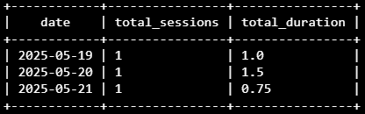


Total Workout Sessions and Durations
All-time total session:
Summarized by date:
Summarized by month:
Summarized by year:
Notes:
Now, I am going to show some example of the queries results from this database.
Here you can see summaries of user’s workout session – giving insight into workout consistency and duration

Slide 10
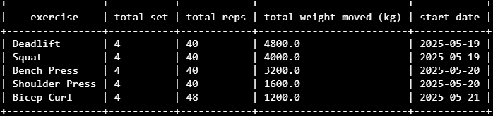
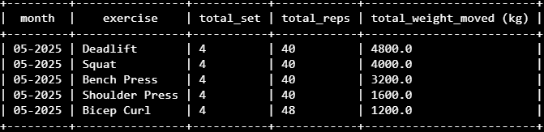
Total Weight Lifted
All-time total weight lifted:
Total weight lifted summarized by time:
Notes:
This query shows the total volume of weight lifted, grouped by exercise or time

Slide 11
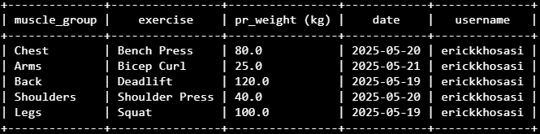
Personal Records (PRs)
Notes:
The system can track the heaviest weight lifted, also known as user’s PR – ranked and filtered using window functions

Slide 12
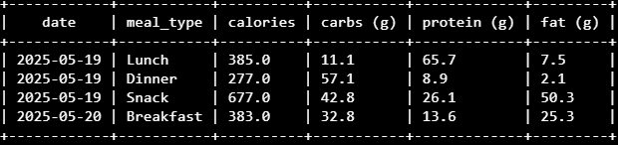
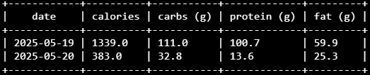
Macronutrient and Calorie Intake
Detail breakdown per meal:
Detail breakdown per day:
Notes:
Nutriotional data is broken down per meal and per day, letting users review their daily intake

Slide 13
Limitations and Future Improvements
No social features and coaching
No support for duration-based exercises
No support for complex meal recipe
Improvement Ideas:
Social media feature (workout sharing and challenges)
Personal trainer profile and coaching session booking
Community challenges
Notes:
There are still some limitations in this database, which include:
No support for social feature and coaching
No support for duration-based exercises logging
No support for complex meal recipe logging
There is some improvement ideas that could be implemented in the future, which include adding social media feature, personal trainer profile and coaching session, and adding community challenges.

Slide 14
CS50 SQL FINAL PROJECT by Erick Khosasi
Thank You
For Your Attention
Notes:
This wraps up my final project for CS50 SQL
Thank you for watching, and I hope you enjoyed exploring my fitness tracker database!

