Slide 1
CS50 R
FINAL PROJECT
Erick Khosasi
Github: erickkhosasi
edX: erickkhosasi98
Location: Medan, Indonesia
Date: 24 Jun 2025
Notes:
Hi, I’m Erick from Indonesia and I’m here to present my final project for the CS50 SQL course

Slide 2
Poker R
A Simplified Texas Hold’em Poker Game
Using R programming language
Notes:
My project is a Fitness Tracker Database that allows users to track their workout routines, dietary intake, and body metrics like weight, body fat, and muscle mass. This database supports raw data logging and meaningful data analysis.

Slide 3
What is PokerR?
R package to play Texas Hold’em poker
Simulates games with npc players
Calculates winning probability using Monte Carlo
Notes:
This package lets you simulate Texas Hold’em poker games on the console. The game will play against computer opponents and it could calculate your chance of winning using monte carlo simulation.

Slide 4
Package Features
play_poker(num_players)
estimate_win_prob()
Evaluate poker hands and calculate score
Modular functions
Notes:
The package includes several key features. You can start the game using play_poker function and specify the number of players joining the game.
It will then estimate your winning chances using the estimate_win_prob function,
and behind the scenes, the game engine will evaluates every possible hand combination – from a simple high card to a royal flush and decides the winner.
The functions are modular and well tested.

Slide 5
How PokerR Works
Uses a 52-cards deck
Each player gets 2 cards
5 community cards revealed
Best 5-cards hand is evaluated for each player
Winner determined with tie-breaker logic
Notes:
Here’s how the game works.
It will first create a shuffled 52-cards deck and each player is dealt two cards, and five community cards are revealed.
The function evaluates the best 5-card combination for each player and calculate the scores.
The winner will be determined based on the evaluated scores with logic following the standard Texas hold’em rules.

Slide 6
Estimating Win Probability (Monte Carlo)
Given player 1 hand and community cards
Randomly simulate remaining unknown cards
Repeat playing simulation N times
Count how often Player 1 wins
Return win % for user’s decision making
Notes:
To estimate your win probability, the function fixes the player 1’s hand and the known community cards.
Then it simulates the remaining unknown cards through n numbers of iterations with a default of 1000.
It checks how often player 1’s hand wins, and returns a win percentage.
This simulation uses the Monte Carlo method, which is great for modeling uncertainty.

Slide 7
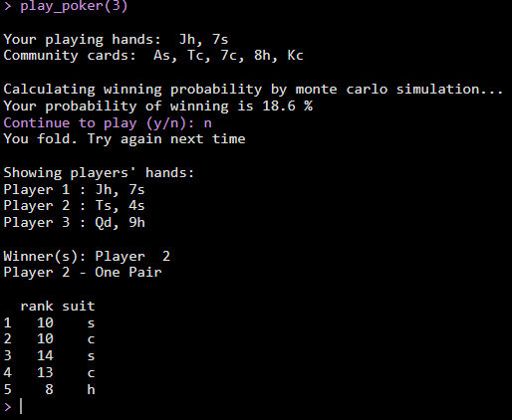
Example Usage
Notes:
Here’s a quick look at how you use the package. You start a game by calling the play_poker function and specify the number of players joining the game. The console will then show your playing hands and the revealed community cards. It will calculate your winning probability with monte carlo and prompt you whether you want to play or fold.
Finally, it will shows every player’s hands and announce the winner and their cards.

Slide 8
Testing and Validation
Unit tested with `testthat` from `devtools` package
Validates all hand types: High Cards -> Royal Flush
Prevents false positive in the hand checking functions
Notes:
Every function in PokerR is unit-tested using the testthat framework.
I’ve included test cases for each hand type to ensure accuracy, as well as negative tests to avoid false positives.
So when the package evaluates a hand, it should be doing it correctly – every time.

Slide 9
Modular Functions
create_deck()
deal(deck, players)
parse_cards(hand, community)
evaluate_hands(parsed_cards)
get_score(evaluations)
get_winner(scores)
Notes:
Under the hood, the package is broken down into modular components.
There’s a function to create the card deck,
Another to deal the cards,
one to parse the cards into rank and suit for easier evaluations,
and others to evaluate and score each hand and decides the winner.
This modular approach keeps everything organized and efficient.

Slide 10
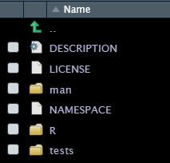
Package Structure Overview
Notes:
Here’s a quick look at the package folder structure.
All the core functions live inside the R/ directory.
Unit tests are in tests/ directory.
Manual documentation are in the man/ folder.
Everything else like NAMESPACE and DESCRIPTION helps R understand how to build and run the package.

Slide 11
CS50 R FINAL PROJECT by Erick Khosasi
Thank You
For Your Attention
Notes:
This wraps up my final project for CS50 R
Thank you for watching, and I hope you enjoyed playing with poker R

