Slide 1
CS50 P
FINAL PROJECT
Erick Khosasi
Github: erickkhosasi
edX: erickkhosasi98
Location: Medan, Indonesia
Date: 16 July 2025
Notes:
Hi, I’m Erick from Indonesia and I’m here to present my final project for the CS50 P course

Slide 2
Genshin Impact Wish Simulator
A console-based simulation of the Genshin Impact gacha system, written in Python
Notes:
For this project, I created the Genshin Impact Wish Simulator, which is a console-based simulation of the game’s gacha system, written in Python

Slide 3
Key Features:
Crystal top-up & spending tracker
Standard and featured wish banners
Pity mechanics (4★/5★ guarantee)
Characters and equipment collection tracking
Duplicate count handling
Notes:
This simulator replicates some of the core features from Genshin Impact.
First, it includes a crystal top-up system, which is the in-game currency used for wishing. Every top-up also adds to a running total of money spent, so players can track their spending.
The simulator supports two types of wishing banners: the standard banner and the featured banner. Each banner comes with its own pity system, and the simulator implements hard pity guarantees for both 4-star and 5-star pulls.
All pulled characters and equipment are stored in a collection, and if the user gets duplicates, the simulator increases the count automatically. This way, the user can keep track of their entire collection, including how many times they’ve pulled each item.

Slide 4
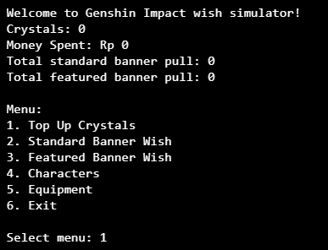
Main Menu
Notes:
I will show you a demo of the simulator.
After starting the program , we will be greeted by the main menu screen which contains information of the user’s crystal’s balance, total amount of money the user have spent for top up, and the total of banner pull.
This menu will keep looping until user choose to exit.
The menu has 6 options. First one is to top up crystal, 2nd and 3rd it to performed the gacha pull, 4th and 5th is to view user’s collection, and last is to exit the program.

Slide 5
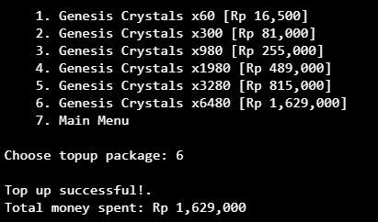
Top Up Crystals
Notes:
We will now go through the 1st menu option, which is top up crystals. There are 6 top-up packages available which replicate the game’s packages.
After top up, the program will update its state of crystal balance and the running total money spent

Slide 6
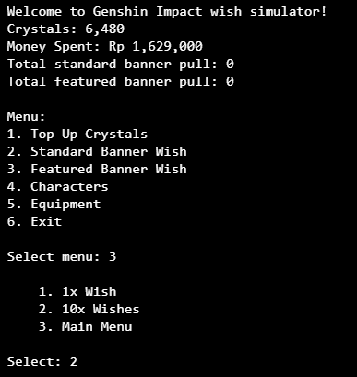
Featured Banner Wish
Notes:
When we are back to the main menu, we can see that the crystal and money spent information has been updated. Now we will try to performed the 10x wishes for featured banner

Slide 7
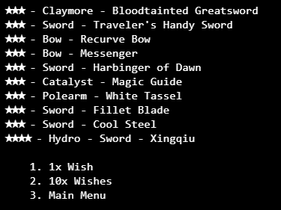
Featured Banner Wish Result
Notes:
The simulator will then display a list of the wishes results and update the characters and equipment collection. We can also see the pity system at work here, which guarantee a 4 star pull on the 10th attempts if user do not receive any 4 star in the previous attempt.

Slide 8
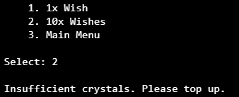
Insufficient Crystals
Notes:
The simulator will also validate the crystal balance before performing wishes, and will fail if there is not enough of crystal left.

Slide 9
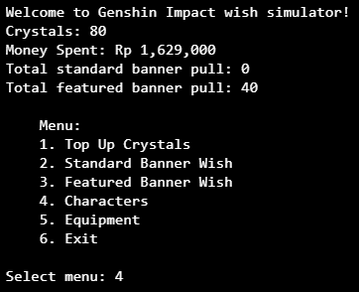
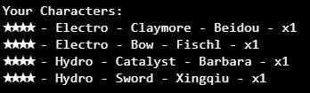
View Characters Collection
Notes:
User can check their character collection and it will display list of characters and the count of the character if there is any duplicate

Slide 10
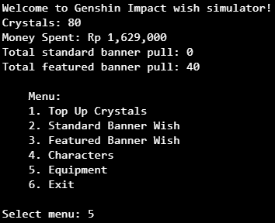
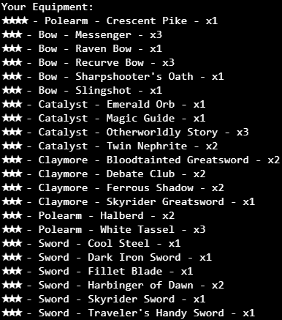
View Equipment Collection
Notes:
The same also goes for equipment collections. We can see that there’s significantly more equipment than character, because the probability of getting 3 star (equipment) is much higher.

Slide 11
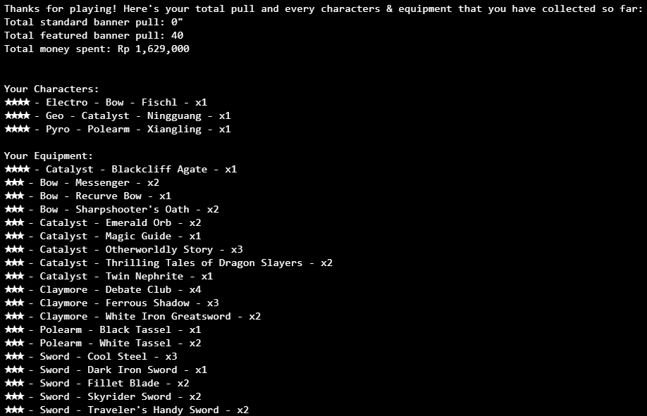
Final Summary
Notes:
When exiting the simulator, a final summary of total pulls, money spent, and collections will be displayed for the user.

Slide 12
Testing and Validation
Unit tested with `pytest` and `unittest.mock.patch`
Validates all major functions
Menu options looping
Notes:
For testing and validation, I wrote unit tests using pytest and mocked user input and force random result with the patch function from unittest
These tests cover all major functions in the program — from core function to helper functions
The program was also designed with looping menu options to handle invalid input.

Slide 13
CS50 P FINAL PROJECT by Erick Khosasi
Thank You
For Your Attention
Notes:
This wraps up my final project for CS50 P
Thank you for watching, and I hope you enjoy the simulator

