Slide 1
PVRD 3D Internal Update
Mar 25th, 2019

Slide 2
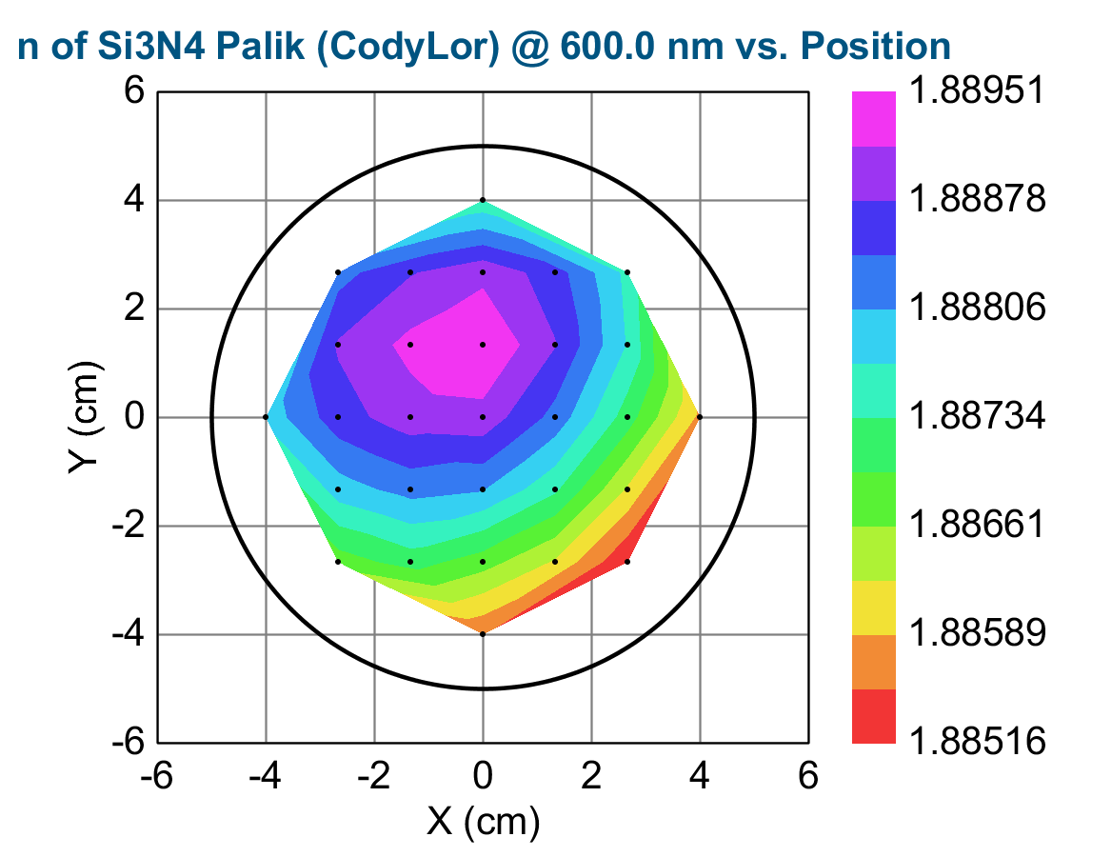
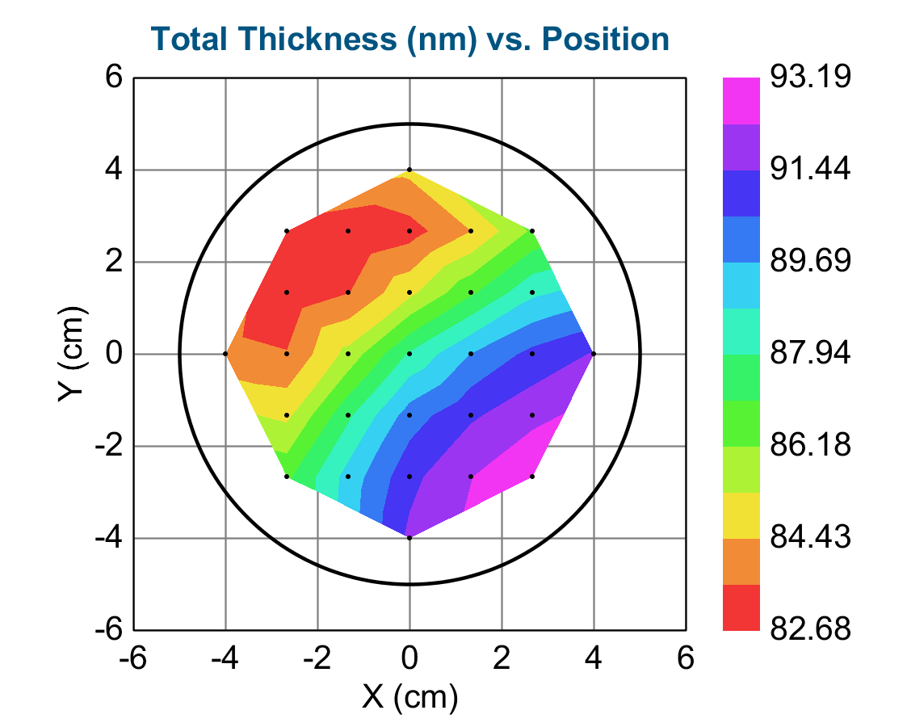
Ellipsometry
n and k vs Wavelength
Samples:
N-type high R wafer with PECVD deposited SiNx
For CV-measurements
Ellipsometry results
Results over full surface
Results:
Thickness across sample
Complex index of refraction
10% in thickness variation of SiNx layer →position tracking required
Wafer
xxx
004
xxx
003
}
Will be shared
xxx
002
xxx
001
Sample summary | AC1 | AC2 | ANa1 | ANa2
Ave Thickness [nm] | 83.97 | 89.51 | 88.22 | 87.42
Index of Refr. | 1.89 | 1.89 | 1.89 | 1.89

