Slide 1
ezomero – connecting Python with OMERO
Dr. Erick Martins Ratamero
From Images to Knowledge– 05/09/22
Notes:
Hi everyone! My name is Erick Ratamero, I am a Systems Analyst in the Research IT department at the Jackson Laboratory, a biomedical research nonprofit based in Bar Harbor, Maine, United States. Today I am here to quickly introduce ezomero, our library to make Python code that talks to an OMERO server simpler and cleaner.

Slide 2
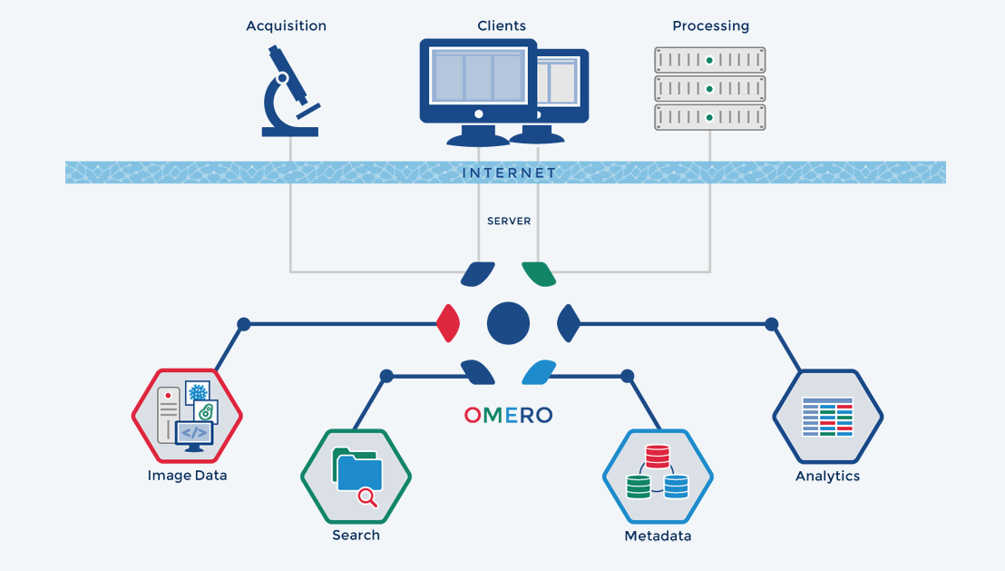
What is OMERO?
Image courtesy of the OME team
ezomero – connecting Python with OMERO
Notes:
If you have not heard about OMERO, it is a data management platform geared towards microscopy data. It uses a client-server framework and the powerful Bioformats library to provide functionality from a secure central repository. It makes it easy to view, organize, analyze and share your data from wherever you have an internet connection.

Slide 3
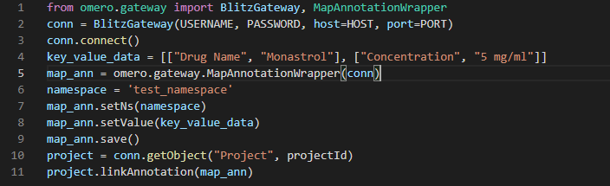
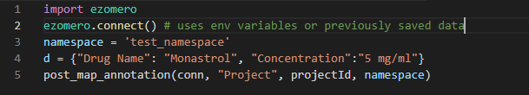
A quick comparison…
ezomero – connecting Python with OMERO
Notes:
Sometimes, the out-of-the-box functionality of OMERO is not enough for your needs, be it for advanced viewing, management or analysis of your data. That's when Python comes to the rescue. The OME team provide a robust Python API to interact with an OMERO server. It is very powerful, but it can be hard to use for novices and very verbose.

Slide 4
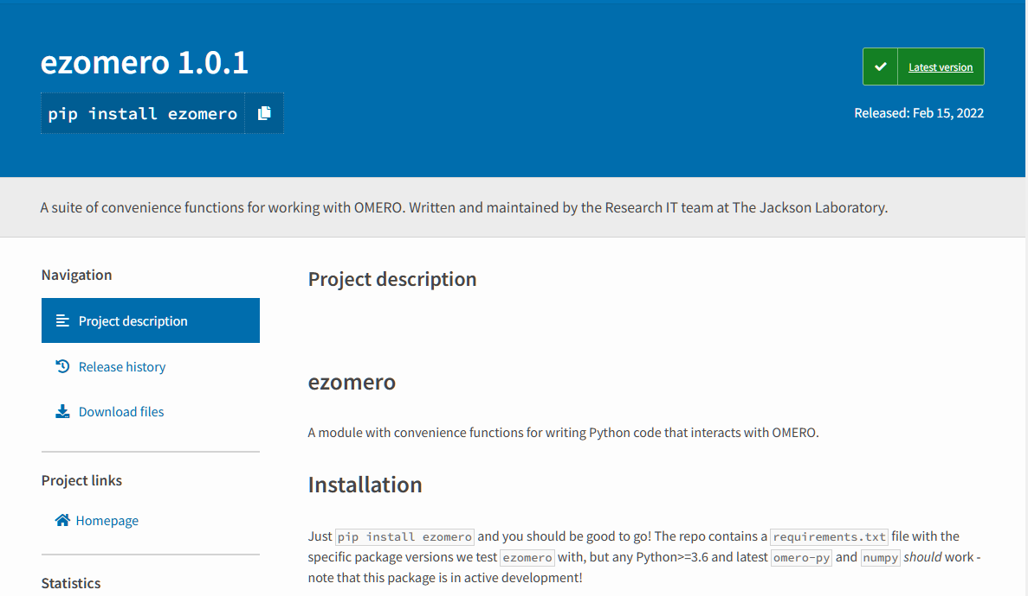
Installing it is easy!
ezomero – connecting Python with OMERO
Notes:
Over time, we ended up with lots of convenience functions to perform common tasks, so we bundled them all together and released them as a Python library! You just need to `pip install ezomero`, then `import ezomero` in your code and you're good to go!

Slide 5
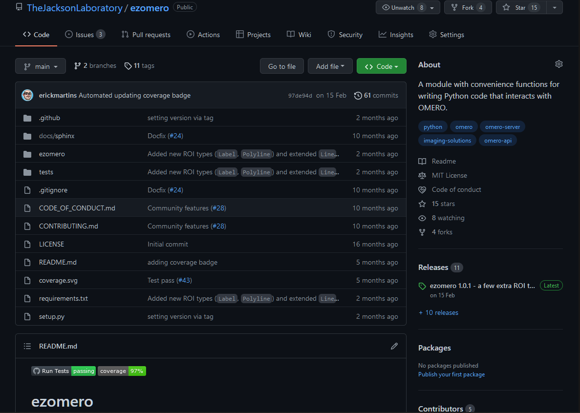
We’re on Github
https://github.com/TheJacksonLaboratory/ezomero
ezomero – connecting Python with OMERO
Notes:
In addition to this workshop, we also have a poster with information on functionality covered by ezomero, but if you would like to see something that is not there yet, we welcome new issues and pull requests on our github repository. Since making ezomero available, we have already had multiple contributions from outside our institution, both suggesting new features and implementing them!
We have released ezomero 1.0 early this year, including new features such as new functions to retrieve regions of interest and images at multiple pyramid levels, and we look forward to getting more people using it!

Slide 6
Notes:
So this was a just a quick preview of what we are actually talking about in this workshop. Now, I will go through some of the main features in a bit more detail.

