Slide 1
ENGI 301 Bop It Play Proposal
10/5
Erick Morales

Slide 2
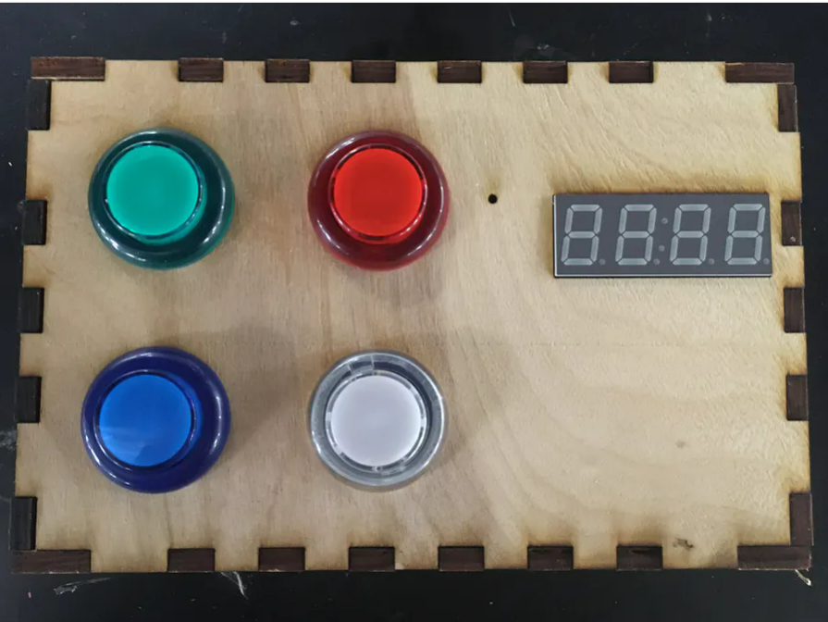
Background Information
Simon Says Button Game
https://www.hackster.io/fdm3/pocketbeagle-arcade-machine-ee661e
Original Inspiration
What improvements / additions over existing project
Diversify inputs to make more interactive (button, joystick, toggle switch, potentiometer)
Add LCD screen to display images
Add sound component for levels
I want to make an interactive game that allows you to interact with multiple mediums and be entertaining.

Slide 3
System Block Diagram
LCD Display
P2.9
P2.11
P2.13
5V
PocketBeagle
GND
P2.2 P2.4 P2.6 P2.8 P2.22
Piezo Buzzer
Transistor
Transistor
Transistor
LED
Transistor
Button
Potentiometer
Joystick
Toggle Switch

Slide 4
Power Block Diagram
3.3 V
LCD Display
5 V
USB Power
Pocket
Beagle
5 V
Button, Toggle, Potentiometer, Piezo, Joystick

Slide 5
Components / Budget
Component | Need to Buy | Cost
PocketBeagle | -- | --
Breadboard | -- | --
Wires | -- | --
Transistors | -- | --
Resistors | -- | --
LCD Display | -- | --
Button | -- | --
Potentiometer | -- | --
Joystick | -- | --
Toggle Switch | -- | --
Piezo Buzzer
* Available at ELEC Lab
Need all components to be purchased by instructor listed; additional components may be purchased by student

