Slide 1
ENGI 301 Homemade Bop It PCB Proposal
11/16/2021
Erick Morales

Slide 2
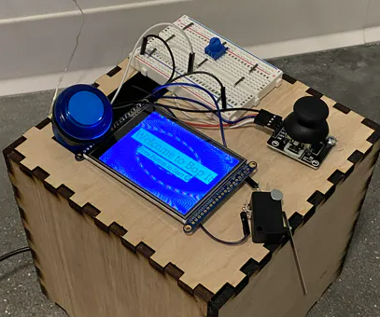
Background Information
Homemade Bop It
Interactive game reduced to a small Printed Circuit Board for space-efficiency
Hackster Page
GitHub
What changes (if any) are you going to make based on your prototype?
No changes
Plan to implement all four interactive devices onto the circuit board along with SPI screen

Slide 3
SPI Display
System Block Diagram
[PB Pin] | P1.16 | P1.14 | P1.08 | P1.10 | P1.12 | P1.02 | P1.04 | P1.06
[SPI Pin] | GND | VIN (3.3V) | CLK | MISO | MOSI | RST | D/C | CS
PocketBeagle
REF +
REF -
5 V
GND
3.3 V
P2.02
P2.04
P1.21
P1.23
P1.19
P2.01
Piezo Buzzer
Transistor
Transistor
Transistor
Transistor
LED
Button
Limit Switch
Joystick
Potentiometer

Slide 4
Mechanical Block Diagram
6”
Button
Limit Switch
Buzzer
Pocket Beagle
SPI Display
USB
5”
Pot
Joystick
FRONT
BACK

Slide 5
Components Required
USB Host connector
Power Connector
SPI Display
Button
Potentiometer
Limit Switch
Joystick
Buzzer

