Slide 1
ENGI 301 Bop It Play Proposal
10/5
Erick Morales

Slide 2
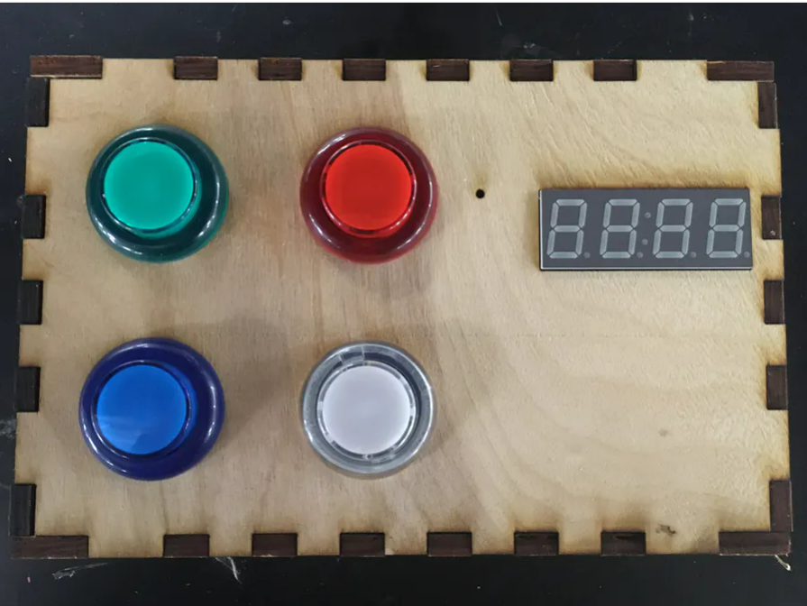
Background Information
Simon Says Button Game
https://www.hackster.io/fdm3/pocketbeagle-arcade-machine-ee661e
Original Inspiration: Make an arcade game
What improvements / additions over existing project
Diversify inputs to make more interactive (button, joystick, limit switch, potentiometer)
Add LCD screen to display images
Add sound component for levels
I want to make an interactive game that allows you to interact with multiple mediums and be entertaining.

Slide 3
System Block Diagram
SPI Display
[PB Pin] | P1.16 | P1.14 | P1.08 | P1.10 | P1.12 | P1.02 | P1.04 | P1.06
[SPI Pin] | GND | VIN (3.3V) | CLK | MISO | MOSI | RST | D/C | CS
PocketBeagle
REF +
REF -
5 V
GND
3.3 V
P2.02
P2.04
P1.21
P1.23
P1.19
P2.01
Piezo Buzzer
Transistor
Transistor
Transistor
Transistor
LED
Button
Limit Switch
Joystick
Potentiometer

Slide 4
Power Block Diagram
LCD Display, Limit Switch, Arcade Button
3.3 V
PocketBeagle
USB Power
Potentiometer, Joystick
1.8 V
5 V
Joystick
5 V

Slide 5
Components / Budget
Component | Need to Buy | Cost
PocketBeagle | -- | --
Breadboard | -- | --
Wires | -- | --
Resistors | -- | --
SPI Display | -- | --
Arcade Button | -- | --
Potentiometer | -- | --
Joystick | -- | --
Limit Switch | -- | --
Piezo Buzzer | -- | --
* Available at ELEC Lab
Need all components to be purchased by instructor listed; additional components may be purchased by student

