Slide 1
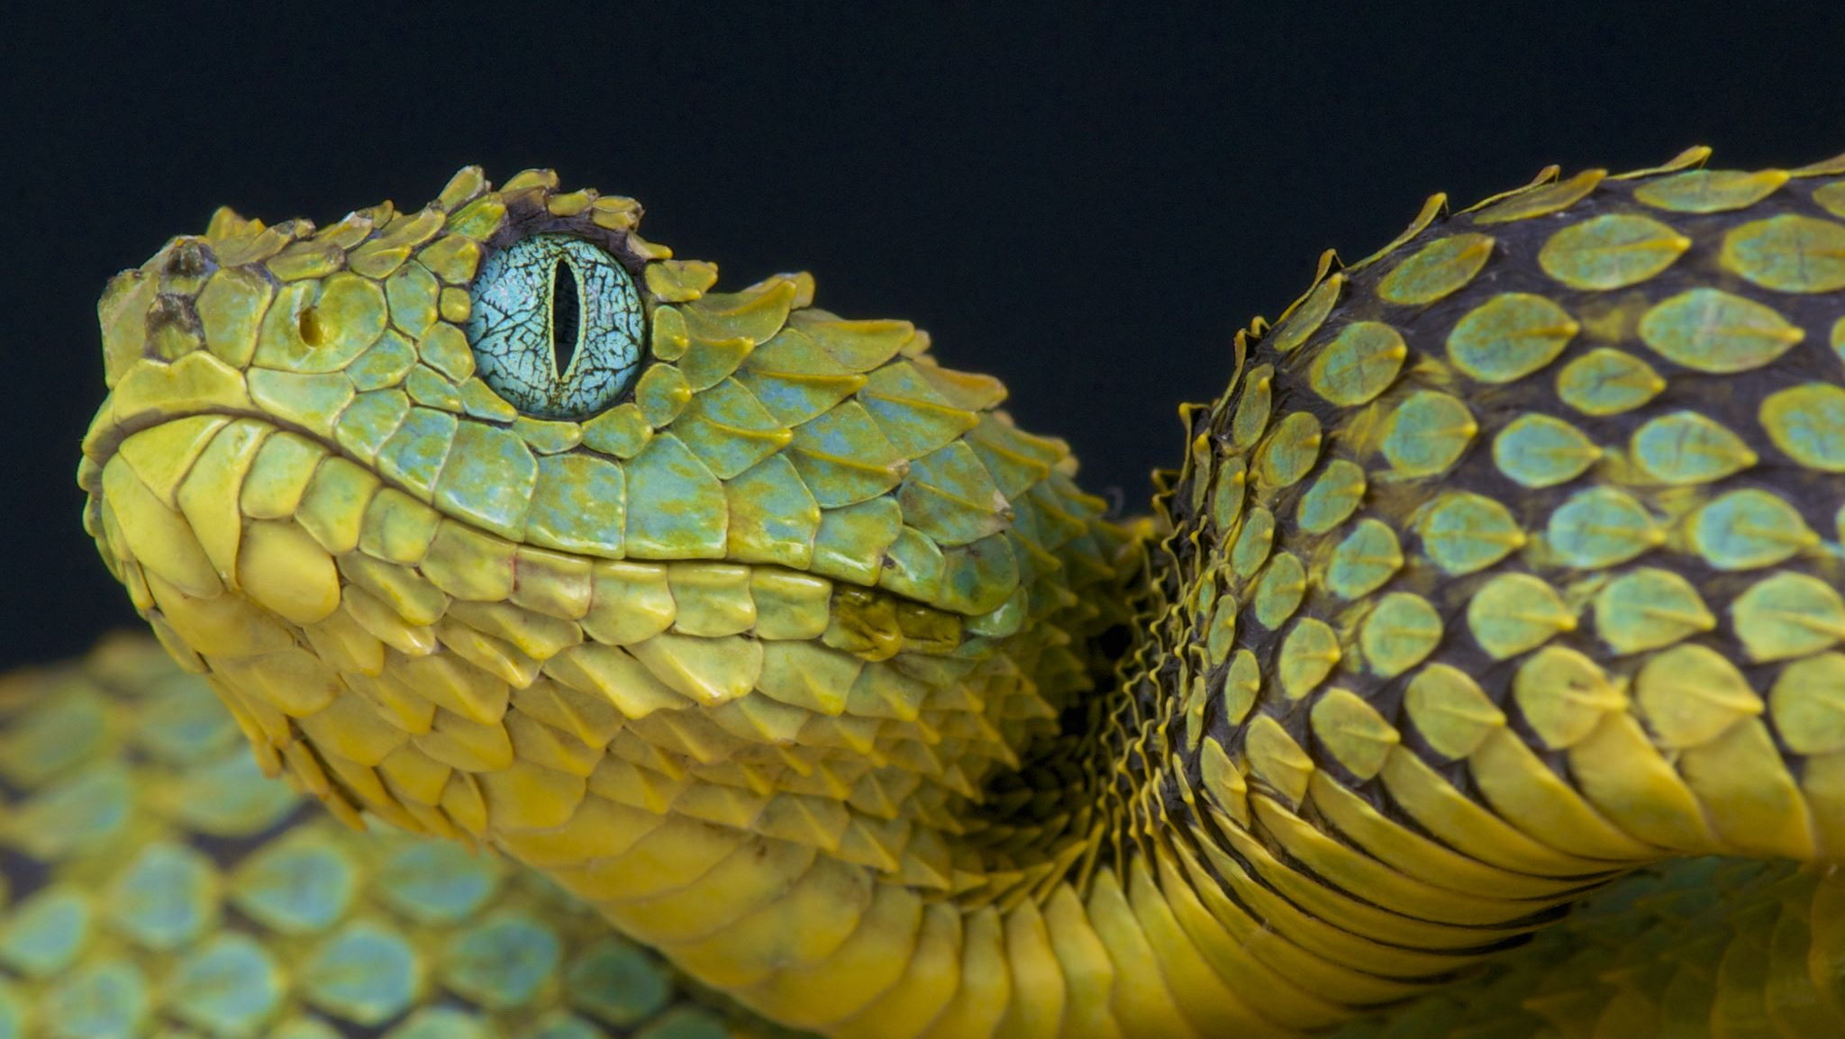
Final Project Snake
B09901076 林冠諺
B09901141 吳聲定
B09901147 林伯叡
B09901151 邱名祺

Slide 2
Assignment
林冠諺：單、雙人限時
吳聲定：單、雙人小精靈
林伯叡：經典、AI
邱名祺：限轉向、無邊界

Slide 3
Time Limit Mode I
In the 1-player mode, the score is recorded, and the time decreases.
Players cannot collect bombs, once they did, they’ll result in a game over.
Players must eat as much apples and bananas before the time runs out. Every apple moves either ↑↓← → direction every 5 seconds (1 pt. for each once collected), and bananas change positions randomly every 1 second (5 pts. for each once collected).
Oranges move the same pattern as apples; once collected, randomly 1~4 seconds are added to the timer.

Slide 4

Time Limit Mode II
In the 2-player mode, the score will not be recorded, but each of the player has their own respective timer.
The two player mode is to test the player’s durability, once one player collects the bomb, run into barriers or itself, or the timer of which runs out, the other player wins.
The Two players motions are independent, that is,
even if the two players collide with each other,
it will not cause the game to stop.

Slide 5

Pac Man Mode I
Apple: Score+1
Ghost: It will chase the snake, moving just when snake changes its direction. Touch it → game over. When it hits the bound, it’ll show up in a random block.
Bomb: Hit it → gameover

Slide 6

Pac Man Mode II
More apples and bombs.
The player who hits the bomb, touched by the ghost or has a lower grade loses.

Slide 7

Classic Mode
Apple: Score+1
Bombs: Hit it → gameover

Slide 8

AI Mode
Also apples and bombs.
When AI eats the apple, the player snake’s length +1, vice versa.
Initially, player and AI have 1 life respectively.
When eating every 10 apples, snake’s life +1.
When hit yourself or the bomb, snake’s life -1.
When someone’s life =0 or it’s snake hit the bound → gameover.

Slide 9

Turn Limit Mode
There are 15 walls randomly showing up in the map.
Initially, the player has 5 turns.
Apple: Score+1. Turns+4.
Orange: Score+3. Turns+2. Every 2 times the snake changes the direction, it’ll move to the adjacent block.
Banana: Turns+7. Every 3 times the snake changes the direction, it’ll move to the random block.
Bomb: Hit it → gameover. Every 4 times the snake changes the direction, it’ll move to the random block.

Slide 10

No Bound Mode
No Bound on the x-axis.
Every row has 2 walls.
Apple: Score+1
Orange: Score+3. Every 2 times the snake changes the direction, it’ll move to the adjacent block.
Banana: Snake’s length+3. Every 3 times the snake changes the direction, it’ll move to the random block.
Bomb: Hit it → gameover. Every 4 times the snake changes the direction, it’ll move to the random block.

Slide 11
Q & A

