Slide 1
PROBLEM
Overlapping classes
Manual class registration involves adding and dropping classes multiple times because they overlap with each other; this process takes time.
Hard to navigate
The current registration system is not user-friendly; it breaks during browser navigation, lacks visual appeal, and requires numerous clicks and manual entries.
MULTIPLES TABS
Students who choose their classes based on RateMyProfessor need to have an additional tab to find their professor, manually looking up each one of them.
WALKING TOO MUCH
Sometimes students have to walk the same route twice.

Slide 2
EnrollEase
SMART CLASS REGISTRATION

Slide 3
PURPOSE
1. Minimize the time required for students to register for classes.
2. Minimize walk-in distance from class to class.
3. Empower students to generate customized schedules.

Slide 4
Scope
College students who need to register for classes in an optimal way.
We cannot guarantee always finding the best option for the student.

Slide 5
appLICATION OVERVIEW
SIMPLE
Choose a set of classes, select preferences, select schedule, register!
OPTIMAL
Get the best possible combination of classes.
SCALABLE
Manage Parking Passes, Books, University Admin Class Scheduler, etc.

Slide 6
Specifications for end user
1. SELECT CLASSES
3. GENERATE AND SELECT
Students will choose courses to include in their schedule, which may be prefilled from their current iPlan.
Students will receive several optimized schedules to choose from. They can compare professors, locations, and times before registering.
2. SELECT PREFERENCES
Students will receive a list of preferences and choose what works best for them in terms of class selection.
4. REGISTER
If the student is satisfied with their schedule, click 'Register,' and it's done! The schedule can be printed.
By default: | - Minimum space between class - Minimum walk distance - Highest-rated professors
Optional | - Breaks - Only class these days - Only On-Campus/Online - Only Morning/Afternoon

Slide 7
Specifications for WEB APP
4. SCHEDULE SELECTOR
1. APP
It will ask for the student's university information. The student signs in, and the app needs to run in the same web browser used for university sign-in.
It will display the best combination of classes. Students can switch between options to compare them. Each schedule is a grid showing days of the week and hours of the day. Colored cells represent a class/course, with each cell containing the class name, section, professor's rating, and class location.
2. PROFILE
The application will store user preferences, university, and class schedules.
5. STATISTICS PANEL
It will vary based on the schedule, showing average walking time, average time between classes, and average professor rating. This will assist students in making better decisions when presented with multiple schedules.
3. CLASS SELECTOR
The application needs to run periodically because classes are being taken by other students simultaneously.
Results will contain class name, section, schedule, and location.
6. REGISTER BUTTON
It will register for the student either by University Integration or Web Scrapping.

Slide 8
HARDWARE REQUIREMENTS
The site should load within standard page loading time.
The system will support modern web browsers.
The system shall support web browsers accessed on both mobile devices and computers.
Supported web browsers shall include Google Chrome, Mozilla Firefox, and Apple Safari.

Slide 9
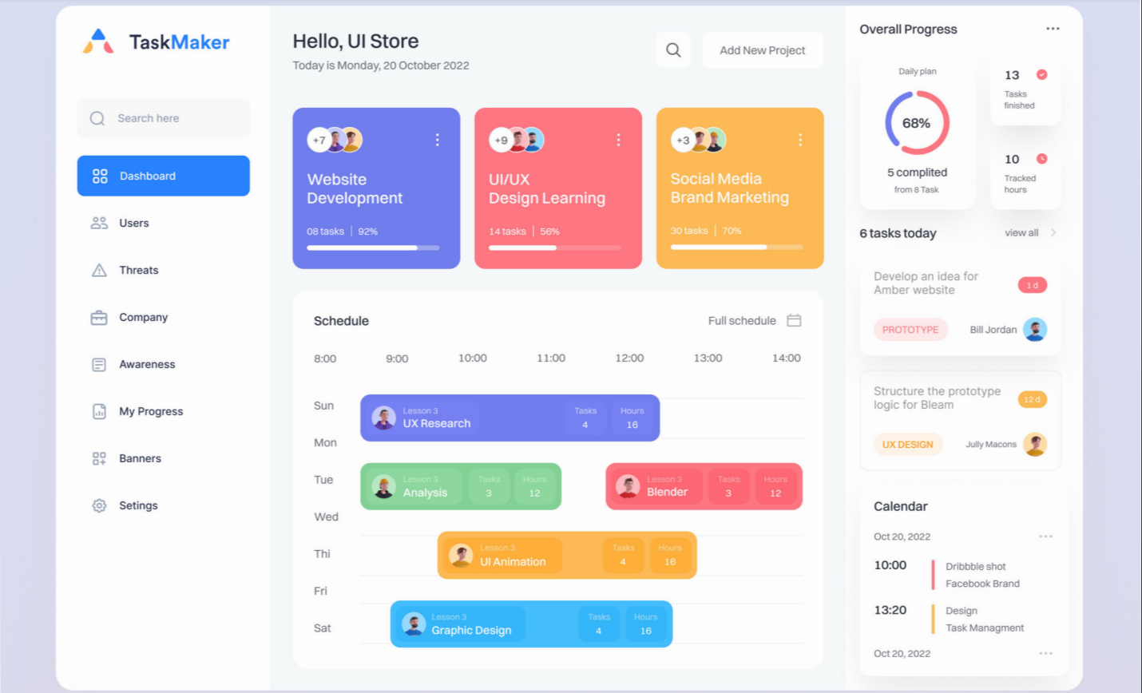

Slide 10
Thank You!!

