Slide 1
CLINICAL PERFORMANCE ANALYTICS
Medicare Value-Based Care
Analytics Pipeline
HCC/RAF Risk Adjustment · Clinical Risk Stratification · Causal Attribution of Shared Savings
50,000
91.5%
−$391
$4.9M
Beneficiaries
Tier Accuracy
ATT per Member
Shared Savings
Erick K. Yegon, PhD · Epidemiologist & Data Science Leader
github.com/erickyegon/medicare-raf-prototypes · linkedin.com/in/erickyegon

Slide 2



THE CORE QUESTION
"Did our clinical programme reduce total cost of care —
and by exactly how much does that translate to shared savings?
"
Answering this rigorously requires three capabilities working together:
Risk Adjustment
Risk Stratification
Causal Attribution
Compare like with like
across diverse beneficiaries
Identify high-risk patients
before costs accumulate
Separate intervention effect
from secular trends & bias

Slide 3

Why This Matters: The US Value-Based Care Landscape
$1.1T
The Analytics Imperative
Medicare annual spend (2023)
ACO REACH and MSSP programmes pay for performance, not volume — organisations that reduce total cost of care share in the savings
13M+
beneficiaries in ACO programmes
Risk adjustment is the foundation: without accurate RAF scores, benchmarks are meaningless and savings calculations misleading
$2.4B+
Causal inference separates genuine programme impact from secular trends, patient mix changes, and regression to the mean
shared savings distributed (2022 MSSP)
Analytics leaders who can bridge clinical evidence and financial performance attribution are the rarest — and most valued — capability in VBC organisations
30%
of Medicare FFS now in value-based models

Slide 4


Pipeline Architecture: Four Analytical Stages
01
02
03
04
DATA FOUNDATION
▶
HCC / RAF SCORING
▶
RISK STRATIFICATION
▶
CAUSAL ATTRIBUTION
50k synthetic beneficiaries
CMS SynPUF structure
ICD-10 → CMS v28 HCC map
RAF score per beneficiary
XGBoost classifier + regressor
91.5% tier accuracy
DiD + PSM · Shared savings
$4.9M MSSP projection
⚡ End-to-end runtime: 29 seconds · 50,000 beneficiaries

Slide 5
Data Foundation: Synthetic Medicare Beneficiary Cohort
50,000
Total beneficiaries
Cohort Variables
Demographics:
Age (65–97), sex, race/ethnicity
100,000
Bene-year records (2-year panel)
Insurance:
Plan type (HMO/PPO/PFFS/SNP)
24,979
Socioeconomic:
Dual Medicare-Medicaid eligibility
Intervention arm (50.0%)
Clinical:
ICD-10 diagnosis codes (multi-code)
10,432
High-risk tier
Geography:
County FIPS (10-county ACO)
Utilisation:
IP admits, ED visits (pre + post)
17,458
Moderate-risk tier
Intervention:
Binary treatment assignment
22,110
Low-risk tier
Costs:
Annual cost w/ secular trend + causal effect
★ Synthetic data only — no PHI used anywhere in this repository

Slide 6
STAGE 1 · HCC/RAF RISK ADJUSTMENT
RAF Score = Demographic Coefficient + Σ HCC Coefficients + Interaction Terms
Demographic
HCC Conditions
Interactions
Age-sex bands (65–69 through 90+)
50+ ICD-10 → HCC mappings
CHF × AFib: +0.175
Community non-dual aged segment
CHF +0.323 · AFib +0.421
CHF × Diabetes: +0.121
Example: 76F = 0.453 coefficient
Metastatic cancer +2.488 · CKD +0.071–0.289
ESRD × CHF: +0.312 ← highest
PMPM cost estimate: Cost = RAF × $9,800 (2023 Medicare FFS baseline) · RAF = 1.0 represents the average beneficiary

Slide 7
RAF in Practice: Complex Patient Walkthrough
Patient Profile
Risk Score
76-year-old female
CHF · Atrial Fibrillation
Type 2 Diabetes with CKD Stage 4
1.812
1.81× the average Medicare beneficiary
Component | ICD-10 | HCC | Coefficient
Demographic (76F, community) | — | — | 0.453
Congestive Heart Failure | I500 | HCC 85 | +0.323
Atrial Fibrillation | I481 | HCC 96 | +0.421
T2DM w/ Chronic Complications | E1141 | HCC 18 | +0.302
CKD Stage 4 | N184 | HCC 137 | +0.138
CHF × AFib interaction | — | — | +0.175
TOTAL RAF SCORE |  |  | 1.812
Estimated annual cost:
$17,758 / year
Why interactions matter:
Without the CHF × AFib interaction term (+0.175), this patient's RAF would be 1.637 — understating expected cost by $1,715/year and skewing the shared savings benchmark.

Slide 8
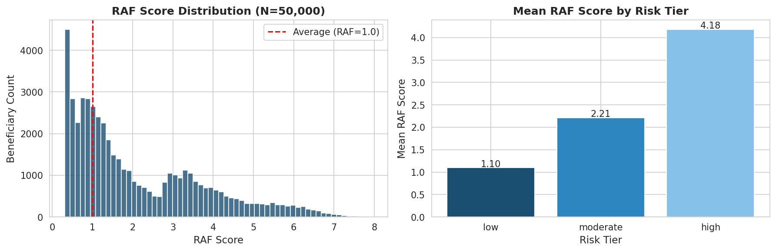
RAF Scoring Results: 50,000 Beneficiary Cohort
2.131
1.505
4.585
40.4%
Mean RAF Score
Median RAF Score
90th Percentile
Beneficiaries RAF>2
vs 1.0 national average
right-skewed distribution
high-complexity patients
high-cost population
Total estimated portfolio cost: $1.044 Billion across 50,000 beneficiaries

Slide 9
STAGE 2 · CLINICAL RISK STRATIFICATION
XGBoost Classifier
XGBoost Regressor
Purpose:
Risk Tier Prediction
Purpose:
Annual Cost Prediction
Target:
High / Moderate / Low
Target:
Continuous $ estimate
Business use:
Care management prioritisation
Outreach list generation
Business use:
Benchmark setting
Budget forecasting
Result:
91.5% tier accuracy
Result:
MAE $2,181 · R² 0.450
Features: 22 HCC flags · RAF score components · disease interactions · age/sex/dual eligibility · HCC count aggregate

Slide 10
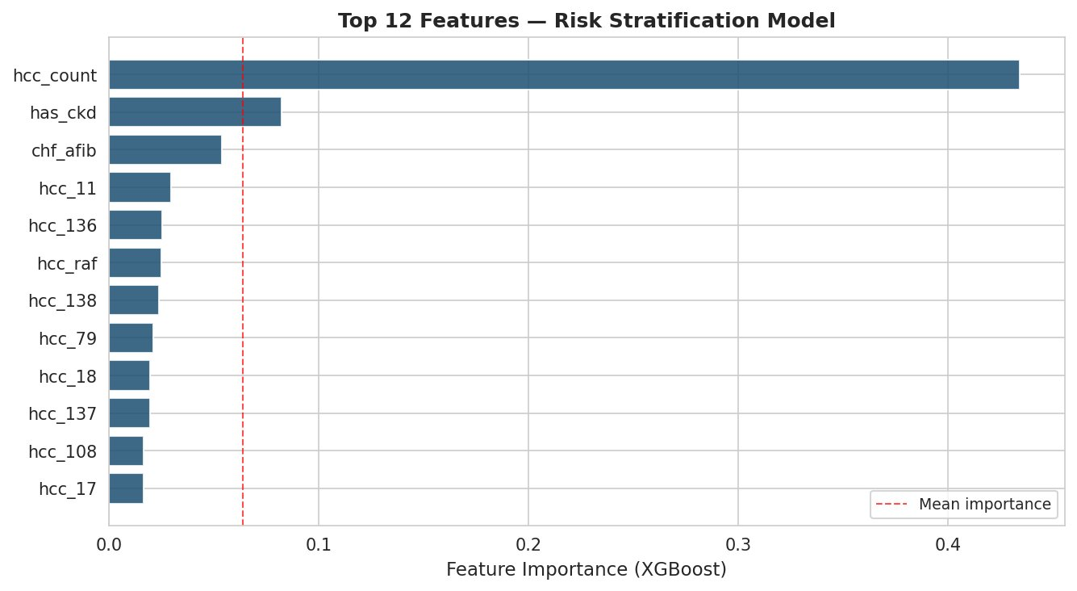
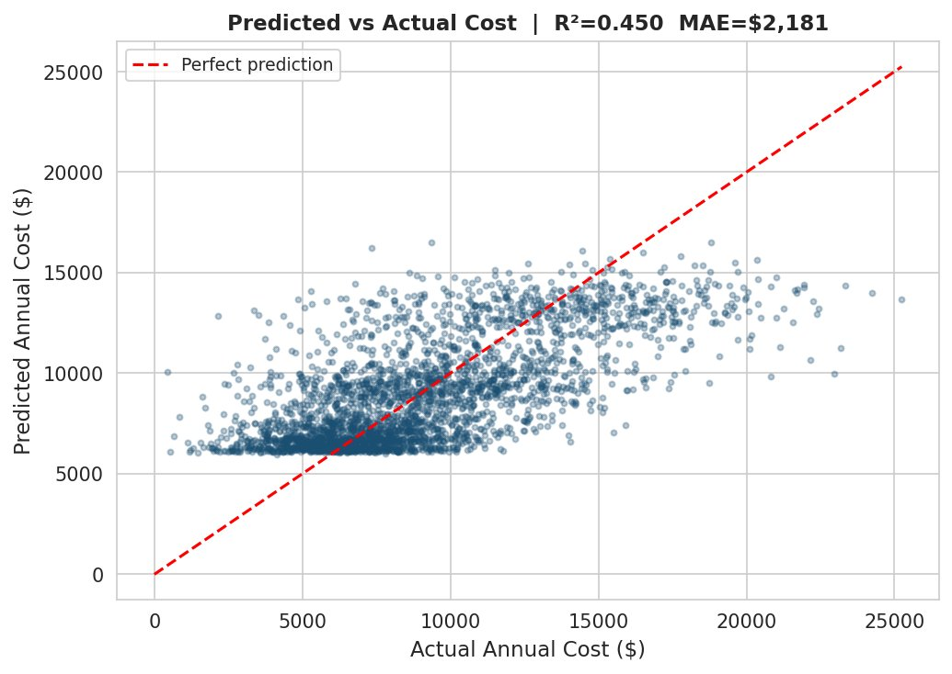
Risk Stratification Model: Performance Results
91.5%
$2,181
0.450
Tier Accuracy
Cost Prediction MAE
Cost R²
Train N=40,000 · Test N=10,000
Mean absolute error, annual
Variance explained
Feature Importance (XGBoost Gain)
Predicted vs Actual Annual Cost

Slide 11
STAGE 3 · CAUSAL ATTRIBUTION
⚠ The naive comparison problem:
Post-period treated cost < post-period control cost ≠ causal effect.
Selection bias, secular trends, and regression to the mean all confound simple pre-post or treated-vs-control comparisons.
Difference-in-Differences (Primary)
PSM Sensitivity
Cost_it = α + β₁·Post_t + β₂·Treat_i + β₃·(Post_t × Treat_i) + γ·X_i + ε_it
· 1:1 nearest-neighbour matching
· Caliper: 0.05
β₃ = ATT = causal cost reduction attributable to the intervention
· PS from logistic regression
Clustered standard errors at beneficiary level
· 24,979 matched pairs
Covariates: age, dual eligibility
· Post-match SMD: 0.000 ✓
Parallel trends assumption validated (p = 0.582)
· Target: DiD & PSM converge

Slide 12
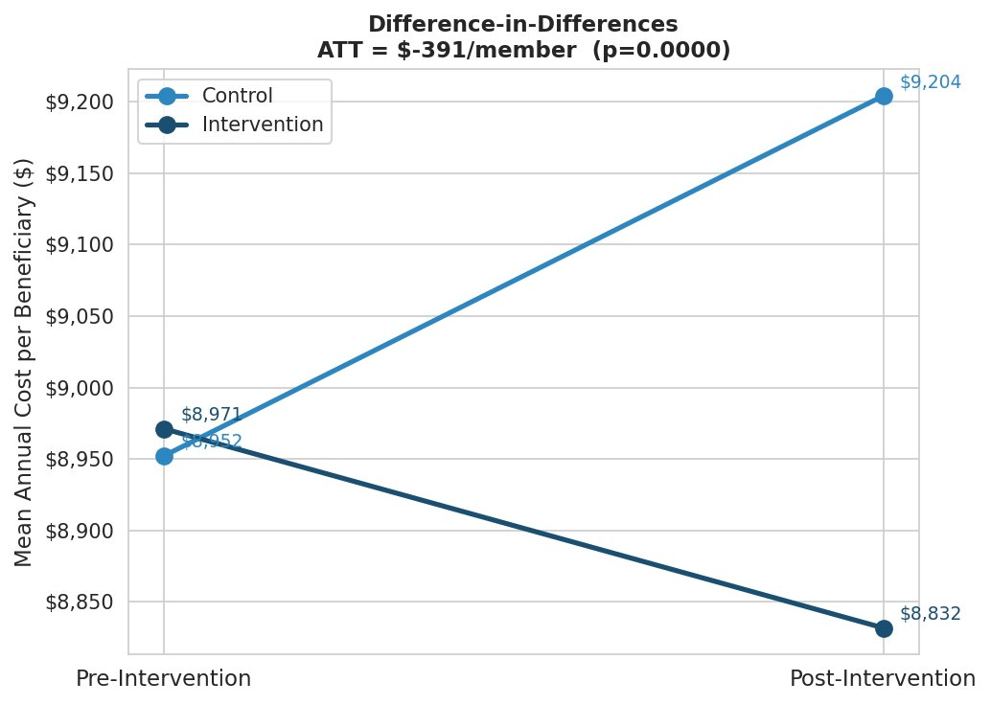
Causal Attribution: Difference-in-Differences Results
ATT
−$391
per member per year
p < 0.0001 · 95% CI: [−$439, −$344]
IP Admits ATT
ED Visits ATT
Parallel Trends
−0.030/member
−0.110/member
p = 0.582
p < 0.0001
p < 0.0001
Assumption holds ✓

Slide 13

Robustness: PSM Sensitivity Analysis
DiD −$391.31 ≈ PSM −$392.43
Estimates converge within $1.12 on a 50,000-person cohort → robust, unbiased causal estimate
24,979
0.000
0.05
< 0.0001
Matched pairs
Post-match SMD (age)
Caliper width
PSM p-value
Why convergence matters:
DiD and PSM rest on different identification assumptions. DiD requires parallel trends; PSM requires no unmeasured confounding conditional on observables. When both approaches yield the same estimate, it provides strong evidence that neither set of assumptions is being violated — and that the $391/member cost reduction is a genuine causal effect, not an artefact of the estimation method.

Slide 14
Who Benefits Most? Heterogeneous Treatment Effects
Clinical logic confirmed
High-risk patients (CHF, multi-morbidity, ESRD) benefit 6× more per-member than low-risk — consistent with care coordination reducing avoidable hospitalisations
Resource allocation signal
Concentrating care management resources on the top 20% high-risk population captures ~60% of total achievable savings
Benchmarking implication
If your intervention arm is disproportionately high-risk, unadjusted comparisons will understate the true savings rate — RAF adjustment is essential
All tier-stratified ATT estimates statistically significant at p < 0.0001

Slide 15
STAGE 4 · SHARED SAVINGS PROJECTION
Gross Savings = (Benchmark PMPM − Actual PMPM) × N Attributed Lives
Benchmark PMPM
Attributed lives
$9,800.00
CMS risk-adjusted
24,979
intervention arm
Actual PMPM
Gross savings
$9,408.69
post-intervention
$9,774,532
4.0% savings rate
Savings/member
Sharing rate
$391.31
ATT from DiD
50%
MSSP basic track
SHARED SAVINGS EARNED
$4,887,266
MSR threshold (2%): Exceeded · Savings rate: 4.0% · MSSP Basic Track assumptions

Slide 16
Results Dashboard: End-to-End Pipeline Summary
50,000
2.131
91.5%
$2,181
Beneficiaries
Mean RAF Score
Tier Accuracy
Cost MAE
−$391
p<0.0001
$9.77M
$4.89M
ATT per Member
DiD p-value
Gross Savings
Shared Savings Earned
⚡ Runtime: 29 seconds · 100,000 bene-year records · 4 analytical stages
All results validated: DiD and PSM convergent within $1.12 · Parallel trends p=0.582 · Post-match SMD=0.000
Data (50k)
→
HCC/RAF
→
XGBoost
→
DiD/PSM
→
Savings

Slide 17



FROM PROTOTYPE TO PRODUCTION
Full HCC Map
HIPAA Infrastructure
Model Governance
~9,000 ICD-10 codes across 86 HCC categories
(v28 complete). Real Part A, B, D claims data.
PHI de-identification, BAA, audit logging,
SOC 2 compliance for claims data access.
Feature drift monitoring, scheduled retraining,
SHAP explainability layer for clinical users.
Scale & Orchestration
Advanced Causal Methods
Real-Time Scoring
Distributed compute (Spark/Dask) for multi-million
bene populations. dbt + Airflow pipelines.
RDD / synthetic control for settings without
clean pre/post. ITS for rolling programmes.
API serving for RAF and risk scores.
Streaming updates as new claims arrive.

Slide 18
About the Author
PhD Epidemiology
Jomo Kenyatta University of Agriculture & Technology
Core Competencies
Causal Inference: PSM · IPW · DiD · ITS · RDD
17+ years
Global health analytics, causal inference, clinical performance measurement
Clinical Risk Modeling: HCC/RAF · Risk Stratification
30+ publications
The Lancet Global Health, Implementation Science — h-index 10
Financial Analytics: PMPM · Shared Savings · CEA
ML Production: Python · R · XGBoost · SageMaker
$35M+ funding
Research portfolio secured across career
Healthcare Data: CMS Claims · EHR · SDOH
8.5M lives
Analytics infrastructure serving beneficiaries across 13 African countries
Executive Influence: C-Suite · 30+ Publications
github.com/erickyegon
WES evaluated
Degrees equivalent to US regionally accredited institutions
linkedin.com/in/erickyegon

Slide 19
Key Takeaways
Medicare Clinical Performance Analytics Pipeline
Risk adjustment is the foundation
Causal inference, not correlation
Accurate HCC/RAF scoring is a prerequisite for any meaningful shared savings calculation. Without it, benchmarks are arbitrary and attribution is meaningless.
DiD ATT −$391/member (p<0.0001), PSM convergent at −$392. The finding is robust across identification strategies — this is a genuine cost reduction, not a selection artefact.
01
02
$4.9M in actionable shared savings
High-risk patients are the highest-leverage target
4.0% savings rate on 25k attributed lives exceeds the MSSP minimum savings rate threshold, generating $4.87M in shared savings under standard 50% track assumptions.
Heterogeneous treatment effects show 6× larger savings per member in the high-risk tier. Care management resources concentrated here maximise ACO performance.
03
04
github.com/erickyegon/medicare-raf-prototypes · Erick K. Yegon, PhD

