Slide 1
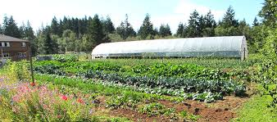
Case Study: The Sprout Factory
By Group 2: Caleb Brown, Eric Langeren, Keith O’Brian, Joseph Ramirez
Notes:
Welcome and thank you for coming to our presentation. We will discuss in detail our pilot project for the company “The Sprout Factory” based in Australia. We were tasked with creating a modern and interactive e-commerce site that would help assist T.S.F. with managing all aspects of online transactions. Also to assist with keeping track of stock and new recipe ideas.

Slide 2
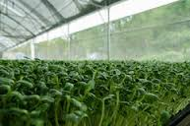
The Sprout Factory
_______
Who We Are:
A Leader of sprouted produce in Australia
Online commerce pioneers
Growing Internationally
Notes:
T.S.F. grows and distributes organically sprouted produce in Western Australia through many of the major retail supermarkets including Coles, Woolworths and Action. They have utilized e-commerce to help give them an edge over competitors and to keep in touch with their customer base.
They also use e-commerce for tasks including electronic payment of staff and customers, tracking emails, and research.
Currently the website is maintained by a single individual and the company would like to see the potential of a professionally created website.

Slide 3
S.W.O.T. for The Sprout Factory
Notes:
What are The Sprout Factory’s market Strengths, Weaknesses, and
What Opportunities and Threats should they be aware of?
Next we will discuss the market strengths and weaknesses including:
-

Slide 4
S.W.O.T.
Strengths
Production capacity
Prime location for Asian markets
E-commerce experience
Diverse line of products
Weaknesses
Outdated and Underutilized
e-commerce site
Non-organic yields higher profit margin
R & D speed must increase
New markets available by ocean freight
Threats
Other produce competitors
Economic concerns in target markets
New markets hesitant to adopt our products
Falling behind technologically
Opportunities
Organic produce demand is high
New products or services to offer
Partner with new market communities
Diverse line of products
Notes:
Here we outline the major strengths, weaknesses, threats and opportunities available to The Sprout Factory.
Although The Sprout Factory has growing potential, they should be aware of some major threats and opportunities and plan accordingly.
Here we have some of the major points to be aware of.
Strengths:
Diverse line of sprouted produce and has production capacity to expand into new markets
Access to markets throughout Australia, including some international customers
Experienced E-commerce users (utilizing electronic payments, customer contact, research including testing products
Leader in Australia sprouted produce market with prime location for expanding to international markets like China and Pacific markets
Weaknesses:
E-commerce site currently managed by a single individual
Non-organic market can return higher profit margins vs organic
Research and development times could be improved
Location, new markets can only be reached via ocean freight(geographic limitations)
Threats:
- Other business competitors
- Economy concerns (local and international)
- New markets resistant to our products: local growers, government concerns
- Weather/technical concerns; losing technological edge to competitors
- Losing product quality due to expanding too quickly or rushing to fill orders
Opportunities:
- Organic market demand is at its highest ever and isn’t slowing down
- Increase product range where costs can stay low, market products with most growth potential
- Look for new products or services to offer
- Control markets where we have dominant brand awareness
- Build relations with Asian countries as sprouting is popular in these regions

Slide 5
DBMS of choice: MS SQL Server
Notes:
MS SQL offers advantages and options that other dbms options lack. Microsoft offers 24/7 technical support, data backup and other services.
Development and troubleshooting are typically the toughest aspects to perfect when thinking about getting a SQL project into production. MSSQL comes with excellent tools that will save us time in these areas – tools like SQL Server Profiler, SQL Server Management Studio, BI tools and Database Tuning Advisor.

Slide 6
MS SQL Server
MS SQL Azure based – low hourly cost
$.015 for MS SQL Standard with 50GB storage and 100 Databases per pool wit 50 Elastic Database Transaction Units (eDTU) per database
$1,314 per year
Scalable on the fly
Upgraded 24/7 support at $300 per month
Notes:
https://azure.microsoft.com/en-us/pricing/details/sql-database/
https://azure.microsoft.com/en-us/support/plans/
Management Tools SQL Server 2016 comes with many management tools that can save you time when working with the database and troubleshooting issues. It comes with SQL Server Management Studio, BI Tools, Database Tuning Adviser and SQL Server Profiler.
Easy Installation
The SQL Server Installation Wizard provides a single feature tree for installation of all SQL Server components so that you do not have to install them individually.
Database Engine
Analysis Services
Reporting Services
Integration Services
Master Data Services
Data Quality Services
Connectivity components
Performance
Microsoft invests heavily in SQL Server’s database engine core, upgrading from previous versions. Microsoft has continued its focus on performance with new features related to in-memory, columnar storage and availability groups. These are a few in a long list of optimizations that result in a faster running product.
Security
A defense-in-depth strategy, with overlapping layers of security, is the best way to counter security threats. SQL Server provides a security architecture that is designed to allow database administrators and developers to create secure database applications and counter threats. Each version of SQL Server has improved on previous versions of SQL Server with the introduction of new features and functionality. However, security does not ship in the box. Each application is unique in its security requirements. Developers need to understand which combination of features and functionality are most appropriate to counter known threats, and to anticipate threats that may arise in the future.
Ref: https://www.pythian.com/blog/sqlserver2016/
http://searchsqlserver.techtarget.com/tip/Pros-and-cons-of-SQL-Server-2012
https://docs.microsoft.com/en-us/dotnet/framework/data/adonet/sql/overview-of-sql-server-security

Slide 7
The Sprout Factory Web App
Notes:
The Sprout Factory web app was designed to be easy to use and simple to navigate. There are several elements that can be upgraded quickly depending on amount of products or changes in web structure. The app will connect to a data source and allows for customer entry. There is also a simple gallery page displaying different products from Sprout Factory and allows for animated product display as well.

Slide 8
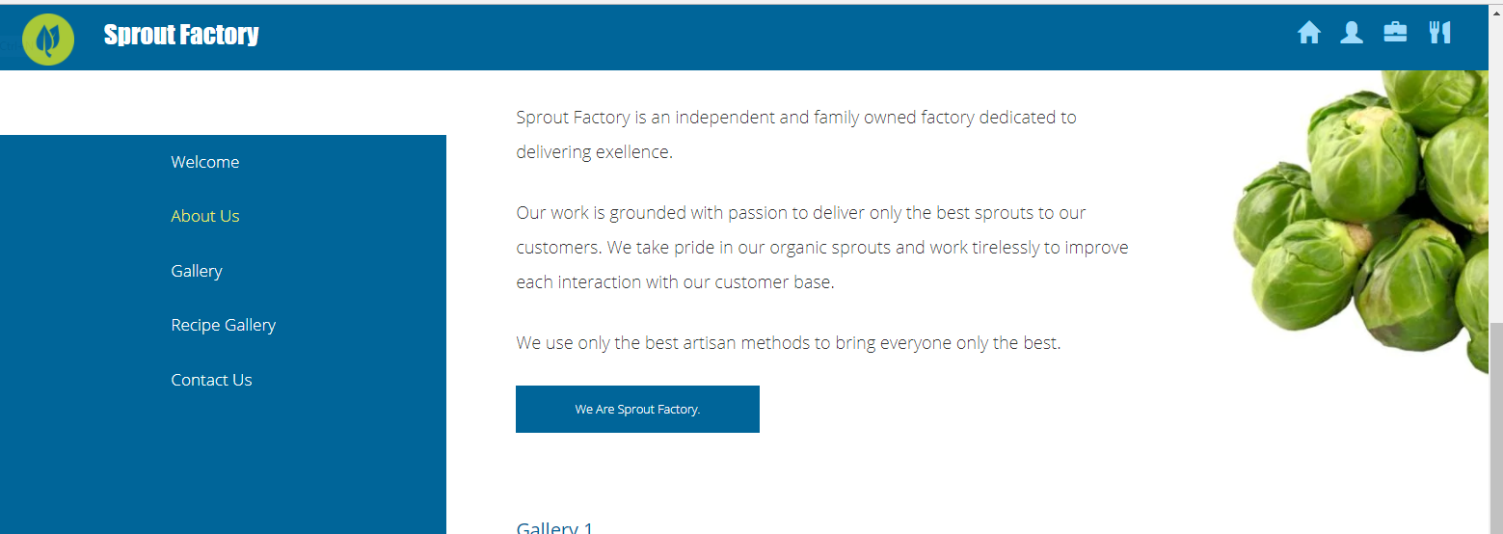
Sample Information Page
Notes:
Here is a simple information page with a side navigation menu. This provides links to other pages and in the top right you will find more icons that can link you to other pages. This area can be quickly expanded depending on what tasks would need to be added.

Slide 9
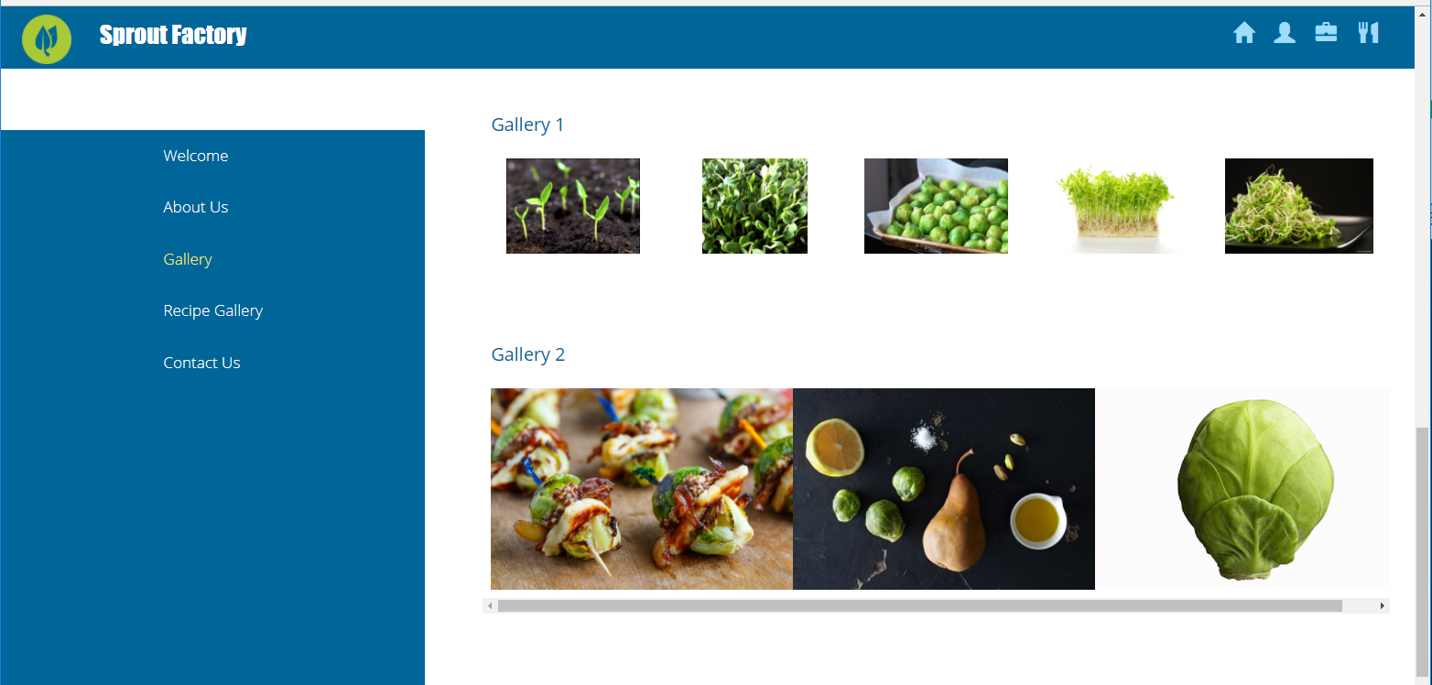
Sample Product Gallery Page
Notes:
Here is a simple example of a product page where customers can quickly view products from Sprout Factory. Using a gallery allows customers to quickly view available products and each image would contain its own webpage with pricing and availability information.

Slide 10
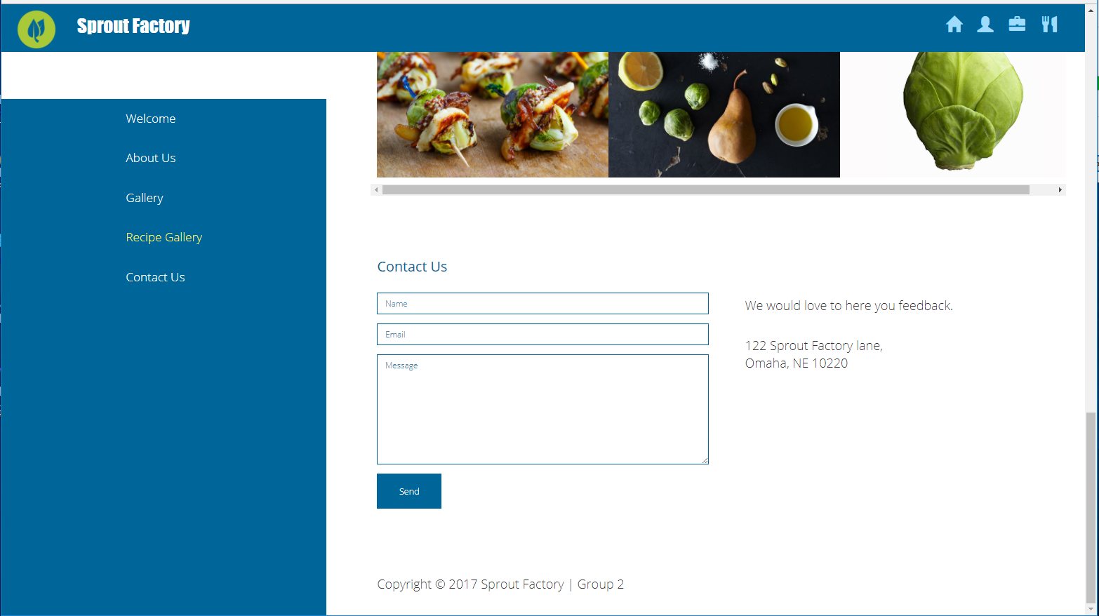
Sample Contact Page
Notes:
This is a simple contact page to allow customers with an easy to use form. Above the page there is a small gallery with products. This could be upgraded to a scrolling banner with different products displayed on a schedule.

Slide 11
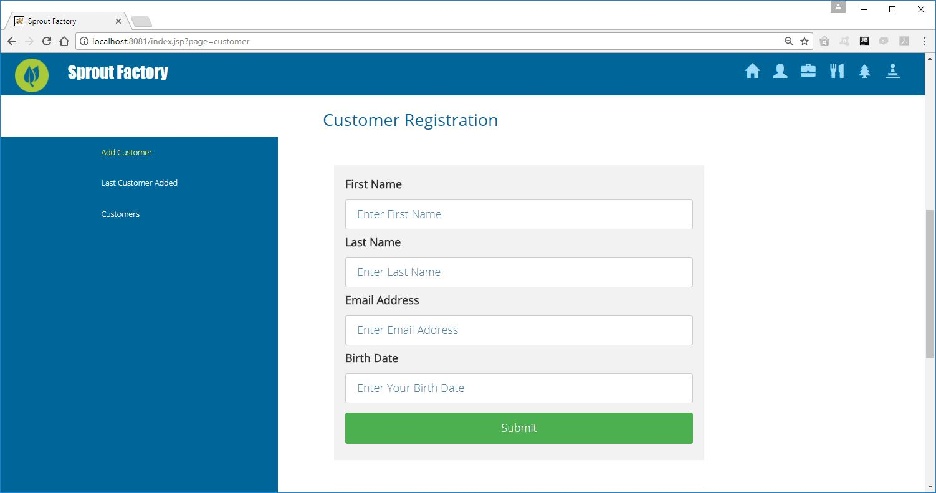
Sample Welcome Page
Notes:
This is the customer entry page using a simple input form to add records to a data source. Below it, the last record to be entered will be displayed and further below show the customer table with a list of records currently in the customer table

Slide 12
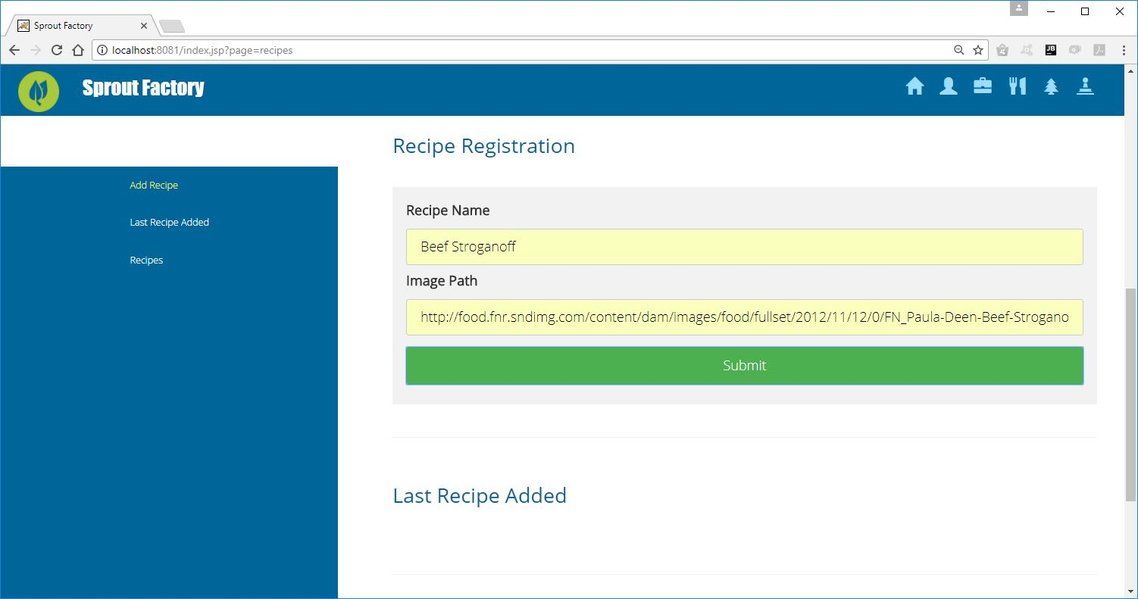
Sample Recipe Page
Notes:
This page allows users to quickly add new recipes using two text fields one for the recipe name and the other for the file address. The output on
the page will show the previously entered recipe and list the records currently in the recipe table.

Slide 13
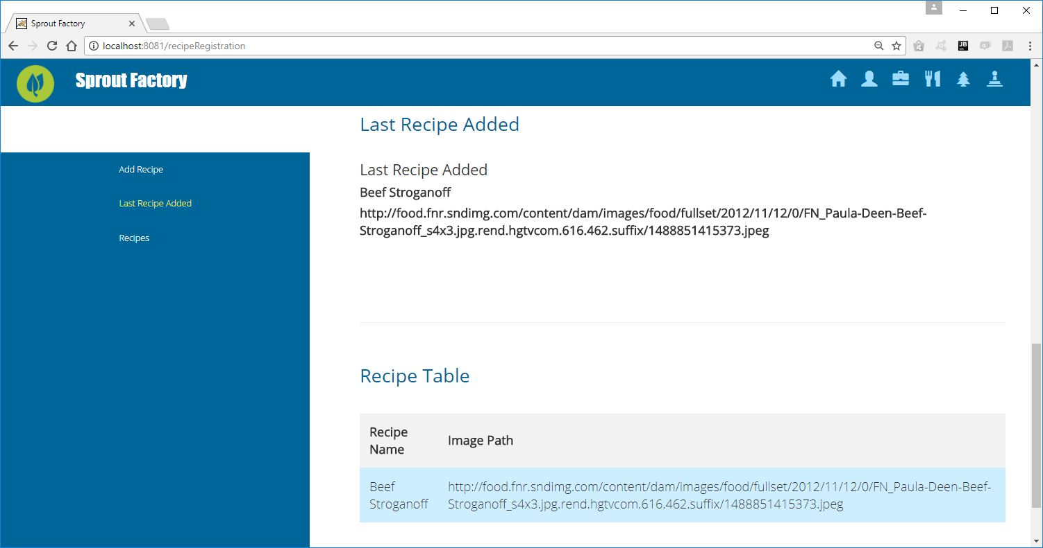
Sample Recipe Page cont.
Notes:
Here is the bottom of the recipe registration page. You can see the new record that has been added to the recipe table. The record shows the recipe name and the image path information.

Slide 14
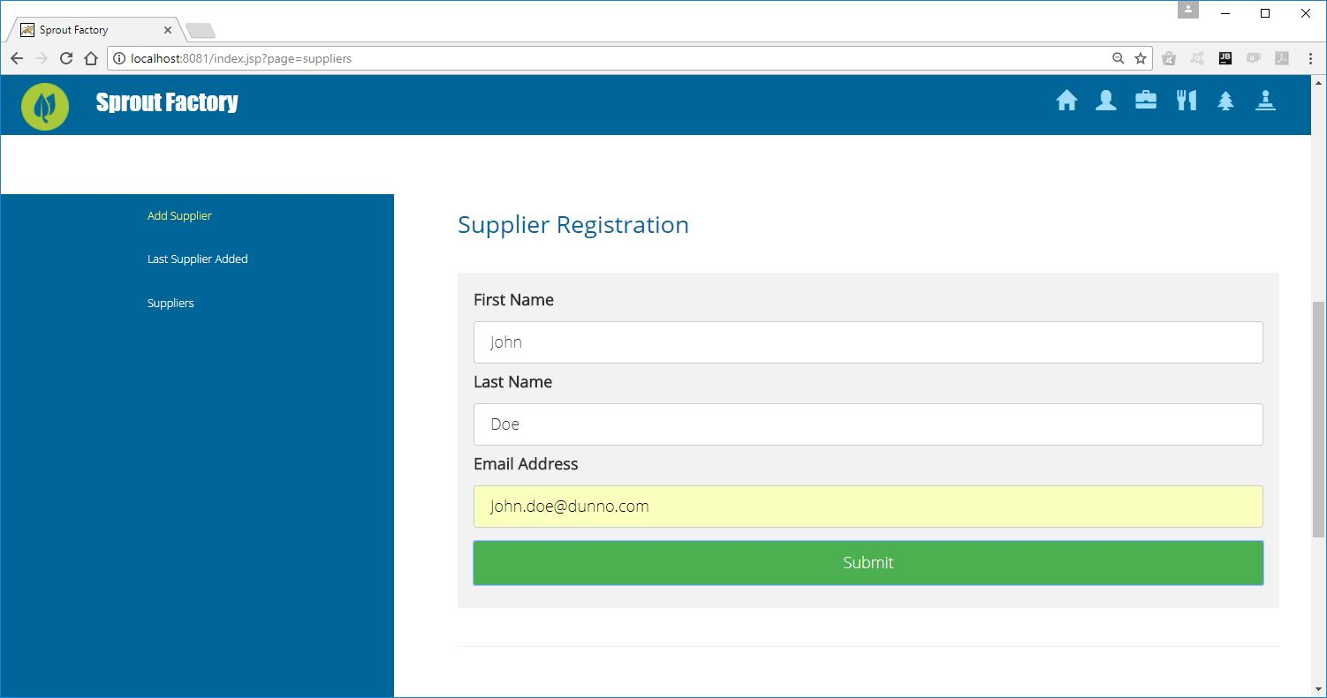
Sample Supplier Page
Notes:
Similar to the previous page in layout, the inputs are slightly different. There are fields for first name, last name and email. Once the user hits submit, the output on the bottom of the page will show the previously entered record and the records that are currently in the Supplier table.

Slide 15
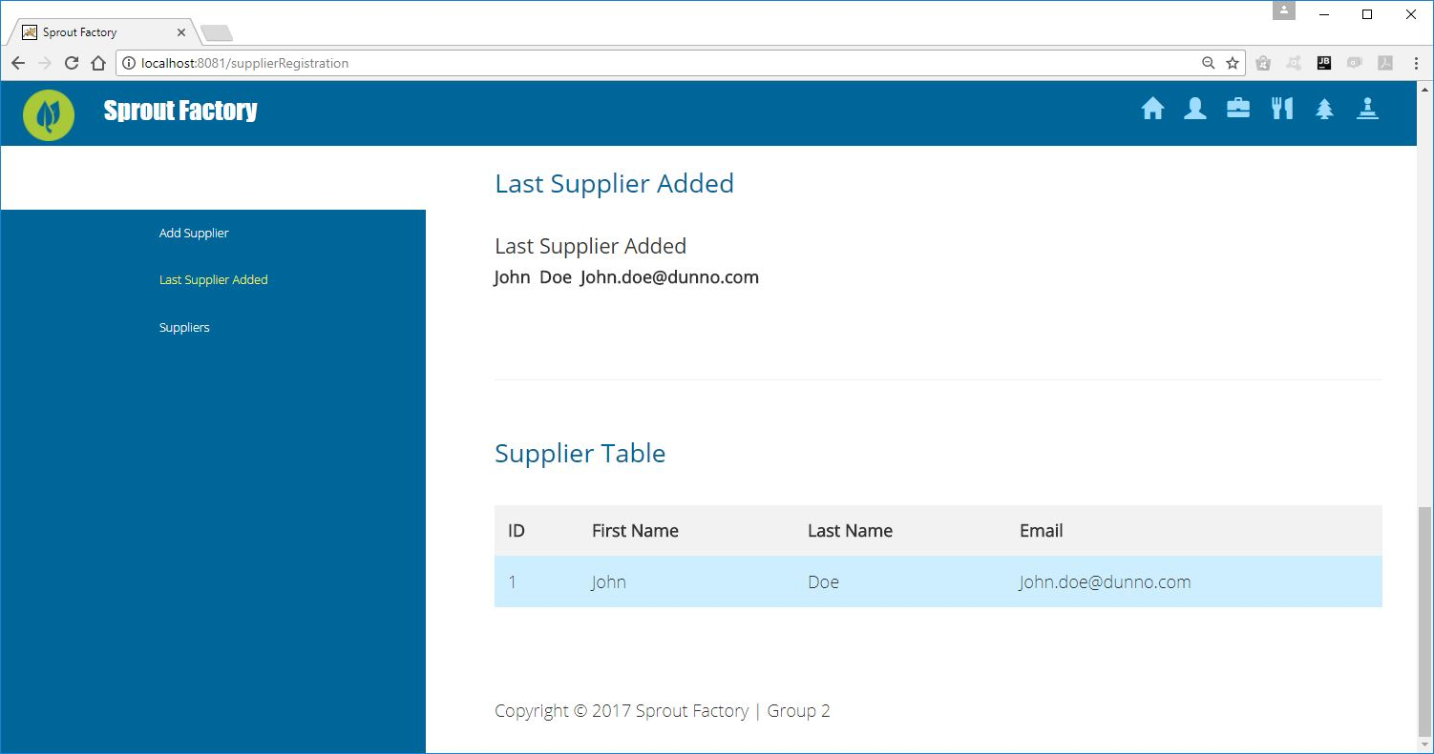
Sample Supplier Page cont.
Notes:
Here is the bottom of the recipe supplier page. You can see the new record that has been added to the supplier table. The record shows the ID, first name, last name and the email information.

Slide 16
THANKS!
Any questions?
You can find us at @group2gmail.com & user123@mail.me
Notes:
Thank you for your time.

