Slide 1
Beers & Breweries EDA
Alexander Lopez & Eric Laigaie

Slide 2
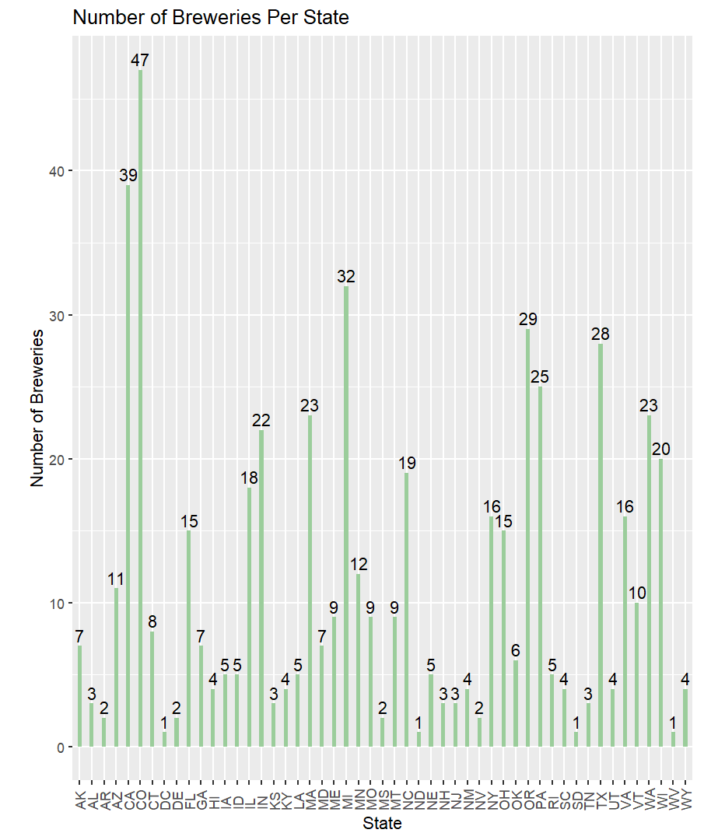
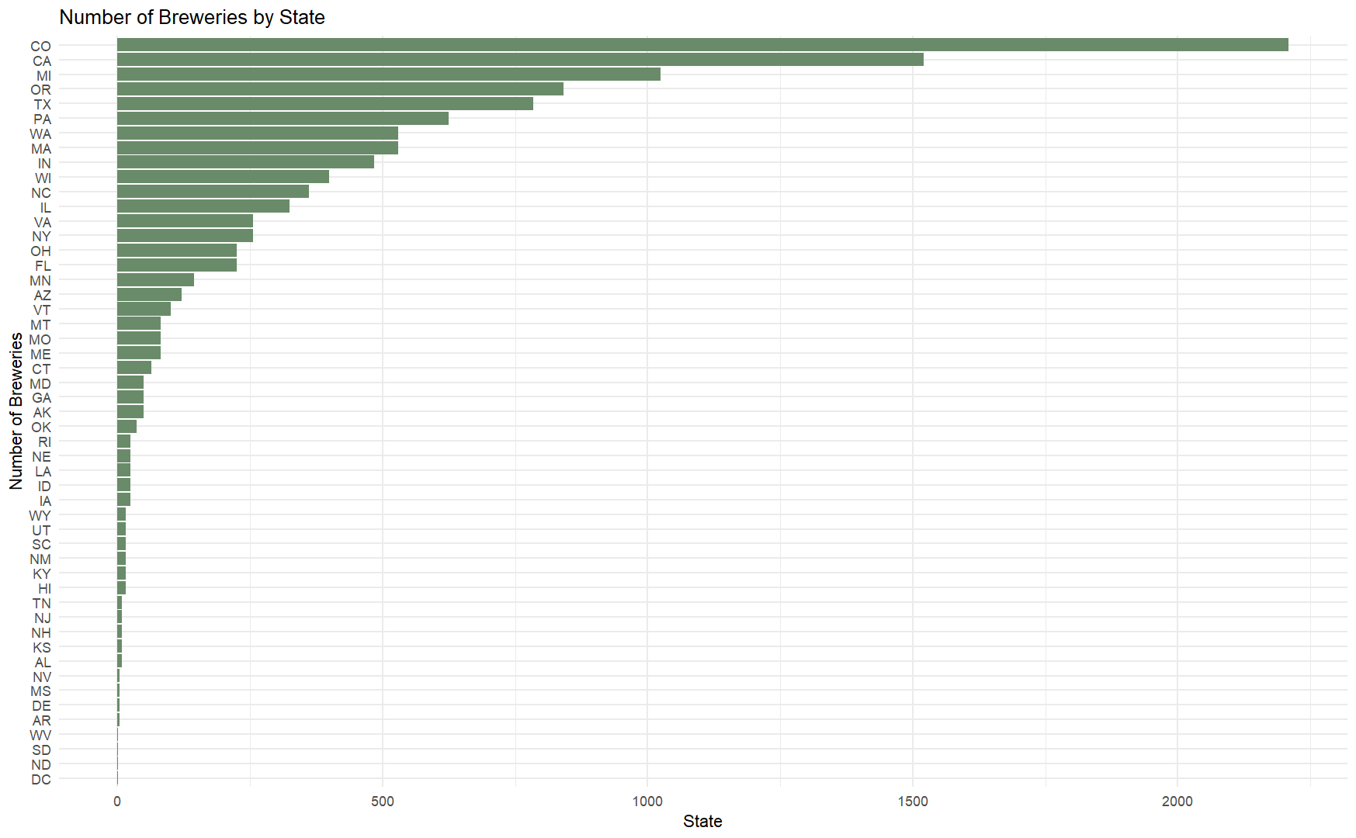
Breweries by State
Insights (X states make up Y% of breweries..)

Slide 3
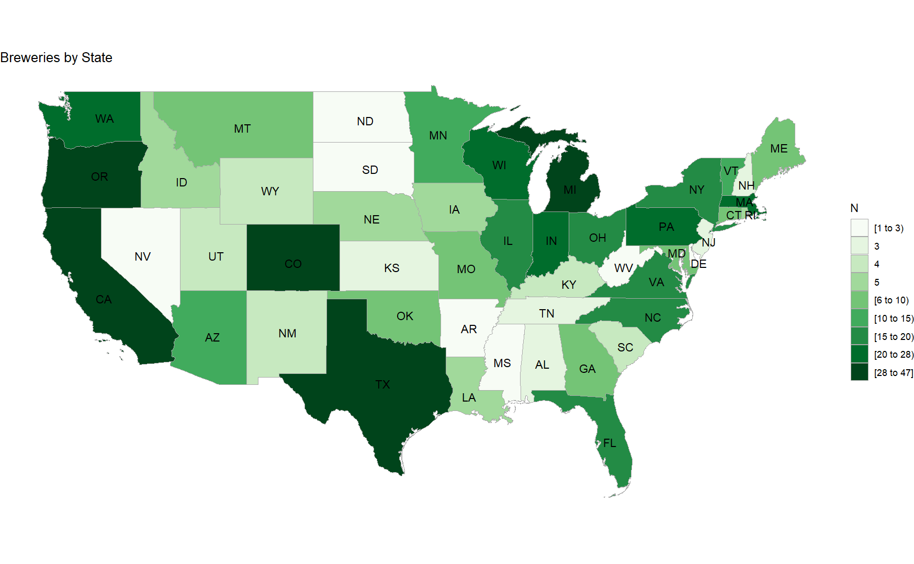
Brewery Choropleth

Slide 4
Null / Missing Values
There are missing values in both ABV (alcohol by volume) and IBU (international bitterness unit)
62 NA values for ABV (62/2410 = 3%)
1005 NA values for IBU (1005/2410 = 42%)
Note: All missing ABV’s also have a missing IBU.
However, it is possible for beers to have 0 ABV or IBU.
Therefore, we can assume NA values are equal to 0 to avoid removing approx. 40% of data.
Lastly, there are 5 NA values in the Style column
Since there are only 5 NA values (5/2410 = 0.2%), observations will be dropped.

Slide 5
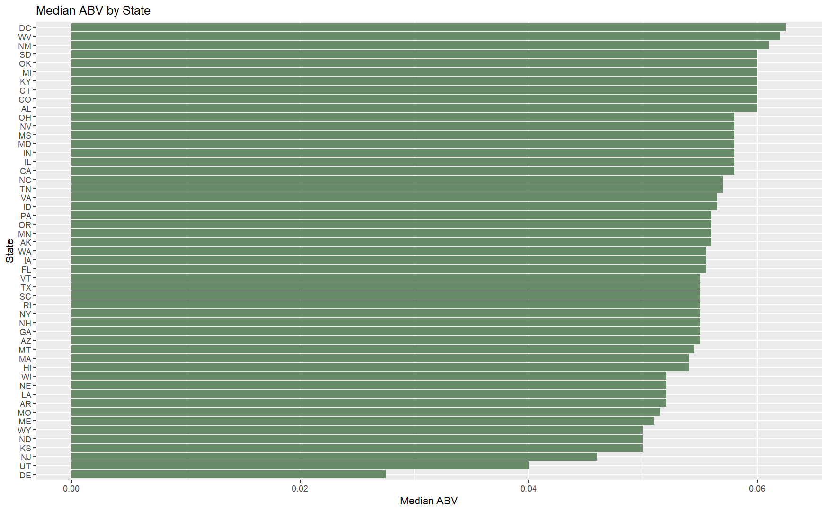
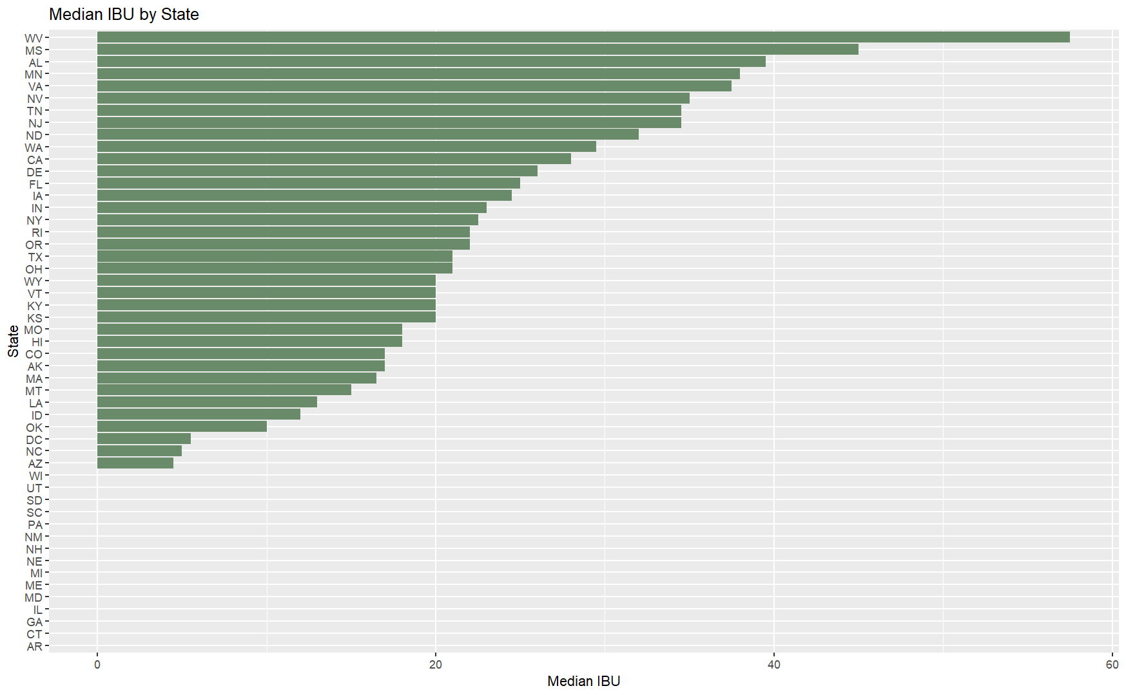
Median ABV / IBU by State

Slide 6
Maximum ABV & IBU
The maximum ABV is .128.
Brewery : Upslope Brewing Company, Boulder, CO.
Beer : Lee Hill Series Vol. 5 - Belgian Style Quadrupel Ale.
Notes : This beer is of the Style ‘Quadrupel’ and has an IBU of 0.
The maximum IBU is 138.
Brewery : Astoria Brewing Company, Astoria, OR.
Beer : Bitter Bitch Imperial IPA.
Notes : This beer is of the Style ‘American Double / Imperial IPA’ and has an ABV of .082.

Slide 7
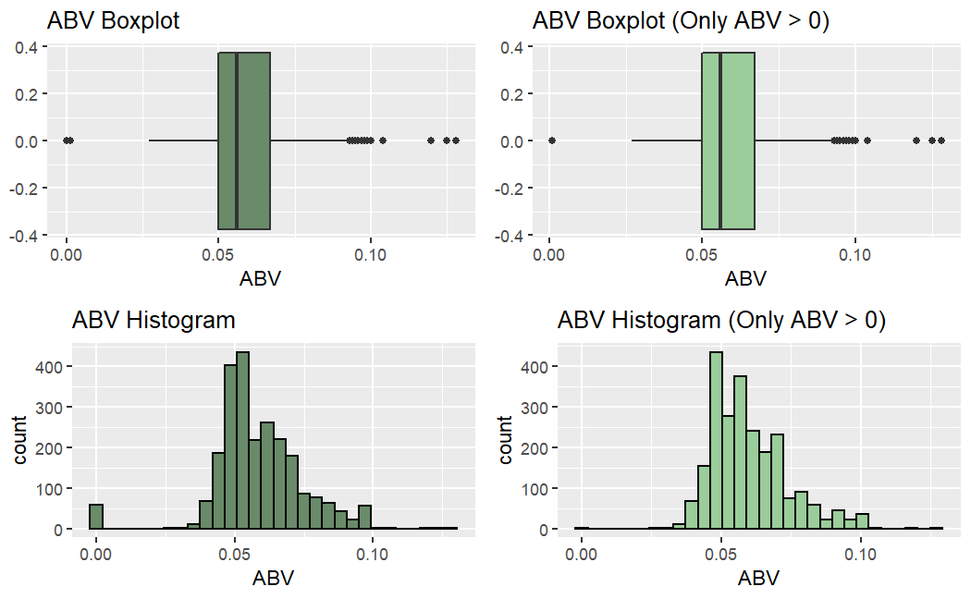
ABV Distribution
Full Dataset
Min | 1st Quartile | Median | Mean | St. Dev. | 3rd Quartile | Max
0 | .05 | .056 | .058 | .016 | .067 | .128
Alcoholic Only
Min | 1st Quartile | Median | Mean | St. Dev. | 3rd Quartile | Max
.001 | .05 | .056 | .06 | .014 | .067 | .128

Slide 8
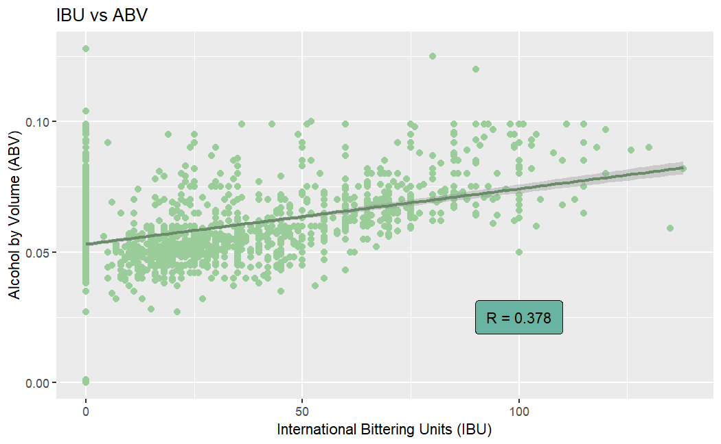
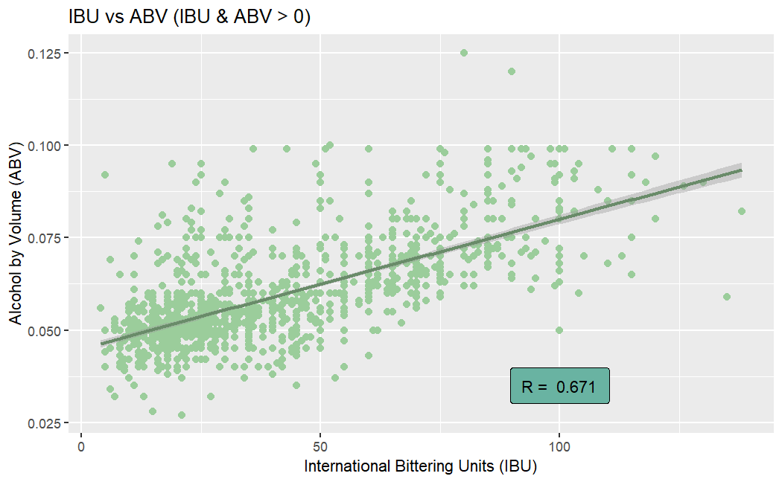
ABV & IBU Correlation
After filtering out beers with 0 IBU and/or ABV, the correlation between IBU & ABV increases by 78%.
Full dataset has a weak positive correlation.
Alcoholic dataset has a moderate positive correlation.

Slide 9
Thank you for your attention.
Any questions or comments?

