Slide 1
Beers & Breweries EDA
Alexander Lopez & Eric Laigaie

Slide 2
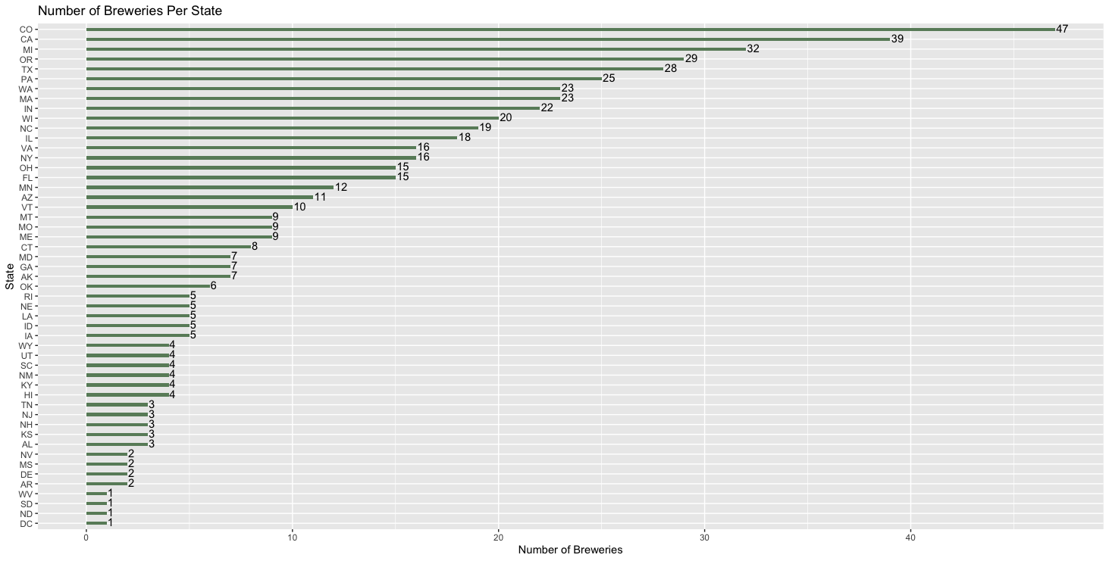
Breweries by State
Insight – top 5 states make up over 30% of breweries

Slide 3
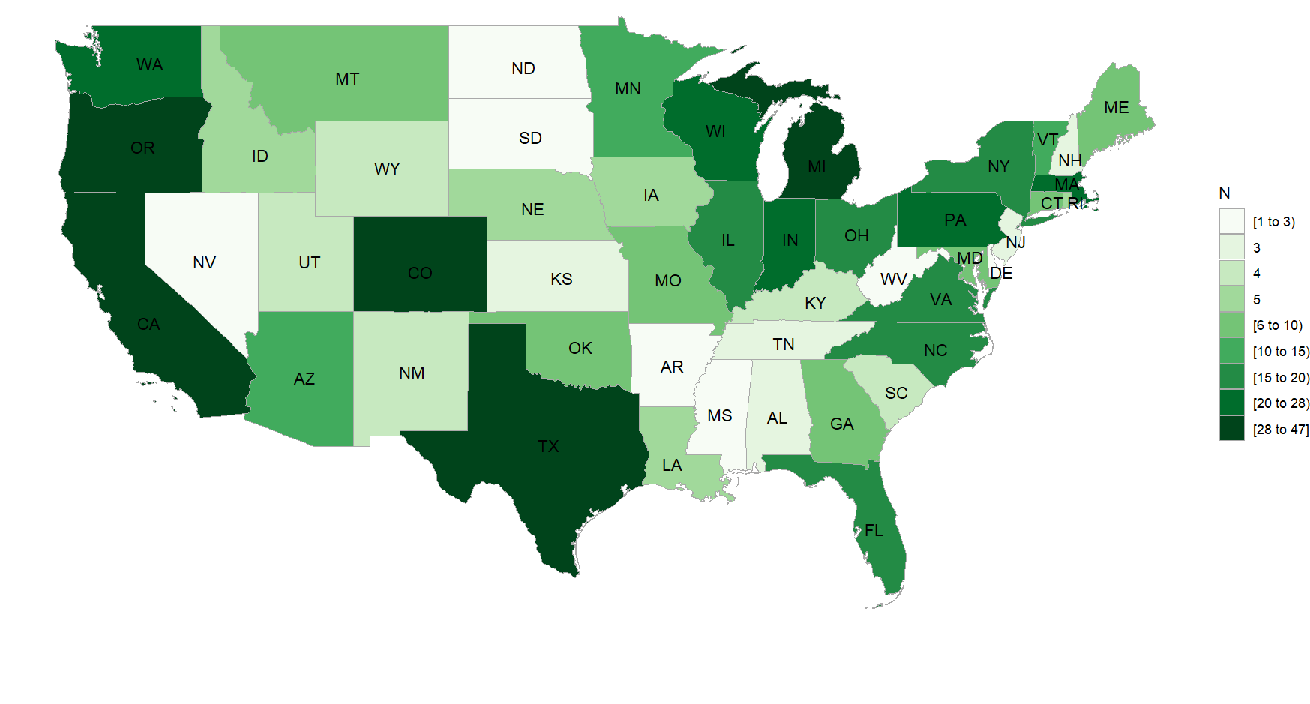
Breweries by State Map
With many breweries already in high-population areas such as Texas & California, expansion into NV/UT and TN/GA may be ideal.

Slide 4
Null / Missing Values
There are large amounts of missing values in both ABV (alcohol by volume) and IBU (international bitterness unit)
62 NA values for ABV (62/2410 = 3%)
1005 NA values for IBU (1005/2410 = 42%)
Note: All missing ABV’s also have a missing IBU.
To avoid removing >40% of the dataset, we can impute by mean ABV / IBU.
Splitting the dataset up by Style categories can give us a more accurate mean to impute.
Style groups: (‘Ale’, ‘IPA’, ‘Stout’, ‘Lager’, ‘Other’).
Lastly, there are 5 NA values in the Style column (5/2410 = 0.2%)
Since there is no simple way to impute the Style of a beer, these 5 observations with values of NA will be dropped.

Slide 5
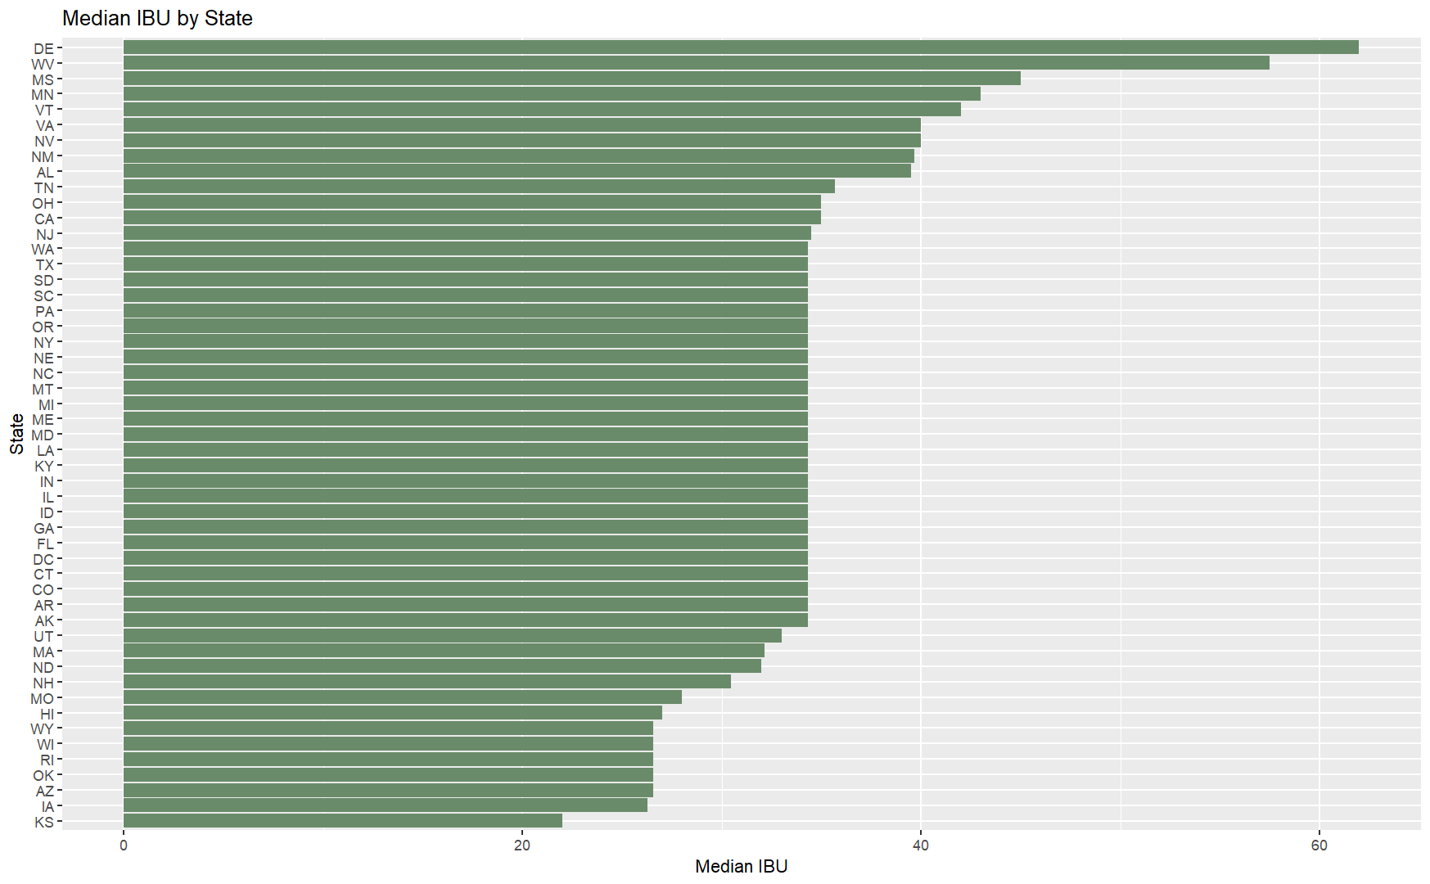
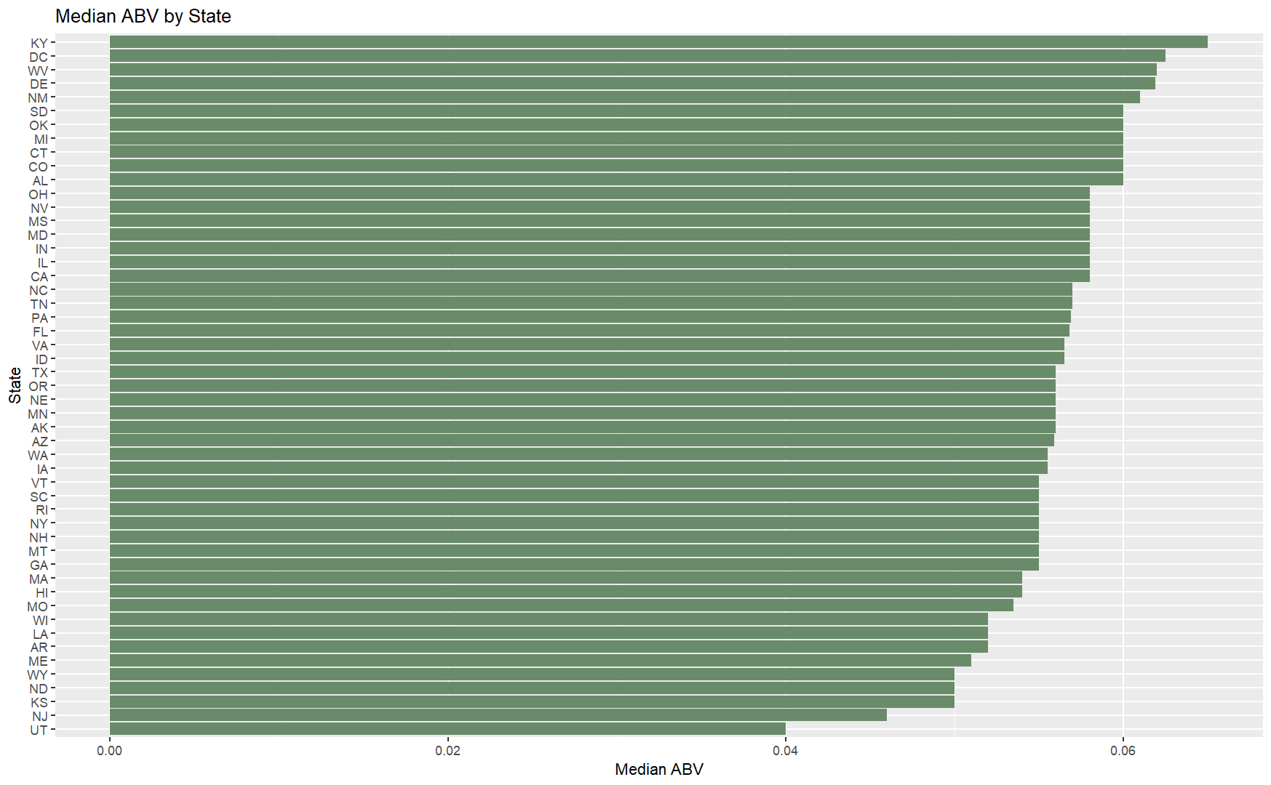
Median IBU / ABV by State
While there is a large range of mean IBUs, most states exist within 30-40 IBU.
44 (88%) of states have a median ABV between .05 and .06.
Our median IBU and ABV should ideally be within the range of 30-40 IBU and 5%-6% ABV.

Slide 6
Maximum ABV & IBU
The maximum ABV is .128.
Brewery : Upslope Brewing Company, Boulder, CO.
Beer : Lee Hill Series Vol. 5 - Belgian Style Quadrupel Ale.
Notes : This beer has an IBU of 26.6.
The maximum IBU is 138.
Brewery : Astoria Brewing Company, Astoria, OR.
Beer : Bitter Bitch Imperial IPA.
Notes : This beer is of the Style ‘American Double / Imperial IPA’ and has an ABV of .082.

Slide 7
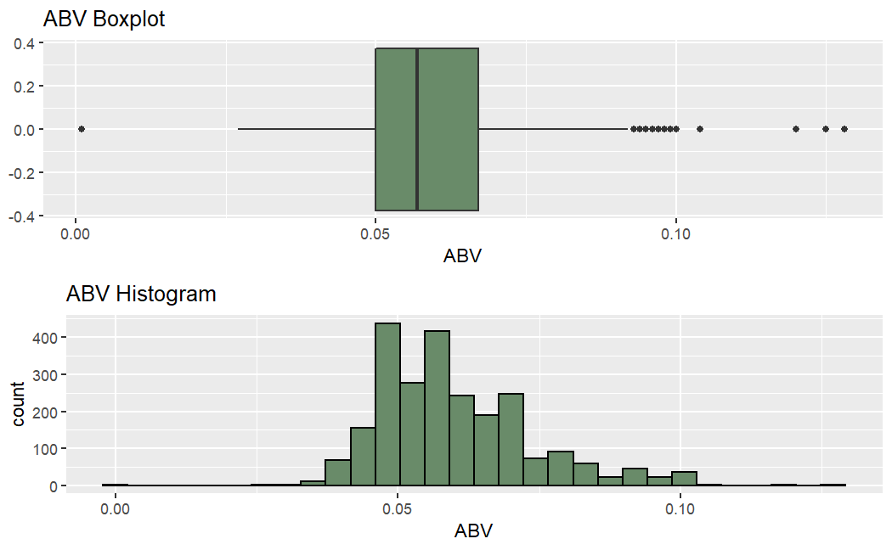
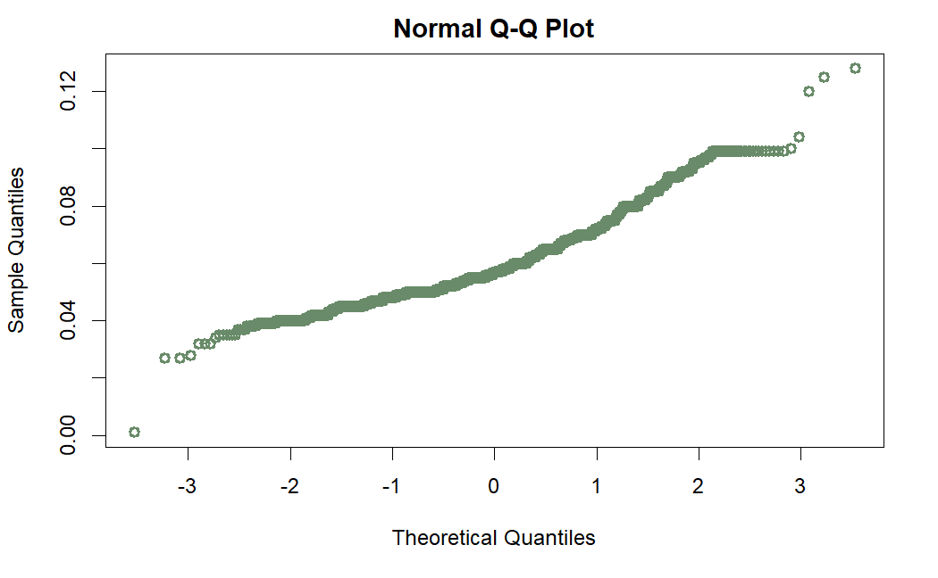
ABV Distribution
The ABV distribution is skewed right.
While the bulk of beers exist within 4.5 – 7 percent ABV, there are outliers with higher ABV percentages (up to 12.8%).
The Shapiro-Wilk Normality Test gives us a p-value of <2.2e-16. This supports the conclusion of non-normality.
Min | 1st Quartile | Median | Mean | St. Dev. | 3rd Quartile | Max
.01 | .05 | .057 | .06 | .013 | .067 | .128
While many of our beers may exist in the popular range of 4.5-7% ABV, there is demand for more alcoholic beverages.

Slide 8
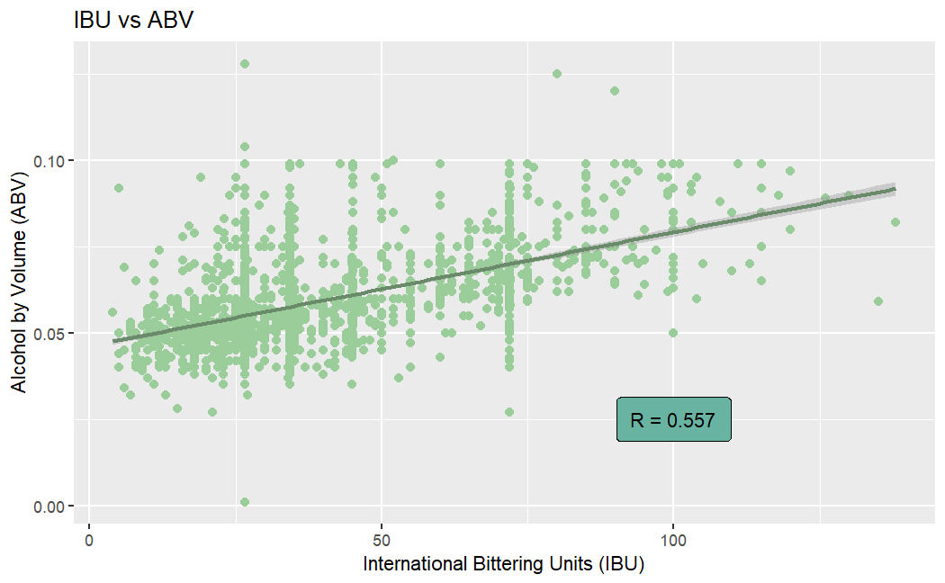
ABV & IBU Correlation
ABV and IBU have a moderate positive correlation.
As ABV changes, we can moderately expect IBU to move in the same direction.
When creating new products, we should aim to have compatible ABV and IBU. For example, a high-ABV and low-IBU beverage would not fit into the market.

Slide 9
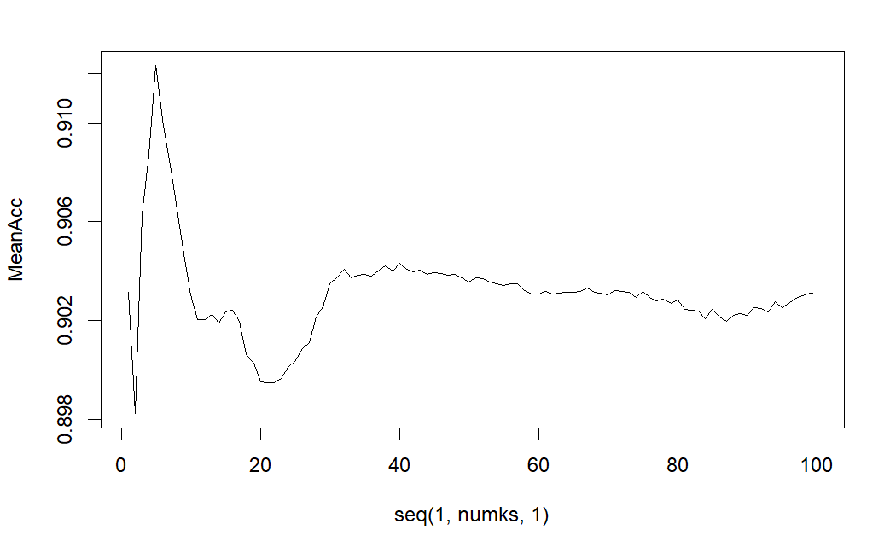
KNN Modeling
Using this modeling, we consider a beer’s K nearest neighbors to determine if they are an Ale or an IPA.
Beers are plotted by their ABV and IBU.
Each neighbor holds 1 vote, majority wins.
Sensitivity: The percentage of Ales that were identified correctly.
Specificity: The percentage of IPA’s that were identified correctly.
Mean Accuracy of 100 Models by K-value
Statistic | Maximum Value | K
Accuracy | 91.2% | 5
Sensitivity (Ale) | 95.0% | 13
Specificity (IPA) | 88.2% | 97
Statistic | Value | K
Accuracy | 91.7% | 5
Sensitivity (Ale) | 95.1% | 5
Specificity (IPA) | 86.2% | 5
When considering only ABV and IBU, a KNN model can identify whether a beer is an Ale or IPA with >90% accuracy. Therefore, we can conclude that ABV and IBU do not vary extremely within Styles.

Slide 10

Naïve Bayes Modeling
Using this modeling, we will consider IBU and ABV are conditionally independent and then find the probability for a beer being either an Ale or IPA.
ABV and IBU are continuous variables.
Sensitivity: The percentage of Ales that were identified correctly.
Specificity: The percentage of IPA’s that were identified correctly.
$P\left(A | B\right)$ = $\frac{\text{P}\text{ (}\text{B}\text{|}\text{A}\text{) }\text{P}\text{(}\text{A}\text{)}}{\text{P}\text{ (}\text{B}\text{|}\text{A}\text{) }\text{P}\text{(}\text{A}\text{) + }\text{P}\text{ (}\text{B}\text{|′}\text{A}\text{) }\text{P}\text{(′}\text{A}\text{)}}$
Statistic | Value
Accuracy | 91.1%
Sensitivity (Ale) | 92.7%
Specificity (IPA) | 88.3%
Like the KNN model, the Naïve Bayes model can identify whether a beer is an Ale or IPA with >90% accuracy.
Both models suggest that more alcoholic beers will likely be more bitter.

Slide 11
Kruskal Wallis – Rank Sum Test Results
This test compares a variable’s distribution between 2+ groups.
The results will either provide or not provide evidence to say that at least one group has a significantly different variable distribution.
ABV:
This test provides overwhelming evidence to suggest that at least one region has a significantly different mean ABV (p-value = .00035).
Further exploration is detailed on the next slide.
IBU:
This test does not provide sufficient evidence to say if any of the regions have a significantly different mean IBU (p-value = .0778).
No further exploration needed.

Slide 12
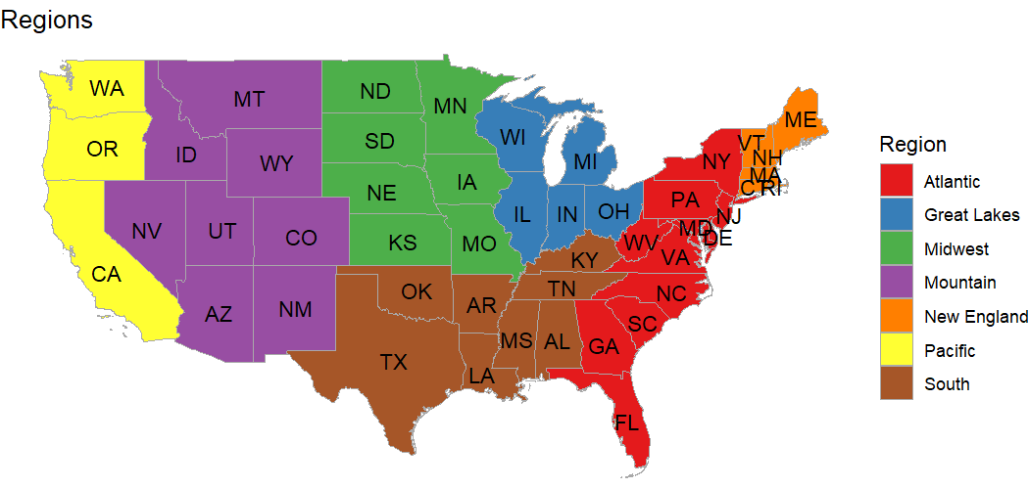
Rank Sum Test – Adjacency Matrix
All region combinations were tested for different mean ABVs.
8 combinations were found to have a significant difference (p-value < .05).
‘South’ is the least unique region, connecting with all others.
‘Great Lakes’ is the most unique, only connecting with 2 regions (South, Mountain).
Adjacency Matrix – Connection indicates a similar mean ABV.
Midwest
Atlantic
Pacific
South
Mountain
New England
Great Lakes
Budweiser can use this evidence to determine where a new product’s ABV may land in each region. For instance, a more alcoholic beer in the Pacific region may stack up differently in the Great Lakes region.

Slide 13
Thank you for your attention.
Any questions or comments?

Slide 14
YouTube Links
Eric Laigaie
https://www.youtube.com/watch?v=E8X-htVDYic&ab_channel=EricLaigaie
Alex Lopez
https://youtu.be/C8lKekMA_rw

Slide 15
Shapiro –Wilk Normality Test, Explained
Two Hypotheses:
Ho : The distribution is normal.
Ha : The distribution is not normal.
Significance level:
α = .05
P-value:
In the case of ABV, p-value = ~0.
This is the probability of observing an as-or-more extreme distribution.
Conclusion:
Since our p-value is lower than α, we REJECT the Ho. We can conclude that there is sufficient evidence of non-normality in the distribution.
If the p-value was greater than .05, we would FAIL TO REJECT the Ho. In this case, we would say that there is not sufficient evidence of a non-normal distribution.

