Slide 1
Beers & Breweries EDA
Alexander Lopez & Eric Laigaie

Slide 2
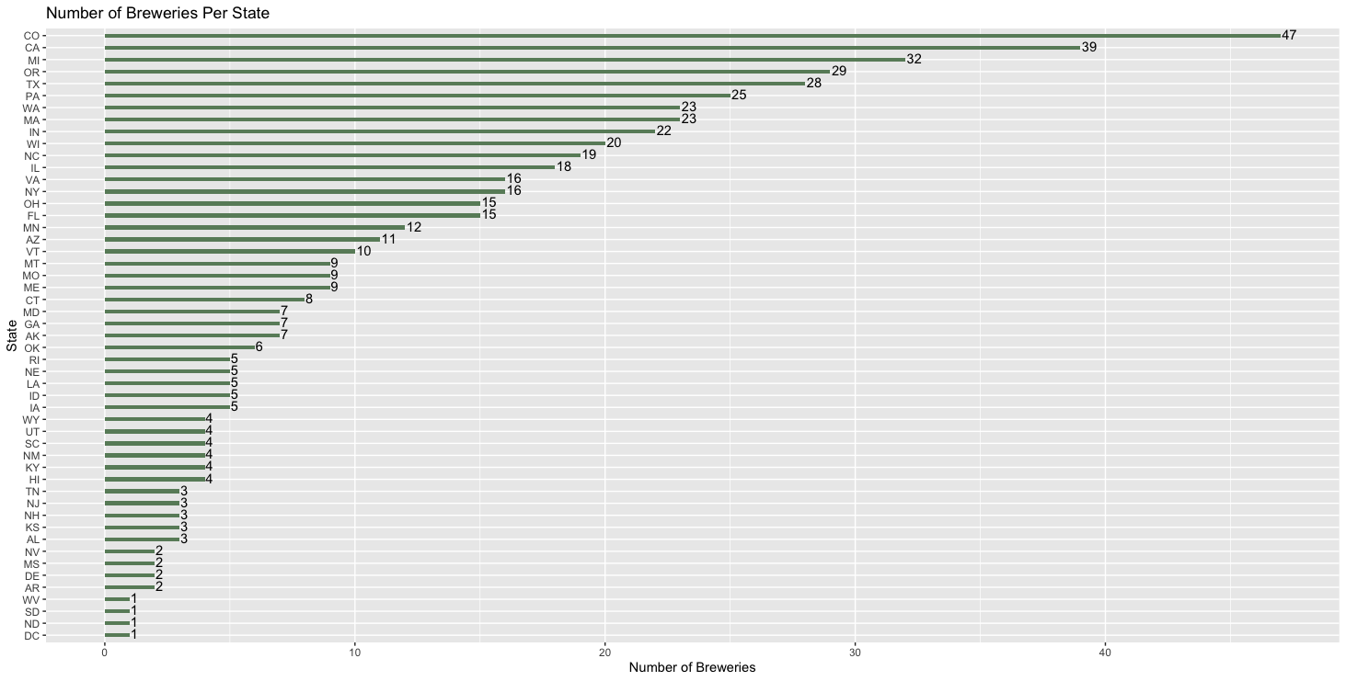
Breweries by State
Insight – top 5 states make up over 30% of breweries

Slide 3
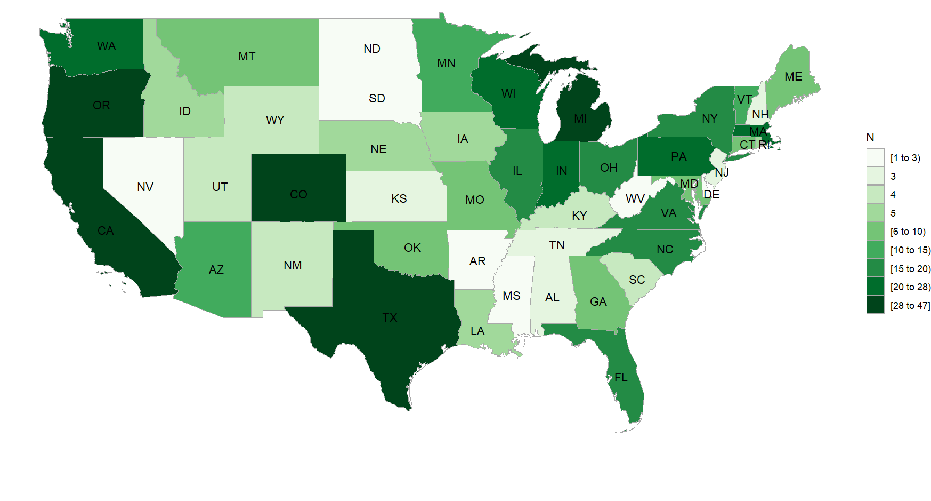
Breweries by State Map

Slide 4
Null / Missing Values
There are large amounts of missing values in both ABV (alcohol by volume) and IBU (international bitterness unit)
62 NA values for ABV (62/2410 = 3%)
1005 NA values for IBU (1005/2410 = 42%)
Note: All missing ABV’s also have a missing IBU.
However, it is possible for beers to have 0 ABV or IBU.
Therefore, we can assume NA values are equal to 0 to avoid removing approx. 40% of data.
Lastly, there are 5 NA values in the Style column (5/2410 = 0.2%)
Since there is no simple way to impute the Style of a beer, these 5 observations with values of NA will be dropped.

Slide 5
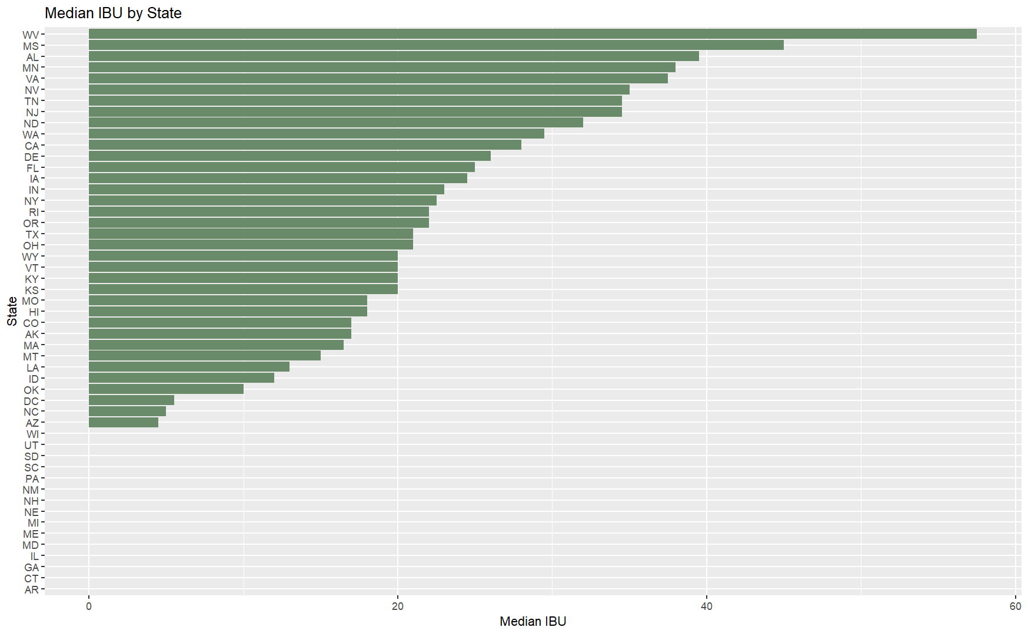
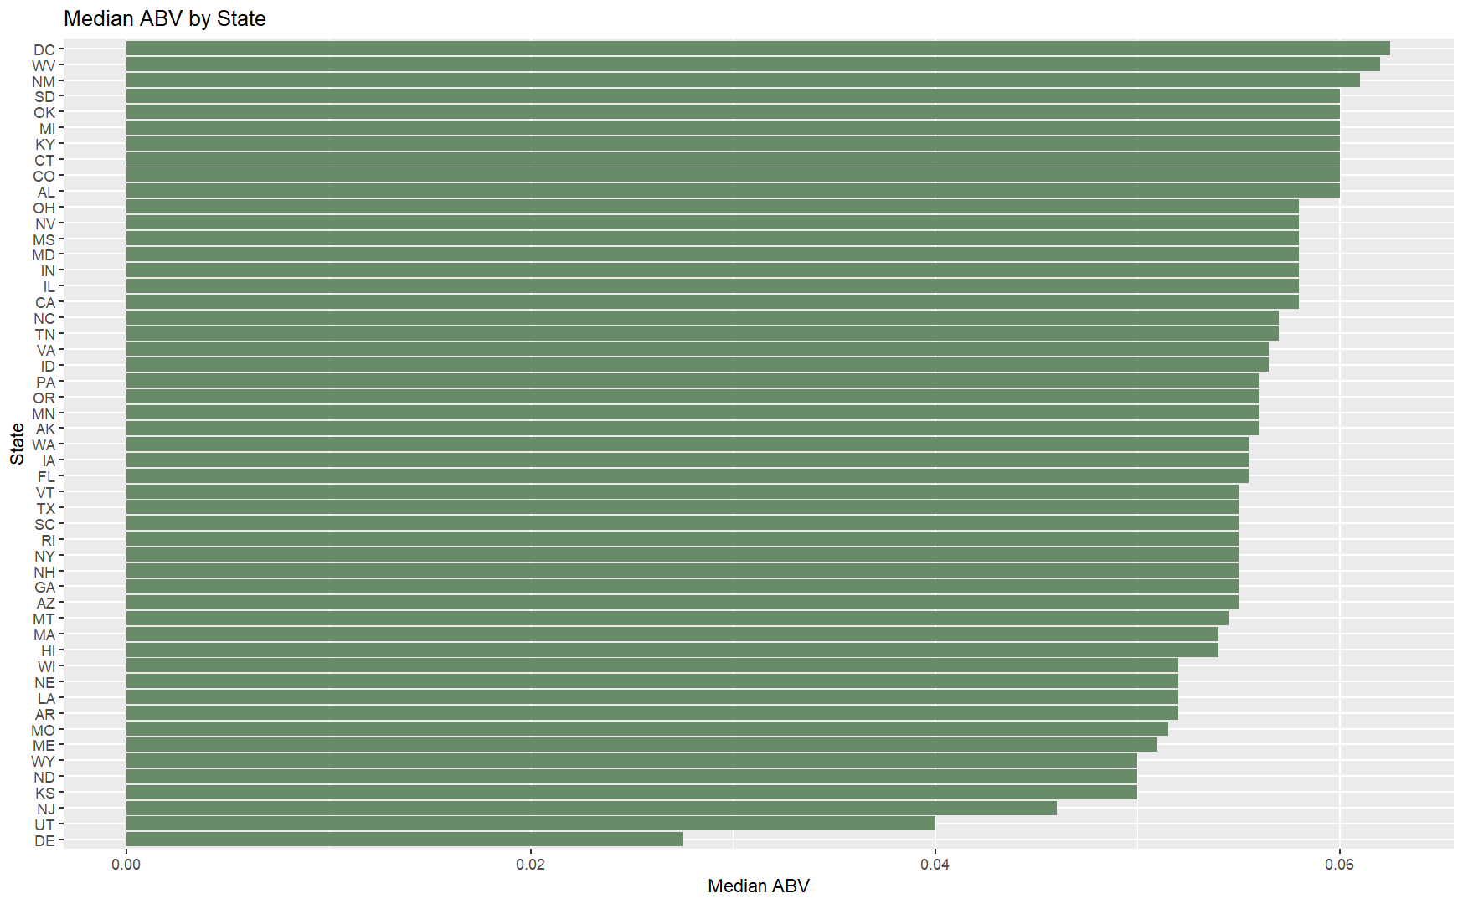
Median ABV / IBU by State
>40% of IBU observations are 0 so many states have median = 0
State IBU Avg gives better insight
44 (88%) of states have a median ABV between .05 and .06.

Slide 6
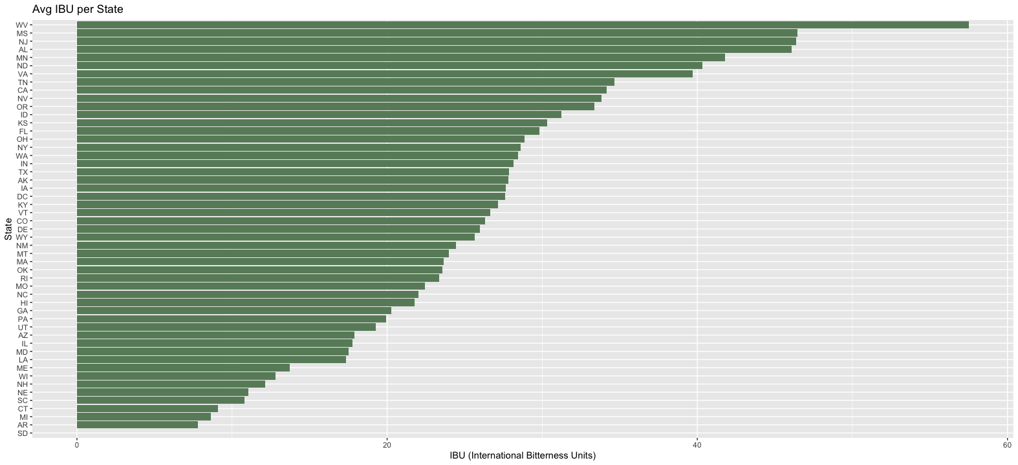
Mean IBU by State

Slide 7
Maximum ABV & IBU
The maximum ABV is .128.
Brewery : Upslope Brewing Company, Boulder, CO.
Beer : Lee Hill Series Vol. 5 - Belgian Style Quadrupel Ale.
Notes : This beer has an IBU of 0.
The maximum IBU is 138.
Brewery : Astoria Brewing Company, Astoria, OR.
Beer : Bitter Bitch Imperial IPA.
Notes : This beer is of the Style ‘American Double / Imperial IPA’ and has an ABV of .082.

Slide 8
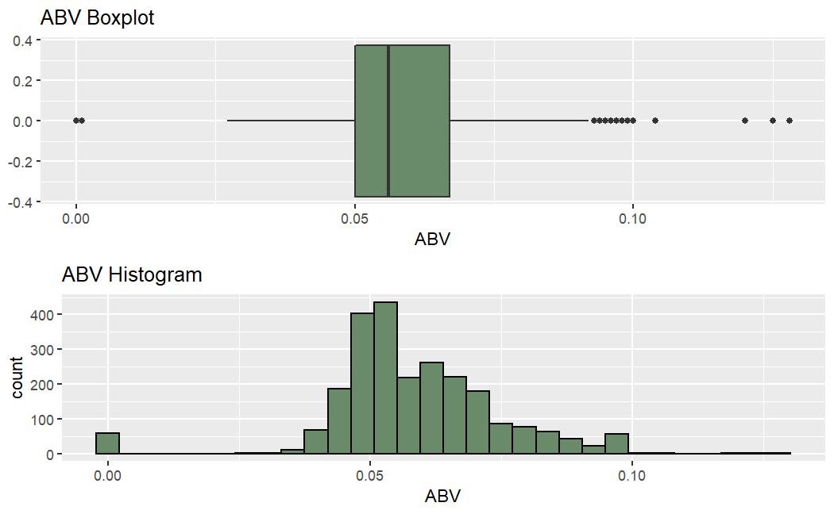
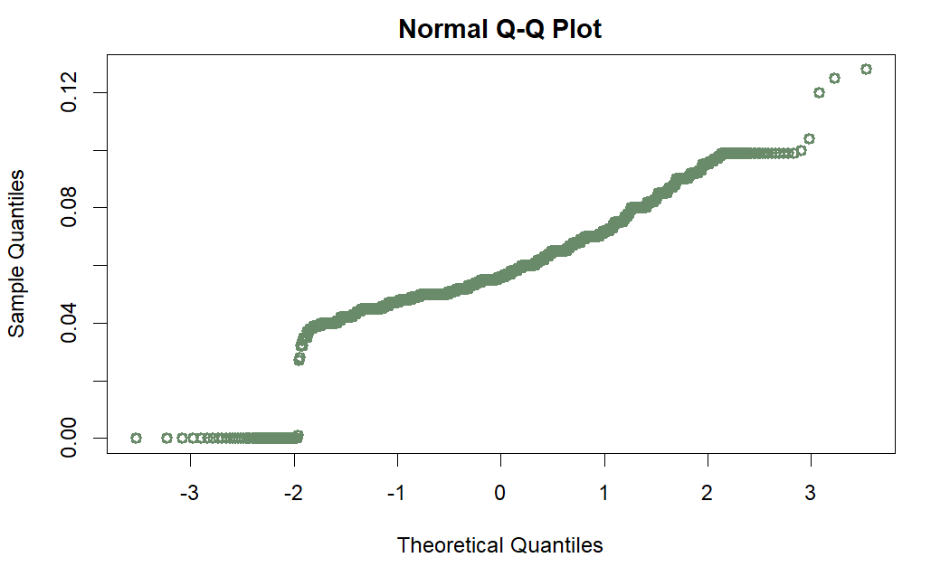
ABV Distribution
The ABV distribution is skewed right.
While there are ~50 beers at ABV=0, there is a long tail of high-ABV beers.
The Shapiro-Wilk Normality Test gives us a p-value of <2.2e-16. This supports the conclusion of non-normality.
Min | 1st Quartile | Median | Mean | St. Dev. | 3rd Quartile | Max
0 | .05 | .056 | .058 | .016 | .067 | .128

Slide 9
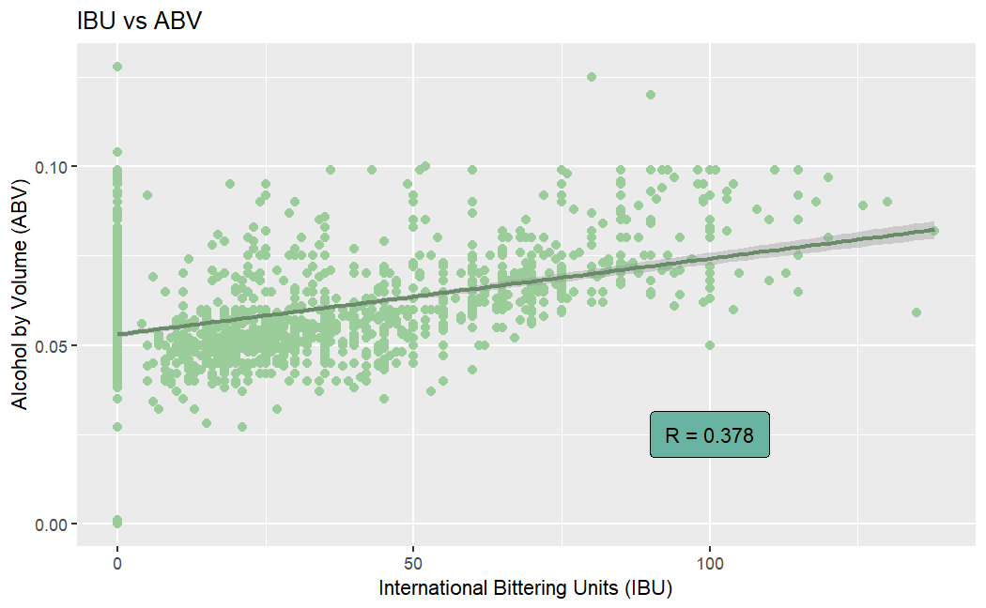
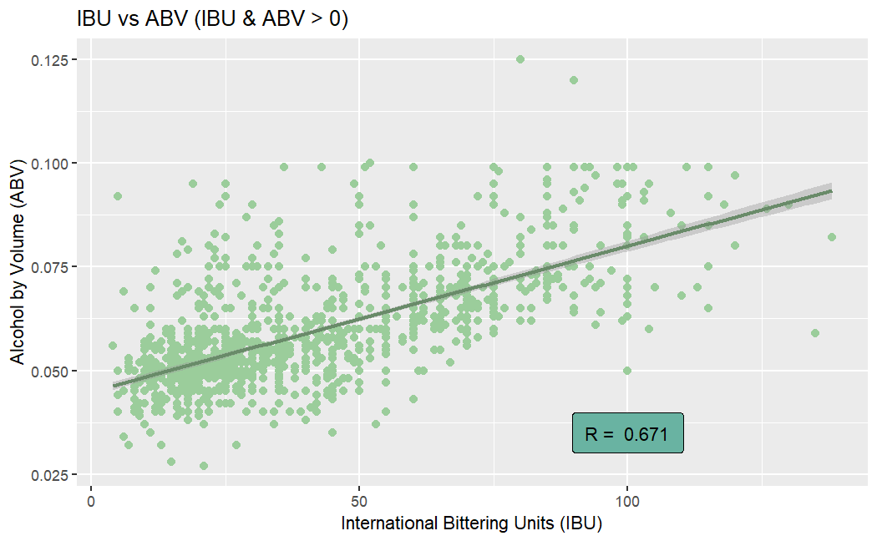
ABV & IBU Correlation
After filtering out beers with 0 IBU and/or ABV, the correlation between IBU & ABV increases by 78%.
Full dataset has a weak positive correlation.
Alcoholic dataset has a moderate positive correlation.

Slide 10
Thank you for your attention.
Any questions or comments?

Slide 11
Shapiro –Wilk Normality Test, Explained
Two Hypotheses:
Ho : The distribution is normal.
Ha : The distribution is not normal.
Significance level:
α = .05
P-value:
In the case of ABV, p-value = ~0.
This is the probability of observing an as-or-more extreme distribution.
Conclusion:
Since our p-value is lower than α, we REJECT the Ho. We can conclude that there is sufficient evidence of non-normality in the distribution.
If the p-value was greater than .05, we would FAIL TO REJECT the Ho. In this case, we would say that there is not sufficient evidence of a non-normal distribution.

