Slide 1
Frito Lay Employment Insights
Eric Laigaie

Slide 2
Data Cleaning
First, categorical variables with only two outcomes were changed to binary variables (0 or 1).
Attrition, Gender, OverTime
Then, unnecessary columns were removed from the dataset.
Multiple income columns were redundant, so DailyRate, HourlyRate, and MonthlyRate were removed.
Columns with only one value were not useful, so EmployeeCount, Over18, and StandardHours were removed.
Id columns were unusable in regression / machine learning models, so Id and EmployeeNumber were removed.
Finally, categorical variables with 3+ factors were ‘dummified’.
Each category became their own column with values 0 or 1.
No null values were documented.

Slide 3
Contributing Factors to Attrition
Variable | Average Rank
OverTime | 1
JobInvolvement | 3.5
JobRole_Manufacturing Director | 3.5
MaritalStatus_Divorced | 4.67
JobSatisfaction | 7.17
JobRole_Research Director | 8
To find these factors, multiple linear regression was utilized.
With all the variables fed into the model, a stepwise method was used to eliminate non-significant variables from the model.
To find each variable’s relative importance within the model, six methods were used. Each model ranks the variables in order of importance.
Last, First, Betasq, Pratt, Genizi, and Car.
These are detailed in the last slide if further information is needed.
An average of these model ranks were used to create an overall hierarchy of the most important variables.
OverTime workers have a 32% attrition rate, while non-OverTime workers only have a 10% attrition rate.
OverTime was consistently the most important contributor to attrition. It may be beneficial to lighten the workload amongst OverTime workers to decrease the attrition rate. Additionally, more attention should be paid to the Manufacturing Director position to avoid attrition.

Slide 4
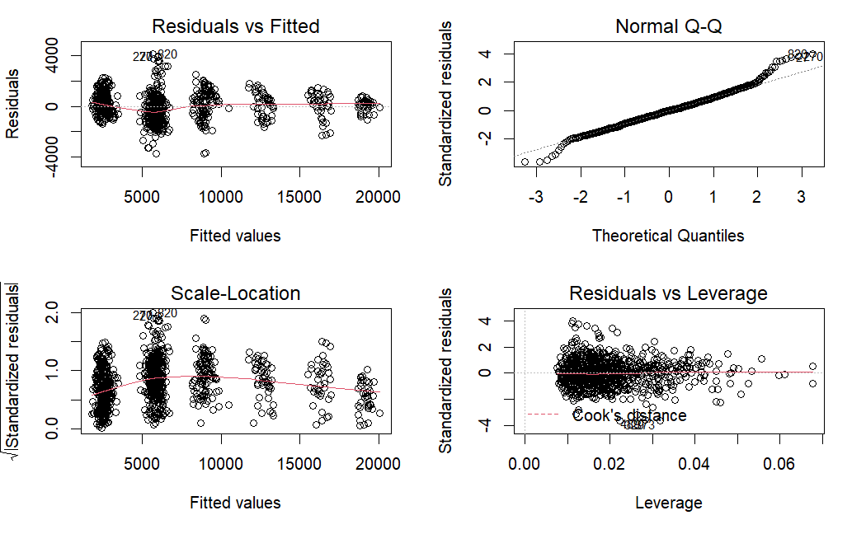
Predicting Monthly Income with Linear Regression
Using all relevant variables within the provided dataset, a formula to predict monthly income was produced.
A stepwise process was used to determine the most significant variables for the model.
The charts below provide information about the linear regression assumptions.
While there is some cause for concern, the assumptions are passable.
To measure error, we can use the Root Mean Square Error (RMSE).
For this model, RMSE = $1,061.06
This value can be interpreted as a normalized distance between the predicted and observed values.
Variable | Coefficient (p < .05) (in USD)
JobLevel | 2,861.42
TotalWorkingYears | 45.43
Non-Travel | -387.56
Research & Development | 508.24
Laboratory Technician | -641.45
Manager | 4,180.51
Research Director | 3,609.32
Research Scientist | -367.09
While this model has passable results for monthly income, the RMSE may become too large when being used to predict larger amounts of payment.

Slide 5
Predicting Attrition with Machine Learning
Confusion Matrix |  | Is Attrition Predicted?
 |  | No | Yes
Did Attrition Occur? | No | 152 | 14
 | Yes | 71 | 24
Using relevant variables within the provided dataset, the Naïve-Bayes algorithm predicts the Attrition status of employee X.
Using a train and test split of 70%, 30%:
The model observes 70% of the full dataset (train).
Then, the model predicts the Attrition status for 30% of the full dataset (test).
Model Statistics:
Accuracy: Probability that a prediction is correct.
Specificity: Probability of a non-attrition prediction given that an employee does not depart.
Sensitivity: Probability of an attrition prediction given that an employee departs.
Accuracy | 67.43%
Specificity | 63.16%
Sensitivity | 68.16%
This model can be useful in predicting attrition (>60% sensitivity). However, a more complex model would likely produce better results.

Slide 6
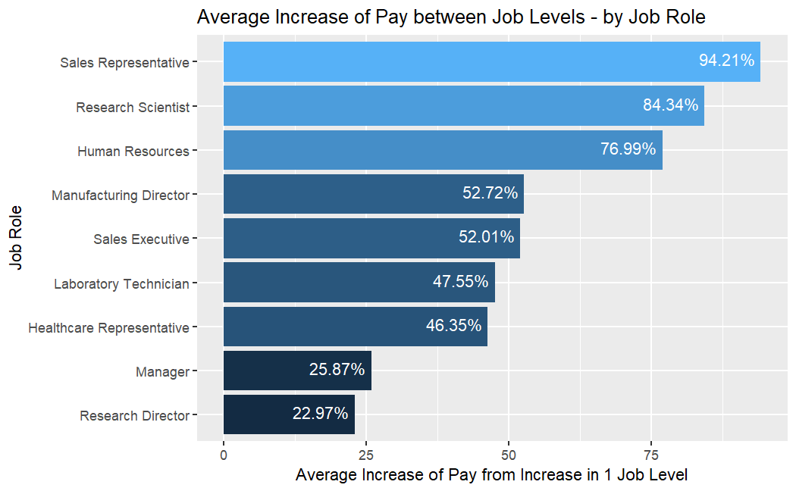
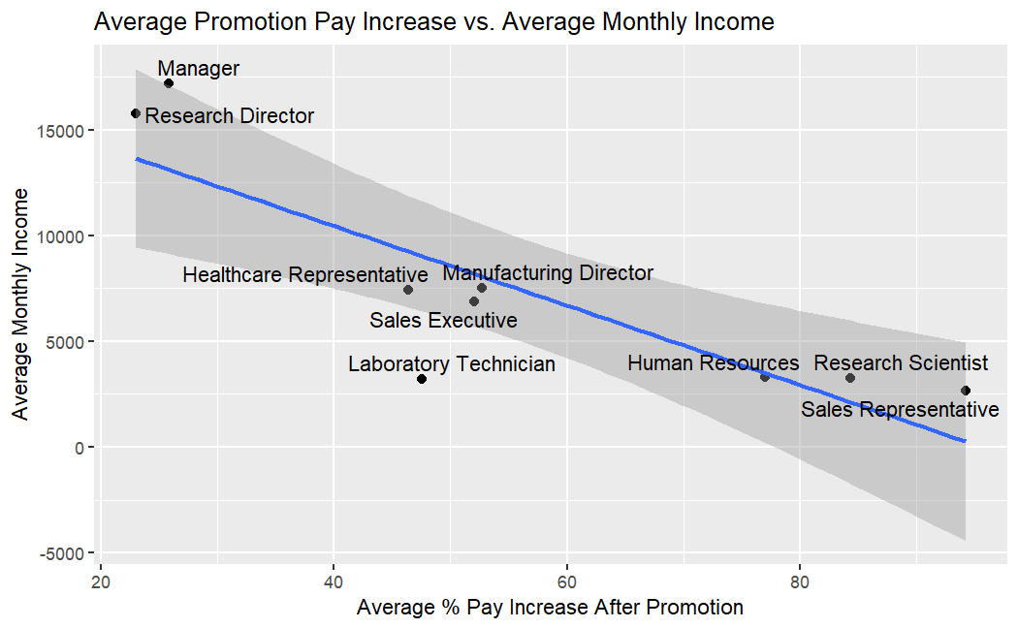
Promotion Pay Raises by JobRole
How do JobRoles differ in their average pay increase after a promotion?
Lower-income jobs tend to have drastically higher pay increases after promotions, in terms of percentage.
When these percentages are plotted against average MonthlyIncome by JobRole, it is evident that there is a strong negative correlation between the variables.
Correlation = -.848.
Lower-level employees are incentivized to seek out promotions. This is beneficial, as it may reduce attrition.

Slide 7
JobRole – Differences Amongst Performance Metrics
Grouping by JobRole, do any of these metrics vary between groups?
JobInvolvement
JobSatisfaction
WorkLifeBalance
PerformanceRating
EnvironmentSatisfaction
Since the distribution of these variables is non-normal, a Kruskal-Wallis test will be used.
Since all p-values are above .05, there is NOT sufficient evidence to suggest that any JobRole has a significantly different variable distribution than any of the other JobRoles.
Variable | P-value
JobInvolvement | .197
JobSatisfaction | .542
WorkLifeBalance | .347
PerformanceRating | .582
EnvironmentSatisfaction | .182
Given these results, no single JobRole is struggling with performance / satisfaction metrics. While this does not prove that employees are happy, it could be proof that no single JobRole is neglected.

Slide 8
Thank for your attention. Any questions are welcomed.

Slide 9

Relative Importance Methods
Last: Each variables contribution when included last.
Sometimes called ‘usefulness’.
First: Each variables contribution when included first.
This is the squared covariance between y and the variable.
Betasq: This is the squared standardized coefficient.
Pratt: Product of the standardized coefficient and the correlation.
Genizi: The $R^{2}$ decomposition, according to Genizi 1993.
Car: The $R^{2}$ decomposition, according to Zuber& Strimmer 2010.
Source: https://www.rdocumentation.org/packages/relaimpo/versions/2.2-6/topics/calc.relimp

