Slide 1
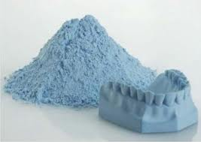
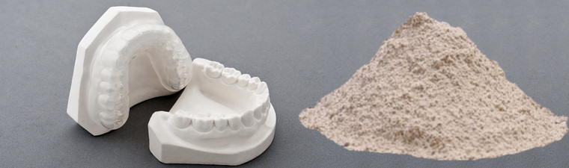

GYPSUM PRODUCTS

Slide 2
GYPSUM PRODUCTS
Outline
DEFINITIONS of few KEY WORDS,
TYPES OF GYPSUM PRODUCTS,
NATURE OF PARTICLES AND SETTING MECHANISMS
TYPES OF TESTS FOR SETTING AND FACTORS AFFECTING SETTING MECHANISM OF GYPSUM PRODUCTS
SETTING EXPANSIONS AND STRENGTH OF GYPSUM PRODUCTS
USES OF GYPSUM PRODUCT IN DENTISTRY

Slide 3
Key words :
Gypsum : Calcium sulfate dihydrate ( CaSO₄.2H₂O)
Models : A study purpose cast which has a positive likeness of an oral cavity or any other object
Cast: Positive replica of on oral cavity or any other object
Impression: It is the negative replica of an oral cavity
Die : Positive replica of a prepared tooth made out of gypsum products , epoxy resins , a metal or a refractive materials.

Slide 4
Keywords (contd.)
Dental plaster :β form of calcium hemihydrate .
Dental stone: α form of calcium hemihydrate.
W/P Ratio: The ratio in which water is mixed with hemihydrate.
Mixing time : Time from addition of the powder to water till the mixing is complete.
Setting time: Time duration between start of mix & point where material hardens.
Working time : Time from start of mix to the point where the consistency of the mix is no longer acceptable for the usage of indented purpose.

Slide 5
Key words (Contd.)
Accelerators : Impurities added to gypsum products which reduces the setting time.
Retarders: Impurities added to gypsum products that enhances the setting time.

Slide 6
Questions :
Long Essay:
Q1) What are the different methods of manufacturing Gypsum products? Write the setting reactions of gypsum. Mention the uses of gypsum products.
Q2) What are the various gypsum products used in dentistry. Describe the setting of gypsum products. How is the setting expansion controlled?
Q3) What are the types of gypsum products used in Dentistry? Describe the theories of setting reaction & various factors which affect the dimensional stability of dental stone.
Q4) Classify Gypsum products and discuss about the tests for the setting of gypsum products.

Slide 7
Questions :
Short Essay:
Q1) Water/powder ratio of Gypsum Products.
Q2) Compare Plaster of Paris & Dental Stone.
Q3) Die Stone.(High strength & high expansion)
Q4) Dental stone.
Q5) Setting reaction of Plaster Of Paris.
Q6) Setting expansion.
Q7) Hygroscopic Expansion.
Q8) Hygroscopic setting expansion.
Q9) Define a Dye & Cast. Mention different types of dye material.
Q10) Mixing, Proportioning & Infection Control of gypsum Products.

Slide 8
Questions :
Short Essay:
Q1) Water/powder ratio of Gypsum Products.
Q2) Compare Plaster of Paris & Dental Stone.
Q3) Die Stone.(High strength & high expansion)
Q4) Dental stone.
Q5) Setting reaction of Plaster Of Paris.
Q6) Setting expansion.
Q7) Hygroscopic Expansion.
Q8) Hygroscopic setting expansion.
Q9) Define a Dye & Cast. Mention different types of dye material.
Q10) Mixing, Proportioning & Infection Control of gypsum Products.

Slide 9
Q1) What are the different methods of manufacturing Gypsum products? Write the setting reactions of gypsum. Mention the uses of gypsum products.

Slide 10
A1)
Dry calcination.
Wet calcination.
Dehydration by boiling with chemicals.
Synthetic Method.

Slide 11
DRY CALCINATION
The process of heating gypsum for the manufacture of plaster is known as “CALCINATION”
Depending on the methods of calcination different forms of hemihydrates are formed viz. Impression plaster , Dental plaster , Dental stone, Die stone low expansion , Die stone high expansion
Commercially gypsum is finely ground and subjected to high temperatures of 110-130º C to eliminate the water of crystallization
CaSO_{4.}. 2H₂O CaSO₄.1/2H₂O
Heat to 383K-413K (β-hemihydrate)
On raising to higher temperatures, we further get dental stone and die stones
CaSO₄.2H₂0 (CaSO₄)2H₂O CaSO₄ CaSO₄
_{GYPSUM} 110-120º c DENTAL STONE 130-200º C HEXA- 200-1000º C ORTHO-
GONAL RHOMBIC
ANHYDRATE ANHYDRATE

Slide 12
WET CALCINATION
When gypsum is ground and heated under steam pressure at a temperature of 110 to 130⁰ C in a closed kettle or kiln, or an autoclave , the process is called wet calcination.
Alpha-calcium sulfate hemihydrate is formed, which consists of smaller, regularly shaped crystalline particles in form of rods and prisms
Type III ( dental stone or hydrocal or class I stone) is formed by this method.
Microscopically, crystals type III (Dental stone) are in the form of rods and prisms

Slide 13
DEHYDRATION BY BOILING CHEMICALS
The gypsum is calcined by boiling it with 30% CaCl₂ solution . The chlorides are then washed away in the presence of 0.5% Sodium Succinate.
Improved stone (α-modified hemihydrate) is manufactured by this method, these methods are denser among all three types.
After controlled grinding, these powders have an even higher apparent density & microscopically the particles that are cuboidal in shape yield an even stronger set material.

Slide 14
Synthetic Gypsum Products:
It is also possible to make alpha & beta Hemihydrate from the by-products or waste products of the manufacture of Phosphoric Acid.
It is more expensive than natural gypsum products but when product is properly made it’s properties are equal or exceed to natural gypsum products.

Slide 15
SETTING REACTION
When plaster is mixed with water it takes up 1.5 molecules of water .i.e. , it regains the water of crystallization and becomes Calcium Sulphate dihydrate.
CaSO₄.2H₂O + 2H₂0 2(CaSO_{4.}2H₂0) + Heat(3900 cal)
The reaction is exothermic.
The reaction is continuous & repeated until Hemihydrate is converted to di-hydrate.
Initially there is a little reaction & thus a little or no rise in temperature. This period is called induction period.
Later there is a thickening of mix which allows it to be poured. As the amount of gypsum formed increases the mass thickens & hardens into needle like clusters called SPHERULITES.
Finally intermeshing of crystals of gypsum leads to a strong solid structure.

Slide 16
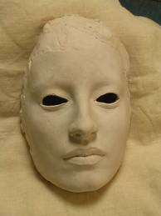
USES:
General Use:
Used for construction purpose.
Orthopedic Use:
Used in preparation of casts.
In Dentistry:
Impression plaster for OMF impression.
Various types of plasters are used to make moulds, casts & dye over which dental prosthesis & restorations are made.
To mount the cast on the articulator.
For bite registration.
Dental investments: when plaster is mixed with silica, it is known as dental investment, mainly used to form moulds into which molten metals are cast.

Slide 17
Q2) What are the various gypsum products used in dentistry. Describe the setting of gypsum products. How is the setting expansion controlled?

Slide 18
A2)
Types of Gypsum products are:
Type I – Impression Plaster.
Type II – Dental Plaster.
Type III – Dental Stone
Type IV – Improved Dental Stone or Die stone or High Strength Stone.
Type V – Dental Stone, High Strength, High Expansion.

Slide 19
A2) Setting expansion
Setting expansion is due to the outward thrust of growing crystals . It is observed based on the mechanism of crystallization i.e., the process of outgrowth of crystals from the nuclei of crystallization .
Setting expansion may range from 0.06%-0.5%
It is of two types ,
Normal setting expansion
Hygroscopic setting expansion
Normal setting expansion refers to the setting expansion when a gypsum product is allowed to expand in air (when placed on table or dry environment)
Hygroscopic setting expansion refers to the expansion of a gypsum products when it is allowed to set , immersed in water

Slide 20
Difference between Normal & Hygroscopic setting expansion
Stages | Normal setting expansion | Hygroscopic Setting expansion
Initial mix | Hemihydrate surrounded by water molecules | Hemihydrate surrounded by water molecules
Initial Crystal Growth | Water around the particles is reduced due to hydration& particles are drawn closer | Since water of hydration is replaced by other water molecules, the particle remain at same place
Solid phase contact | Water around the particles get exhausted due to hydration and hence crystals tend to shrink which is opposed by outward thrust of crystal growth | Since lost water molecules are replaced by new water molecules, the growth of crystal is not opposed by the shrinkage and the particles are separated as crystal grow
Expansion | The crystals become more entangled & intermeshed with each other and inhibits expansion | Since there is no loss of water, the intermeshing of crystal takes long time and hence expansion goes undisturbed
Termination | The crystals undergo further entangling with each other . Water is further lost | Crystal expansions continue without any disturbances

Slide 21
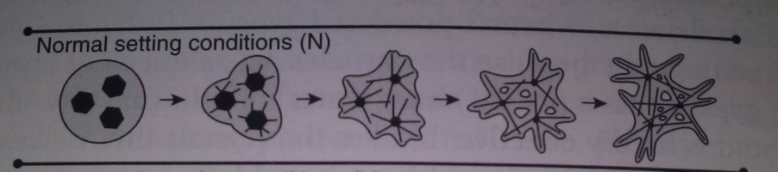
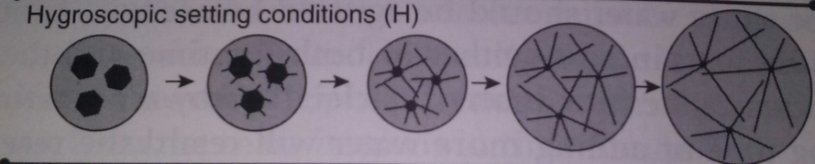
Difference between Normal & Hygroscopic setting expansion
Normal setting expansion when placed in air
Hygroscopic setting expansion

Slide 22
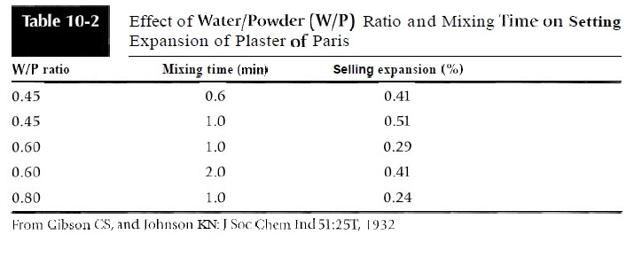
Lower the W/P ratio & a longer mixing time increases setting expansion, since these factors increases the nuclear density.
At higher W/P ratios, fewer nuclei of crystallization per unit volume are present than with that of lower W/P ratio.
In cases of higher W/P ratio inter-nuclear spaces will be more & there is lesser growth interaction of di-hydrate crystals resulting in lesser outward thrust.
The most effective method of controlling the setting expansion is by adding chemicals by the manufacturer.
Increased spatulation increases setting expansion.
Setting expansion can be reduced by adding Potassium Sulphate, Sodium Chloride or Borax.
Control of setting Expansion:

Slide 23
Q3) What are the types of gypsum products used in Dentistry? Describe the theories of setting reaction & various factors which affect the dimensional stability of dental stone.

Slide 24
A3) Types of gypsum products and their uses in various aspects of dentistry
Type I plaster / Impression plaster :
It is used making primary impression of edentulous oral cavity in complete denture fabrication. (It is now replaced by elastomers and hydrocolloids as they are less rigid materials)
It is composed of plaster of Paris and is colored and flavored to make them more acceptable for patient .
Few modifiers are added to regulate the setting time and expansion

Slide 25
Types of gypsum products and their uses in various aspects of dentistry (contd.)
Type II dental plaster (Model plaster)
It is used in producing study cast or primary cast
It is used to fill flasks during complete denture constructions
It is marketed in the natural white colour .
Requisites for a dental plaster
It should set fast but should have enough time for manipulation.
It should set to a very hard and strong mass.
It should neither expand nor contract appreciably.
It should not lose its strength when subjected to moulding and curing procedures

Slide 26
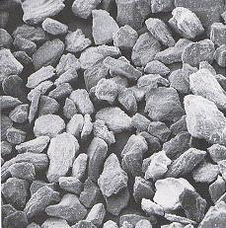
It is a β form of Calcium sulfate Hemihydrate
It has an irregular orthorhombic crystal shape with capillary pores and requires more water for hydration to get converted in calcium sulfate dihydrate
It should have a water powder ratio of 0.45 – 0.5

Slide 27
Types of gypsum products and their uses in various aspects of dentistry (contd.)
Type III Dental Stone:
It is an α – form of calcium sulfate hemihydrate which is used in making master cast
It is marketed as coloured powder or cement .
It is preferred for casts used to process denture as the stone has adequate strength and hardness and denture can be easily removed after processing
Requisites:
Same as that of dental plaster

Slide 28
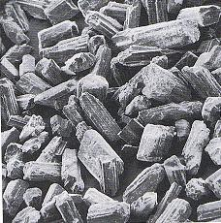
It is an α from of Calcium sulfate hemihydrate
It has a prismatic shape i.e. in the form of rods and prisms
When mixed with water dental stone sets as a harder mass than does the dental plaster due to its more dense and prismatic structure.
Gypsum calcined under high pressure produced a better quality crystals of calcium sulfate hemihydrate

Slide 29
Types of gypsum products and their uses in various aspects of dentistry (contd)
Dental Stone (High strength) {Type IV}
It is an α- hemihydrate of densite type with CUBOIDAL SHAPED CRYSTAL
Principal requisites
Hardness , Abrasion resistance , strength and minimal setting expansion
Hard surface is necessary for a die stone since the cavity preparation is filled with the wax that is carved flush with the margins of the die
Gypsum hardening solution , silver plating and other methods are used to increase the abrasion resistance
Also known Die Stone and High strength stone.

Slide 30
Types of gypsum products and their uses in various aspects of dentistry (contd)
Dental Stone {High strength and High expansion } Type V
The type V dental stone exhibit higher compressive strength than does type IV
This strength is achieved by making it possible to a lower water powder ratio upto 0.18 to 0.22
Setting expansion is increased from a minimum of 0.10 to 0.30 since a few base metal alloys have a greater tendency of shrinkage which is limited by expansion.
Its usage is contraindicated in production of die and inlays

Slide 31
Theories of Setting reaction :
Crystalline theory ( Dissolution precipitation theory)
Gel theory (Colloidal theory)
Hydration theory.

Slide 32
Crystalline theory:
This is based on the dissolution of plaster & instant recrystallization of gypsum followed by the interlocking of the crystals.
Mechanism:
When hemihydrate is mixed with water a fluid workable suspension is formed.
The hemihydrate dissolves until it forms a saturated soln.
This saturated hemihydrate soln. is super-saturated in di-hydrate and precipitates out di-hydrate.
As the di-hydrate precipitates, the soln. is no longer saturated with hemihydrate so the hemihydrate continues to dissolve.
Dissolution of hemihydrate & precipitation of di-hydrate proceeds as either new crystals form or grow occurs on the crystals already present. The reaction continues until no further precipitation of di-hydrate occurs out of the solution.

Slide 33
Gel theory
This theory proposes that when mixed with plaster, the plaster enters into the colloidal state through the sol-gel mechanism.
In the sol state the hemihydrate particles are hydrated to form di-hydrate, thereby entering into a active state.
As the measured amount of water is consumed, the mass converts into a solid gel.
Hydration theory
According to this theory the rehydrated plaster particles join together through H-bonding to the sulphate group to form the set material.

Slide 34
Factors affecting dimensionally stability of Dental Stone:
W/P Ratio
Method of Mixing
Manufacturing Process.

Slide 35
Q4) Classify Gypsum products and discuss about the tests for the setting of gypsum products.

Slide 36
Tests for setting of gypsum products
A4)
The tests done for setting of gypsum products are listed as below :
Loss of gloss test.
Gillmore’s test.
Vicat test for setting time.
Ready for use criterion.

Slide 37
Loss of gloss test
As the reaction proceeds, some of the water is taken up in forming the dihydrate so that the mix loses its gloss.
Cast can be safely recovered from the mould once the mix loses its gloss.
At this stage the mix will not have a measurable compressibility.

Slide 38
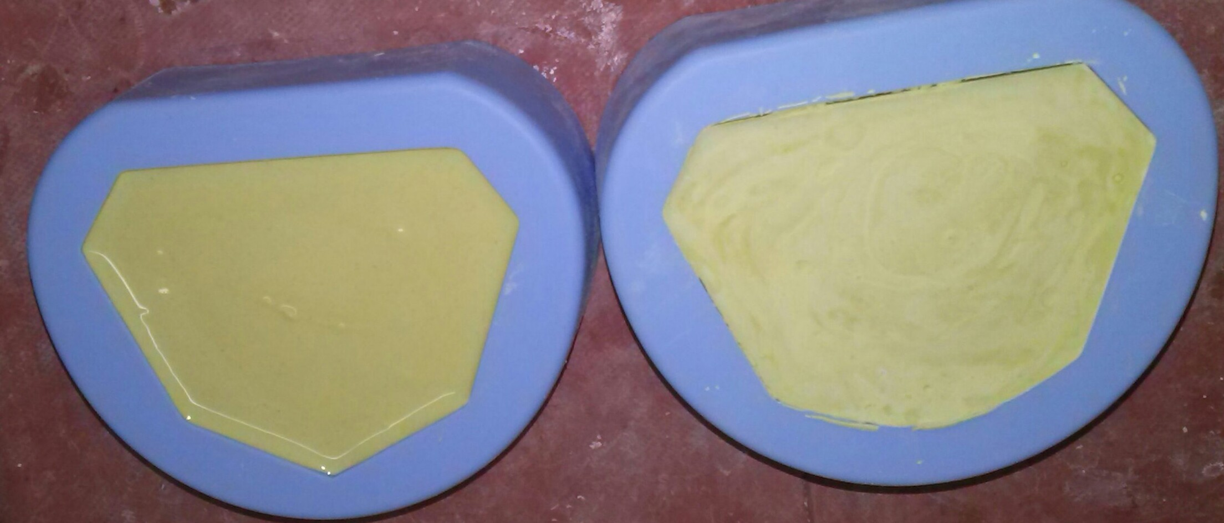

Slide 39
Gillmore’s test
Initial Gillmore’s Test | Final Gillmore’s test
Smaller needle is used to for initial set testing | Heavier needle is used for final set testing
Mixture is spread out and the needle is spread and the needle is lowered | The next stage in the setting process is measured by using heavier Gillmore’s needle
The time at which no longer leaves an impression is called INITIAL SET | The by which this needle leaves only a barely predictable mark o the surface is referred to as FINAL SET

Slide 40
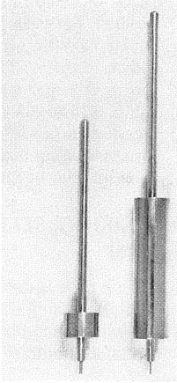
(A) Gillmore’s needle
used for initial setting
(B)
(A)
(B) Gillmore’s needle
used for final setting

Slide 41
Vicat’s test for setting time
After initial setting the further reaction is determined by an instrument called Vicat penetrometer .
The needle with a weighted plunger rod is supported and held just in contact with the mix
The time elapsed until the needle no longer reach the bottom of the mix is known as setting time
In some cases it may come along with Initial setting and some times may vary

Slide 42
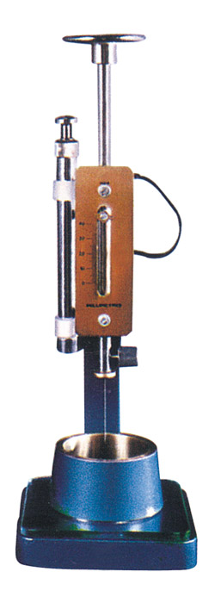
Vicat’s Apparatus

Slide 43
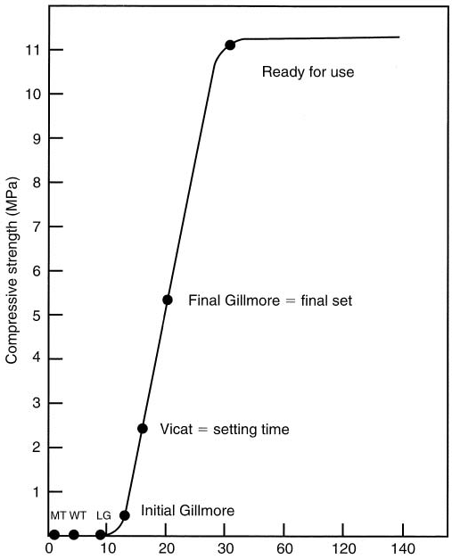

Slide 44
Proportioning, Mixing & Infection Control of gypsum products:
Proportioning :-
The strength of a stone is inversely proportional to the w/p ratio.
It is better to keep the amount of water as low as possible.
Once the optimum proportion is noted , the same must be used subsequently
An accurate graduated cylinder has to be used for water and a proper weighing balance for powder has to be used
Powder should NOT BE MEASURED USING SCOOP

Slide 45
Mixing
If the mixing has to be done by hand , the bowl must be parabolic , smooth and abrasion resistant
Spatula should have a stiff blade and a convenient handle
Stirring of the water powder during mixing has to be done more vigorously in order to avoid air entrapment
Wetting of all powder particles with water must be ensured

Slide 46
Water/powder ratios for gypsum model and die materials.
For hand mixing, a clean, scratch free rubber or plastic bowl having a top diameter of about 130 mm is normally recommended.
 | Water (ml) | Powder(g) | W/P ratio (ml/g)
Plaster | 50-60 | 100 | 0.55
Stone | 20-35 | 100 | 0.30
Theoretical ratio | 18.6 | 100 | 0.186

Slide 47
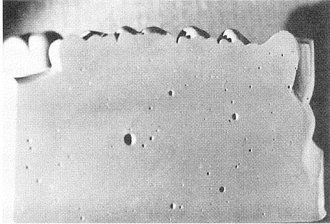
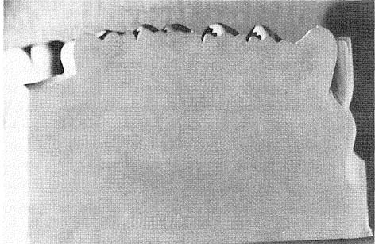
Improper mixing
Proper mixing

Slide 48
Caring for the cast
If the cast surface is not hard and smooth when removed from the mould , then its accuracy is questionable
Cast once set will maintain the dimensions relatively stable with changes in humidity and room temp.
But in few cases the cast has to be immersed in water , negligible expansion may occur ,if the water is saturated with calcium sulphate
The safest method of soaking the cast in water is to immerse the cast in water bath that contain plaster debris at the bottom of the container.

Slide 49
Infection control
There are chances of cross infection of HBV, HIV etc on clinicians due to impression which has lead to the idea of disinfection sprays and immersion techniques to disinfect the impressions and its effect on the surface of the cast
If the impression is not disinfected then the cast should be disinfected . This can be done using dental stone containing disinfectant
Commonly used stone disinfectants are spray disinfectants, hypochlorites and iodophores and gluteraldehyde

Slide 50
Ref. books and sources
Phillips science of dental materials
Craig’s restorative dental materials
Dental materials V.K.Subbarao
Internet
Under the guidance of Dr. Kalavathi Ma’am Dr. Sounder Raj Sir

Slide 51

A Presentation By :
Ajeya Ranganathan
Ansha Bharath
Anubhav Koul
Anvitha Prakash
Arpitha Lobo
Ashrith K Malalur
Nida Suroor
Thank You

Slide 52
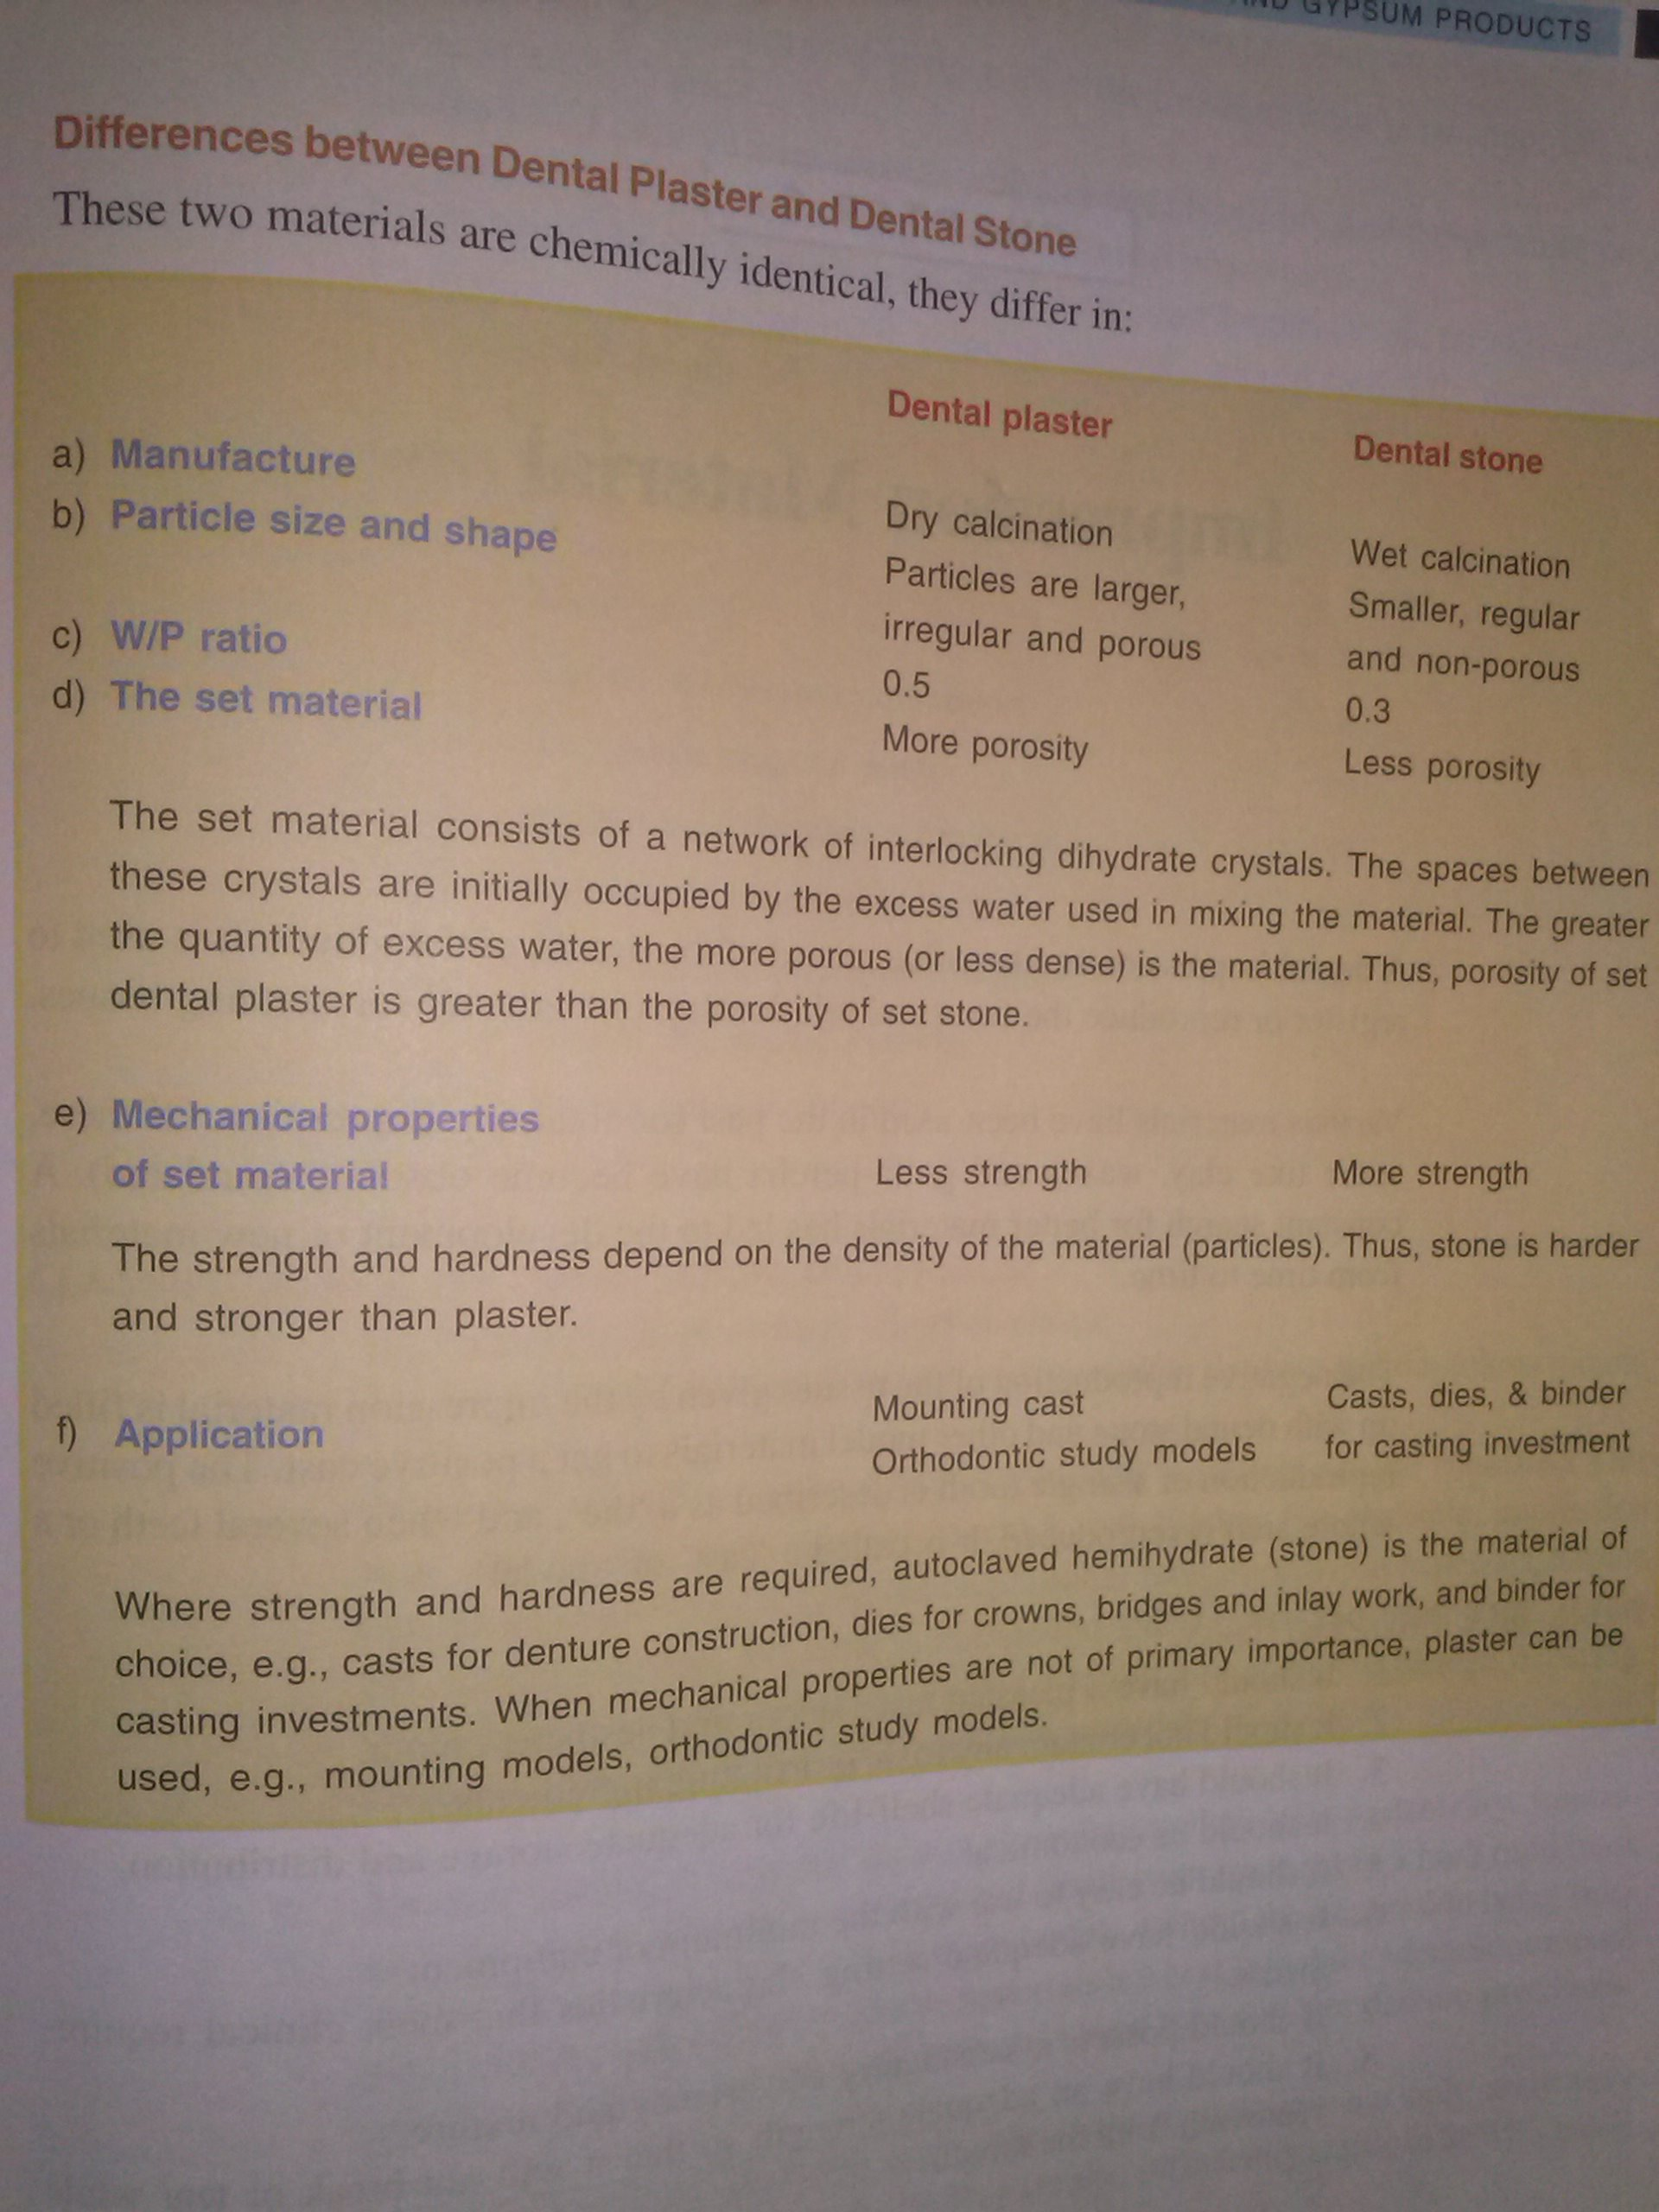

Slide 53
