Slide 1
OSS: a SWOT analysis
Eric Lease Morgan (emorgan@nd.edu)
University of Notre Dame
April 23, 2010

Slide 2

Much of my history

Slide 3
OSS is a qualified “free”
Free as in liberty, not necessarily gratis – We have licensed rights to run, modify, and distribute a program’s source code.
Free as a “free kitten” – There are costs involved in any software, both financial and emotional.

Slide 4
OSS is about community
While OSS may begin with “scratching an itch”, it is sustained by the building of communities. Like stone soup, everybody contributes a little something and we all go away with something much greater.

Slide 5
Support is the biggest challenge
The creation and maintenance of a community to support software is probably the biggest challenge – more difficult than writing code. This is true because there are no hard-and-fast rules regarding the issues of governance.

Slide 6
OSS strengths
It benefits from the numbers game – Chances are there is somebody out there with your particular interests. The Internet makes that happen.
There is plenty of choice – Many people are trying to scratch the same “itches”.

Slide 7
OSS weaknesses
Support is its biggest weakness – The people who write the software are not necessarily the best people to provide assistance.
OSS requires specialized skills – Not everybody can do everything. Skills represent limited resources.
Institutions change slowly – Change takes time and it often makes people nervous.

Slide 8
OSS opportunities
Low barrier to entry – Computer hardware is cheap, and the software is “free”.
Only limited by one’s time, imagination, and ability to think systematically – OSS is like a hunk of unshaped clay. Build the thing that is in your mind.

Slide 9
OSS threats
Established institutions – The status quo is threatened by OSS. They are human too, and their reactions come across as FUD.
Past experience – The profession’s leadership liken OSS with the “homegrown” systems of yesterday. Perceptions are slow to change.

Slide 10
“Next Generation” library catalogs
Library catalogs are and have been essentially inventory lists, but given the current environment, the problem to be solved is not find and access but use and understand.

Slide 11
Indexes, not databases
The way to find is through the use of indexes, not databases. Databases are great at creating and maintaining content. Think catalogs. Indexes are great search. Think Solr.

Slide 12
TFIDF
A simple formula
score = ( c / t ) * log( d / f )
where
  c - number of times a word is found in a document
  t - number of words in a document
  d - number of documents in a corpus
  f - number of documents containing the word

Slide 13
Digital full text
The availability of digital full text provides a host of opportunities for libraries to go beyond find and move towards use – services against texts. The root of these services grows on the ability to count the words in any set of documents.

Slide 14
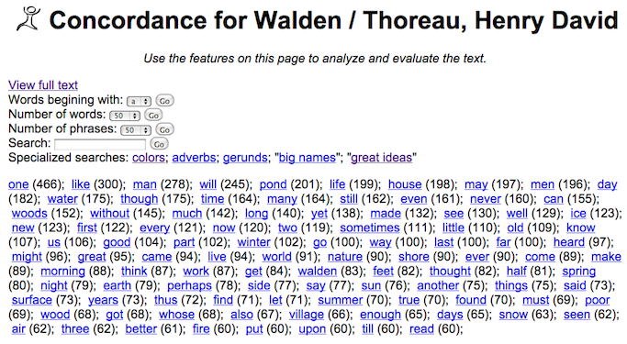
Most commonly used words
http://tinyurl.com/yjvvtj5

Slide 15
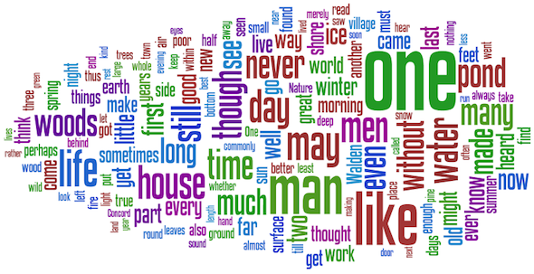
Pretty word cloud

Slide 16
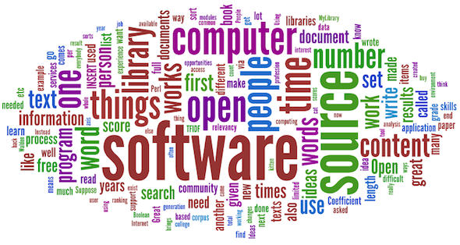
Word cloud of this presentation

Slide 17
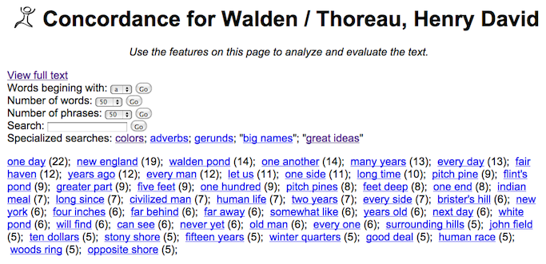
Most common two-word phrases
http://tinyurl.com/yfznuhv

Slide 18
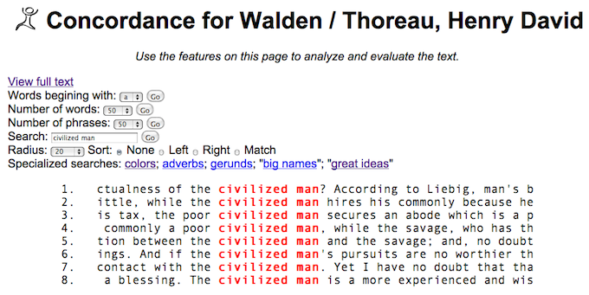
Simple concordance
http://tinyurl.com/yc8u659

Slide 19
Great Ideas Coefficient
Create a list of “great ideas”
Compute TFIDF for each idea in a text
Sum the scores; associate them with the text
Go to Step #2 for each text in a corpus
Search the corpus for items of interest
Compare & contrast the result

Slide 20
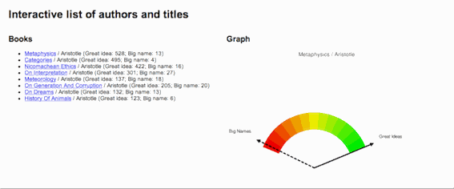
Great Ideas in Aristotle
http://tinyurl.com/yjscquj

Slide 21
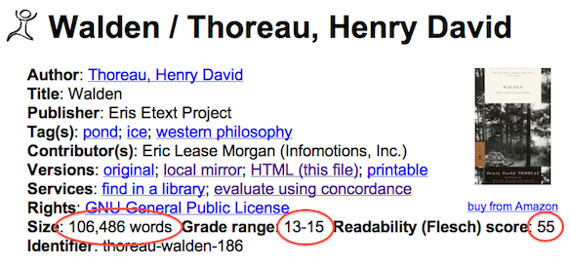
Additional numeric metadata
http://tinyurl.com/yalpuoo

Slide 22
Analyze and visualize the metadata
Once content is described numerically, it can be analyzed mathematically. Plot the content on graphs. Compare length to great ideas. Compare reading levels with dates published. Ask questions of the texts and answer them with the numeric evidence. These are types of services against texts. Remember, “Save the time of the reader” and “Books are for use.”

Slide 23
The End
“Thank you for the opportunity to share some of my ideas with you.”
Eric Lease Morgan (emorgan@nd.edu)
University of Notre Dame

