Slide 1
Lab2: Multiply Accumulation Unit Design with SystemC
Machine Learning Intelligent Chip Design
2024 Spring

Slide 2
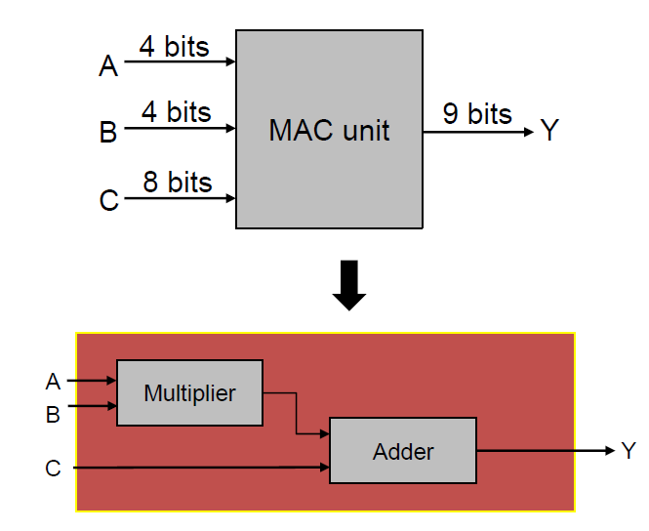
Introduction
Design a multiply accumulate unit
𝑌=𝐴×𝐵+𝐶

Slide 3
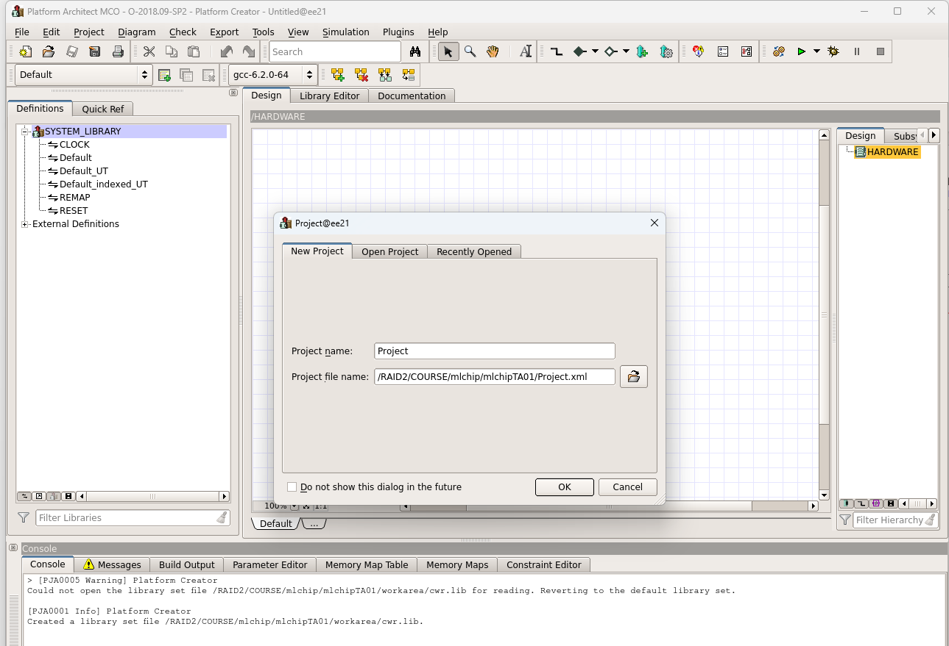
Environmental preparation
cp /RAID2/COURSE/mlchip/mlchipTA01/sharing/lab2.zip .
unzip lab2.zip
source /RAID2/cad/synopsys/CIC/pa_virtualizer.cshrc
pct &

Slide 4
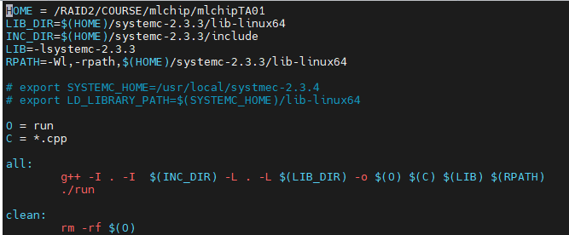
SystemC
Source file
xxx.h
xxx.cpp
Main.cpp
Makefile
Compile the source file

Slide 5
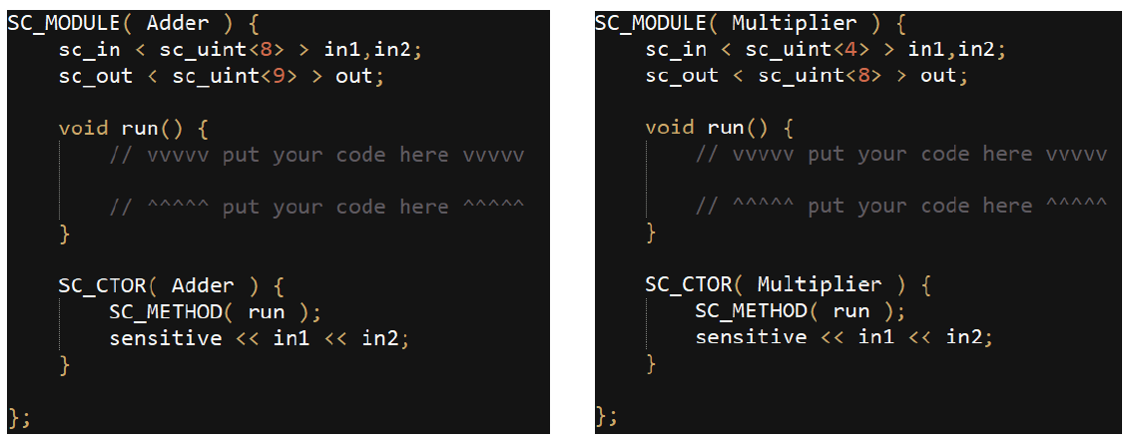
SystemC
Edit your source code by editor (e.g., notepad++,…)
MAC.h

Slide 6
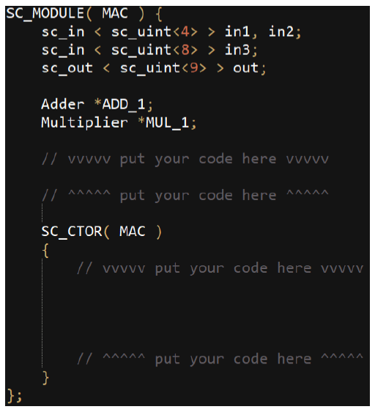
SystemC
Edit your source code by editor (e.g., notepad++,…)
MAC.h

Slide 7
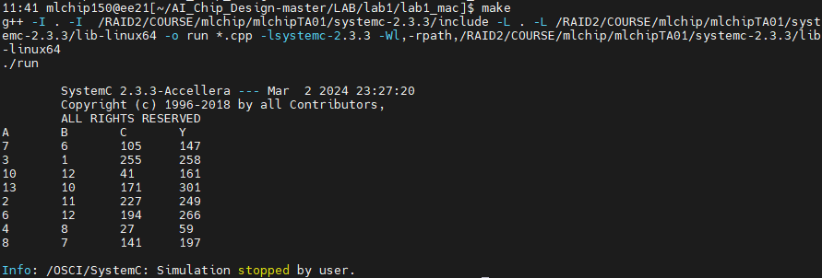
Build & Run
cd < file path >
%make

Slide 8
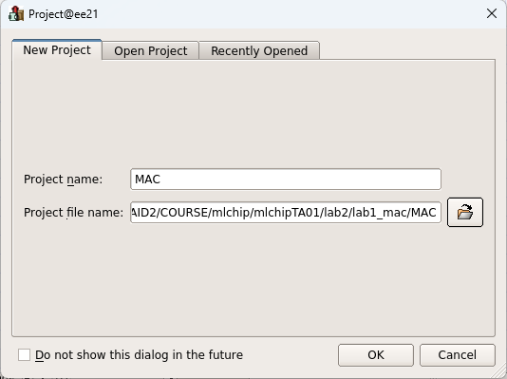
Platform Architect
Create project -> Project name -> Project file name -> OK

Slide 9
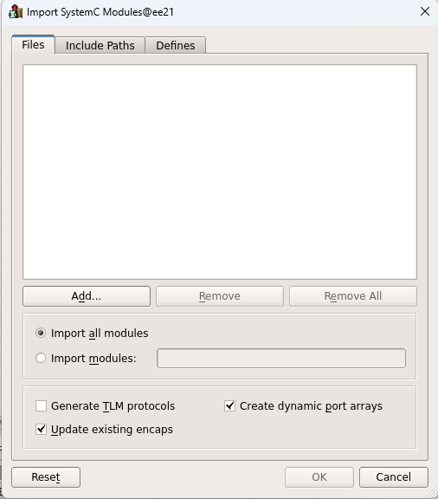
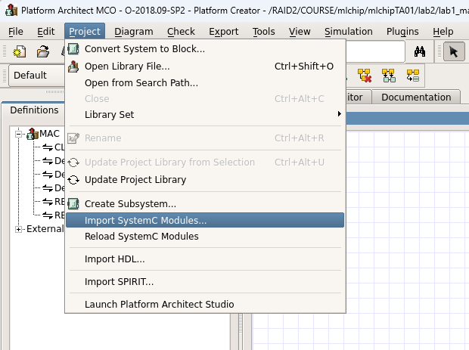
Platform Architect
Import SystemC Modules -> Add

Slide 10
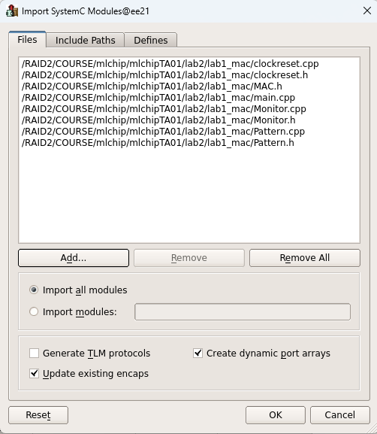
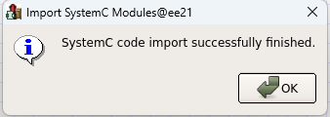
Platform Architect
Choose the source file -> OK

Slide 11
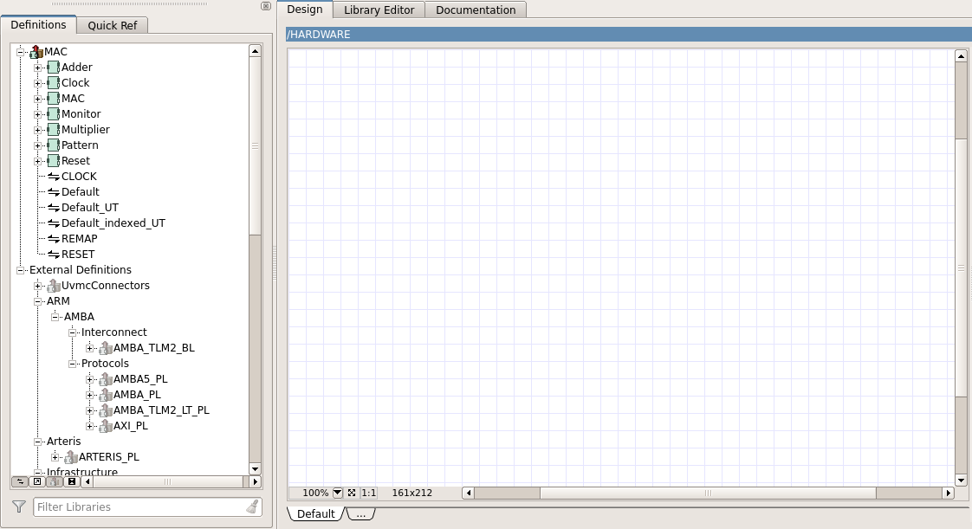
Platform Architect
Hardware block
IP Library

Slide 12
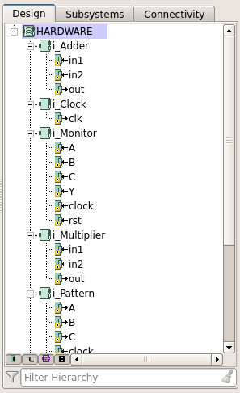
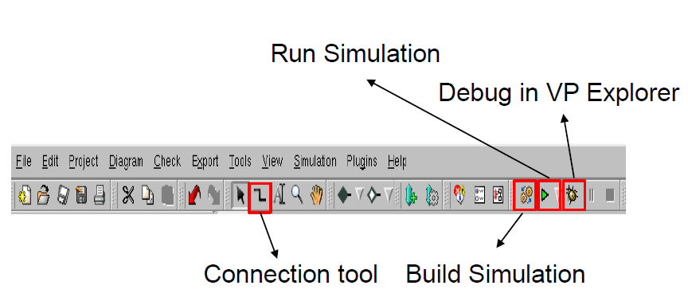
Platform Architect

Slide 13
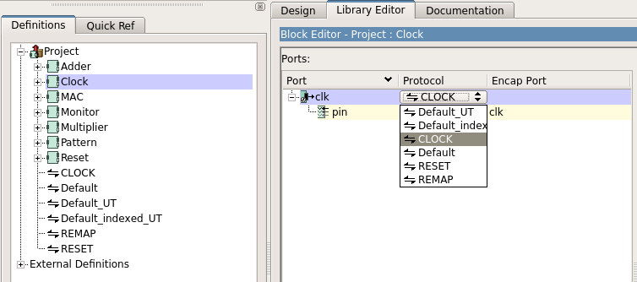
Platform Architect
Change protocol of clock port
Double click Clock -> Click Default -> Choose CLOCK

Slide 14
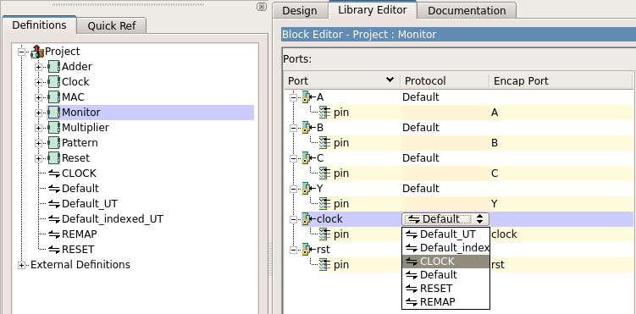
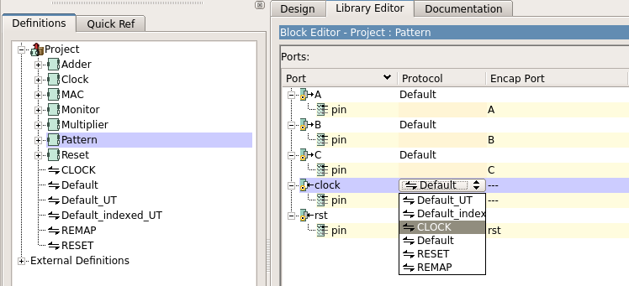
Platform Architect
Repeat the same action to change the clock protocol of Pattern and Monitor block

Slide 15
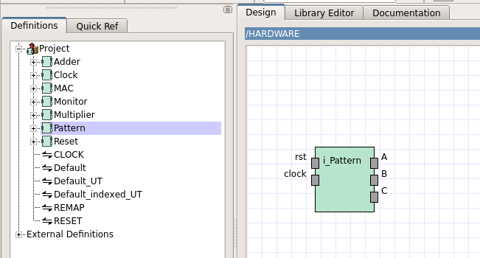
Platform Architect
Create the block
Click and drag to the design window

Slide 16
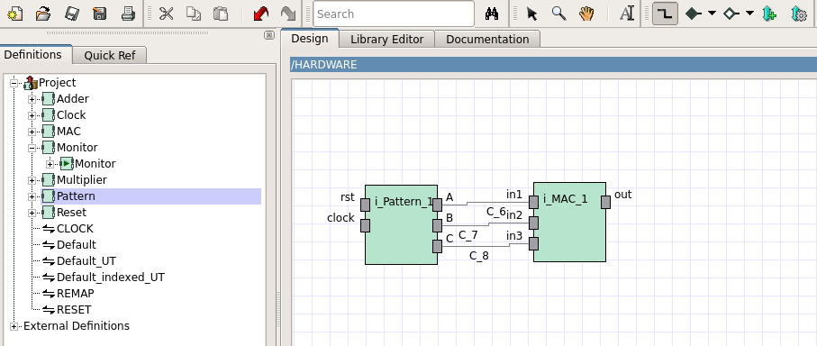
Platform Architect
Use connection tool to connect the block

Slide 17
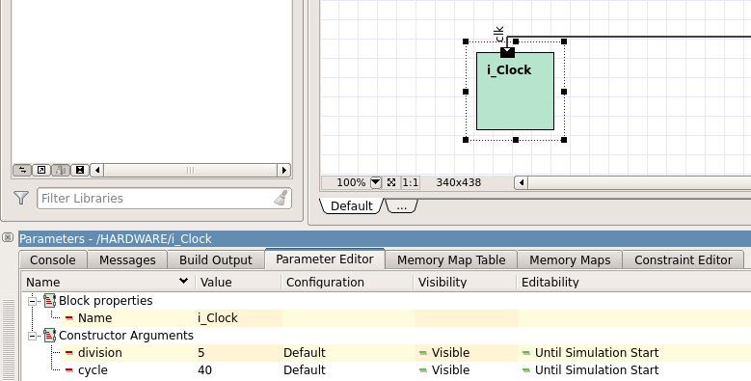
Platform Architect
Click Clock block -> Set clock period
division -> 5
cycle -> 40

Slide 18
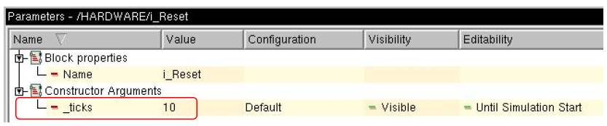
Platform Architect
Click Reset block -> Set reset period
_ticks -> 10

Slide 19
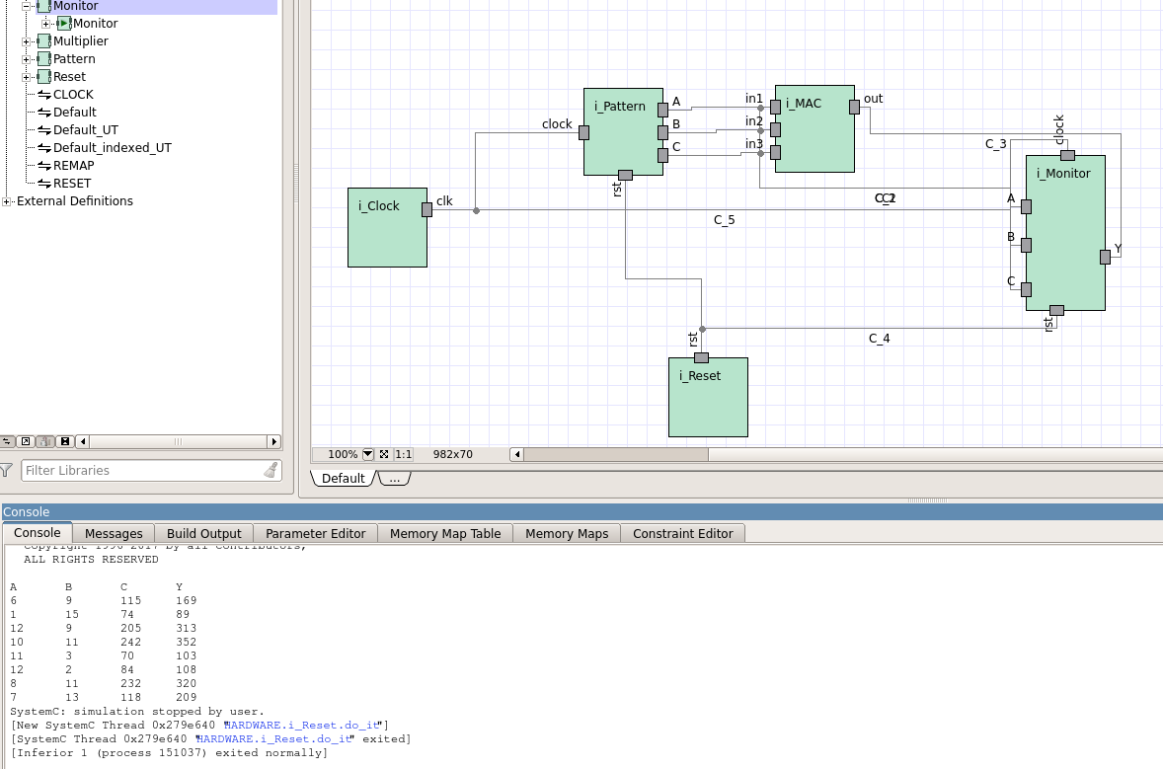
Platform Architect
Console
Show the simulation result

Slide 20
Lab Requirement
Complete MAC unit.
Use Platform Architecture to simulate output result.
Upload screenshots of simulation results and module connection to E3@NYCU

