Slide 1
A Thorough Analysis of RL models plus self-attention DQN based on Atari’s Space Invader
Yu-Chen Lin 705315195
Jo-Chi Chuang 005350427
Adrian Hsu 405331564
Po-Chun Yang 605297984
Yu-Chi Lee 705331666

Slide 2
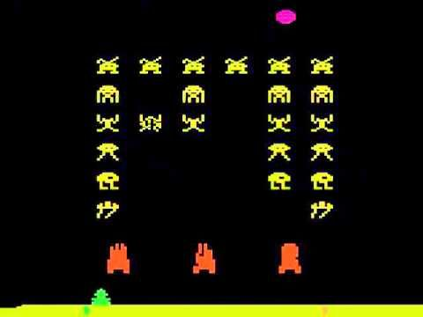
Abstract
In our project, we will adopt the classic Atari game space invader, where players use a craft to explore the space and defeat enemies in the space. In this project, we proposed a new DQN architecture called Self-Attention DQN that combine the attention techniques with current DQN model. We also analyze Self-Attention DQN and compare it with DQN, double DQN, and dueling DQN.

Slide 3
Background
Reinforcement Learning
Q-learning
Deep Q Network (DQN)
Double DQN
Dueling DQN
Self-Attention

Slide 4
Background - Reinforcement Learning
Machine learning techniques can be separated into 3 different categories -
1. supervised learning
2. unsupervised learning
3. reinforcement learning
For reinforcement learning, the learning models will continuous adjusted itself by interacting with the environment to achieve a goal or simply learning from reward and punishments.

Slide 5
Background - Reinforcement Learning (conti.)
Elements of Reinforcement Learning
Agent
Action
State
Reward
Policy
Value
Notes:
Action: all the possible moves that the agent can make
State: current situation returned by the environment or the state/situation where an agent is operating now.
Reward: feedback from the environment when the work is done
Policy: agents’ strategy to determine the next action based on the current state
Value: expected future reward that an agent would receive by taking action in a particular state/states

Slide 6
Background - Q-learning
Q-learning is a basic form of Reinforcement Learning which uses Q-values to iteratively improve the behavior of the learning agent.
In Q-learning, we start to consider the quality of an action that is taken to move to a state. We will have the following equation to update the Q-value.
where Q_{t}(s, a) is the new Q-value and Q_{t-1}(s, a) is the old Q-value. R is the reward function. Alpha is the learning rate of Q-learning and gamma is the discount factor.
Notes:
Gamma is

Slide 7

Background - DQN
In the environment where the number of states outnumber the capacity of contemporary computers, RL might not be applicable.
Replace the huge table with Deep Neural Network.
In the neural network, environment states are mapped to Agent actions.
learning is conducted during training phrase of this neural network.
In DQN, the Q-learning use the following loss function to update

Slide 8



Background - Double DQN
Problem of DQN: Q-learning is known for its overoptimism on value estimation
Solution: Double DQN - two Q networks
Separate selection and target
d : selection network. I : target network
Double DQN can be used to succesfully reduce the overestimation problem.

Slide 9
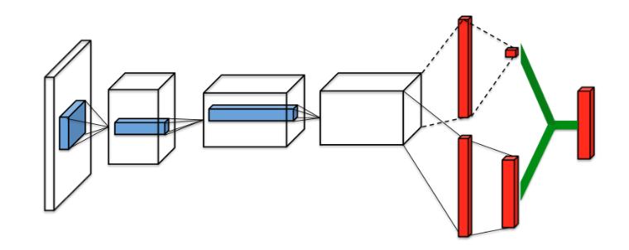



Background - Dueling DQN
New Architecture: dueling architecture
DQN: Unnecessary to know the value of each action at every timestamp
Architecture changes: split the network into two streams after convolution layers
: a scalar. Estimating the state-value
: a vector. Estimating the state-dependent action advantages
More effective to update Q-value.

Slide 10
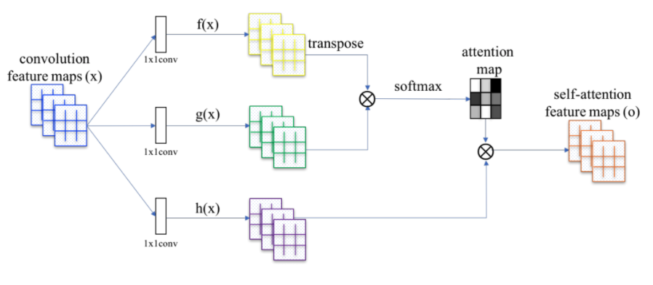
Background - Self Attention
Self-Attention is simply a vector, often the outputs of dense layer using softmax function. With self attention, the machine can look over all the information in the input data, and generate the output based on current input date and the context.

Slide 11
Self-Attention: Design
In order to implement self-attention, we perform convolution with kernel size = 1, padding = 1 to generate 3 tensors: f(x), g(x) and h(x).
We do `matmul` operation on f and g, and then after we generated the attention map, we then again do `matmul` on h and the map. Finally we got our self-attention map o.

Slide 12
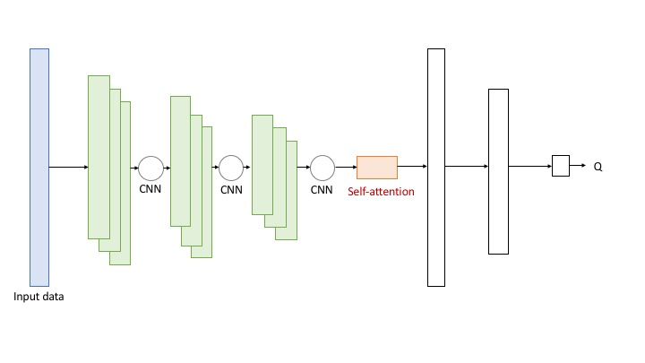
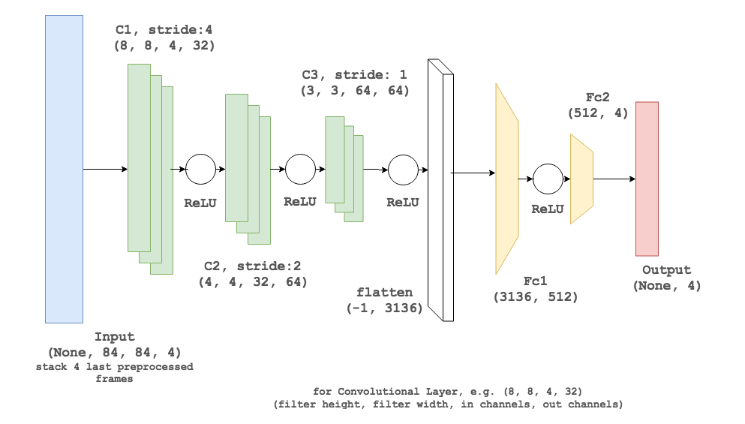
Synthesize Attention Mechanism with DQN
Self-attention calculates the response at a position in a sequence by attending to all positions within the same sequence.
We added an self-attention layer after the last CNN layer and before the FC layer
Before
After

Slide 13
Experimental Setting
Hardware
CPU: AMD Ryzen 7 1700Eight-Core Processor
GPU: GeForce GTX 1080 Ti
Memory: 16GB
Software
Tensorflow: 1.6.0
Python: 3.6.4
Compare Q-value, average rewards, and loss value of the following architectures
DQN
Double DQN
Dueling DQN
Attention DQN

Slide 14
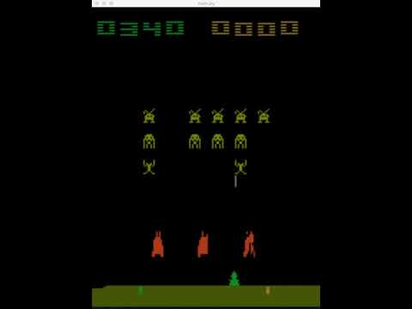
Demo

Slide 15
Results
We use three metrics to evaluate our results:
Q-value
Average rewards
loss
We tested the following four models:
DQN
Double DQN
Dueling DQN
Self-Attention DQN

Slide 16
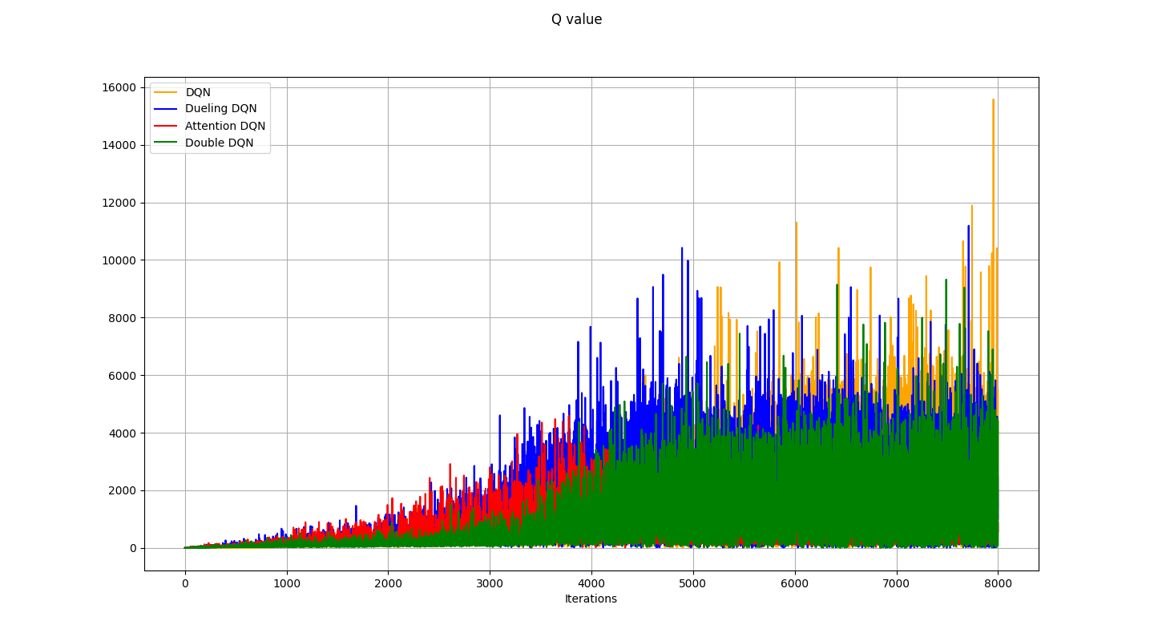
Q-value

Slide 17
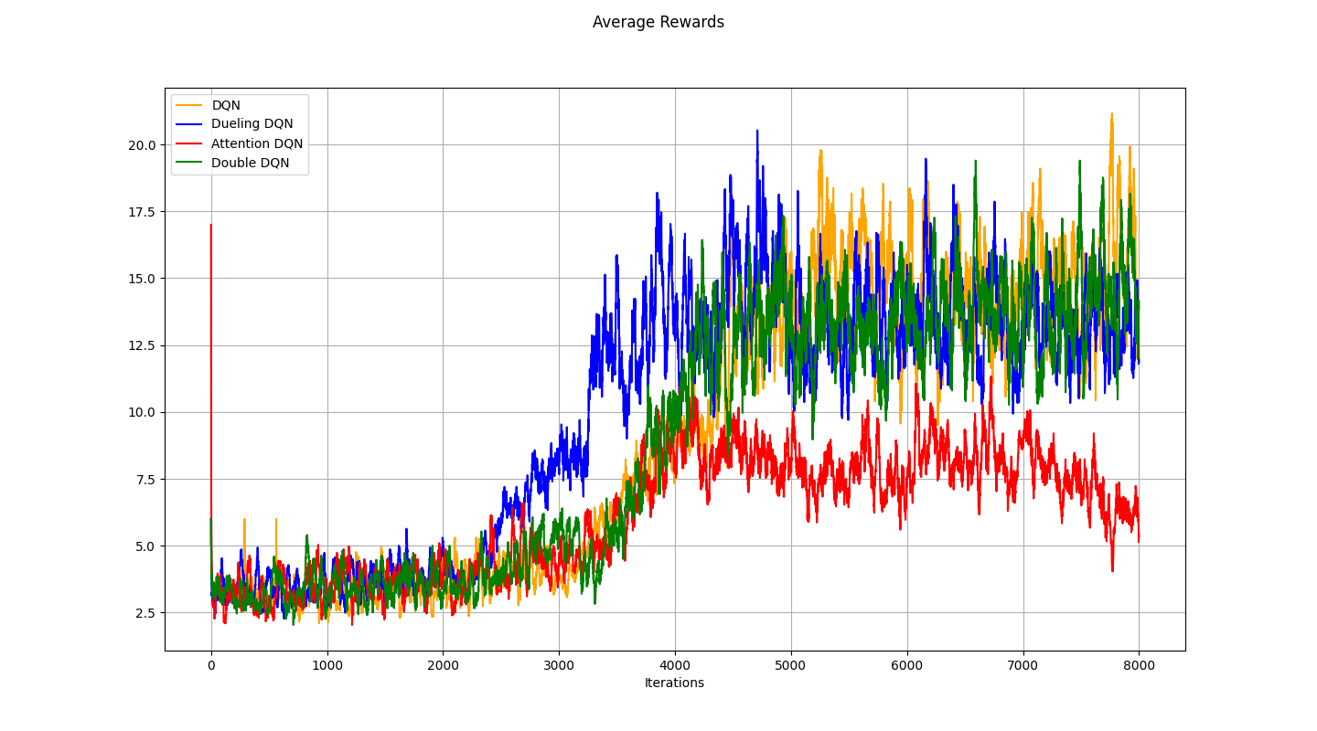
Average Rewards

Slide 18
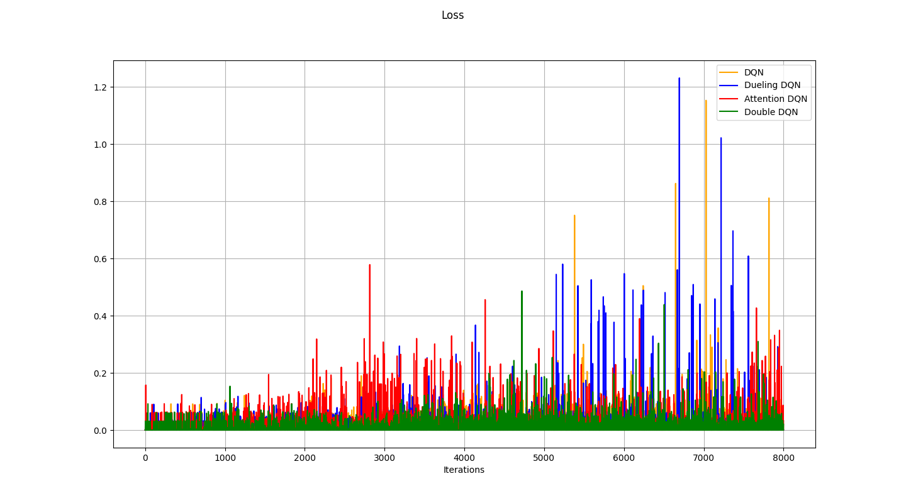
Loss

Slide 19
Conclusion
Self-Attention DQN can learn faster than other models.
Self-attention layer can help the DQN model learn from the whole environment rather than local region.
In the future, we might use attention to build a image model or even video model that could extract information across different time.

