Slide 1
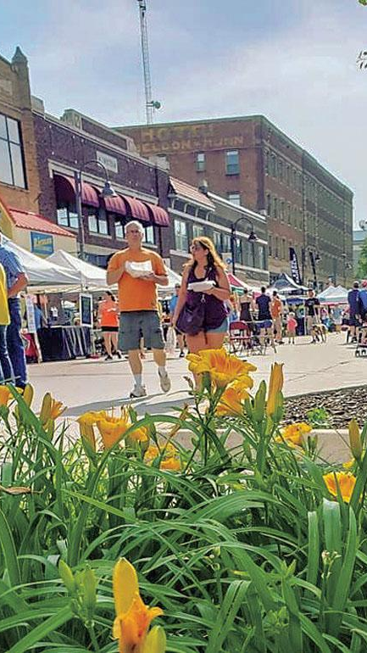


House Price Predictions Ames, IA
Little Deuce
Eric Lundy
Jill Cheney

Slide 2

Ames, IA
Location: Central Iowa
Population: 59K (2010 Census)
Median household income: 46132 USD
Poverty rate: 28.4%
Crime: below national & state averages
Landmarks:
Iowa State University (~28K)
Ames Laboratory (US DoE National Lab)
USDA’s Agricultural Research National Animal Disease Center (NADC)
2010: ranked 9th on CNN Money’s ‘Best Places to Live’

Slide 3
Goals of Kaggle Competition
To predict the sales price for each house
Performance evaluated on Root-Mean-Squared-Error (RMSE)

Slide 4

Methodologies
Method 1: Parsimonious Approach
Focus: Explainable model
How much can be explained by how little?
Target: 10 to 15 features
Method 2: Predictive Accuracy Approach
Focus: Predictable model with minimized RMSE
What combination of features provides the most explanatory power?
No constraints on feature numbers
Outlier Approach

Slide 5
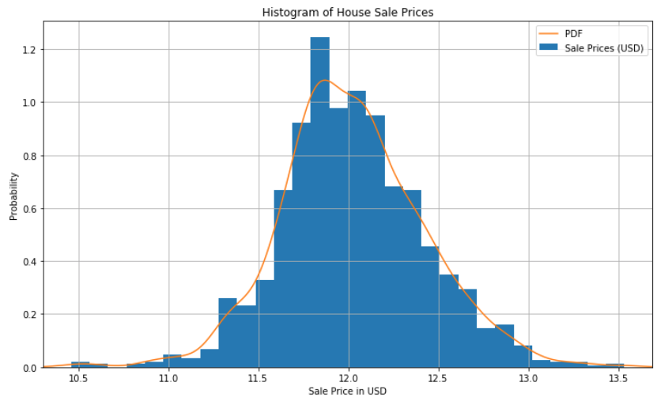
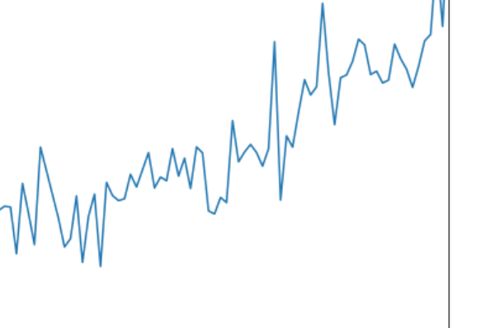
Method 1: Parsimony
What home buyers seek……
Well-maintained home
As much square footage as is affordable
Garage desirable
Storage
4 season location
Basement desirable
Storage
Storm cellar

Slide 6
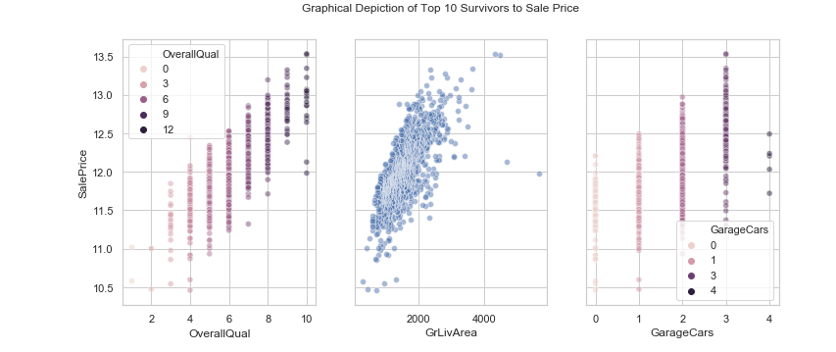
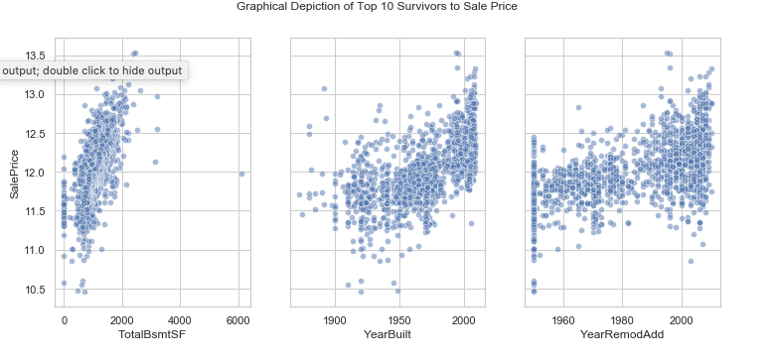
Exploratory Data Analysis
Evaluate top 10 correlated features to price
OverallQual: Overall quality of the house
GrLivArea: square footage at & above ground level
GarageCars: number of cars garage supports
TotalBsmtSF: total square footage of basement
FullBath: number of full baths in house
YearBuilt: year house was built
YearRemodAdd: year house was remodeled
GarageArea: square footage of garage
1stFlrSF: square footage of first floor
GarageYrBlt: year garage was built

Slide 7
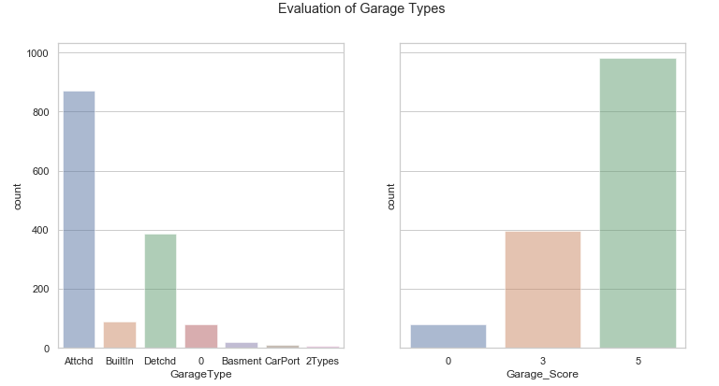
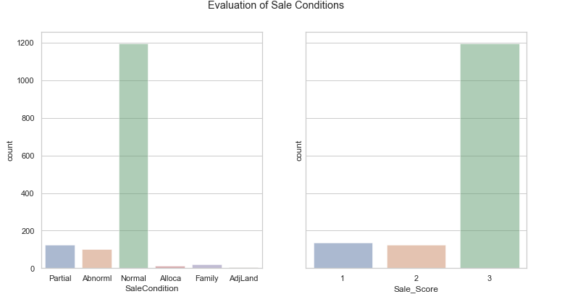
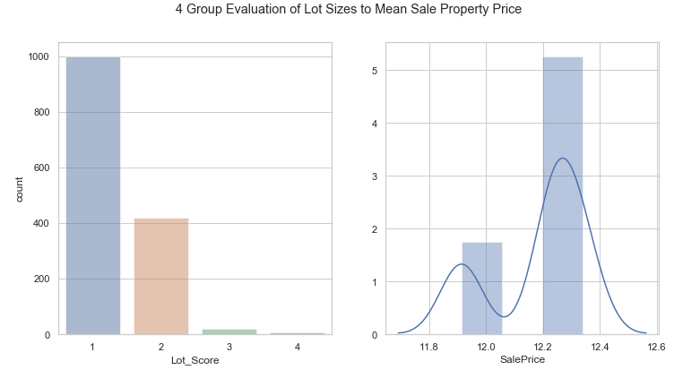
Additional Supporting Features
Bathroom Comparison (Full & Half)
Quality of House Elements
Exterior
Kitchen
Sale Condition
Lot Size
Building Type

Slide 8
Results: Method 1
Model (# Var) | RMSE | R2 | Adj R2
7 – Survivors | 26,057 | 0.842 | 0.814
7 – Bath Swap | 26,062 | 0.842 | 0.813
9 - Qualities | 25,982 | 0.843 | 0.815
8 – Garage | 25,558 | 0.848 | 0.821
10 – Sale/Lot | 23,816 | 0.868 | 0.844
12 – Bldg | 23,812 | 0.868 | 0.844
Linear Regression
Ridge Regression
Lasso Regression
Kaggle Score: 0.1618

Slide 9
Method 2: Predictive Accuracy

Slide 11

Extra Stuff

Slide 12

Excluded Variables
Neighborhood - Schools
Garage SF
Garage Condition
Heating
Central Air
Electrical
Kitchen Quality
Exterior Condition
Basement Quality
Basement Condition
Roof Material

Slide 13
Way Forward
Linear Regression Model
Variables: GrLivArea, YearBuilt, OverallQual
Initial Results
RSME 57,365
R-Squared .452
Current First place
RSME .00044
Decision Tree/Random Forest
Expand Considered Variables
Categorize variables
Create ranked lists of non-numerical variables
Notes:
Year built with buckets
Heating Quality
Porch (Y/N variable only)
Proximity to desirable features

Slide 14

Exploratory Data Analysis
Evaluate top 10 correlated features to price
OverallQual: Overall quality of the house
GrLivArea: square footage at & above ground level
GarageCars: number of cars garage supports
TotalBsmtSF: total square footage of basement
FullBath: number of full baths in house
YearBuilt: year house was built
YearRemodAdd: year house was remodeled
GarageArea: square footage of garage
1stFlrSF: square footage of first floor
GarageYrBlt: year garage was built
Evaluate remaining for supporting features

Slide 15
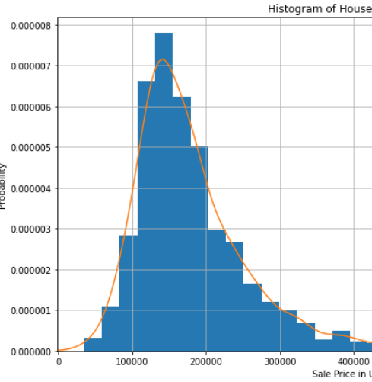
Sale Price Distribution
Mean: 180K ish
Median:
Mode:
Year built with buckets
Heating Quality
Porch (Y/N variable only)
Proximity to desirable features

Slide 16
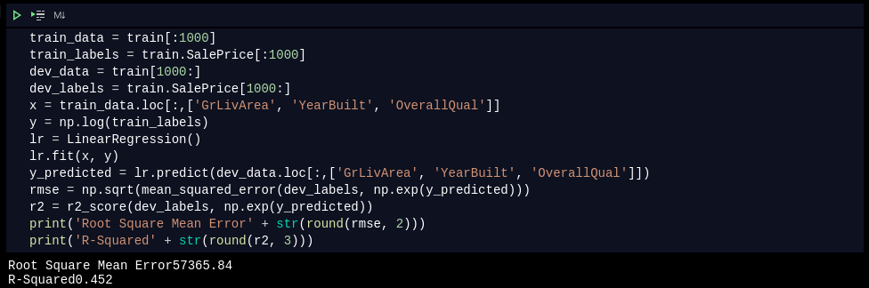
Initial Results Code

Slide 17
Technical References
https://towardsdatascience.com/regression-an-explanation-of-regression-metrics-and-what-can-go-wrong-a39a9793d914
Pix:
https://financebuddha.com/blog/tax-benefits-owning-multiple-houses/
https://www.nuviewtrust.com/self-directed-regulation-d-real-estate-fund-investments/
https://bks-partners.com/insights/capture/

Slide 18
0…………………..
https://www.census.gov/quickfacts/fact/table/amescityiowa/INC110218
https://www.census.gov/quickfacts/fact/table/amescityiowa/INC110218
https://data.bls.gov/timeseries/LASST190000000000005?amp%253bdata_tool=XGtable&output_view=data&include_graphs=true
https://www.areavibes.com/ames-ia/crime/

