Slide 1
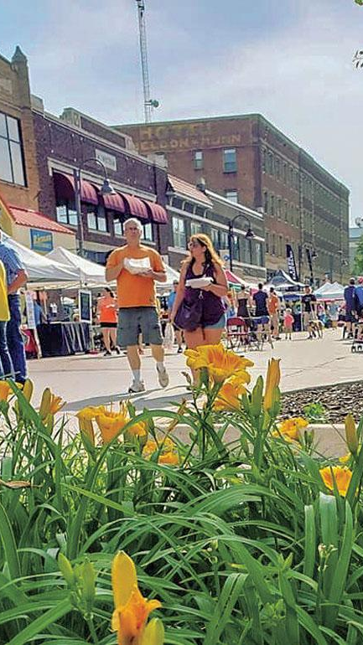


House Price Predictions Ames, IA
Little Deuce
Eric Lundy
Jill Cheney

Slide 2
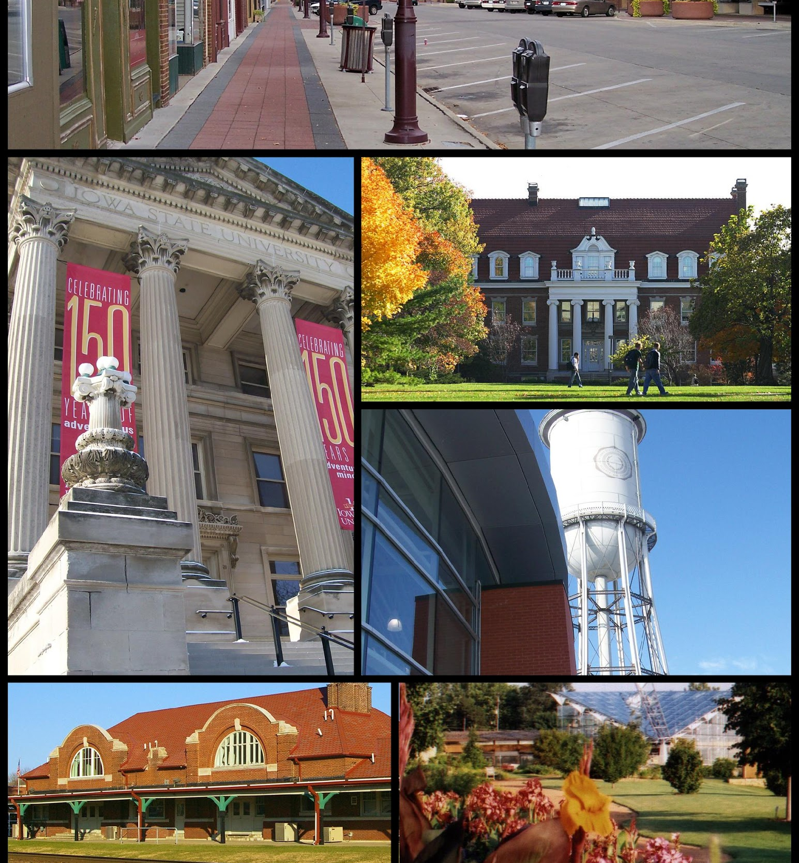
Ames, IA
Location: Central Iowa
Population: 59K (2010 Census)
Median household income: 46132 USD
Poverty rate: 28.4%
Crime: below national & state averages
Landmarks:
Iowa State University (~28K)
Ames Laboratory (US DoE National Lab)
USDA’s Agricultural Research National Animal Disease Center (NADC)
2010: ranked 9th on CNN Money’s ‘Best Places to Live’

Slide 3
Goals of Kaggle Competition
To predict the sales price for each house
Performance evaluated on Root-Mean-Squared-Error (RMSE)
“Submissions are evaluated on Root-Mean-Squared-Error (RMSE) between the logarithm of the predicted value and the logarithm of the observed sales price. (Taking logs means that errors in predicting expensive houses and cheap houses will affect the result equally.)”

Slide 4

Methodologies
Method 1: Parsimonious Approach
Focus: Explainable model
How much can be explained by how little?
Target: 10 to 15 features
Method 2: Predictive Accuracy Approach
Focus: Predictable model with minimized RMSE
What combination of features provides the most explanatory power?
No constraints on feature numbers
Outlier Approach

Slide 5
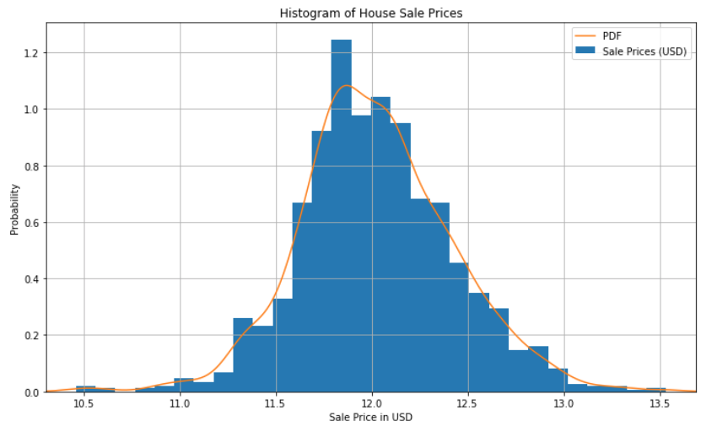
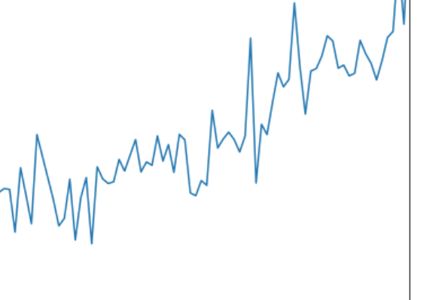
Method 1: Parsimony
What home buyers seek……
Well-maintained home
As much square footage as is affordable
Garage desirable
Storage
4 season location
Basement desirable
Storage
Storm cellar

Slide 6
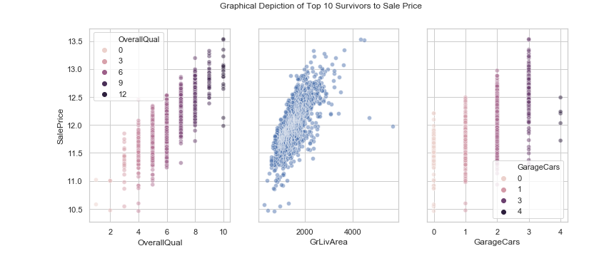
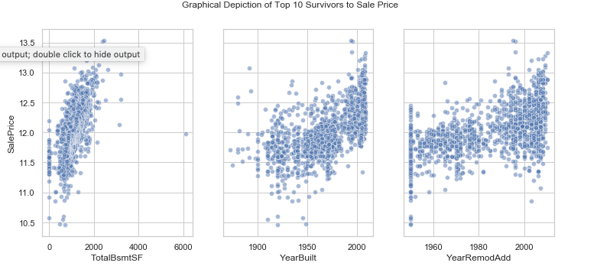
Exploratory Data Analysis
Evaluate top 10 correlated features to price
OverallQual: Overall quality of the house
GrLivArea: square footage at & above ground level
GarageCars: number of cars garage supports
TotalBsmtSF: total square footage of basement
FullBath: number of full baths in house
YearBuilt: year house was built
YearRemodAdd: year house was remodeled
GarageArea: square footage of garage
1stFlrSF: square footage of first floor
GarageYrBlt: year garage was built

Slide 7
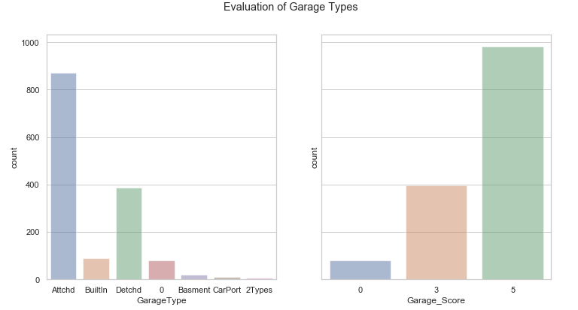
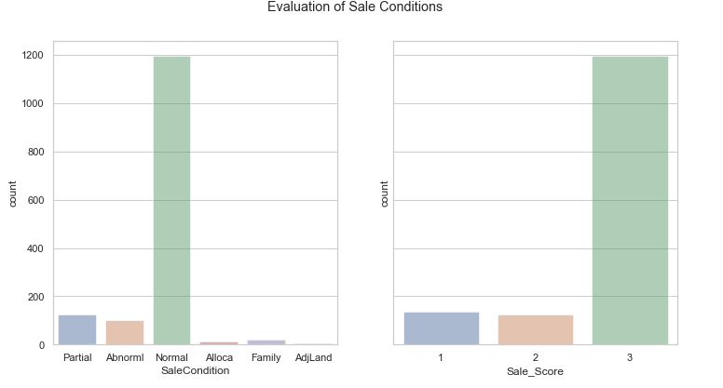
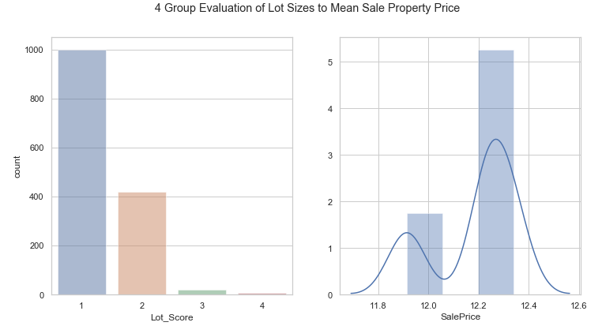
Additional Supporting Features
Bathroom Comparison (Full & Half)
Quality of House Elements
Exterior
Kitchen
Sale Condition
Lot Size
Building Type

Slide 8
Results: Method 1
Model (# Var) | RMSE | R2 | Adj R2
7 – Survivors | 26,057 | 0.842 | 0.814
7 – Bath Swap | 26,062 | 0.842 | 0.813
9 - Qualities | 25,982 | 0.843 | 0.815
8 – Garage | 25,558 | 0.848 | 0.821
10 – Sale/Lot | 23,816 | 0.868 | 0.844
12 – Bldg | 23,812 | 0.868 | 0.844
Linear Regression
Ridge Regression
Lasso Regression
Kaggle Score: 0.1618

Slide 9
Method 2: Predictive Accuracy

Slide 10
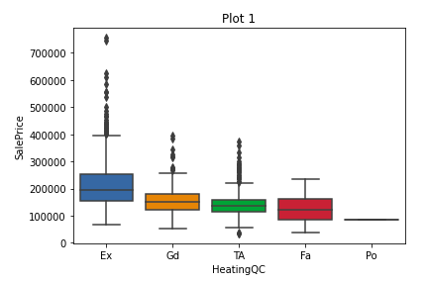
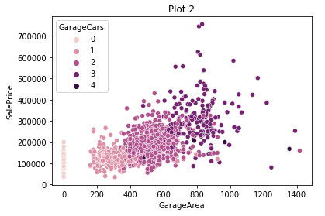
Looking at the data
Boxplots show if there is a difference in SalePrice for categorical variables
Scatterplots can visually show the relationship between numeric values

Slide 11
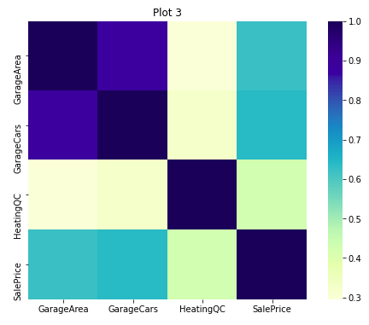
Pearson Correlation
Identify all potential variables correlated to SalePrice
See how variables relate to one another
Remove variables with high correlation. This will reduce multicollinearity
Reduced 80 variables to 25
Back up to 48 after creating dummy variables

Slide 12
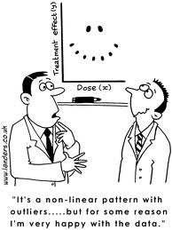

Model Comparison
Visually selecting far out performed our base model
Adj R2 of .89 mean the model does a good job explaining the variability in the data.

Slide 13
ElasticNetCV
Lasso L1 - penalizes the sum of the abs of coefs (may set coefs to zero)
Ridge L2 - penalized sum of squared coefs
Elastic Net - Combines Lasso and Ridge
started with 80 and 212 with dummy variables
25 selected variables to 59 Elastic Net variables
48 with dummies to 95 with dummy variables
4 out of 25 variables were not used by Elastic Net
LowQualFin SF, Alley, Electrical, SaleCondition

Slide 14


Model Comparison
Had a lower R2 value but higher Kaggle Score
Elastic Net CV had the best overall Kaggle score

Slide 15
Main takeaways
Reproducibility: train_test_split(train_data, train_labels, test_size=0.2)
Not cheating is hard (continually running on test data in kaggle)
The model is pretty smart but the less is more approach is probably better

Slide 16

Extra Stuff

Slide 17

Excluded Variables
Neighborhood - Schools
Garage SF
Garage Condition
Heating
Central Air
Electrical
Kitchen Quality
Exterior Condition
Basement Quality
Basement Condition
Roof Material

Slide 18
Way Forward
Linear Regression Model
Variables: GrLivArea, YearBuilt, OverallQual
Initial Results
RSME 57,365
R-Squared .452
Current First place
RSME .00044
Decision Tree/Random Forest
Expand Considered Variables
Categorize variables
Create ranked lists of non-numerical variables
Notes:
Year built with buckets
Heating Quality
Porch (Y/N variable only)
Proximity to desirable features

Slide 19

Exploratory Data Analysis
Evaluate top 10 correlated features to price
OverallQual: Overall quality of the house
GrLivArea: square footage at & above ground level
GarageCars: number of cars garage supports
TotalBsmtSF: total square footage of basement
FullBath: number of full baths in house
YearBuilt: year house was built
YearRemodAdd: year house was remodeled
GarageArea: square footage of garage
1stFlrSF: square footage of first floor
GarageYrBlt: year garage was built
Evaluate remaining for supporting features

Slide 20
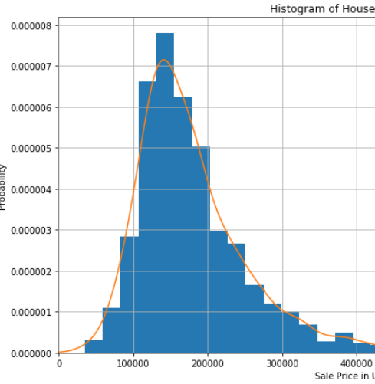
Sale Price Distribution
Mean: 180K ish
Median:
Mode:
Year built with buckets
Heating Quality
Porch (Y/N variable only)
Proximity to desirable features

Slide 21
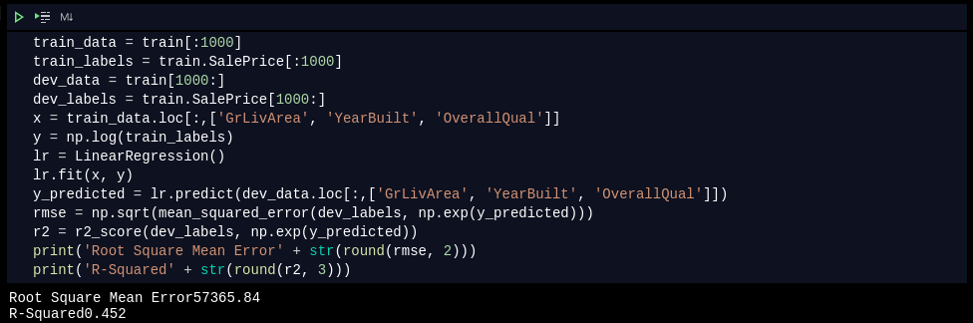
Initial Results Code

Slide 22
Technical References
https://towardsdatascience.com/regression-an-explanation-of-regression-metrics-and-what-can-go-wrong-a39a9793d914
Pix:
https://financebuddha.com/blog/tax-benefits-owning-multiple-houses/
https://www.nuviewtrust.com/self-directed-regulation-d-real-estate-fund-investments/
https://bks-partners.com/insights/capture/

Slide 23
0…………………..
https://www.census.gov/quickfacts/fact/table/amescityiowa/INC110218
https://www.census.gov/quickfacts/fact/table/amescityiowa/INC110218
https://data.bls.gov/timeseries/LASST190000000000005?amp%253bdata_tool=XGtable&output_view=data&include_graphs=true
https://www.areavibes.com/ames-ia/crime/

Slide 24
Sources
https://bostonbiotechwatch.com/2012/01/17/quant-vc-correlation-ventures-vcs-new-dream-date/
https://www.datacamp.com/community/tutorials/tutorial-ridge-lasso-elastic-net
https://www.dataapplab.com/wp-content/uploads/2017/04/kaggle-competition-263x263.png

