Slide 1
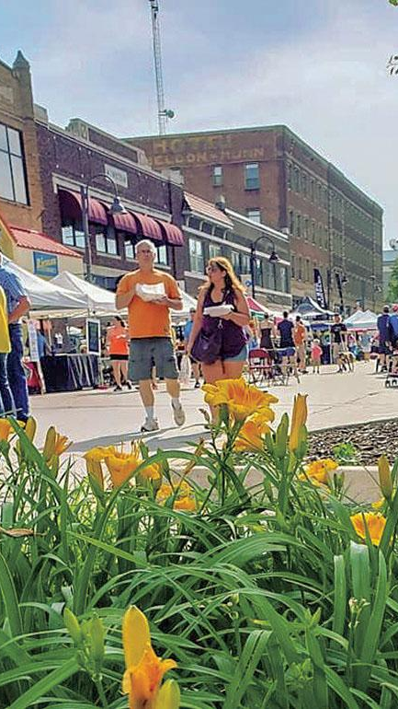


House Price Predictions Ames, IA
Little Deuce

Slide 2
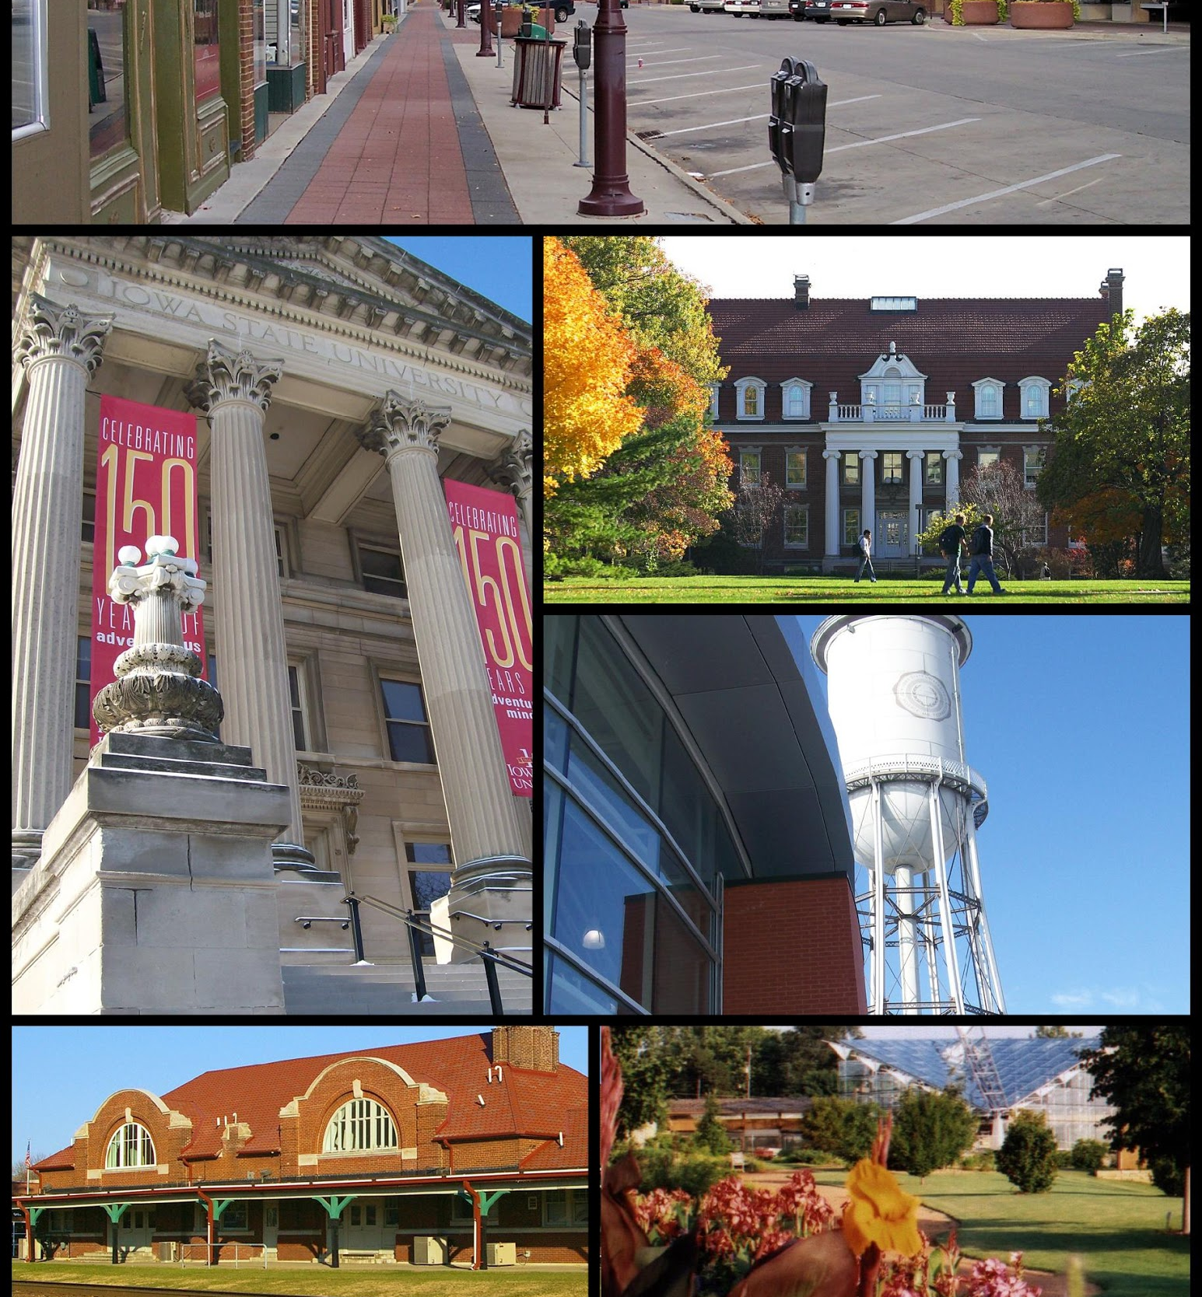
Ames, IA
Location: Central Iowa
Population: 59K (2010 Census)
Median household income: 46132 USD
Poverty rate: 28.4%
Crime: below national & state averages
Landmarks:
Iowa State University (~28K)
Ames Laboratory (US DoE National Lab)
USDA’s Agricultural Research National Animal Disease Center (NADC)
2010: ranked 9th on CNN Money’s ‘Best Places to Live’

Slide 3

The Nitty Gritty…..
4 years of data (2006-2010)
80 feature variables
1,460 sales at 300 annually
180K average sale price with 2 car garage
Home age:
38% of homes (551) less than 20 years old
55% less than 40 years old
70% of sales (1015) have 2 - 4000 SF
Primary sales: Normal & conventional

Slide 4
Goals of Kaggle Competition
Our job is to predict the sales price for each house. For each Id in the test set, we will predict the value of the SalePrice variable.
The submissions will be evaluated on Root-Mean-Squared-Error (RMSE) between the logarithm of the predicted value and the logarithm of the observed sales price.

Slide 5
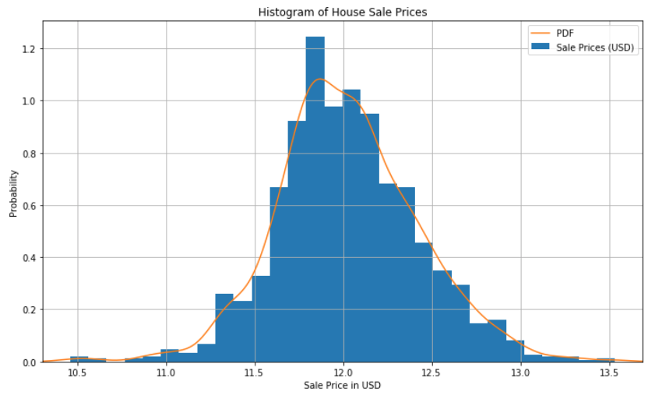
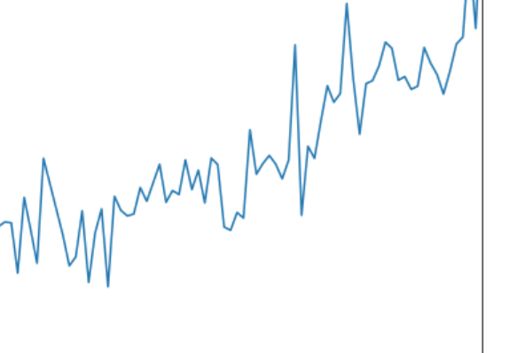
Sale Price Transformation
Log transformation
Root Mean Square Error (RMSE)
Time series depicts a steady, but not aggressive overall growth in the last 40 years

Slide 6

Exploratory Data Analysis
Year Built
Overall Quality
Total Square Footage (GrLivArea)
Garage Size – number of cars
Total Basement Square Footage
Lot Size

Slide 7

Excluded Variables
Neighborhood - Schools
Garage SF
Garage Condition
Heating
Central Air
Electrical
Kitchen Quality
Exterior Condition
Basement Quality
Basement Condition
Roof Material

Slide 8
Way Forward
Linear Regression Model
Variables: GrLivArea, YearBuilt, OverallQual
Initial Results
RSME 57,365
R-Squared .452
Current First place
RSME .00044
Decision Tree/Random Forest
Expand Considered Variables
Categorize variables
Create ranked lists of non-numerical variables
Notes:
Year built with buckets
Heating Quality
Porch (Y/N variable only)
Proximity to desirable features

Slide 9

Extra Stuff

Slide 10
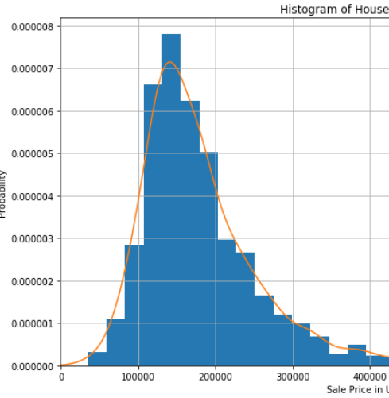
Sale Price Distribution
Mean: 180K ish
Median:
Mode:
Year built with buckets
Heating Quality
Porch (Y/N variable only)
Proximity to desirable features

Slide 11
Evaluation Metrics
Mean Square Error (MSE)
Average of the squared difference between the target value & predicted value
Easy to optimize & penalizes even small errors
Root Mean Square Error (RMSE)
Most common regression metric used
Useful when large errors are undesired – high penalty placed on large errors
Mean Absolute Error (MAE)
Robust to outliers & does not penalize as severely as MSE
Linear scoring where individual differences are weighted equally
Not suitable with attention is desired on outliers
R² Error
Compares current model with constant baseline model (mean of data)
Adjusted R²
Variant of R-squared

Slide 12
Home age:
38% NMT 20 years old (1990-2010) - 551
17% 20-40 years old(1970-1989) – 249
23% 40-60 years old (342)
22% (318) rest
Home size:
232: < 2000SF
553: 2000-3000 SF
462: 3000-4000 SF
213: > 4000 SF

Slide 13
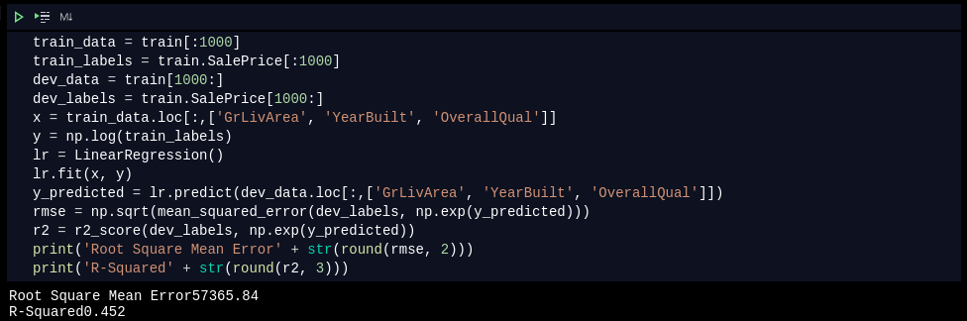
Initial Results Code

Slide 14
Technical References
https://towardsdatascience.com/regression-an-explanation-of-regression-metrics-and-what-can-go-wrong-a39a9793d914
Pix:
https://financebuddha.com/blog/tax-benefits-owning-multiple-houses/
https://www.nuviewtrust.com/self-directed-regulation-d-real-estate-fund-investments/
https://bks-partners.com/insights/capture/

Slide 15
0…………………..
https://www.census.gov/quickfacts/fact/table/amescityiowa/INC110218
https://www.census.gov/quickfacts/fact/table/amescityiowa/INC110218
https://data.bls.gov/timeseries/LASST190000000000005?amp%253bdata_tool=XGtable&output_view=data&include_graphs=true
https://www.areavibes.com/ames-ia/crime/

