Slide 1





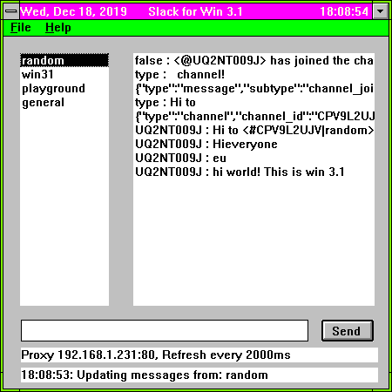


IBM Thinkpad 390E
Mac OS Catalina
Bridged Network
SMB share folder
SMB share folder

Slide 2

HTTP to HTTPS proxy

Slide 3
Jsnparse
jsnparse.h
jsnparse.c
test.h
test_jsnparse_parseChannelList()
test_jsnparse_parseMessageList()
test_jsnparse()
Network
network.h
network.c
test.h
test_data_send_recv()
test_large_data_send_recv()
test_network()
Test.mak
TestMain.c
RestAPI
restapi.h
restapi.c
test.h
test_restapi_sendMessageToChannel()
test_restapi_getChannelMessages()
test_restapi_getChannelList()
test_restapi()

