Slide 1
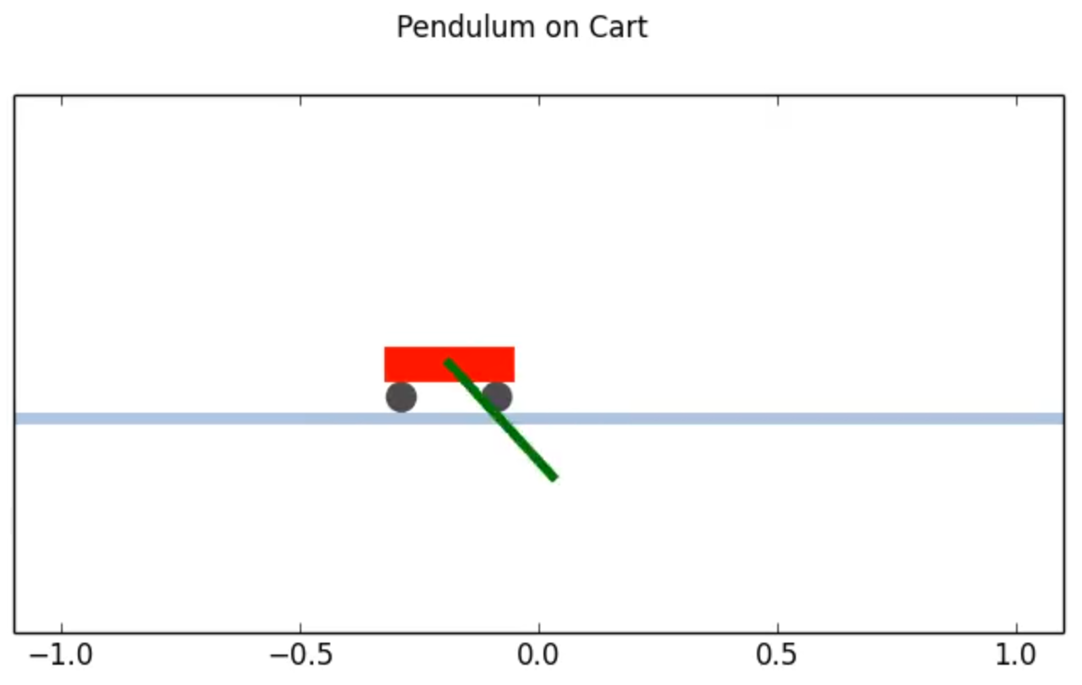
0 radians
Θ
x

