Slide 1
DuQuantum Pasqal Challenge
Quantum Optimization with Pasqal neutral atoms
Tenne Tian Eric Mao Vidith Kondapalli Godwin Smart
Notes:
Tenne Tian
0:00–0:20 · 20 seconds
We built a hybrid solver for capacitated vehicle routing using Pasqal’s neutral-atom tools. It connects a routing problem to QUBO energies, measured simulator outputs, and validated delivery routes. We will explain the mathematics, compare with classical optimization, and discuss what the results teach us.
Sources and provenance:
https://github.com/ericmao2007/DuQuantum-Pasqal
https://github.com/ericmao2007/DuQuantum-Pasqal/blob/3cc9c574cf4a57be6537286ef968ac41538e01f9/docs/challenge_contract.md

Slide 2
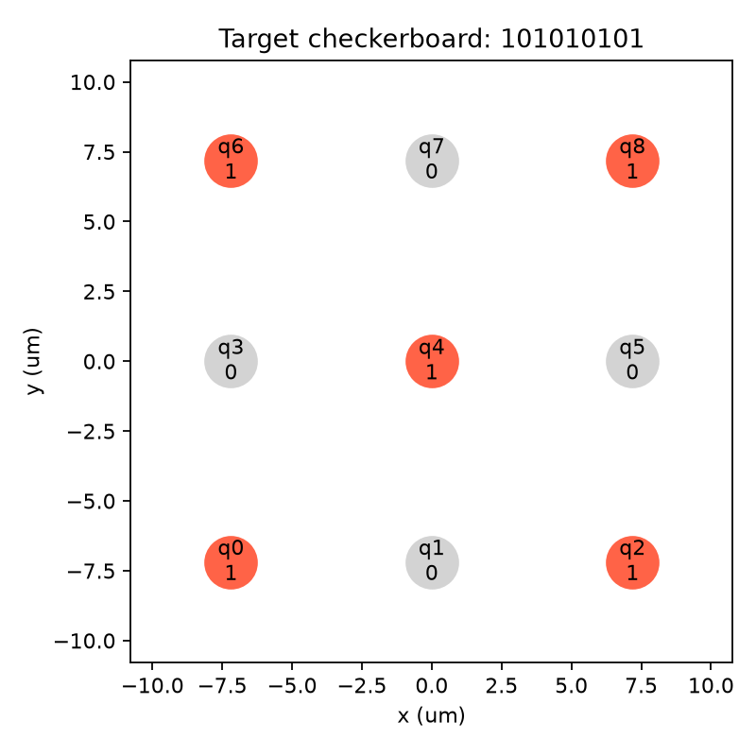
Pasqal and neutral-atom optimization
Analog quantum processors from neutral atoms held in optical traps.
Lasers drive atoms between a ground state and an excited Rydberg state.
Rydberg interactions allow the system to enter a ground state mimicking the ideal
Pulser specifies the register and pulses, then samples binary outcomes.
Saved nine-atom tutorial register; nearest-neighbor spacing 7.19 µm.
02
Notes:
Tenne Tian
0:20–0:55 · 35 seconds
Pasqal uses individual neutral atoms as qubits. Optical traps hold them in an arranged register, and lasers drive transitions into a Rydberg state. Nearby excited atoms interact strongly, so their positions shape an optimization landscape. We use Pulser to program those positions and controls. This saved tutorial shows a nine-atom checkerboard target. All our quantum evolution runs in a local, noiseless CPU emulator. The challenge allows emulation, and we have not used a real QPU.
Sources and provenance:
https://docs.pasqal.com/pulser/tutorials/qubo/
https://docs.pasqal.com/pulser/register/
https://github.com/ericmao2007/DuQuantum-Pasqal/blob/3cc9c574cf4a57be6537286ef968ac41538e01f9/output/pulser_tutorial/target_register.png
https://github.com/ericmao2007/DuQuantum-Pasqal/blob/3cc9c574cf4a57be6537286ef968ac41538e01f9/docs/challenge_contract.md

Slide 3
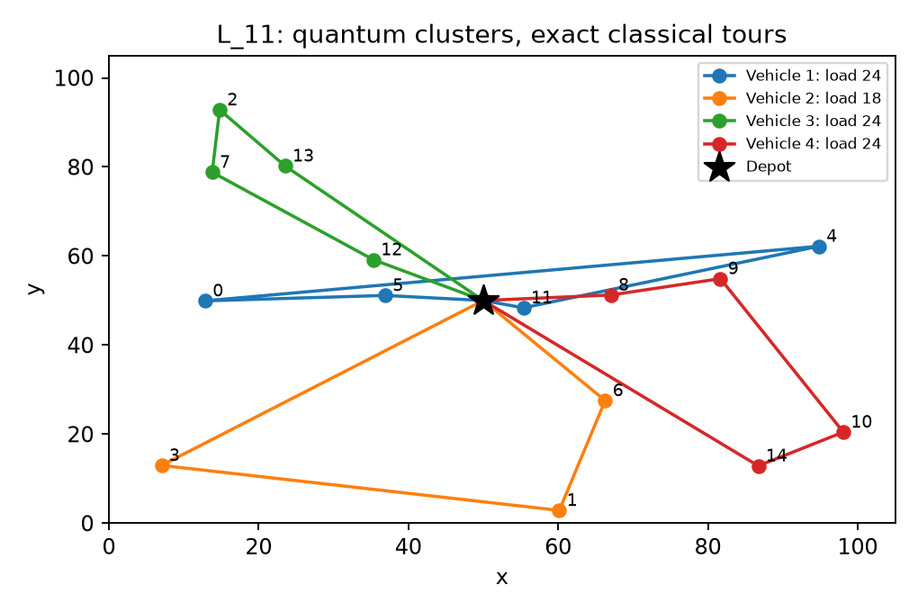
The capacitated vehicle routing problem
Tier | Customers | Vehicles | Capacity
S | 4 | 2 | 7
M | 10 | 3 | 20
L | 15 | 4 | 30
Minimize total depot-to-depot distance.
Serve every customer once.
Respect each vehicle’s capacity.
Allow unused vehicles.
Saved L₁₁ example: quantum clustering with exact classical tours
03
Notes:
Tenne Tian
0:55–1:45 · 50 seconds
The challenge is capacitated vehicle routing. A fixed fleet serves customers whose deliveries cannot be split. Every customer must appear once, each route returns to the depot, and every vehicle stays within capacity. The goal is minimum total travel. The three tiers have four, ten, and fifteen customers. We test uniform and heterogeneous demands using reproducible, certified-feasible instances. The sampler never receives the certificates. This example illustrates cluster-first routing: colors assign customers to vehicles, then tours connect each group to the depot. The displayed within-group tours use an exact classical solver. Eric will explain the quadratic models behind our grouping and routing decisions.
Sources and provenance:
https://github.com/ericmao2007/DuQuantum-Pasqal/blob/3cc9c574cf4a57be6537286ef968ac41538e01f9/docs/challenge_contract.md
https://github.com/ericmao2007/DuQuantum-Pasqal/blob/3cc9c574cf4a57be6537286ef968ac41538e01f9/challenge/MODEL.md
https://github.com/ericmao2007/DuQuantum-Pasqal/blob/3cc9c574cf4a57be6537286ef968ac41538e01f9/challenge/results/example_routes.png

Slide 4
QUBO formulation and capacity slack
Binary decisions become an energy
Linear terms score selections. Pair terms score joint choices.
Slack represents unused vehicle capacity
Load 5 + unused capacity 2 = capacity 7
The exact slack model is a reference. Our executed sampler checks capacity classically.
04
Notes:
Eric Mao
1:45–2:40
A QUBO gives an energy to each binary answer. Linear terms score individual selections and pair terms score joint choices. To convert a capacity inequality into an equality, introduce slack: unused room on a vehicle. With capacity seven, selecting deliveries of three and two leaves slack two. The capacity penalty can therefore be zero for a valid underfilled vehicle. The full assignment-and-slack construction is an exact mathematical reference, shown in backup. Our smaller executed sampler uses a different energy and enforces capacity through classical rejection.
Revision reviewed October 25, 2026 against repository 3cc9c574cf4a57be6537286ef968ac41538e01f9.
Official benchmark and new 3D demo are distinct experiments. All quantum evolution is CPU emulation.
Sources:
https://github.com/ericmao2007/DuQuantum-Pasqal/blob/3cc9c574cf4a57be6537286ef968ac41538e01f9/challenge/MATH_WRITEUP.md
https://github.com/ericmao2007/DuQuantum-Pasqal/blob/3cc9c574cf4a57be6537286ef968ac41538e01f9/challenge/TRACK_B_MODEL.md
Exact model uses F≥0, integer residuals, and a checked feasible score U. A=B=U+1 is sufficient for exact global minimizers only. Symmetric matrix convention Qij=Jij/2 off the diagonal.
Editable LaTeX equation sources:
E(\mathbf b)=c_0+\sum_i h_i b_i+\sum_{i<j}J_{ij}b_i b_j,\qquad b_i\in\{0,1\}
3x_1+2x_2+s=7,\qquad s=u_0+2u_1+4u_2

Slide 5
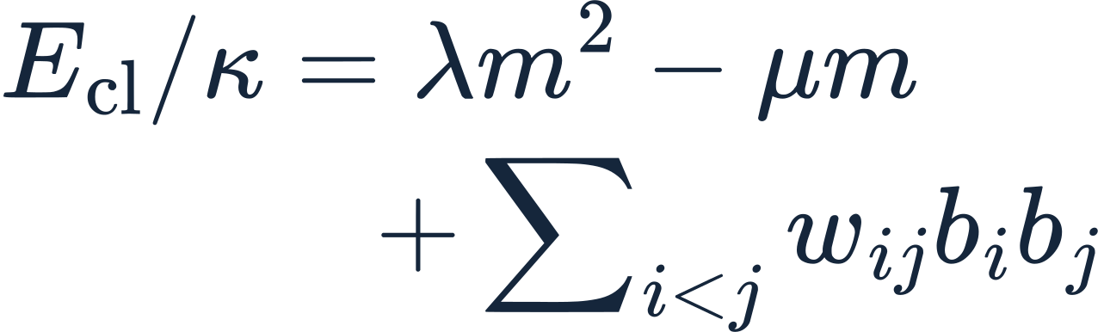
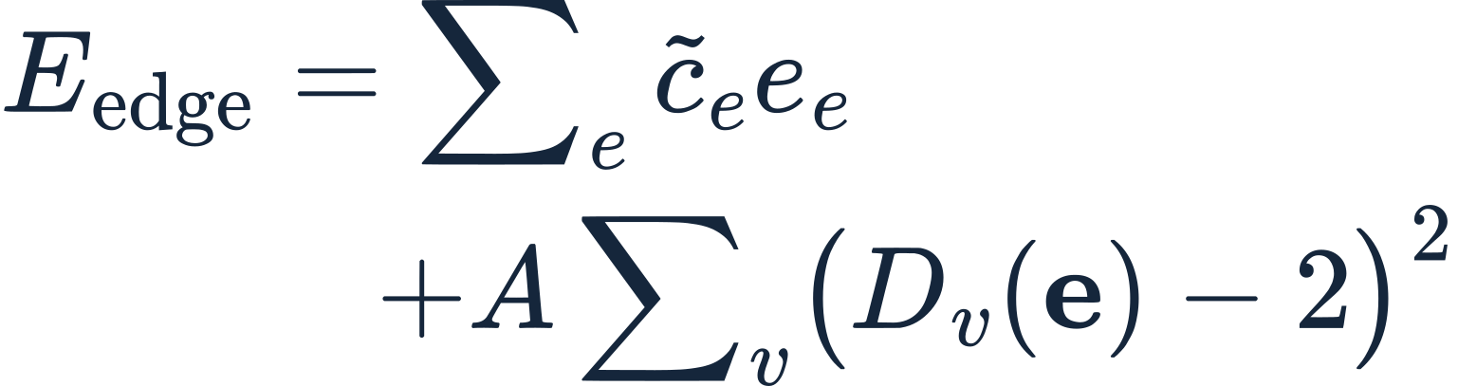
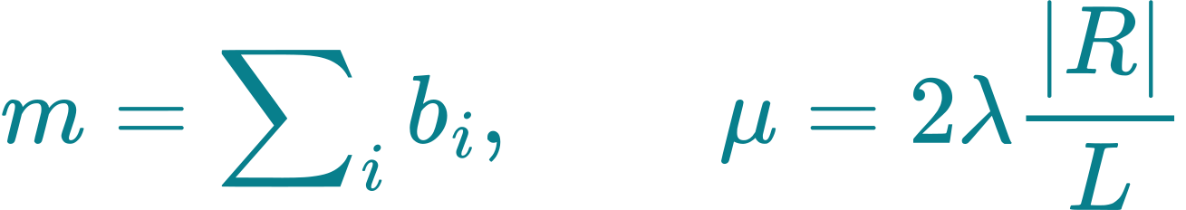
The implemented hybrid solver
Propose the next group
Order each group’s stops
4 customers: 10 edge bits
or 16 position bits.
A strict decoder checks every sampled tour.
At most 8 candidate customers per call.
Group size is centered near |R|/L.
Classical checks reject overloaded proposals.
λ = 0.15; κ > 0 sets the energy scale.
Degree = selected edges at a location.
Official benchmark: groups of ≤3 or >4 customers use classical routing. Atlas Orbit samples all three tours.
05
Notes:
Eric Mao
2:40–3:30
Our clustering sampler considers at most eight candidates at a time. The quadratic size term and linear reward favor a group near the remaining average size, while pair distances favor nearby customers. Demands do not appear in this proposal energy, so classical checks enforce capacity. We then order the customers in each group. In the official benchmark, four-customer groups use ten edge bits or sixteen position bits, and other sizes follow the declared classical rules. The updated planetary demo separately samples every ship tour, including its three-customer groups.
Revision reviewed October 25, 2026 against repository 3cc9c574cf4a57be6537286ef968ac41538e01f9.
Official benchmark and new 3D demo are distinct experiments. All quantum evolution is CPU emulation.
Sources:
https://github.com/ericmao2007/DuQuantum-Pasqal/blob/3cc9c574cf4a57be6537286ef968ac41538e01f9/challenge/MATH_WRITEUP.md
https://github.com/ericmao2007/DuQuantum-Pasqal/blob/3cc9c574cf4a57be6537286ef968ac41538e01f9/challenge/TRACK_B_MODEL.md
https://github.com/ericmao2007/DuQuantum-Pasqal/blob/3cc9c574cf4a57be6537286ef968ac41538e01f9/challenge/SPACE_OPTIMIZATION.md
https://github.com/ericmao2007/DuQuantum-Pasqal/blob/3cc9c574cf4a57be6537286ef968ac41538e01f9/challenge/space_demo_results/dashboard.json
Latest demo: 334/512 feasible clustering trajectories, 201000 clustering bank shots, 48000 routing shots. Valid route shots per ship: 51/16000, 1279/16000, 1178/16000. Selected group sizes 4,3,3; atoms 10,6,6. No route fallback or reference plan inserted. Selected clustering minimizes measured feasible F without exact route tie-breaking. Final-run timer 23.57 s includes reference evaluation and output and is not comparable to slide 7 online-only timings.
Editable LaTeX equation sources:
\begin{aligned}E_{\mathrm{cl}}/\kappa&=\lambda m^2-\mu m\\&\quad+\sum_{i<j}w_{ij}b_i b_j\end{aligned}
m=\sum_i b_i,\qquad \mu=2\lambda\frac{|R|}{L}
\begin{aligned}E_{\mathrm{edge}}&=\sum_e\widetilde c_e e_e\\&\quad+A\sum_v\bigl(D_v(\mathbf e)-2\bigr)^2\end{aligned}

Slide 6
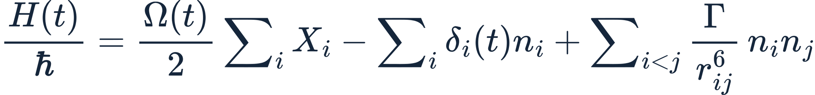
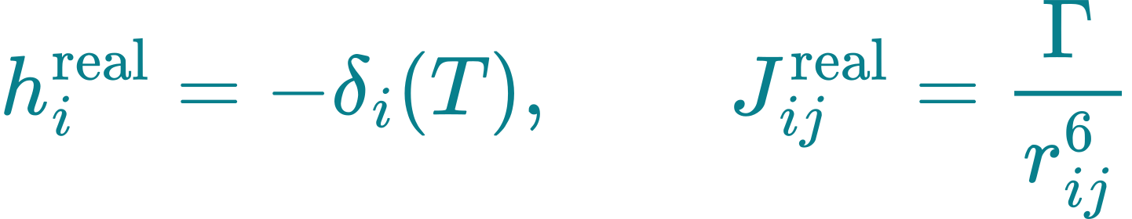
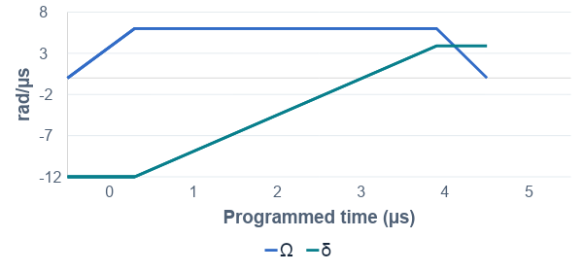
Mapping QUBO coefficients to atoms
Detuning sets selection costs.
Atom separation sets pair costs.
The drive prepares the state.
5.2 µs pulse duration
Local CPU emulation; DMM adds local detuning
Baseline pulse at 15 remaining customers / 4 vehicles
06
Notes:
Vidith Kondapalli
3:30–4:15
Detuning sets individual selection costs, and atom separation sets positive pair interactions proportional to inverse distance to the sixth power. The drive prepares the quantum state. When it reaches zero at the end of the pulse, the remaining diagonal energy scores bitstrings. Global detuning shares one cost across atoms. The declared DMM emulation adds local variation, but geometry still links the pair couplings. The plotted baseline pulse lasts five point two microseconds. That duration differs from CPU simulation and total solver time.
Revision reviewed October 25, 2026 against repository 3cc9c574cf4a57be6537286ef968ac41538e01f9.
Official benchmark and new 3D demo are distinct experiments. All quantum evolution is CPU emulation.
Sources:
https://github.com/ericmao2007/DuQuantum-Pasqal/blob/3cc9c574cf4a57be6537286ef968ac41538e01f9/challenge/MATH_WRITEUP.md
https://github.com/ericmao2007/DuQuantum-Pasqal/blob/3cc9c574cf4a57be6537286ef968ac41538e01f9/challenge/TRACK_B_MODEL.md
Editable LaTeX equation sources:
\frac{H(t)}{\hbar}=\frac{\Omega(t)}{2}\sum_i X_i-\sum_i\delta_i(t)n_i+\sum_{i<j}\frac{\Gamma}{r_{ij}^{6}}\,n_i n_j
h_i^{\mathrm{real}}=-\delta_i(T),\qquad J_{ij}^{\mathrm{real}}=\frac{\Gamma}{r_{ij}^{6}}

Slide 7
CPLEX leads on the 12-instance benchmark
Metric | CPLEX MILP | QUBO-assisted
Feasible full routes | 36/36 | 33/36
Mean route gap* | 0% | 20.59%
Median total time | 0.042 s | 1.401 s
Proven optimal runs | 36/36 | 0/36
12 instances × 3 repeats
797 / 797
S/M/L, uniform and heterogeneous demands
Same routing objective and feasibility checks
target QUBO minima proven by CPLEX
and checked by exhaustive enumeration
*Mean across 11 instances with successful emulator runs. CPU timings, no QPU. All 3 failures: M_heterogeneous_11.
07
Notes:
Vidith Kondapalli
4:15–5:15 · 60 seconds
We compare against a direct CPLEX mixed-integer formulation of the original routing problem, using twelve instances and three fresh repeats per method. CPLEX proves optimal routes in all thirty-six runs. Our baseline pipeline returns feasible routes in thirty-three. Its mean route gap is twenty point five nine percent across the eleven instances with successful runs. All three failures occur on one heterogeneous medium instance, during clustering. Median total time is zero point zero four two seconds for CPLEX and one point four zero one for the CPU emulator pipeline. These medians span different sizes. We also solve all seven hundred ninety-seven target QUBOs with CPLEX and exhaustive checks. Small cases use classical within-group routing. Godwin will discuss the newer tuning experiment.
This is the local baseline comparison, not a rerun with the new tuned sampler. Full pipeline: sequential clustering + edge/DMM routing with declared classical trivial/size fallback. CPLEX uses one thread, zero requested relative MIP gap, 30 s solve limit. Both total timings include required online construction, solve/simulation, validation and fallback, excluding imports, I/O, independent scoring and diagnostic QUBO solves. Gaps are undefined for failures. The gap average is instance-weighted across successful cases. Three repeats are descriptive.
Sources and provenance:
Classical-comparison provenance: separate local CPU-emulator versus CPLEX experiment, 12 instances and three repeats. These local evidence datasets are not part of the upstream repository or the new planetary experiment. The presentation retains the verified summary and protocol.

Slide 8
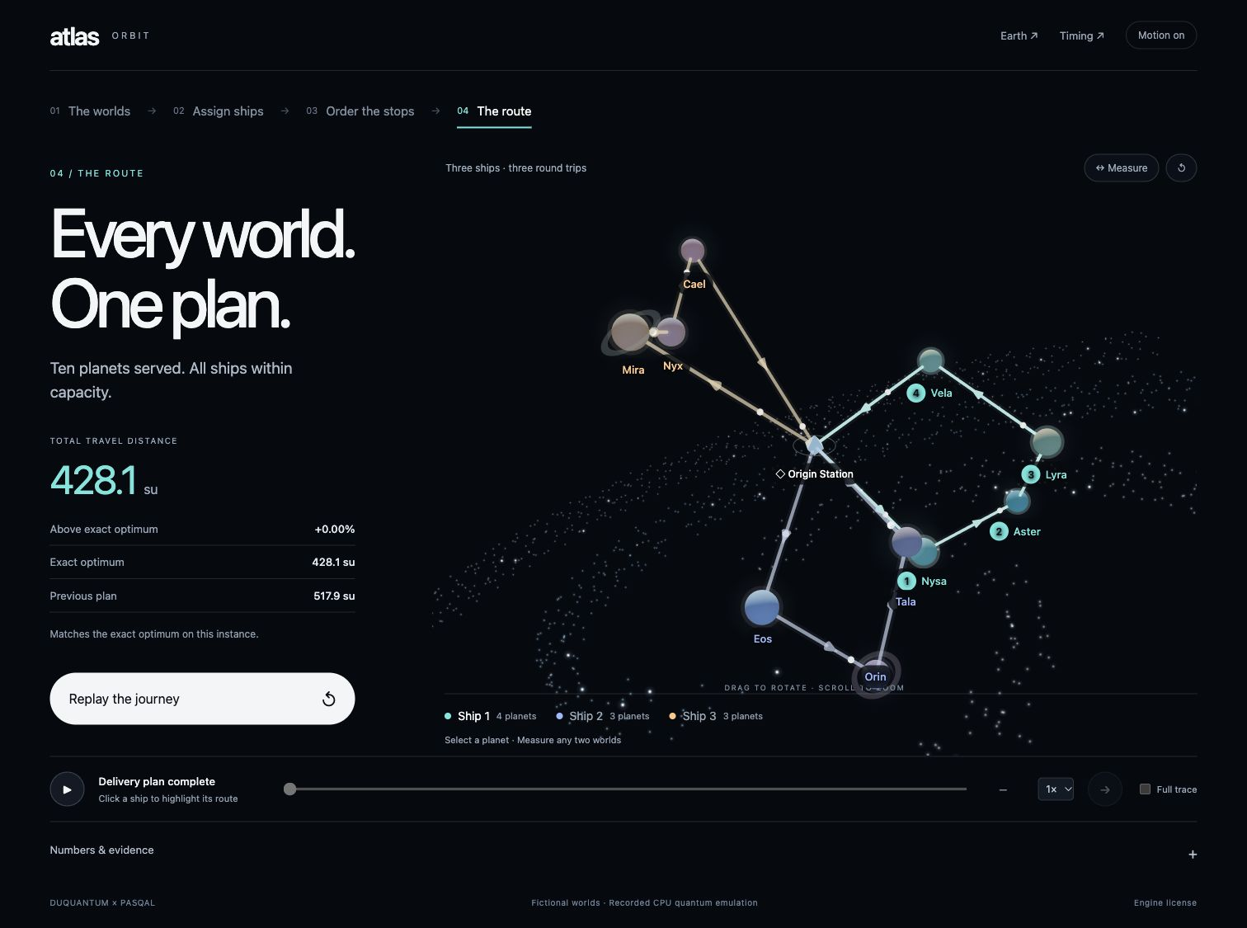
Atlas Orbit matches the optimum on one instance
428.13 su
Matches the exact CVRP optimum
17.34% less travel
Compared with the prior
517.93 su demo run
All 3 tours sampled
10, 6 and 6 atoms
16,000 shots per ship
Fixed 3D demo. Larger budget: 512 clustering attempts, 4 window orders. CPU emulation; no speedup claim.
08
Notes:
Godwin Smart
5:15–6:00
The newest repository update improves the fixed ten-planet demo. Four seeded window orders and five hundred twelve clustering attempts explore more groupings. Each ship then receives sixteen thousand routing shots. All three tours come from measured edge and DMM bitstrings, with ten, six, and six atoms. Their combined distance is four hundred twenty-eight point one three space units, matching the independently computed global optimum on this instance. Travel falls seventeen point three four percent from the previous demo. This uses a larger budget on one fixed instance. It does not update the official benchmark or demonstrate speedup.
Revision reviewed October 25, 2026 against repository 3cc9c574cf4a57be6537286ef968ac41538e01f9.
Official benchmark and new 3D demo are distinct experiments. All quantum evolution is CPU emulation.
Sources:
https://github.com/ericmao2007/DuQuantum-Pasqal/blob/3cc9c574cf4a57be6537286ef968ac41538e01f9/challenge/MATH_WRITEUP.md
https://github.com/ericmao2007/DuQuantum-Pasqal/blob/3cc9c574cf4a57be6537286ef968ac41538e01f9/challenge/TRACK_B_MODEL.md
https://github.com/ericmao2007/DuQuantum-Pasqal/blob/3cc9c574cf4a57be6537286ef968ac41538e01f9/challenge/SPACE_OPTIMIZATION.md
https://github.com/ericmao2007/DuQuantum-Pasqal/blob/3cc9c574cf4a57be6537286ef968ac41538e01f9/challenge/space_demo_results/dashboard.json
Latest demo: 334/512 feasible clustering trajectories, 201000 clustering bank shots, 48000 routing shots. Valid route shots per ship: 51/16000, 1279/16000, 1178/16000. Selected group sizes 4,3,3; atoms 10,6,6. No route fallback or reference plan inserted. Selected clustering minimizes measured feasible F without exact route tie-breaking. Final-run timer 23.57 s includes reference evaluation and output and is not comparable to slide 7 online-only timings.

Slide 9
Where solution quality is lost
0 / 797
Clustering surrogate
Compact groups can still produce long depot tours.
fitted native models retain a target ground-state bitstring
Sequential capacity checks
A feasible early group can leave an infeasible remainder.
Finite-time pulses can still sample useful excited states.
Physical embedding
Geometry distorts pair costs, even with local detuning.
09
Notes:
Godwin Smart
6:00–6:35 · 35 seconds
The diagnostics expose several losses. The clustering score omits depot travel, so compact groups can still give poor routes. Sequential choices can leave an infeasible remainder. None of the seven hundred ninety-seven native models shares a lowest-energy bitstring with its target QUBO. That demonstrates representation loss, although pulses can still sample useful excited states. More shots alone cannot guarantee recovery of the intended problem.
Ground-state mismatch concerns each final static Hamiltonian and the exact energy minimum. It does not prove that every measured bitstring is invalid or that driven evolution cannot reach useful target states. Full-pipeline accepted routes always pass independent coverage and capacity checks. Historical exact routed-cost tie-breaking qualifies claims of wholly reference-independent clustering selection.
Sources and provenance:
Classical-comparison provenance: separate local CPU-emulator versus CPLEX experiment, 12 instances and three repeats. These local evidence datasets are not part of the upstream repository or the new planetary experiment. The presentation retains the verified summary and protocol.

Slide 10
What we built and what comes next
A reproducible hybrid routing experiment
QUBO derivations, measured bitstrings, strict route validation,
and independent classical comparisons
Next: improve the model and embedding,
then retest across more seeds
The updated Atlas Orbit demo reaches its exact optimum.
One larger-budget demo succeeds. CPLEX remains stronger on the 12-instance benchmark.
10
Notes:
Godwin Smart
6:35–7:00
We built a hybrid routing experiment with explicit mathematical models, measured simulator outputs, and validated routes. The updated planetary demo reaches the exact optimum on one instance, with every tour selected from measurements. The broader twelve-instance comparison still favors CPLEX. Our next priorities are demand and depot modeling, more faithful embeddings, and evaluation across additional independent seeds. Atlas makes the saved process inspectable. Thank you.
Revision reviewed October 25, 2026 against repository 3cc9c574cf4a57be6537286ef968ac41538e01f9.
Official benchmark and new 3D demo are distinct experiments. All quantum evolution is CPU emulation.
Sources:
https://github.com/ericmao2007/DuQuantum-Pasqal/blob/3cc9c574cf4a57be6537286ef968ac41538e01f9/challenge/MATH_WRITEUP.md
https://github.com/ericmao2007/DuQuantum-Pasqal/blob/3cc9c574cf4a57be6537286ef968ac41538e01f9/challenge/TRACK_B_MODEL.md
https://github.com/ericmao2007/DuQuantum-Pasqal/blob/3cc9c574cf4a57be6537286ef968ac41538e01f9/challenge/SPACE_OPTIMIZATION.md
https://github.com/ericmao2007/DuQuantum-Pasqal/blob/3cc9c574cf4a57be6537286ef968ac41538e01f9/challenge/space_demo_results/dashboard.json
Latest demo: 334/512 feasible clustering trajectories, 201000 clustering bank shots, 48000 routing shots. Valid route shots per ship: 51/16000, 1279/16000, 1178/16000. Selected group sizes 4,3,3; atoms 10,6,6. No route fallback or reference plan inserted. Selected clustering minimizes measured feasible F without exact route tie-breaking. Final-run timer 23.57 s includes reference evaluation and output and is not comparable to slide 7 online-only timings.

Slide 11
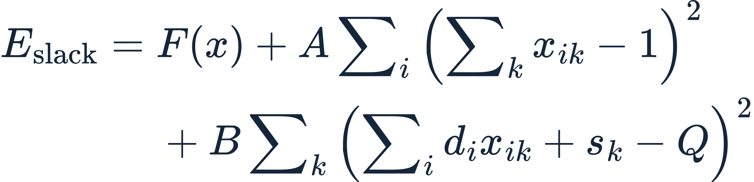
Exact assignment model and variable budget
Encoding | S | M | L
Assignment x | 8 | 30 | 60
Assignment + slack | 14 | 45 | 80
Implemented window peak | 4 | 8 | 8
A = B = U + 1 makes exact global minima feasible, given a feasible score U and nonnegative F.
BACKUP 1
Notes:
Q&A
Backup, outside the seven-minute talk
The exact slack model has NK+K ceil(log2(Q+1)) bits, reaching the challenge’s 80-atom cap on L. The sequential eight-atom window is a different heuristic, not an equivalent compressed encoding. It exchanges simultaneous variables for repeated calls and classical rejection.
A feasible certificate bounds F by U. Every violated integer equality adds at least A or B and F is nonnegative, so U+1 excludes infeasible global minima. This is an algebraic guarantee and does not establish a physically exact register embedding.
Sources and provenance:
Revision reviewed October 25, 2026 against repository 3cc9c574cf4a57be6537286ef968ac41538e01f9.
Official benchmark and new 3D demo are distinct experiments. All quantum evolution is CPU emulation.
Sources:
https://github.com/ericmao2007/DuQuantum-Pasqal/blob/3cc9c574cf4a57be6537286ef968ac41538e01f9/challenge/MATH_WRITEUP.md
https://github.com/ericmao2007/DuQuantum-Pasqal/blob/3cc9c574cf4a57be6537286ef968ac41538e01f9/challenge/TRACK_B_MODEL.md
Editable LaTeX equation sources:
\begin{aligned}E_{\mathrm{slack}}={}&F(x)+A\sum_i\left(\sum_k x_{ik}-1\right)^2\\&+B\sum_k\left(\sum_i d_i x_{ik}+s_k-Q\right)^2\end{aligned}
s_k=\sum_{\ell=0}^{B_Q-1}2^\ell u_{k\ell},\qquad B_Q=\left\lceil\log_2(Q+1)\right\rceil

Slide 12
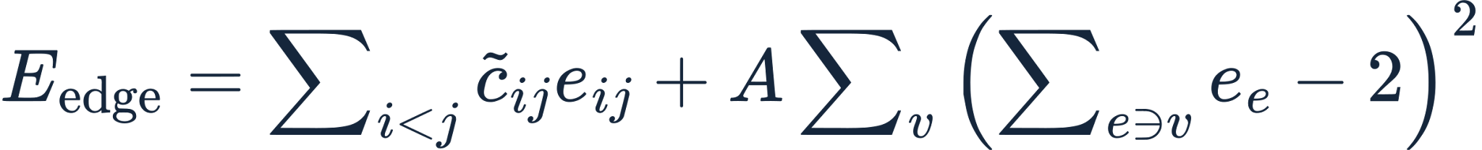
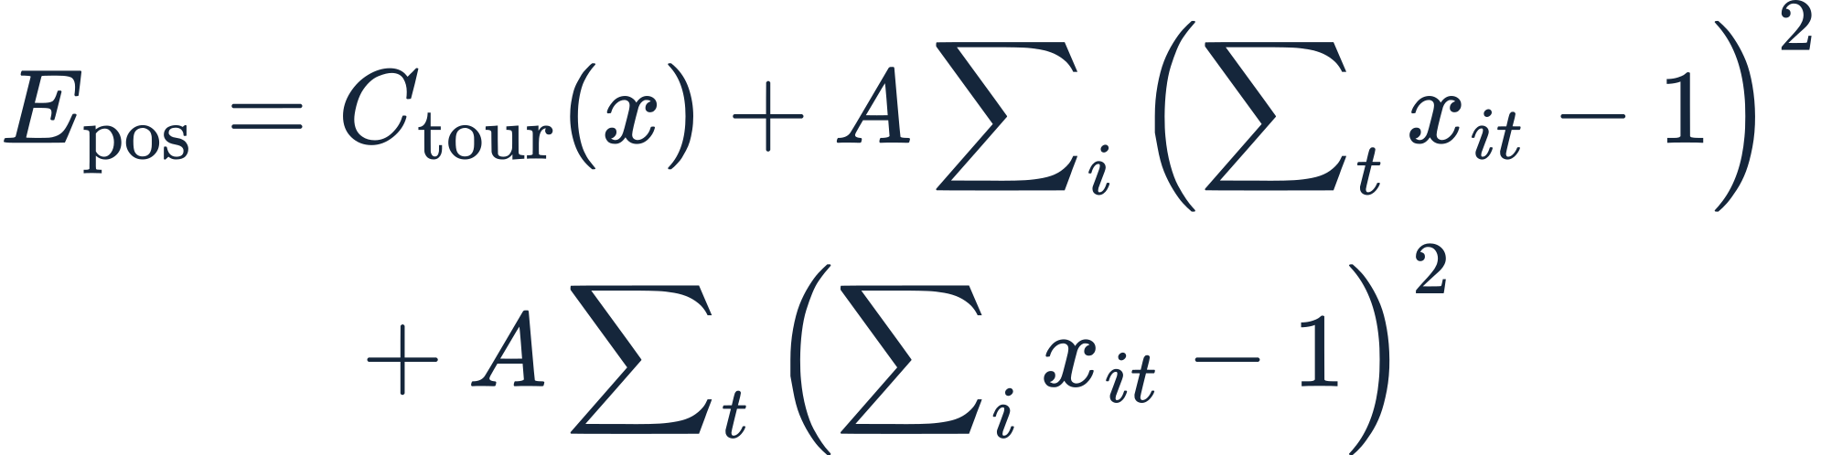
Two routing encodings for four customers
Edge encoding: 10 binary variables
Position encoding: 16 binary variables
Degree two implies one tour only for ≤4 customers here. Position bits encode a permutation. A = 10.
BACKUP 2
Notes:
Q&A
Backup, outside the seven-minute talk
Both target encodings are algebraically valid at the executed four-customer size. Degree-two edge constraints alone are insufficient in general, but five total vertices cannot contain two disjoint simple cycles. For larger groups the implementation declares a classical size fallback. Position encoding fixes the depot outside four customer positions and enforces one-hot rows and columns.
Costs normalized by 100 sqrt(2), so any valid four-customer tour costs at most 5. A nonzero squared integer violation costs at least 10. Edge constant is 4(n+1)A. Position constant is 2nA. Constants do not affect minimizers. Symmetric-matrix off-diagonals halve the unordered-pair coefficient. Global-only projection of h_e to its mean removes direct distance discrimination among valid edge tours. DMM restores those linear terms in declared emulation, while pair distortion remains.
Sources and provenance:
Revision reviewed October 25, 2026 against repository 3cc9c574cf4a57be6537286ef968ac41538e01f9.
Official benchmark and new 3D demo are distinct experiments. All quantum evolution is CPU emulation.
Sources:
https://github.com/ericmao2007/DuQuantum-Pasqal/blob/3cc9c574cf4a57be6537286ef968ac41538e01f9/challenge/MATH_WRITEUP.md
https://github.com/ericmao2007/DuQuantum-Pasqal/blob/3cc9c574cf4a57be6537286ef968ac41538e01f9/challenge/TRACK_B_MODEL.md
x_it=1 means customer i at position t. C_tour(x) includes first/last depot terms and consecutive-position pair costs. At n=4, 24 valid position bitstrings represent 12 tours up to reversal; edge encoding has 12 valid states. For n≥5, degree two alone permits disconnected cycles. Global-only projection of edge linear coefficients removes direct distance discrimination among valid tours; with the exact target pair matrix they become degenerate. DMM restores linear terms within declared emulation bounds, but not pair interactions.
Editable LaTeX equation sources:
E_{\mathrm{edge}}=\sum_{i<j}\widetilde c_{ij}e_{ij}+A\sum_v\left(\sum_{e\ni v}e_e-2\right)^2
h_e=\widetilde c_e-6A,\qquad J_{ef}=2A\quad\text{for incident edges}
\begin{aligned}E_{\mathrm{pos}}={}&C_{\mathrm{tour}}(x)+A\sum_i\left(\sum_t x_{it}-1\right)^2\\&+A\sum_t\left(\sum_i x_{it}-1\right)^2\end{aligned}

Slide 13
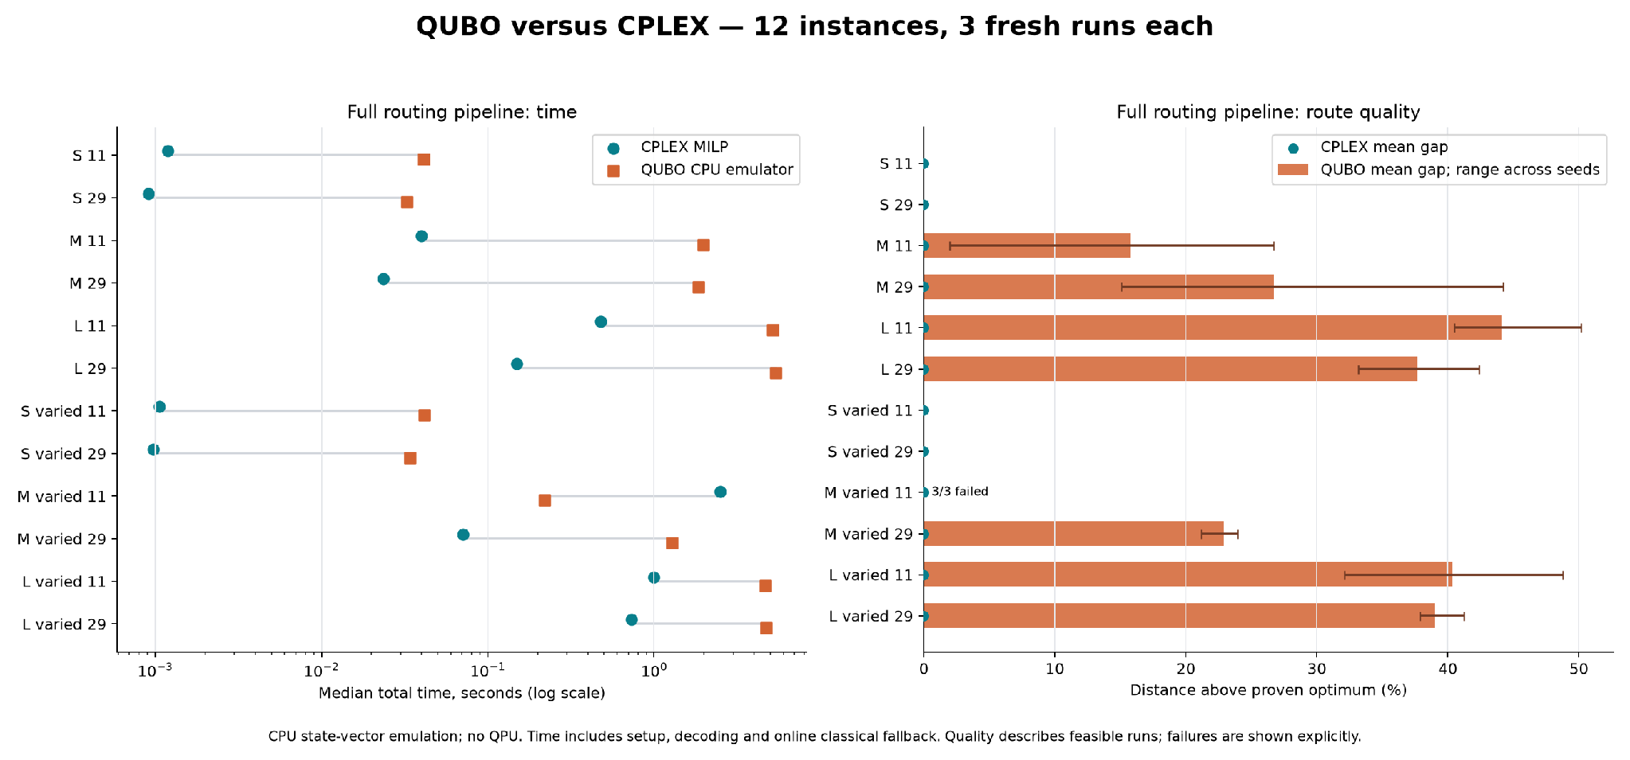
Classical comparison by instance
Local baseline runs, three repeats per instance. Failed solutions retain undefined route gaps.
BACKUP 3
Notes:
Q&A
Backup, outside the seven-minute talk
The full source chart preserves the per-instance comparison behind the aggregate table. Inspect per-instance runtime rather than treating a median across mixed sizes as a universal speed ratio. All three baseline pipeline failures are M_heterogeneous_11.
Sources and provenance:
Classical-comparison provenance: separate local CPU-emulator versus CPLEX experiment, 12 instances and three repeats. These local evidence datasets are not part of the upstream repository or the new planetary experiment. The presentation retains the verified summary and protocol.

Slide 14
Identical-QUBO diagnostics
Stage / encoding | Banks | Sampled target optimum | Native optimum overlap
Clustering / subset | 754 | 707/754 | 0/754
Routing / edge | 36 | 19/36 | 0/36
Routing / position | 7 | 0/7 | 0/7
Every target and native minimum passed CPLEX and exhaustive checks.
Edge banks return valid sampled tours in 36/36 cases.
Position banks return valid sampled tours in 3/7 cases.
BACKUP 4
Notes:
Q&A
Backup, outside the seven-minute talk
Sampling a target optimum and returning a valid tour answer different questions. All edge routing banks contain at least one valid tour, but only nineteen contain an optimal target tour. Position/DMM diagnostics are seven paired side experiments. They do not form an end-to-end position-routing benchmark and are excluded from pipeline timing.
These counts are numbers of banks containing at least one successful sample, not raw single-shot probabilities. Target clustering optima need not be capacity-feasible or part of the best full CVRP partition.
Sources and provenance:
Classical-comparison provenance: separate local CPU-emulator versus CPLEX experiment, 12 instances and three repeats. These local evidence datasets are not part of the upstream repository or the new planetary experiment. The presentation retains the verified summary and protocol.

Slide 15
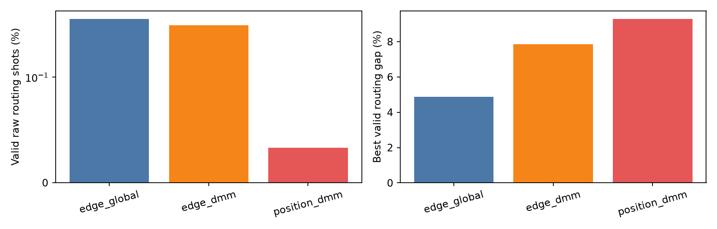
Historical Track B encoding comparison
Original GitHub benchmark evidence. Different experiment from the fresh local CPLEX runs.
BACKUP 5
Notes:
Q&A
Backup, outside the seven-minute talk
This preserves the historical source graph for the two routing encodings and random baseline. It belongs to the original Track B protocol and should not be pooled with local reruns or new tuning results. Random routing samples valid permutations, a strong baseline on four-customer groups with only twelve undirected tours.
Sources and provenance:
https://github.com/ericmao2007/DuQuantum-Pasqal/blob/3cc9c574cf4a57be6537286ef968ac41538e01f9/challenge/TRACK_B_MODEL.md
https://github.com/ericmao2007/DuQuantum-Pasqal/blob/3cc9c574cf4a57be6537286ef968ac41538e01f9/challenge/track_b_results/routing_comparison.png

Slide 16
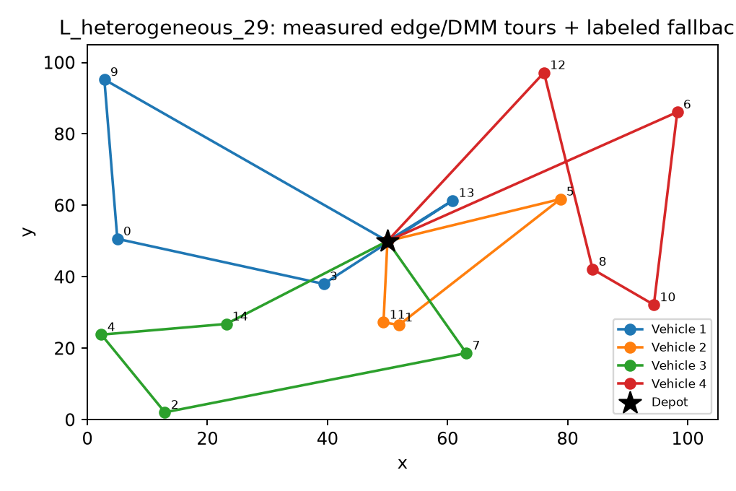
Historical Track B route example
Quantum routing applies to eligible four-customer groups. Trivial and size fallback groups remain classical.
BACKUP 6
Notes:
Q&A
Backup, outside the seven-minute talk
This original route graph illustrates the complete hybrid pipeline. Use the source’s per-cluster accounting to identify quantum routes and classical contributions. A failed eligible quantum route stays a failure rather than triggering repair.
Sources and provenance:
https://github.com/ericmao2007/DuQuantum-Pasqal/blob/3cc9c574cf4a57be6537286ef968ac41538e01f9/challenge/TRACK_B_MODEL.md
https://github.com/ericmao2007/DuQuantum-Pasqal/blob/3cc9c574cf4a57be6537286ef968ac41538e01f9/challenge/track_b_results/end_to_end_routes.png

Slide 17
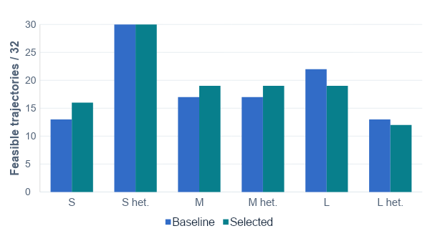
Sampler tuning on six held-out cases
58.85% to 60.42%
Mean feasible trajectory fraction
8.41% to 7.57%
Mean best clustering-model gap
18.59 s to 43.42 s
Total held-out solver time
16 settings. Seed 11 training, seed 101 validation. Track A only. Separate from the latest Orbit run.
BACKUP 7
Notes:
Godwin Smart
5:15–6:00 · 45 seconds
The newest experiment tunes clustering proposals while keeping the objective and capacity checks fixed. We screen sixteen configurations, select on training seed eleven, freeze the winner, and validate on six cases at seed one hundred one. Mean feasible trajectory fraction rises from fifty-eight point eight five to sixty point four two percent. Mean best model gap falls from eight point four one to seven point five seven percent. Both methods solve all six cases, but some large-case counts worsen. Total solver time increases from eighteen point five nine to forty-three point four two seconds. This small pilot does not update the baseline CPLEX comparison.
GitHub observed at commit 0434354dd2320e4c69caa7db02abb6167ede3817 on October 24, 2026. Baseline/selected counts are [13,31,17,17,22,13] / [16,31,19,19,19,12]. Selected settings: Ω=8 rad/µs, scale=2, reward factor=0.8, durations 800/3600/800 ns, three embedding starts. Different branches use 126 versus 153 backend calls (126,000 versus 153,000 bank shots). Equal trajectory budgets do not imply equal total-shot budgets. One instance seed per split, one sampler seed per case, shared banks and shared family coordinates limit independence. The baseline remains the default. This result concerns clustering, with exact within-group route evaluation, not the full Track B pipeline.
Sources and provenance:
https://github.com/ericmao2007/DuQuantum-Pasqal/blob/0434354dd2320e4c69caa7db02abb6167ede3817/challenge/TUNING.md
https://github.com/ericmao2007/DuQuantum-Pasqal/blob/0434354dd2320e4c69caa7db02abb6167ede3817/challenge/tuning_results/selected.json
Revision reviewed October 25, 2026 against repository 3cc9c574cf4a57be6537286ef968ac41538e01f9.
Official benchmark and new 3D demo are distinct experiments. All quantum evolution is CPU emulation.
Sources:
https://github.com/ericmao2007/DuQuantum-Pasqal/blob/3cc9c574cf4a57be6537286ef968ac41538e01f9/challenge/MATH_WRITEUP.md
https://github.com/ericmao2007/DuQuantum-Pasqal/blob/3cc9c574cf4a57be6537286ef968ac41538e01f9/challenge/TRACK_B_MODEL.md

Slide 18
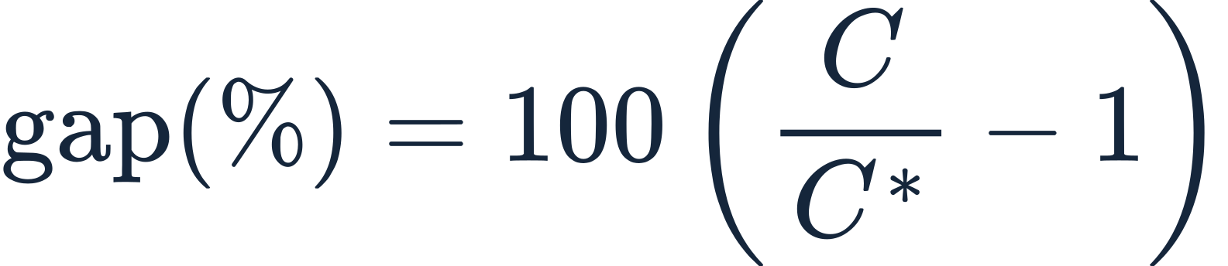
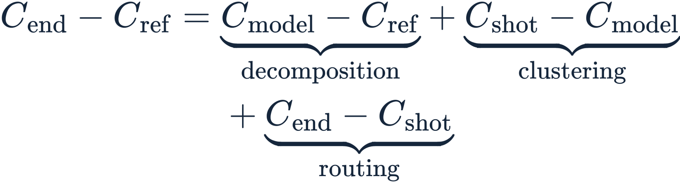
Evaluation metrics and loss accounting
Full-route optimality gap
C* is the exact CVRP optimum. Failed runs have an undefined gap.
Where excess travel enters
Absolute distances add. The clustering term can be negative because the objectives differ.
BACKUP 8
Notes:
Q&A
Backup, outside the seven-minute talk
This deck keeps experiment families separate. Complete source details and limitations are attached to the relevant slide notes. The main benchmark compares identical CVRP inputs and feasibility rules. Independent Held–Karp subset tours and partition dynamic programming cross-check every claimed full-route optimum. Timings include required optimization and validation work, excluding independent scoring, file I/O, imports and separate QUBO diagnostics equally.
Historical clustering selection uses exact within-group routed cost to break equal surrogate-cost ties. The baseline pulse settings are predetermined. New sampler tuning is a bounded joint search, not a controlled single-parameter ablation or extensive machine-learning training. Main speaking time totals 420 s: Tenne 105, Eric 105, Vidith 105, Godwin 105. AI assisted the modeling, implementation, analysis, documentation and presentation preparation. The team should review and explain the submitted work.
Sources and provenance:
https://github.com/ericmao2007/DuQuantum-Pasqal/blob/0434354dd2320e4c69caa7db02abb6167ede3817/challenge/TUNING.md
Revision reviewed October 25, 2026 against repository 3cc9c574cf4a57be6537286ef968ac41538e01f9.
Official benchmark and new 3D demo are distinct experiments. All quantum evolution is CPU emulation.
Sources:
https://github.com/ericmao2007/DuQuantum-Pasqal/blob/3cc9c574cf4a57be6537286ef968ac41538e01f9/challenge/MATH_WRITEUP.md
https://github.com/ericmao2007/DuQuantum-Pasqal/blob/3cc9c574cf4a57be6537286ef968ac41538e01f9/challenge/TRACK_B_MODEL.md
C_model: exact tours of a chosen surrogate-optimal partition. C_shot: exact tours of the fixed selected measured partition. C_end: actual returned tours. Use one consistent selected grouping. The telescoping identity adds absolute losses, not percentages with different denominators.
Editable LaTeX equation sources:
\mathrm{gap}(\%)=100\left(\frac{C}{C^{*}}-1\right)
\begin{aligned}C_{\mathrm{end}}-C_{\mathrm{ref}}={}&\underbrace{C_{\mathrm{model}}-C_{\mathrm{ref}}}_{\text{decomposition}}+\underbrace{C_{\mathrm{shot}}-C_{\mathrm{model}}}_{\text{clustering}}\\&+\underbrace{C_{\mathrm{end}}-C_{\mathrm{shot}}}_{\text{routing}}\end{aligned}

