Slide 1
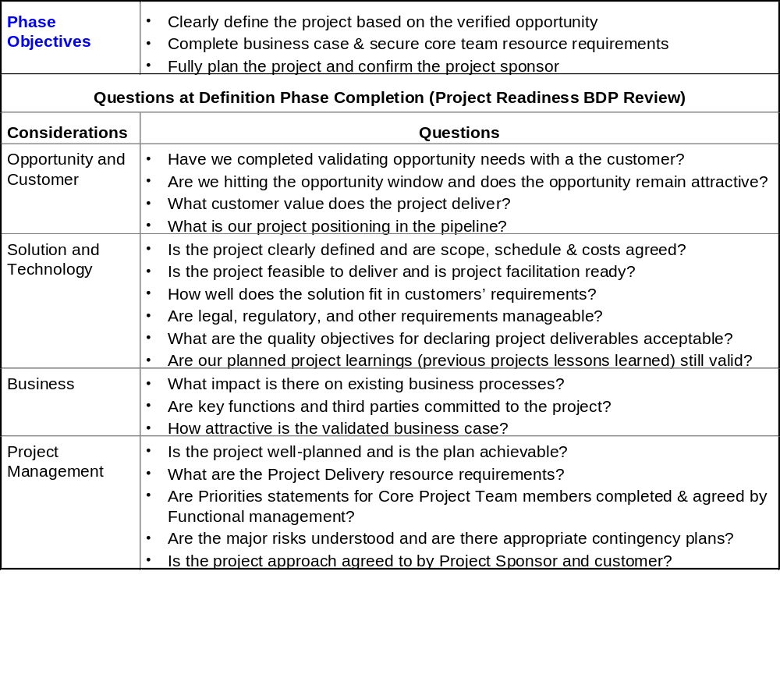
Definition Phase Objectives
Project Readiness BDP Questions

