Slide 1

1999
Presidents’
Forum

Slide 3
1999
Presidents’
Forum

Slide 5
Presidents’ Forum
Customer Support Services Team

Slide 6
Team Members
Pascal Debon Team Leader
John Roddy Team Leader
Eric Ross
Don DeBoer
Dianne Prowse
Randy Hedrick
Richard Reid
Patty Goyette
Ken Pecot
Ron Walters
Stan Chilton
Charles Drayton
Ross Lau
Bill Joll
Pete Meldrum
Monty Parker
Susan Spradley
Mysore Prakash
Simon Littlejohn
Alf D’Silva

Slide 7
Nortel Service History
“Those Account and Product Guys, always giving away our product for free.”
“Had to decrease their margin, but main product got it’s price”
1989 - Young Regional Sales Manager gives away 5 years EWP to acquire $100m DMS Contract

Slide 8
Nortel Service History
One Industry VP said:
“Do you really think the customer thinks it’s free?”

Slide 9
Nortel Service History
Past:
It’s been an internal thing!
From Here:
Services Portfolio is growing and Mission Critical

Slide 10
Market Analysis

Slide 11
Why we need
Customer
Support Services...

Slide 12
This is what our customers want...
New Technologies and new networks will continue to be the driving force for outsourcing. Interested in vendors with proven track record and global reach.
We will certainly outsource services such as RF engineering which require high level of technical competency. We are not motivated to explore outsourcing of network operations, unless there is a financially compelling offer.
One of our international strategies is to offer services across European countries. In these countries we compete as new entrants against the incumbent operators. To deploy infrastructures we ask suppliers for “turnkey projects”. We need professional services
to do it.

Slide 13
proven track record
and global reach.
British Telecom
Vodafone-AirTouch
financially compelling offer.
“turnkey projects”
professional services
Telefonica

Slide 14
Customer Needs
NEW
Network Evolution
Presourcing
RBOCs & Established Service Providers
New & Convergent Service Providers
Services
Outsourcing
Global Resourcing
RBOCs & Established Service Providers
Global Carriers and Expanding International Providers
EXISTING
NEW
Markets

Slide 15
Competitive
Landscape

Slide 16

IBM
IBM
Lucent
Cisco

Slide 17
IBM
IBM Global Services - Revenue & Margins
35%
Strategy
Reengineered itself to become a professional services firm not just hardware and software vendor
35
29%
32%
Share Price
$
1
4
0
30
$
1
2
0
12-fold increase
Moving from Vendor
$
1
0
25
0
%of Total Revenue
to Solutions Provider
$
8
20
0
Actions To Date
Focussed stand alone business
Organized by vertical industries and functional expertise
Provide e-business driven solutions
$
6
0
15
$
4
0
10
$
2
0
5
0
0
9
3
9
4
9
5
9
6
9
7
9
8
9
9
1996
$22B
1997
$25B
1998
$29B
35%($29B) of 1998 Total Revenue,
15% Growth, $51B Backlog

Slide 18
IBM
IBM
Lucent
Lucent
Lucent
Cisco
Cisco

Slide 19
Lucent
Strategy
Become a dominant player in the telecom services market
NetCare
Integral part of GSP (sales and marketing) Enterprise & Carrier.
More than 19,000 employees
  Matrixed to products
Well ahead of competition in providing system solutions
Moving to IBM model.
Actions to Date
Built a powerful systems solutions & OSS portfolio.
  INS
  Keenan
  Ascend
Built a powerful services brand in NetCare
  Provides network solutions including network operations

Slide 20
IBM
Lucent
Cisco
Cisco

Slide 21
Cisco
Strategy
Move from box supplier to solutions provider including
business solutions
“The Internet ecosystem is the business model of the Internet economy.” – Cisco
Actions to Date
Introduced Total Implementation Solutions (TIS)
– January ‘99
  Includes planning, design and implementation
Introduced the “New World Ecosystem” programming
– May ‘99
  Works with third party developers to produce
  end-to-end e-business solutions based on Cisco’s API
KPMG Investment and IBM strategic alliance – August ‘99

Slide 22



IBM
“Total Systems Management Services: meet future needs and current demands”
strategies
Lucent
Cisco
“You can run your business while we run your network”
“We are your business partner for the e-commerce and
Internet space”

Slide 23
Opportunity:
Global Carrier Services Market
$142B
$160
CAGR = 16%
$140
$120
$90B
$89B
$100
$ in Billions
$80
Total
Market
$60
$37B
CAGR = 34%
$40
Carrier
Services
Market
$20
$0
1999
2002
* Does not include associated hardware and software market such as OAM and Billing.
Source: DataQuest
Source: Internal

Slide 24
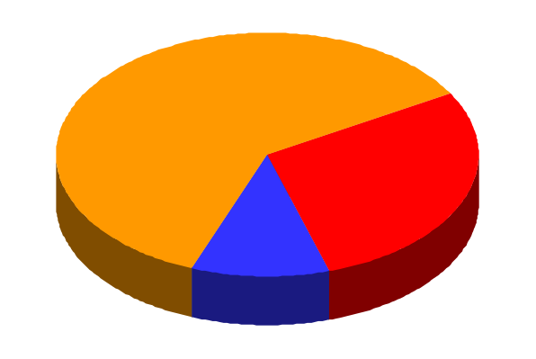

Nortel Networks’ Current
Services Business
1998 Nortel Networks Product &
Services Revenue Split
$2.3B Services Revenue
Breakdown (Estimates)
EF&I
14
$12.3B
12
Services
10
$1.8B
8
$2.3B
$B
6
$4.9 B
Network
4
$0.5B
2
$4.4B
$10.5B
Product
0
Enterprise
Carrier
Business
Service
Nortel Networks is in the business today

Slide 25

Strategy:
To focus on Nortel Networks leadership in enabling
network services
Complete suite of build and operate services
Professional Services focused on unlocking the revenue potential of the network
Service Provider
We are your network partner from
business case to the bottom line,
enabling network services

Slide 26
This is what
we need
to do...

Slide 27
What do we have to work with?
Traditional Customer Service
Professional Services

Slide 28
Traditional Customer Service
Why do we need to change?
Cost
Single interface to customer
...
How?
Organizational consolidation - Done!
Transformation of team is the next step

Slide 29
Sales Process
Customer
Channel to Market
Solution
Hardware Software Services

Slide 30



Sales Driver
Customers
Channel to Market
Hardware
Software
Services
Middle Ages
Renaissance
3rd Millennium

Slide 31
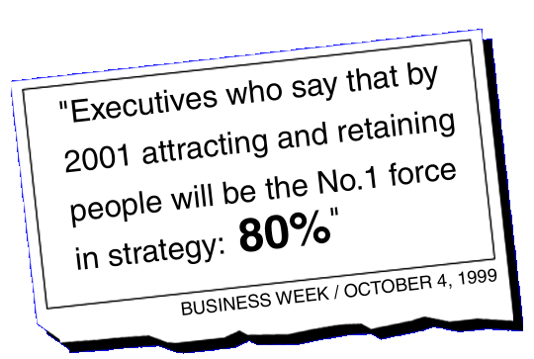

Slide 32
Change in the Market
Old Model
New Model
Vendor
Vendor
Partner
EFI
EFI
Network
Consultant
Basic
Basic
Cutting
Edge
“Boxes”
“Boxes”
Solutions

Slide 33
Target of Nortel Networks Revenue from Services
30%
Cultural Transformation:
from RBOC
to ISP mentality

Slide 34
Today’s Challenge
Competitors understand the changing market
they are ahead of us
    Cross-corporate brand
    Major market communications
    Mergers and acquisitions

Slide 35
we
must
act

Slide 36
Team
Recommendations

Slide 37
Required Services
P o r t f o l i o
Business &
Consulting
Services
Network
Optimization
Services
Product Performance
Services

Slide 38
Required Services
P o r t f o l i o
Business and Market Planning
Application Planning & Introduction
Operations Consulting
Service Launch
    Network Planning & Design
    Network Integration
    Operations Solutions/NOC Centres
    Program and Project Management
Business &
Consulting
Services
Network
Optimization
Services
Product Performance
Services
    Maintenance & Technical Support Configuration Management
    Technology Deployment

Slide 39
Gaps in Our Requirements
Multiple product-oriented customer service structures
No single service face to customer / RBOC-centric
Data IP engineers in short supply
Systems integration skills missing or in short supply
Operational Support Systems (OSS)
Customer relationship management
Applications development
OEM management
Multi-vendor knowledge
Nortel Networks has not positioned itself as a
strong player.
Need to productize Nortel Networks services

Slide 40

Transformation Steps
Actions
NOW:
Key pillar in Nortel Networks branding
Integrate Cogent and Carrier Professional Services
Integrate sales force into major accounts and establish account plans (quotas) for services
Create a services PMT to drive strategy & investment
Identify appropriate acquisitions/alliances
Initiate a comprehensive transformation of services skill set
2000:
Acquisitions/alliances: close the deals
Tools/process investment plan
Consolidate financials (P&L) for services to track results

Slide 41
end game
Changed value proposition
for Customers
end game
Changed value proposition
for Customers

Slide 42

Branding - Add Services Pillar
Nortel
Networks
Integrated in total solutions offer
Identified globally
Seamless carrier and
enterprise offer
Support with acquisitions
Consistent and trusted
Unified Networks
Intranet Services
Optical Internet
Wireless Internet
Internet Telephony
Customer Needs
Make it central to our offer

Slide 43

Branding - Add Services Pillar
Nortel
Networks
Integrated in total solutions offer
Identified globally
Seamless carrier and
enterprise offer
Support with acquisitions
Consistent and trusted
Unified Networks
Intranet Services
Optical Internet
Wireless Internet
Internet Telephony
SERVICES
Customer Needs
Make it central to our offer

Slide 44
Target Global Strategic Clients
Integrate services sales force into account teams
Create service sales strategies by account and target revenue (quota)
Invest services expertise & resources into account teams
Develop & experiment (outsourcing / consulting) Dedicate Integrated Project Teams (IPTs) to fulfill agreed customer projects
Highlight/reward initial successes

Slide 45
make it real!
make it real!

Slide 46

Creation of a Services PMT
Charter:
Fast integration of services into product
portfolio through proper investment prioritization
Appropriate
Major Account
Teams
Customer
Service
Professional
Services
Segment
Primes
Strategy
Services branding
Acquisitions & alliances
Processes & tools
Skills enhancement

Slide 47
Acquisitions & Alliances Objectives
Fill gaps quickly
  Obtain needed skills, tools, and human resources
  Support/reinforce & acquire brand equity
Drive exponential revenue growth

Slide 48

Customer Service Organization
Customers
Market Service Operations
US
Carrier
Enterprise
Canada
Carrier
Enterprise
CALA
Carrier
Enterprise
Europe
Carrier
Enterprise
Asia Pac
Carrier
Enterprise
Escalations & Support
Knowledge & Readiness
Product
Service
Operations
Customer& Professional Services
Succession
Optical
High Speed
Access
Data
Wireless
Enterprise

Slide 49
Transforming the Customer Services Skillset
Old Skills
New Skills
Telephony knowledge
EF&I
RF
Basic applications
IP knowledge
Data skills
Advanced applications
Network operations management

Slide 50
Actions
Recruit / Alliance / Acquire / Outsource “service professionals”
Data/IP training plan
Buddy system in place for cross-training
Network operational/cost management training
Sales 101 for Customer Facing Teams
Business acumen training
…
Deliver on “Customer for Life” philosophy

Slide 51
Summary

Slide 52
Operators need a different approach from vendors
Our competitors have a lead
We must change our approach to change our offer
  Services central to Brand
  Target strategic customers
  Acquisitions and alliances
Drive as business with P&L in 2000

Slide 53
1999
Presidents’
Forum

Slide 54
1999
Presidents’
Forum

