Slide 1

Information Systems Process Assessment
Fundamentals Training
1998
Notes:
1

Slide 2
Introductions
Name
Location
Primary Responsibilities
Familiarity with Subject Matter
Course Expectations
Hello!
My Name is…….

Slide 3
Course Objectives
To present
  Overview on how to conduct an ISPA
To provide
  Experience developing the main work products

Slide 4
Agenda
Start-up Activities
ISPA Fundamentals
Planning an ISPA
Conducting an ISPA
Analyze ISPA Results
Course Wrap-up

Slide 5
ISPA Fundamentals

Slide 6

IS Process Assessment is a Tool
Provides I/S organizations an initial analysis of process, organization and technology areas
Documents gap between the I/S organization’s current processes and CSC recommended practices
Provides foundation for process improvement program

Slide 7




ISPA Assesses an Organization’s Ability to Maintain Legacy Systems & Formulates an improvement Program
Project
Management
Quality
Assurance
Configuration
Management
Demand
Management
Usable
Practices
System
Engineering
Analysis
Missing
Processes
Action Plan
Needs
improvement
Climate
Best
Practices
Current
Tools &
Skills
Benefits
Risk
Human
Factors
Costs
Site
Processes
Notes:
Assesses process against CSC best practice processes
Identifies good site practices to populate
Educates the site team on the missing elements
Identifies improvement opportunities & assists the account in determining where to concentrate for the best return
Assists in the formulation of a process improvement plan

Slide 8





Time Line for an Assessment is a Minimum of 6 Weeks
1 - 2 days to Plan the Assessment
2 Week to Analyze Gaps & Develop Action Plan
One Week to Conduct Assessment
Presented to Management the Release Plan for Process Insertion with Buy-in from Implementers
Sponsorship is Confirmed
& Account lead is identified.
Notes:
Elapsed time is a minimum of 6 weeks. Planning will not be a full time job. The client needs time to get together the required information and to begin their communications program.
Actual time will depend on the specific engagement.

Slide 9

TMG Policy & Procedure Lotus Notes Database
Practice Guide
Samples of Work Products
Templates

Slide 10
Planning an ISPA

Slide 11
ISPA Planning Provides the Foundation for the Assessment
Determine
Interest
Brief
Executive
Determine
Scope
Develop Engagement Letter
Form &
Train
Team
Request
Advance
Materials
Develop
Communication
Program
Conduct
User Management
Briefing
Identify
Participants
Prepare Work Plan,
Logistics &
Facilities
Review
Advance Materials
Customize
Assessment
Materials
Assessment
Planned
Notes:
The first phase, Planning the Assessment, if performed in order to prepare the site for an assessment.
While each activity may not require large amount of time, the duration of this stage normally requires a minimum of three weeks.
Two important show stoppers are:
lack of strong sponsorship is required
if an organization lacks the the will to implement the insertion strategy
Tasks in this phase need to be customized to reflect the type of engagement, the relationship of IS to their customer and the culture of the IS department.

Slide 12
Assessment Start-up Tasks
Brief the Executive **
Develop and Send Engagement Letter **
  Can be a statement of work, confirming memo or engagement letter depending on type of engagement
Form and Train Assessment Team
Determine Scope and Focus
Develop and Execute Communication Program
Notes:
Brief the Executive
2 - 3 hours in length
Provide a common grounding to the I/S Executives on the assessment
Tailor presentation to interests of audience
Outcome is authorization to proceed and a active, visible sponsor

Slide 13
Determining Team Members
The make-up and size of the team will vary depending on the type of assessment.
Average size of team is 5 members
The team has two components
  External Members
    Assessment Team Leader
    May included members with additional expertise
  Site Members
    Site leader must be the person who will be responsible for implementing improvements
    May include metrics, infrastructure, toolbox expertise
    May include “legitimizers” of the organization
Select people with open minds
Notes:
The people responsible for the implementation plan MUST be involved. The participation in the assessment is part of the education program for them to understand what types of changes need to be made in their organization
Identify the members of the assessment team and assign each member general roles
Validate the members availability
Provide training for the team members

Slide 14
Determine Scope of Assessment
Whole Organization
  Uses a representative sampling across organization
  Similar to the SEI method
  Target improvement area is total organization
  Still allows for piloted roll-out of improvements
Pilot Group
  Assessment and improvement plan focused on a specific group
  All improvements are implemented in this group
  Roll-out to the rest of organization is assessed as a separate project

Slide 15
Assessment Scope Pros and Cons
Pilot Group
Whole Organization
Pros
  Initial costs are less
  Less disruptive to organization
  Allows for the selection of a group of early adopters & forward thinkers
Cons
  May cost more in the long run
  Productivity of the group is greatly reduced during the assessment
  Myopic view, only sees what one group does
Pros
  Only one implementation plan needed
  No one group feels that it has been selected for scrutiny
  Reduces rework on processes being implemented
  Provides a vehicle to identify ways of doing business that should perpetuated
  Considers needs across an organization
  Improvements to the processes may still be piloted in different parts of the organization to reduce shock
Cons
  Implementation of improvement plan will take longer
Notes:
An organization that appears to have several fragmented processes, should still consider a whole organization approach
The scope does not change the number of participants

Slide 16
Determine Assessment Focus as Part of Scope
Typical assessment will cover 3 -5 focus areas
Focus areas are determined by organizations’ interests, maturity levels, known problem areas and reason for the assessment
Focus areas Candidate
  Configuration Management
  Demand Management
  Process Management
  Project Management
  Quality Management
  System Engineering
  Technology Management
  Training
  Subcontractor Management
Notes:
Common focus areas for typical organizations are:
Configuration Management
Demand Management
Project Management
System Engineering
Quality Assurance
These category have some relationship to the SEI KPA but are not one-to-one. For more information on their relationship there is a matrix showing what elements of the assessment support which KPA.

Slide 17
Develop and Execute Communications Program
Announcements to the organization that an assessment will take place, why it is occurring, and how the results will be used
Information to the participants on what their role is and what will be occurring
Interim progress information on what has occurred and what are the tentative findings
Information on the recommendations and how the organization plans to proceed
Progress announcements on the execution of the improvement plans
Notes:
The mechanism of the communication will be dependent on the organizations culture
It is important to address the “what is in it for me” question
Appoint a point person that is identified in the communication vehicle to whom questions can be addressed

Slide 18


Assessment Preparation Work
Standard
Process
Available
Documents
Tailored
Process
Client/Account
Issues
Assessment
Team
Time Line
Participants
Sponsor
Expectations

Slide 19


Prepare Workplan, Arrange Logistics, and Prepare Schedule
Tailor Standard Process
Establish assessment schedule
Arrange logistics
  Room reservations
  Equipment and supplies
  Refreshments
  Access to building
  Reproduction resources
Generate work plan

Slide 20
Identify Participants
The scope and focus are the drivers for identifying participants
Participants are selected for their specific role
More than one participant is selected for many of the roles
A participant may play more than one role
Not all participants will be involved in all activities
Confirmation letters are sent to all identified participants
Notes:
Do not place managers and their employees in the same group
Do not select people just because they are available
Select participants based on their knowledge of how things really work and not how they are suppose to work

Slide 21

Request and Review Advance Materials
Advance materials are gathered to provide a foundation for the assessment team
Materials are gathered in the team “war room”
When appropriate, copies are sent to team members
Results of the review include:
  Identification of areas to explore
  Identification of elements to verify
  Insight to site language and culture
Notes:
Ask the group what types of advance materials do they think might be useful. Answers should include:
organization charts
Standards and procedures
Sample requests
Architecture plans
Inventory of tools, techniques, hardware or methodologies
Change control logs
Back logs
Previous assessment or survey results
Metrics
standard management reports

Slide 22

Prepare and Conduct User Management Briefing
Brief the user management on the assessment
Ask for user participation in the assessment
Request the user management to show support by speaking at the Kick-off meeting
Notes:
This activity is always done by the site management

Slide 23
Customize Assessment Materials
Assessment materials are customized to reflect
  Scope and focus of assessment
  Site-specific language
  Previous assessment results
  Site “hot buttons”
  Organizational culture
Types of materials to customize
  Kick-off meeting presentation
  Skills and technique survey
  Role questions
  Workshop materials
  Final Report and presentation template

Slide 24

Introduction to Case Study
Form Case Study Teams
Read Introduction to Case Study Materials
Answer Team Exercise 1 Questions
Time: 30 minutes

Slide 25
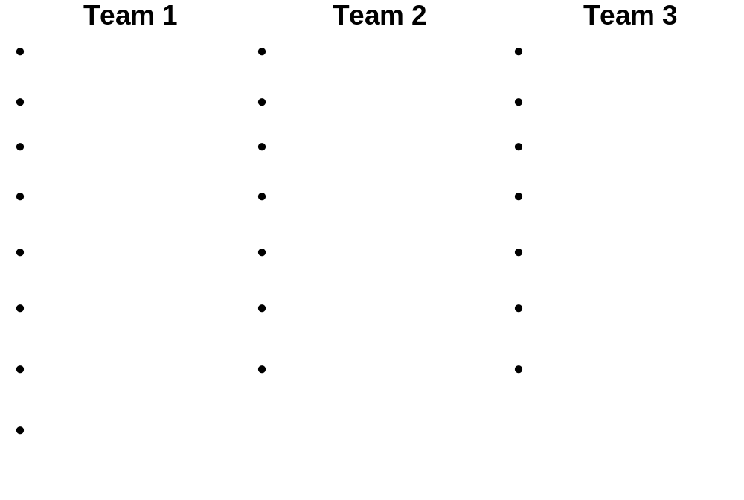
Exercise Teams

Slide 26
Conducting an ISPA

Slide 27






Assessment Week
Kick-off
Meeting
Workshops
Interviews
Preliminary Findings
Presented
to Participants
Surveys
Document
Reviews

Slide 28
Many Tasks for Conducting an ISPA are Executed in Parallel
Time To Conduct Assessment
Conduct
Kick-off
Meeting
Conduct
I/S Process
Workshop
Conduct
Role
Interviews
Complete
Measurement
Gathering
Consolidate
Surveys
Conduct Tools
& Technique
Workshop
Summarize
Preliminary
Findings
Present
Preliminary
Findings
Assessment
Information
Gathered

Slide 29
Plan and Conduct Kick-Off Meeting
Provides the participants an understanding of the assessment process and their involvement
Demonstrates organizations commitment by management
Mechanism for distributing schedule, surveys and role questions
Provides a forum for participants to voice concerns
Integrated into the communication plan

Slide 30
Conduct Role Interviews
Structured information gathering sessions
Participants clustered by role
Session length typically 1 1/2 hour, depending on number of questions and participants
Customized questions are used but interviewer may add additional questions for clarifications or reduce the number of questions
Scribe documents information during session

Slide 31

Conduct I/S Process Workshop
Formal workshop based on Catalyst Process Mapping Workshop
Documents how work is really done, not how it is supposed to be done from time that idea is thought through implementation
Include wide range of roles including customer
Duration is normally full day

Slide 32

Consolidate Skills and Techniques Survey
Surveys distributed during Kick-off session
Consolidate Information
Primarily a data input task

Slide 33
Conduct Tools & Techniques Workshop
Informal Workshop
Based on information provided in other activities
Participants are mainly people in technical roles
Duration normally 4 hours
Areas to focus on
  How wide spread is the use?
  Are there competing products?
  Why is the use of some tools declining?
  What is being under utilized?

Slide 34
Complete Measurement Baselining Readiness Analysis
Highly dependent on process maturity of organization
Gather available information in order to baseline organization’s processes
Identify missing elements and determine if they can be obtained through another mechanism
Establishing missing baseline information is a key activity in beginning of improvement plan

Slide 35
Summarize and Present Preliminary Key Findings
Present the preliminary findings back to the participant to gain feedback on whether the team heard the participants correctly
Findings assembled quickly and are not a polished presentation
Encourage participants to react
The findings are fact based with no indication of rightness nor solution

Slide 36
Preliminary Findings Sample
Organizational readiness to improve is apparent and people are committed to producing quality products
Several projects have been using tools, metrics collection, and analysis innovative manner
Current environment is “Date driven”
No visible, dedicated resources specifically committed to ensure implementation of process improvements
Project management procedures and training have been a focused area
There is a lack of early involvement of CSC by the customer
Acceptance criteria and planning is not always done

Slide 37
Preliminary Findings Quiz
Mark the statement out of each group that is the better worded preliminary finding
There is no penalty for non-compliance with division policy & procedures
There needs to be a penalty for not following policy & procedures
Performance reviews need to include the following of policy & procedures
No one enforces consistency in what procedures they use
Lack of consistency between groups at the procedural level
Each group does what they want
There is opportunity for improving the testing environment
Testing is done poorly
Test planning needs to be implemented
Notes:
This quiz is trying to enforce just what a preliminary finding is and is not.
Have the the people do it individually then discuss it as a group.
First group
Correct
Incorrect - Judgmental
Incorrect - States possible solution
Second group
Incorrect - Judgmental
Correct
Incorrect - Too blunt
Third group
Correct
Incorrect - Judgmental
Incorrect - States possible solutions
Note: Make sure they have a clear understanding before going on to the exercise.

Slide 38

Team Exercise 2
Review rest of Case Study Materials
Develop Preliminary Findings
Time: 1 Hour
TIP: Preliminary findings do not include the solution

Slide 39
Analyze ISPA Results

Slide 40
Analyzing the ISPA Results is the Meat of the Assessment
Document
Other Observed
Findings
Compile
Infrastructure
Information
Information
Gathered
Analyze
Skill Survey
Conduct Gap
Analysis
Determine
Insertion
Strategy
Formulate
Insertion
Workplan
Review
Strategy With
Management
Prepare
Business
Case
Prepare
Final
Report
Conduct
Executive
Briefing
Perform
Project
Wrap-up
Assessment
Complete

Slide 41
Conduct Gap Analysis Using CSC “Best Practices”
Activity is done for each focus area included in assessment
Used to distill the large volume of information and gauge it against a predefined scale
If an element does not fit neatly in the predefined levels, use the “spirit” of the level.
Document results in Gap Analysis Worksheet
Notes:
Pass out the Gap document so the students can see what it looks like.
Pass out the Gap Analysis Worksheet

Slide 42
Document Other Observed Findings
Capture salient observations, not documented elsewhere about the organization, it’s culture and operating practices
No formal structure
Very dependent on the types of information found

Slide 43

Analyze Skills Survey Results
Use primarily information from the consolidated worksheet
Determine what areas are strengths and which areas will need to be addressed to support the improvement plan

Slide 44
Compile Infrastructure Information
Document and assess elements of the I/S organization that will impact the environment in which the recommendations will be implemented
Very engagement dependent activity
Elements include:
  Training
  Cost Collection methods
  Outsourcing contract obligations & performance requirements
  Workflow management tools
  Other areas initiatives
  Server administration
  Network considerations
  Organization strategic directions

Slide 45

Team Exercise 3
Perform Gap Analysis using the Gap worksheet and criteria matrix for Demand Management, Project Management, Quality Management and Configuration Management
Document any other observed findings
Present ratings for each subphase, how the team approach the ratings and any observed findings
Time: 2 1/2 Hours
Notes:
Need to explain where they can find the criteria and worksheet in their manuals.
Explain just how to use the documents and emphasis what focus areas to do and how to handle gray areas.
The instructor can clarify information. The teams may want the instructor to act as a sponsor. Remind the team that in real life, the team will have limited interactions with the sponsor expect at prescribed time. And even at those meetings, the sponsor will be looking for the assessment to provide direction.
During exercise review, have each team present the ratings they gave for each sub area. Also have them discuss how they approached the assignment

Slide 46

Determine Insertion Strategy
Review findings and determine recommended level
Determine any supporting environmental changes associated with the recommendations
Prioritize by improvement value and amount of effort into releases

Slide 47

Review Findings with Management
Review recommendations with sponsor
“Trial balloons” should have already been launched to sponsor
Provides feedback on insertion approach and findings

Slide 48

Formulate Insertion Workplan
Decompose improvement elements
Involve those who will be responsible for implementing to ensure buy-in
Develop Workplan for the first two releases

Slide 49
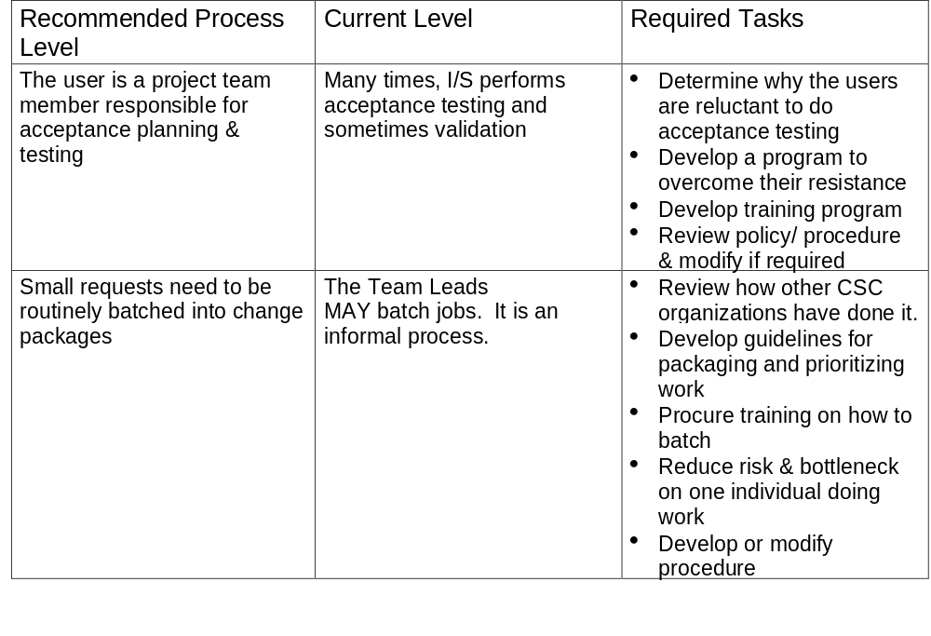
Sample Decomposition

Slide 50

Prepare Business Case
Needs to be done by the site people
Requires baseline data
Format is driven by the what is expected by the organization

Slide 51
Prepare Final Report and Executive Findings Briefing
Summarize and consolidate information gathered and developed during the assessment.
Final report provides:
  Information on how assessment was conducted
  Detailed level findings
  Detail recommendations and insertion strategies
Executive Findings Briefing provides the information on the most important findings and at a summary level.
Graphics can be used to show gaps in the processes

Slide 52



Demand Management: Change Management
DM01
A Request for service is submitted stated as business problem / opportunity
Provides information on business benefit (ROI) (including associated risks)
Recommends schedule/timeframe
I/T Practitioners
Change Request
A
Business Initiatives
D
Change Control Board
Change Packages are reviewed for merit
Change Packages are evaluated and cross business unit priorities are balanced with funding and resources
Change packages are reviewed and either allocated to a release, back-log or rejected
End Users
Change Request
Status
Change Control Board
Change Package
Requestor
Change Control Package
Change Request
Acceptance Criteria
Requirement Document
Change Control Package
Change Request
Acceptance Criteria
Requirement Document
Change Control Package
Change Request
Acceptance Criteria
Requirement Document
Change
Request
Package
Back Log
Release Management
APER
DM02
Service
Request
Existing Release Definitions
Enterprise
System
Architecture
B
Change Control Office
Consolidate (Batch) Change Requests in to a change package that provides greatest business value
Prepare supporting materials
Distribute to CCB
Research, elicit & document requirements
Document acceptance criteria
Review Change Request with Change owner
I/T Budgets
Provides first level support to satisfy request
Verify “change owner” of request
Checks for completeness, duplication or overlap
Classify type of work
Assign tracking number & assign status
Help Desk
Change Control Package
Change Request
Acceptance Criteria
Requirement Document
Estimate
Domains of Change Index
Change Control Package
Change Request
Acceptance Criteria
Requirement Document
Estimate
Domains of Change Index
Business Priorities
Change Control Analyst
Request Tracking
C
Software Engineering
Lessons Learned
Enterprise
Architecture
Change Request
Analyze Problem to develop high level solution
Propose system & user changes
Analyze Impacts
Develop estimate of effort, cost and schedule
Develop cost/benefit analysis in order to support business decision.
System Document-ation
Review all Change Requests including backlog
Categorize on severity, type, system, date required
Identify potentially related requests
Assign to Project Manager
SE Analyst
Change Request Coordinator
Change Control Package
Change Request
Acceptance Criteria
Requirement Document
CSC Corporate Metrics
Change Control Package
Change Request
Acceptance Criteria
Requirement Document
Estimating Guidelines
Estimating History
Change Request
Acceptance Criteria
Requirement Document
Historical Planning Data
5/5/97 TGA-N211

Slide 53
Team Exercise 4
Develop Insertion Strategy
Decompose Release 1
Present strategy and recommendation to management
Time: 3 1/2 hours
Recommendations

Slide 54

Course Wrap-up

