Slide 1


Model Checking Functional Integration of Human Cognition and Machine Reasoning
Eric Mercer*
Brigham Young University
Provo UT, USA
Keith Butler
University of Washington
Seattle WA, USA
Ali Bahrami
Bionous LLC
Kirkland WA, USA

Slide 2

Functional integration of human cognition and machine reasoning is challenging especially where failure risks health or safety
Notes:
Human machine teaming is fast becoming ubiquitous as machine reasoning and automation is integrated into workflows.
It business, it creates a capitol risk.
It healthcare, it creates a health and safety risk.
As workflows are defined that include automation or machine reasoning, functional integration is very important.

Slide 3
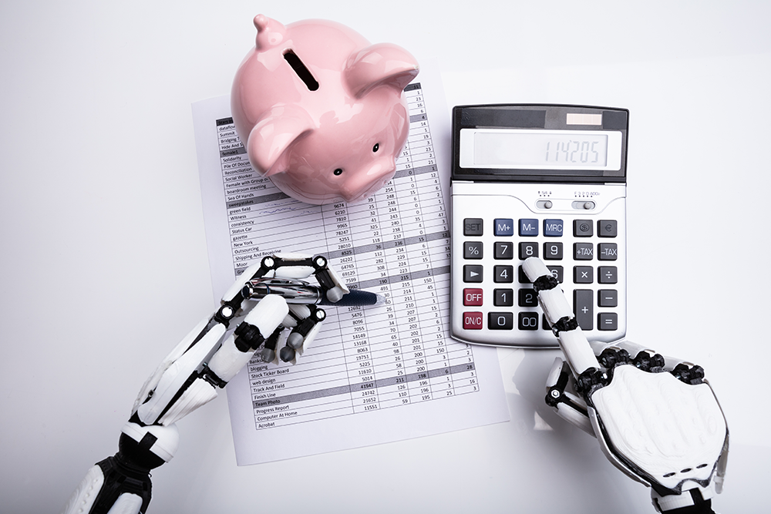
The vast difference between humans and machines challenge conventional methods of integration
Notes:
There is an inherent discontinuity in performance and ability between a human and a machine.
That goes both ways.
There are things the machine can do that the human cannot and there are things the human can do that the machine cannot.
When thinking of functional integration, these differences in ability and performance challenge traditional methods.
Conventional methods are event sequence diagrams and use cases. These do not directly address decisions, and they do not specify the behavior of the entire system. These are just a set of scenarios. They don’t address integrating these scenarios.
Other conventional methods focus of appropriate responsibility assignments. Assignments are not integration.
UML sequence charts are not functional integration. Who-should-do-what is not integration either.

Slide 4
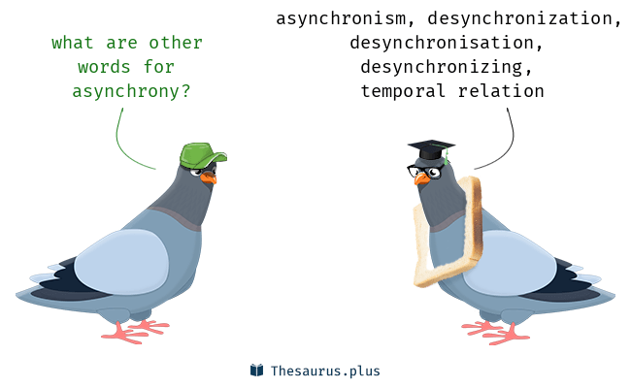
Asynchrony and distribution make manual analysis of systems difficult at best
Notes:
Humans are not good when it comes to reasoning about asynchronous interaction.
They don’t see emergent behavior, and they don’t see unintended consequences of synchronization (or the lack thereof).

Slide 5
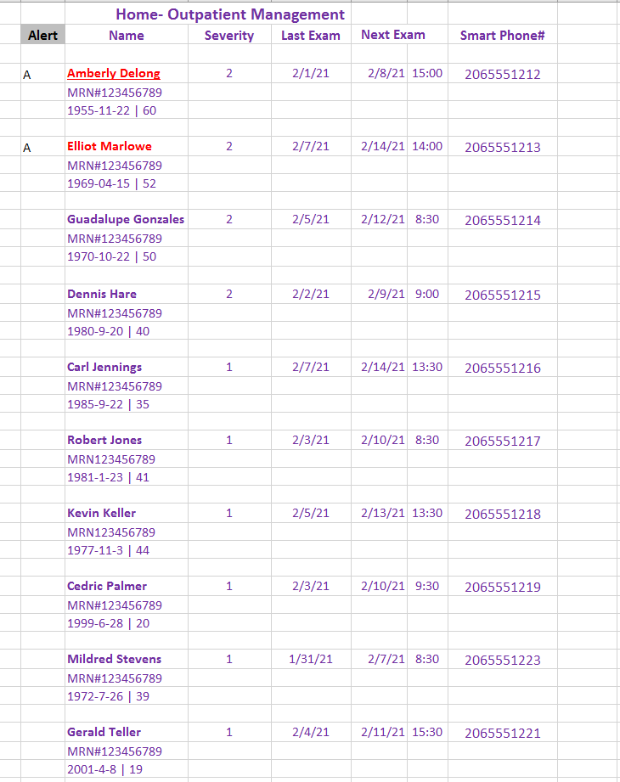
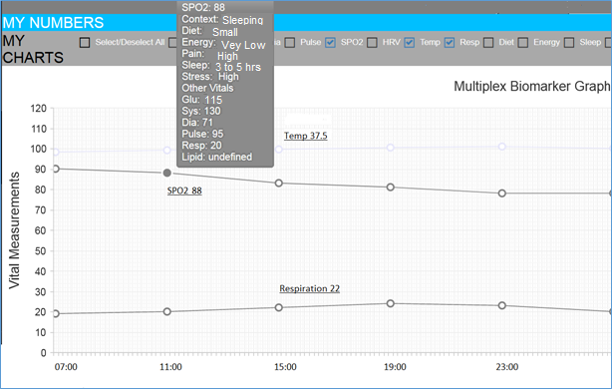
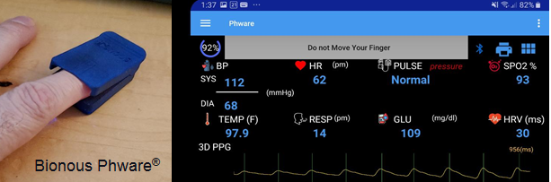
Remote Patient Monitoring
Notes:
Complex, distributed, asynchronous and safety-critical
Patent-pending technology for a single finger-clip to capture 7 major vital signs in a single 60-90 second session.
The clip sends data to a smart phone app to relay to the AI Cloud Server, where numerical values are assigned and time trends analyzed.
An alert is generated if changes in vitals exceed healthy limits.
Doctors or nurses can monitor the patient’s vitals remotely with a special web app. The app prioritizes the patients with alerts, and the data of an alert can be reviewed with one click.

Slide 6
Proposed Solution
What
How
Cognitive Work Problem (UML)
System Design (BPMN)
To Linear Temporal Logic (LTL)
To Process Meta Language (Promela)
Model Checking (SPIN)
Does the BPMN implements the CWP?
Notes:
We distinguish between WHAT a system must accomplish vs HOW it will do it.
Graphical standards were used to include doctors and other SMEs to participate and critique design
The graphs must be translated for formal model-checking. UML state machines to LTL and BPMN to Promela.

Slide 7
The CWP of remote patient monitoring is actionable risk awareness
Defined with a UML State diagram
Notes:
Computation Independent Model
Content based on NIH Guidelines for non-hospitalized COVID patients.
Defines the state for the functional integration—see the conditions on the edges.
Finite state machine represents-
relevant states home care patients can occupy
physical events and exam findings that guard state transitions.
Graphical UML standard that allowed SME participation in design.

Slide 8
UML Translation to Linear Temporal Logic
1. State
Identify variables
Define states
2. Global Properties
All states covered
Reachable goals
3. State Properties
Reachable
Unique
Allowed edges
2 + 3(N) properties to check on BPMN

Slide 9
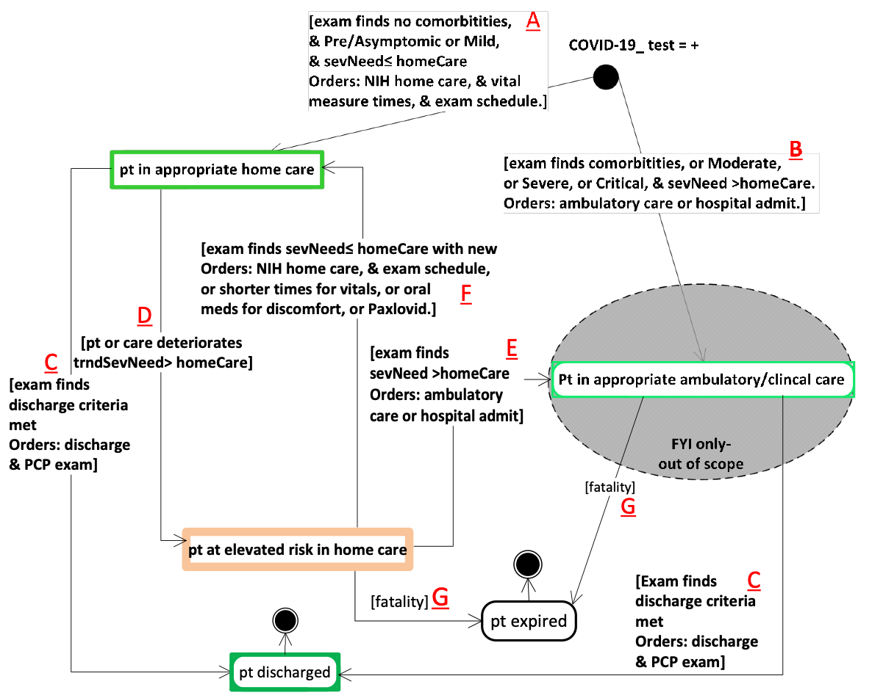
1. State: variables
Actionable Risk Awareness in Remote Patient Monitoring
orders (A, B, C, E, F)
sevNeed (A, B, E , F,)
homeCare (A, B, D, E, F)
trndSevNeed (D)

Slide 10
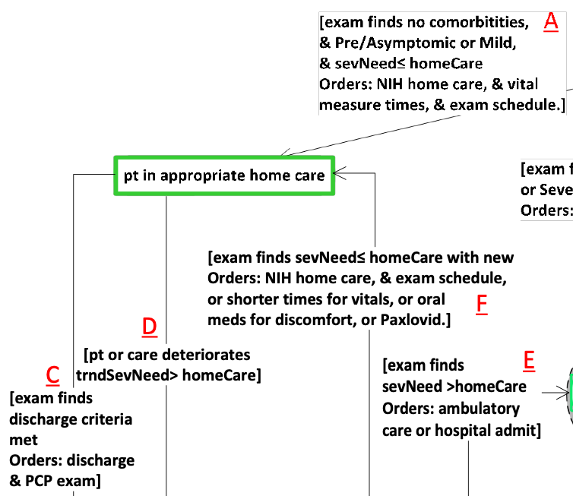
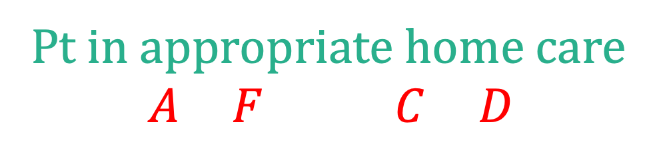
1. State: definitions
Actionable Risk Awareness in Remote Patient Monitoring
Defined by conditions
Must satisfy input conditions and
Must not satisfy any output conditions
2
2
Pt in appropriate home care
$$\left(A∧F\right)∧¬(C∨D)$$

Slide 11






2. Global Properties
Actionable Risk Awareness in Remote Patient Monitoring
2
1
The system design state, when mapped to the UML state variables, is always in a state
4
1
$$∨$$
2
$$∨$$
3
always
$$∨$$
4
$$∨$$
5
$$∨$$
6
3
The goal states are reachable (fair)
6
5
eventually
5
$$∨$$
6
Notes:
The “object” is the state of the BPMN claiming to implement this CWP.
That BPMN must have a mapping from it’s state to the variables that define the state of the CWP.
Every state of the BPMN must be is some state of the CWP. Always.

Slide 12










3. State Properties
Actionable Risk Awareness in Remote Patient Monitoring
2
1
BPMN reaches state (witness)
fair
$$⟹$$
always
$$¬$$
2
4
BPMN only in one CWP state at a time
$$¬$$
1
$$∧$$
2
$$∧¬$$
3
3
always
2
$$⟹$$
$$∧¬$$
4
$$∧¬$$
5
$$∧¬$$
6
6
Only transitions defined in CWP allowed
5
fair
$$⟹$$
always
2
$$⟹$$
2
until
3
$$∨$$
5

Slide 13
UML Translation to Linear Temporal Logic
✓
✓
✓
1. State
Identify variables
Define states
2. Global Properties
All states covered
Reachable goals
3. State Properties
Reachable
Unique
Allowed edges
2 + 3(6)=20 properties to check for actionable risk awareness in remote patient care with integrated human and machine reasoning

Slide 14
examTime =now
examTime =!now
alert dismissed- no exam orders
System Design in BPMN for PHware Remote Patient Monitoring
examTime =now
Must satisfy the actionable risk awareness CWP

Slide 15
BPMN translation to Promela
1. Token Semantics
Token activation
Consume & pass
2. State Mapping
Import CWP state
Add other state
Add state updates
3. Environment
Define values
Weak as possible
2 and 3 Require Help from Designer

Slide 16
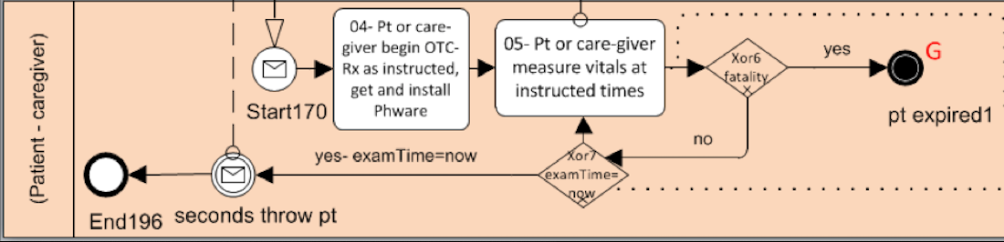
1. Token Semantics
active proctype patientCaregiver() {
do
:: hasToken(Start170) ->
atomic {
consumeToken(Start170)
/* State and environment updates */
putToken(Task04)
}
:: hasToken(Task04) -> …
:: …
od
}
Notes:
There are no attributes on the tokens.

Slide 17
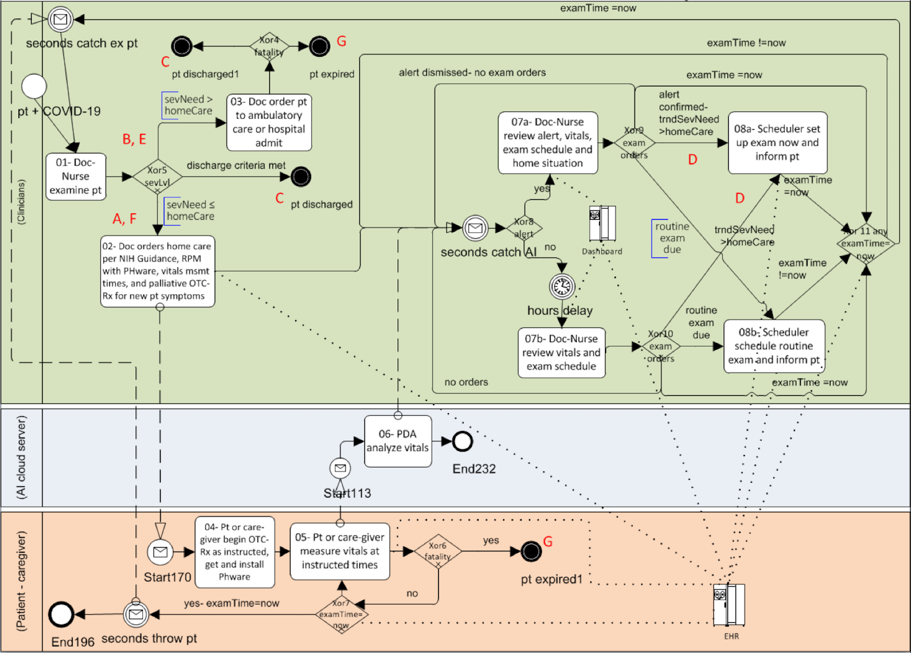
examTime
2. State Mapping
alert
Import CWP state
orders
sevNeed
homeCare
trndSevNeed
examTime
orders
sevNeed
homeCare
fatality
(sevNeed)
trndSevNeed
alert
Add other variables
alert
examTime
Add state updates

Slide 18
2. State Mapping
active proctype patientCaregiver() {
do
:: hasToken(task05) ->
atomic {
consumeToken(task05)
updatePatientMortality(tndSevNeed,sevNeed)
putToken(Task04)
}
:: …
od
}
Notes:
There are no attributes on the tokens.

Slide 19
3. Environment (weakest possible)
inline updatePatientMortality(trndSevNeed, sevNeed) {
if
:: (! isWithinHomeCare(trndSevNeed)) ->
setSeverity(sevNeed, EXPIRED)
:: (! isWithinHomeCare(sevNeed)) ->
setSeverity(sevNeed, EXPIRED)
:: true
fi
}
At Home
Hospital

Slide 20
SPIN Verification Results
./short-verify.sh
never claim + (alwayInAState)
State-vector 60 byte, depth reached 3654, errors: 0
never claim + (fairPathExists)
State-vector 60 byte, depth reached 84, errors: 1
Global Properties
Witness (good)
The PHWare System Design for remote patient care implements the CWP of actionable risk awareness
never claim + (ptInAppropriateHomeCareExists)
State-vector 60 byte, depth reached 84, errors: 1
never claim + (ptInAppropriateHomeCareMutex)
State-vector 60 byte, depth reached 3654, errors: 0
never claim + (ptInAppropriateHomeCareEdges)
State-vector 60 byte, depth reached 3654, errors: 0
Properties for one of the states
never claim + (ptInElevatedRiskHomeCareEdges)
State-vector 60 byte, depth reached 3654, errors: 0
real 1m5.452s
user 1m0.701s
sys 0m3.009s
Verification time
Notes:
SPIN provided several counterexamples along the way to the final verification.
Sometimes the counter-examples revealed issues with the CWP definition of actionable risk awareness.
Sometimes the counter-examples revealed issues with the system design to integrate human and machine reasoning for remote patient monitoring where the design did not maintain actionable risk awareness.
None of the counterexamples were spotted by the designers manually.

Slide 21
Conclusions and Future Work
Functional integration of human and machine reasoning is hard
CWP is a technology-neutral specification of what an integrated human and machine reasoning system must accomplish
The integration itself was developed with workflows using BPMN
UML can be translated into LTL and BPMN into Promela
SPIN verified the BPMN against the CWP of actionable risk awareness
Future work is to complete automation of translations
Raises important questions about the relationship between the system design state and the CWP state: mapping required

