Slide 1


Model Checking Functional Integration of Human Cognition and Machine Reasoning
Eric Mercer*
Brigham Young University
Provo UT, USA
Keith Butler
University of Washington
Seattle WA, USA
Ali Bahrami
Bionous LLC
Kirkland WA, USA

Slide 2

Functional integration of human cognition and machine reasoning is challenging especially where failure risks health or safety
Notes:
Human machine teaming is fast becoming ubiquitous as machine reasoning and automation is integrated into workflows, and it is not uncommon for emergent, unexpected behavior, to arise in such teaming.
Identifying and analyzing emergent behavior is most important in capital, or safety, critical systems where such behavior can lead to significant harm, injury, or even loss of life.

Slide 3

The vast difference between humans and machines challenge conventional methods of integration
Notes:
There are two challenges to analyzing the functional integration in these workflows.
The first is the inherent discontinuity in performance and ability between a human and a machine.
When thinking of functional integration, these differences challenge traditional analysis methods such as use cases with sequence diagrams as these do not reason about the system as a whole, through time, where unexpected behaviors arise.

Slide 4
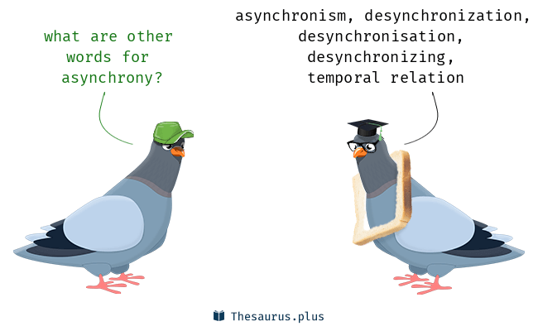
Asynchrony and distribution make manual analysis of systems difficult at best
Notes:
The second challenge is that humans are not good at reasoning about parallel and distributed systems.
Behaviors in asynchronous systems grow exponentially making it impossible to reason manually over any but the most trivial systems.

Slide 5
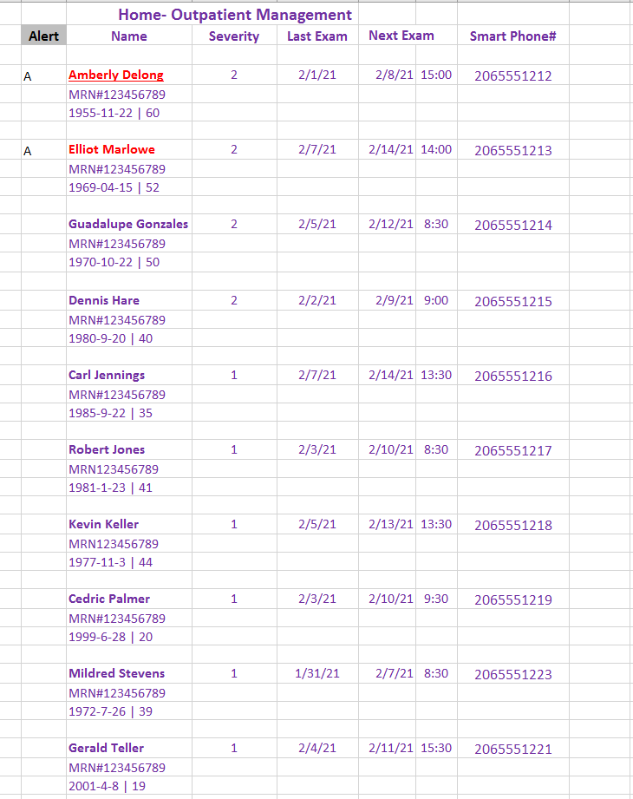
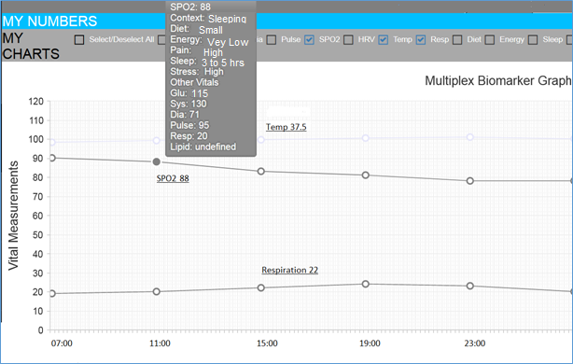
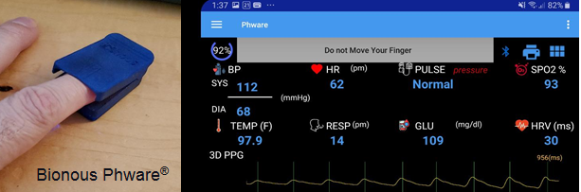
Remote Patient Monitoring with PHware®
Notes:
An example of functional integration of human and machine reasoning is in a system for remote patient monitoring of COVID-19 patients with Phware.
It is a complex, distributed, asynchronous, and safety-critical system.
It consists of a Patent-pending technology for a single finger-clip to measure vital signs.
Those vitals are sent by a smart phone application to the cloud for AI analysis.
The AI predicts trends, and generates alerts, if trends or values exceed healthy limits.
The trends and alerts are sent to doctors or nurses that monitor the patient’s vitals remotely.
The fundamental question about this system is does it ever risk patient safety?
That question cannot be answered without knowing what patient safety means and defining a way to check it on the system.

Slide 6
Proposed Solution
What
How
Cognitive Work Problem (UML)
System Design (BPMN)
To Linear Temporal Logic (LTL)
To Process Meta Language (Promela)
Model Checking (SPIN)
Does the BPMN solve the CWP?
Notes:
The solution proposed in this work is to separate WHAT a system must do from HOW it does it.
The meaning of ”patient safety” is first described as a cognitive work problem.
It is a declarative statement in the from of a UML state diagram that describes what a system must accomplish.
The state diagram defines allowable states of the problem and allowable ways that problem evolves overtime until it reaches some set of goal or end states.
The HOW is the system design. In this application, it is a workflow in the business process modeling notation.
Graphical standards are used so that doctors and other stake holders are able to participate in the design process.
The WHAT and HOW are related to one another through model checking.
In this application the model checker is SPIN. The WHAT is a set of linear temporal logic properties from the state diagram, and the HOW is a Promela version of the system design.
The model checker then proves whether or not the system design solves the cognitive work problem.
This work claims that without such analysis it is difficult to argue the absence of unwanted emergent behavior in the functional integration of human and machine reasoning.

Slide 7
The CWP of remote patient monitoring is actionable risk awareness
Defined with a UML State diagram
Notes:
Patient safety is defined by the cognitive work problem of actionable risk awareness.
It is computation independent, defined by a UML state diagram, and complies with NIH guidelines.
It starts with a positive exam. Based on the severity and the ability of the patient to be cared for at home, the doctor prescribes homecare (A) or other appropriate care (B).
Click
When the doctor prescribes homecare, the orders include an monitoring and exam schedule, and it is hoped that at some point an exam finds that the patient meets discharge criteria and no longer needs monitoring.
Click
It is also possible that the severity of the disease progresses in homecare to a point where the patient is at an elevated risk.
Here there is a possibility of the patient passing.
Click
That said, an exam may find that the patient is no longer safe at home.
Click
Or that the patient can still be safe at home with an appropriate change in monitoring or other prescriptions to manage the disease.
Click
The patient of course may pass while being cared for outside the home.
Click
Or recover and be discharged from care.

Slide 8
UML Translation to Linear Temporal Logic
1. State
Identify variables
Define states
2. Global Properties
All states covered
Reachable goals
3. State Properties
Reachable
Unique
Allowed edges
2 + 3(N) properties to check on design
Notes:
The cognitive work problem defines the states of actionable risk awareness for the patient.
The model checker is going to show that the system only resides in those states _and_ only follows allowed transitions to the goal states.
To prove these claims, the state diagram is turned into a set of properties for the model checker to verify. If all the properties pass verification, then the system solves the cognitive work problem.

Slide 9
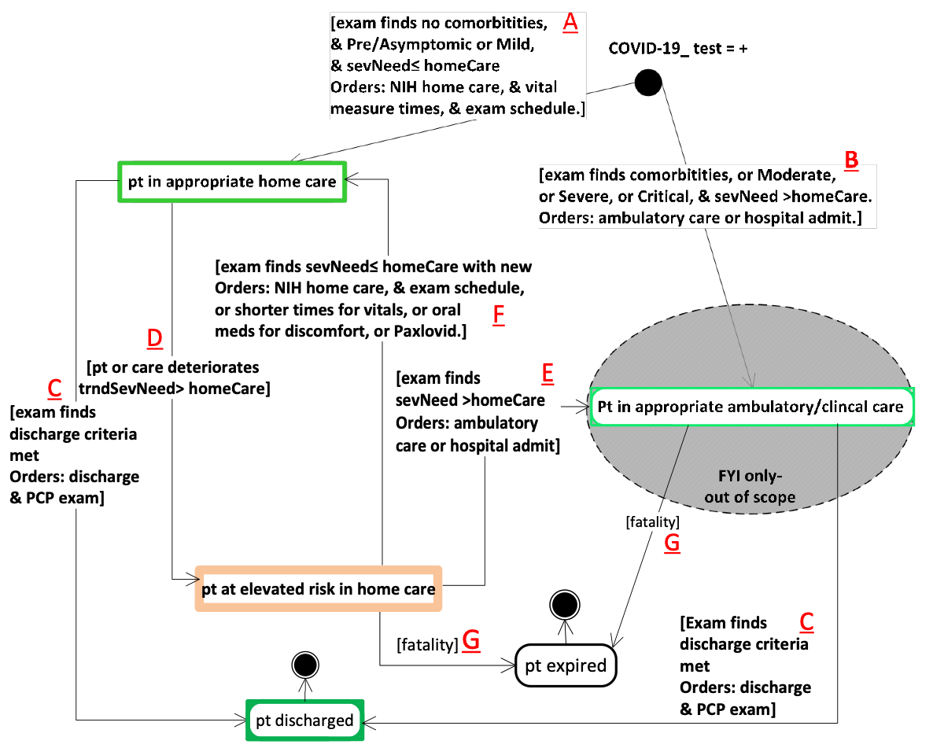
1. State: variables
Actionable Risk Awareness in Remote Patient Monitoring
orders (A, B, C, E, F)
sevNeed (A, B, E , F,)
homeCare (A, B, D, E, F)
trndSevNeed (D)
Notes:
Every state is associated with a predicate that is true if the system is in that state and false otherwise.
The predicates are defined by the variables referenced in the conditions on the edges in the state diagram.
Here the edges look at orders, sevNeed, homeCare, and trndSevNeed.
The values of these variables determine where a system is at in the state diagram.

Slide 10
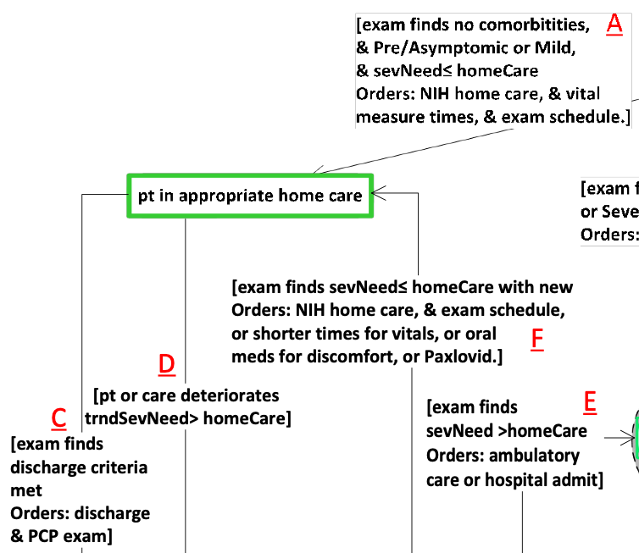
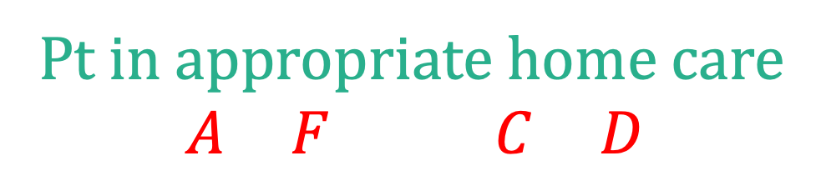
1. State: definitions
Actionable Risk Awareness in Remote Patient Monitoring
Defined by conditions
Must satisfy an input condition and
Must not satisfy any output conditions
2
2
Pt in appropriate home care
$$\left(A∨F\right)∧¬(C∨D)$$
Notes:
The state predicates are defined by the conditions on the transitions entering and leaving each state.
Consider state 2: at least one input condition, A or F must be true to reside in state 2, but that is not all.
None of the conditions on edges C and D may be true, otherwise the implementation is in a different state.
These requirements are captured in the predicate shown for Pt in appropriate home care
There is as similar predicate defined for every state in the diagram.
The predicates for each state are now used to define the properties that the model checker must verify.

Slide 11






2. Global Properties
Actionable Risk Awareness in Remote Patient Monitoring
2
1
The system design state, when mapped to the UML state variables, is always in a state
4
1
$$∨$$
2
$$∨$$
3
always
$$∨$$
4
$$∨$$
5
$$∨$$
6
3
The goal states are reachable (fair)
6
5
eventually
5
$$∨$$
6
Notes:
The first is that a system must always be in some state of the cognitive work problem. Always. So at least one of the predicates must be true at every point of the system.
Click.
The second is that the system eventually arrives at the goal states: discharged or expired.
This property is labeled fair and is used later in other properties.
The model checker considers everything allowed by the system, however improbable, so it might be possible that the system has paths where a patient is never discharged and never dies.
When analyzing systems, these impossible paths should be ignored; hence, the term fair, the model checker should only reason about fair paths or the paths that end in any one of the goal states.
Additionally, the model checker must prove that at least one fair path exists in the system.
That is the meaning of the second global property: at least one fair path exists.

Slide 12










3. State Properties
Actionable Risk Awareness in Remote Patient Monitoring
2
1
BPMN reaches state (witness)
fair
$$⟹$$
always
$$¬$$
2
4
BPMN only in one CWP state at a time
$$¬$$
1
$$∧$$
2
$$∧¬$$
3
3
always
2
$$⟹$$
$$∧¬$$
4
$$∧¬$$
5
$$∧¬$$
6
6
Only transitions defined in CWP allowed
5
fair
$$⟹$$
always
2
$$⟹$$
2
until
3
$$∨$$
5
Notes:
There are three properties created by every state of the cognitive work problem.
The first property says that the state must be reachable on some fair path of the system.
Here it is "always not (2)" because if the model checker finds a path to 2 in the system, then it will report that path as a witness to the existence of state 2.
Click
The second property is that the system is never in more than one state at a time--mode confusion. If this property is every violated, then more information must be added to the state diagram for the cognitive work problem in order to differentiate the states.
Click
The third property is that the system, when moving from one state to another in the state diagram only follows the defined transitions.
So anytime the system is in state 2 on some fair path, it stays in state 2 until it transitions to either state 3 or state 5.

Slide 13
UML Translation to Linear Temporal Logic
✓
✓
✓
1. State
Identify variables
Define states
2. Global Properties
All states covered
Reachable goals
3. State Properties
Reachable
Unique
Allowed edges
2 + 3(6)=20 properties to check for actionable risk awareness in remote patient care with integrated human and machine reasoning
Notes:
There are 20 properties in total that must hold for any system claiming to solve the cognitive work problem of actionable risk awareness for remote patient care for COVID 19.
These systems, in this work, are specified as workflows using the BPMN modeling language.

Slide 14
examTime =now
examTime =!now
alert dismissed- no exam orders
System Design in BPMN for Remote Patient Monitoring with PHware
examTime =now
Must satisfy the actionable risk awareness CWP
Notes:
The top portion of the workflow represents the responsibilities of the clinicians.
The workflow begins with a patient testing positive for COVID-19 and then having a subsequent exam.
Depending on the exam, the patient is prescribed home care or other appropriate care.
The orders include an exam schedule, so at some future exam, discharge criteria maybe satisfied and the patient no longer needs monitoring.
Similarly, if the patient is not in home care, but other ambulatory or hospital care, then that patient may be discharged or expire.
Click.
The bottom portion represents the responsibilities of the patient or those caring for the patient at home.
A patient in home care must start the doctor prescribed interventions and setup the PHware system.
Once PHware in configured, the patient follows the prescribed schedule for exams and measuring vitals.
The patient may expire in homecare, and if not, is expected to meet with the doctor or clinician at the scheduled times.
Here, the patient process ends at each exam time, and that process is restarted after an exam if needed.
Click
The middle portion of the workflow represents the responsibilities of the AI analytics in the cloud.
It starts when it receives vitals, and it ends after its analyses have sent their results back to the clinicians.
Click.
The vitals, and alerts, are reviewed by the appropriate clinicians depending on the alert status.
Click
In the presence of an alert, and based on the scheduled exam, the exam maybe rescheduled sooner.
Click
Similarly, in the absence of an alert, if the exam has yet to be scheduled, the normal routine exam is arranged.
Click
The person reviewing the vitals from the AI analytics may change the exam priority of the patient as appropriate.
Click
The workflow returns to the beginning if the scheduled exam is now.
Click
Or it returns to the monitoring state if it is not time for the exam.
This workflow must be expressed in the model checkers input language for verification.

Slide 15
BPMN translation to Promela
1. Token Semantics
Token activation
Consume & pass
2. State Mapping
Import CWP state
Add other state
Add state updates
3. Environment
Define values
Weak as possible
2 and 3 Require Help from Designer
Notes:
The translation takes place in three steps with the last two requiring some help from the designer as they involve mapping the state of the workflow to that of the state diagram for the cognitive work problem being solved.

Slide 16
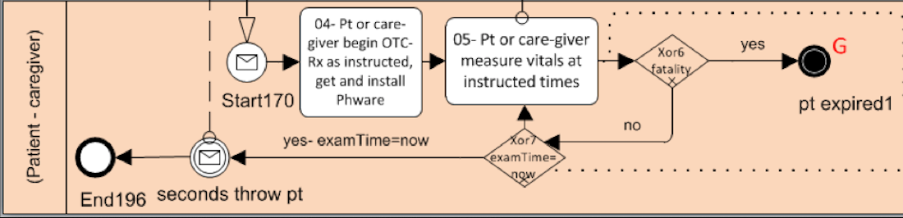
1. Token Semantics
active proctype patientCaregiver() {
do
:: hasToken(Start170) ->
atomic {
consumeToken(Start170)
/* State and environment updates */
putToken(Task04)
}
:: hasToken(Task04) -> …
:: …
od
}
Notes:
The first step is to represent the BPMN token semantics in Promela shown in the bottom portion of the slide.
In Promela, a proctype is a process. There is one process for each actor in the workflow: clinician, AI, and Patient.
Click
The workflow itself relies on tokens to mark where it is in the process. Here the token is in "Start170" according to the workflow at the top of the slide.
In Promela, the presence of that token at the indicated workflow location is designated with a global Boolean variable.
The line pointed to with the arrows in the Promela checks if the token is present at the Start170 element.
If that token is present, as determined by "hasToken", then it is possible for that token to activate the associated element.
Click.
In this example, the token is first consumed, since the element is now activated.
Click
The element then affects the global and local state according to its definition. More on this later.
Click
And then the token is moved along in accordance with the workflow semantics.
Click
In this example, it is placed in the 04 task as indicated by the token now on that visual element at the top of the slide.
These are the token semantics for BPMN workflows and how they are implemented in Promela.

Slide 17
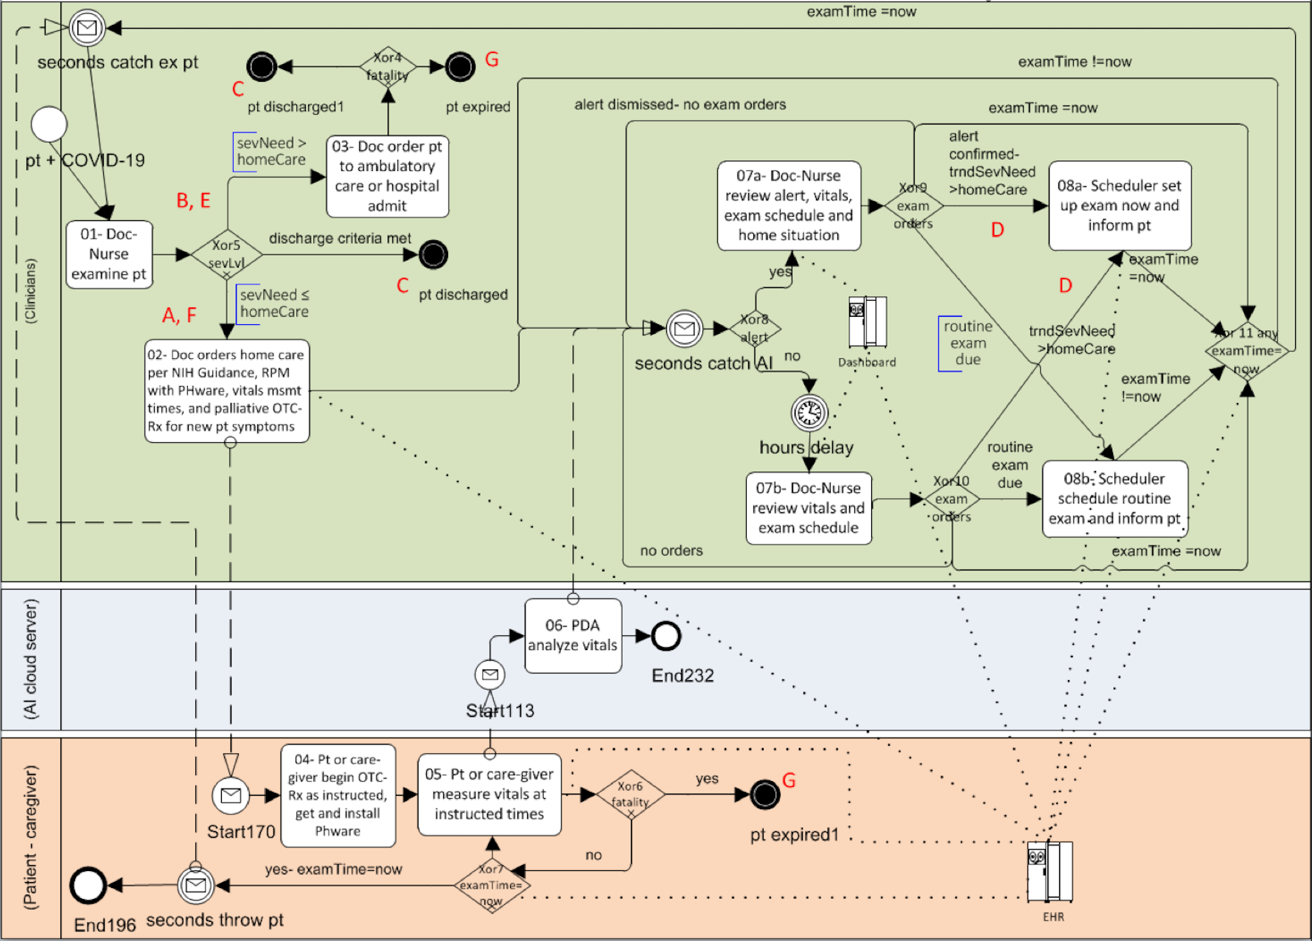
examTime
2. State Mapping
alert
Import CWP state
orders
sevNeed
homeCare
trndSevNeed
examTime
orders
sevNeed
homeCare
fatality
(sevNeed)
trndSevNeed
alert
Add other variables
alert
examTime
Add state updates
Notes:
The workflow state must be mapped to the state of the cognitive work problem.
That begins with the state variables from the state diagram: orders, sevNeed, homeCare, and trndSevNeed.
Click
Additional state variables are added to the workflow for things not mentioned in the state diagram.
In this example, an alert and examTime is needed.
Click
Finally, where these variables are mutated must be identified in the workflow.
Some of these locations are shown here.
For example, on the left, the orders, sevNeed, and homeCare must be assessed and assigned during the exam.
Similarly, on the right, the exam time must be set by the scheduling tasks.

Slide 18
2. State Mapping
active proctype patientCaregiver() {
do
:: hasToken(task05) ->
atomic {
consumeToken(task05)
updatePatientMortality(tndSevNeed,sevNeed)
putToken(Task04)
}
:: …
od
}
Notes:
Having identified where state updates take place, the promela is modified to make those updates after consuming the token and before putting the token in the next element.
Here we are updating whether or not the patient expires in home care.
It is determined by the updatePatientMortality definition that relies on the trending severity predicted by the AI and the actual severity determined by the in person exam.

Slide 19
3. Environment (weakest possible)
inline updatePatientMortality(trndSevNeed, sevNeed) {
if
:: (! isWithinHomeCare(trndSevNeed)) ->
setSeverity(sevNeed, EXPIRED)
:: (! isWithinHomeCare(sevNeed)) ->
setSeverity(sevNeed, EXPIRED)
:: true
fi
}
Home
Hospital
No Change
Model Checking considers all possibilities
Notes:
The model checker has three choices in updating the patient mortality.
Click
The first looks at the trending severity level, indicated by the green arrow, and is applicable when the patient is in home care.
The trending severity affects the risk level of the patient, and if the patient is at a higher risk, then that patient may expire.
Click
The second looks at the actual severity as assessed by the clinician and is applicable when the patient is in ambulatory or hospital care.
In both cases, home or hospital, if the severity, trending or otherwise, exceeds the level of care that can be provided at home, then the patient may expire.
Click
The third choice is always available to the model checker, and that is that nothing happens to the patient.
Click
In this way, the model checker can reason about the patient expiring or not expiring at any time that the patient's illness exceeds home care capabilities.

Slide 20
SPIN Verification Results
./short-verify.sh
never claim + (alwayInAState)
State-vector 60 byte, depth reached 3654, errors: 0
never claim + (fairPathExists)
State-vector 60 byte, depth reached 84, errors: 1
Global Properties
Witness (good)
The PHWare System Design for remote patient care correctly implements the CWP of actionable risk awareness
never claim + (ptInAppropriateHomeCareExists)
State-vector 60 byte, depth reached 84, errors: 1
never claim + (ptInAppropriateHomeCareMutex)
State-vector 60 byte, depth reached 3654, errors: 0
never claim + (ptInAppropriateHomeCareEdges)
State-vector 60 byte, depth reached 3654, errors: 0
Properties for one of the states
never claim + (ptInElevatedRiskHomeCareEdges)
State-vector 60 byte, depth reached 3654, errors: 0
real 1m5.452s
user 1m0.701s
sys 0m3.009s
Verification time
Notes:
Here is the output from SPIN for verification.
Click
The global properties passed. Note the second reports an error, which is good, because that is a witness that at least one fair path exists in the system.
Click
Here are the properties for patient in appropriate home care. As before, the error is good since it says the state exists on at least one fair path.
Click
Finally, the total time is under 3 minutes on my laptop.
Click
SPIN provided several counterexamples along the way to the final verification.
Sometimes the counter-examples revealed issues with the state diagram
Sometimes the counter-examples revealed issues with the workflow
None of the counterexamples were spotted manually by the designers---they believed the system to be correct.

Slide 21
Conclusions and Future Work
Functional integration of human and machine reasoning is hard
CWP is a technology-neutral specification of what an integrated human and machine reasoning system must accomplish
The integration itself was developed with workflows using BPMN
UML can be translated into LTL and BPMN into Promela
SPIN verified the BPMN against the CWP of actionable risk awareness
Future work is to complete automation of translations
Raises important questions about the relationship between the system design state and the CWP state: mapping required
Notes:
Reasoning about functional integration is hard but necessary in capital and safety critical workflows requiring a clear definition of what a system is intended to do and how it accomplishes it.
The cognitive work problem is an effective way to specify the what of integration while a workflow model specifies the how.
These can be translated to the input of a model checker to prove that a workflow solves, or does not solve, the cognitive work problem.
The translation turns the state diagram for the cognitive work problem into linear temporal logic properties and the workflow into Promela
Future work is to automate the translation and to map the counter examples from the model checker back into the graphical representations.
Other work is to make explicit the mapping between the state diagram and the state of the workflow including where and how the updates take place in the workflow representation.
Please see the paper for details on the specification, translation, and verification in SPIN.
Thank you for your attention in viewing this presentation, and I certainly welcome questions. My contact information is available with a google search of my name with Brigham Young University.

