Slide 1


Model Checking Functional Integration of Human Cognition and Machine Reasoning
Eric Mercer*
Brigham Young University
Provo UT, USA
Keith Butler
University of Washington
Seattle WA, USA
Ali Bahrami
Bionous LLC
Kirkland WA, USA

Slide 2
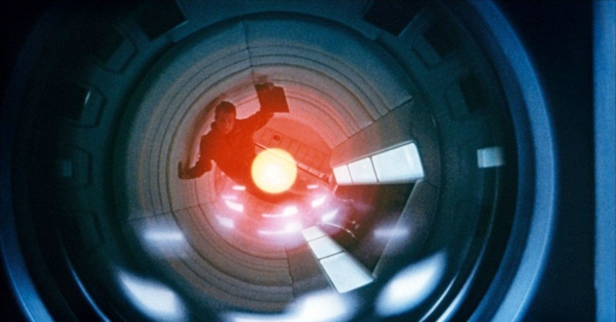
Functional integration of human cognition and machine reasoning is challenging especially where failure risks health or safety
Notes:
Human machine teaming is fast becoming ubiquitous as machine reasoning and automation is integrated into workflows.
It business, it creates a capitol risk.
It healthcare, it creates a health and safety risk.
As workflows are defined that include automation or machine reasoning, functional integration is very important.

Slide 3
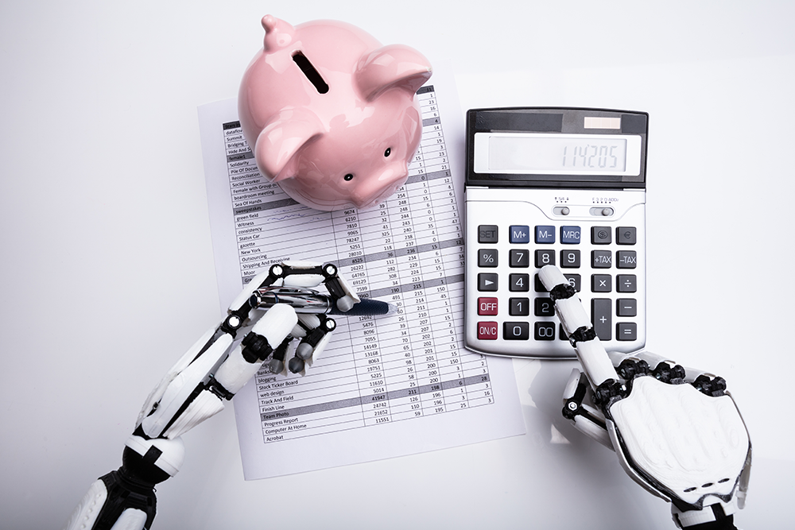
The vast difference between humans and machines challenge conventional methods of integration
Notes:
There is an inherent discontinuity in performance and ability between a human and a machine.
That goes both ways.
There are things the machine can do that the human cannot and there are things the human can do that the machine cannot.
When thinking of functional integration, these differences in ability and performance challenge traditional methods such as … ASK KEITH FOR MORE HERE.

Slide 4
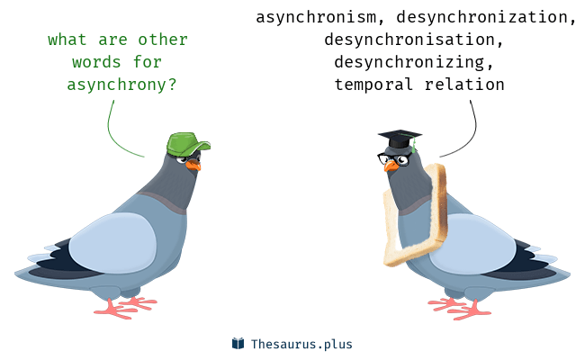
Asynchrony and distribution make manual reasoning difficult at best
Notes:
Humans are not good when it comes to reasoning about asynchronous interaction.
They don’t see emergent behavior, and they don’t see unintended consequences of synchronization (or the lack thereof).

Slide 5

Asynchrony and distribution make manual reasoning difficult at best

Slide 6
Proposed Solution
What
How
Cognitive Work Problem (CWP)
Workflow Model (BPMN)
Model Checking (SPIN)
Does the BPMN implements the CWP?

Slide 7
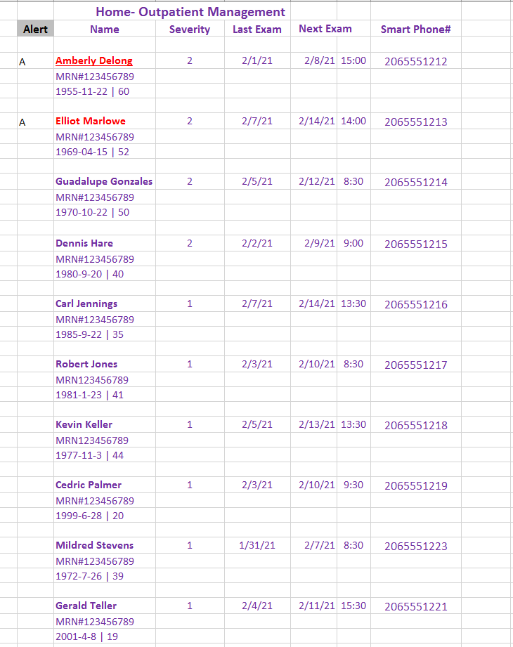
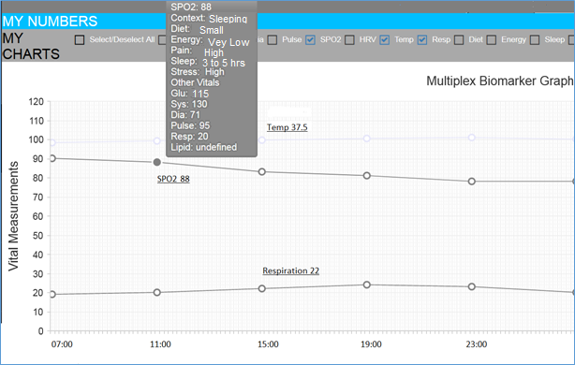
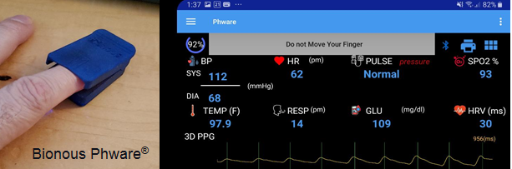
Remote Patient Monitoring

Slide 8
CWP
Remote Patient Monitoring
Notes:
Computation Independent Model
Content based on NIH Guidelines for non-hospitalized COVID patients.
Finite state machine represents-
relevant states home care patients can occupy
physical events and exam findings that guard state transitions.
Graphical UML standard that allowed SME participation in design.

Slide 9
Linear Temporal Logic for the CWP
CWP States
Conjunct inputs
Negate outputs
Global Properties
All states covered
Reachable goals
State Properties
Reachable
Unique
Allowed edges
2 + 3N properties to check on BPMN

Slide 10
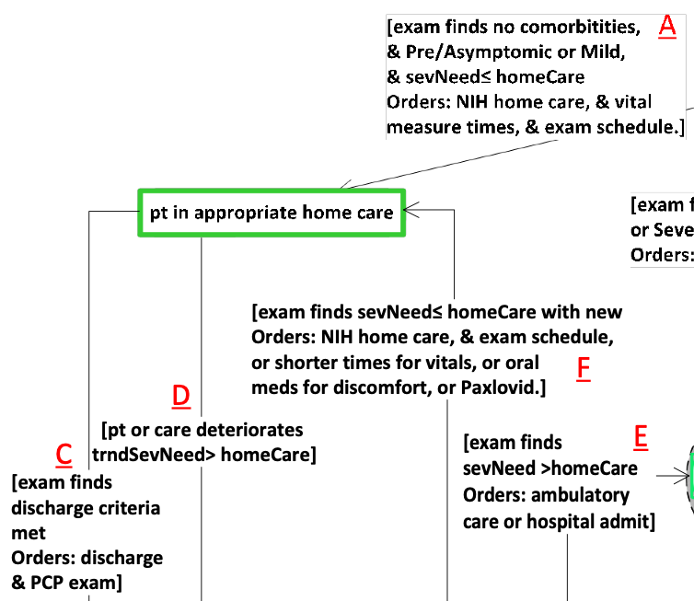

CWP States
Must satisfy input conditions and
Must not satisfy any output conditions
Pt in appropriate home care
$$\left(A∧F\right)∧¬(C∨D)$$

Slide 11
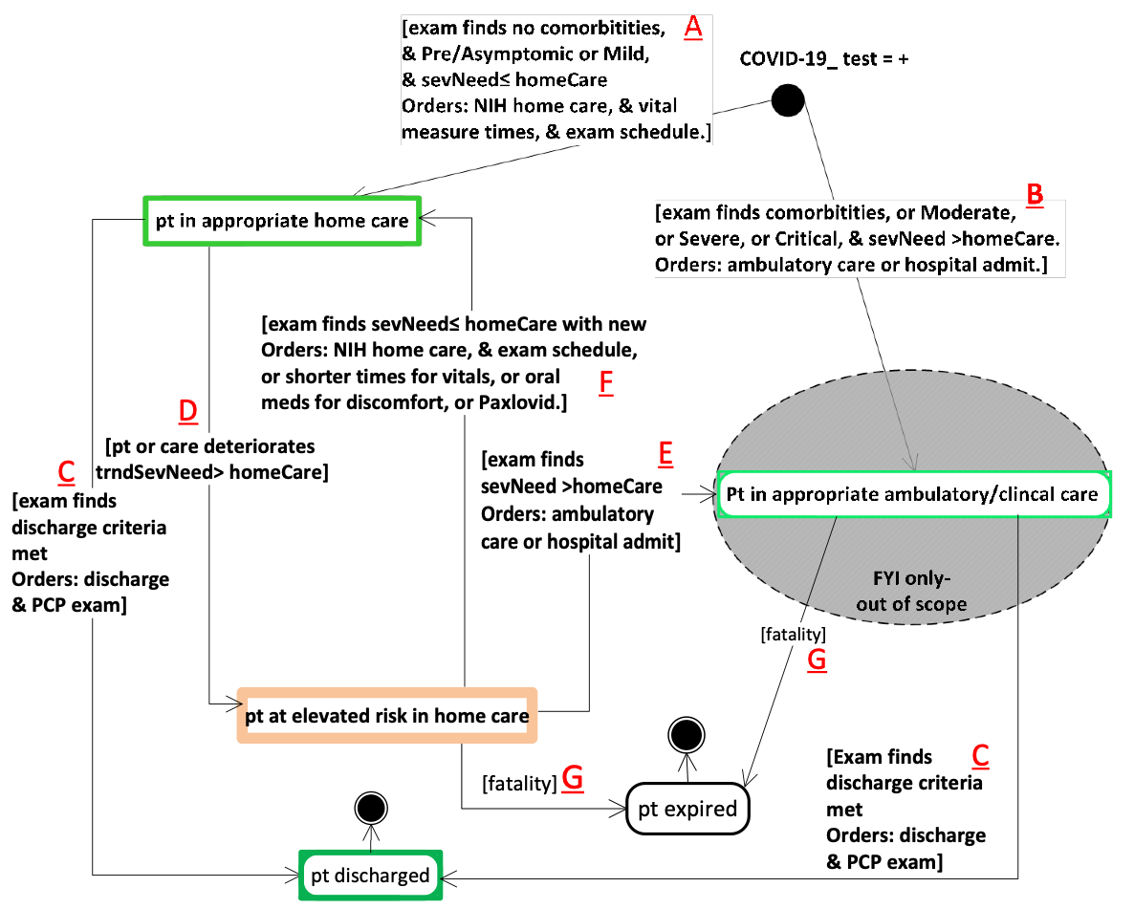






Global Properties
1
2
Object covered by some CWP state
$$∨$$
$$∨$$
4
1
2
3
always
$$∨$$
4
$$∨$$
5
$$∨$$
6
3
The goal states are reachable (fair)
6
5
eventually
5
$$∨$$
6

Slide 12
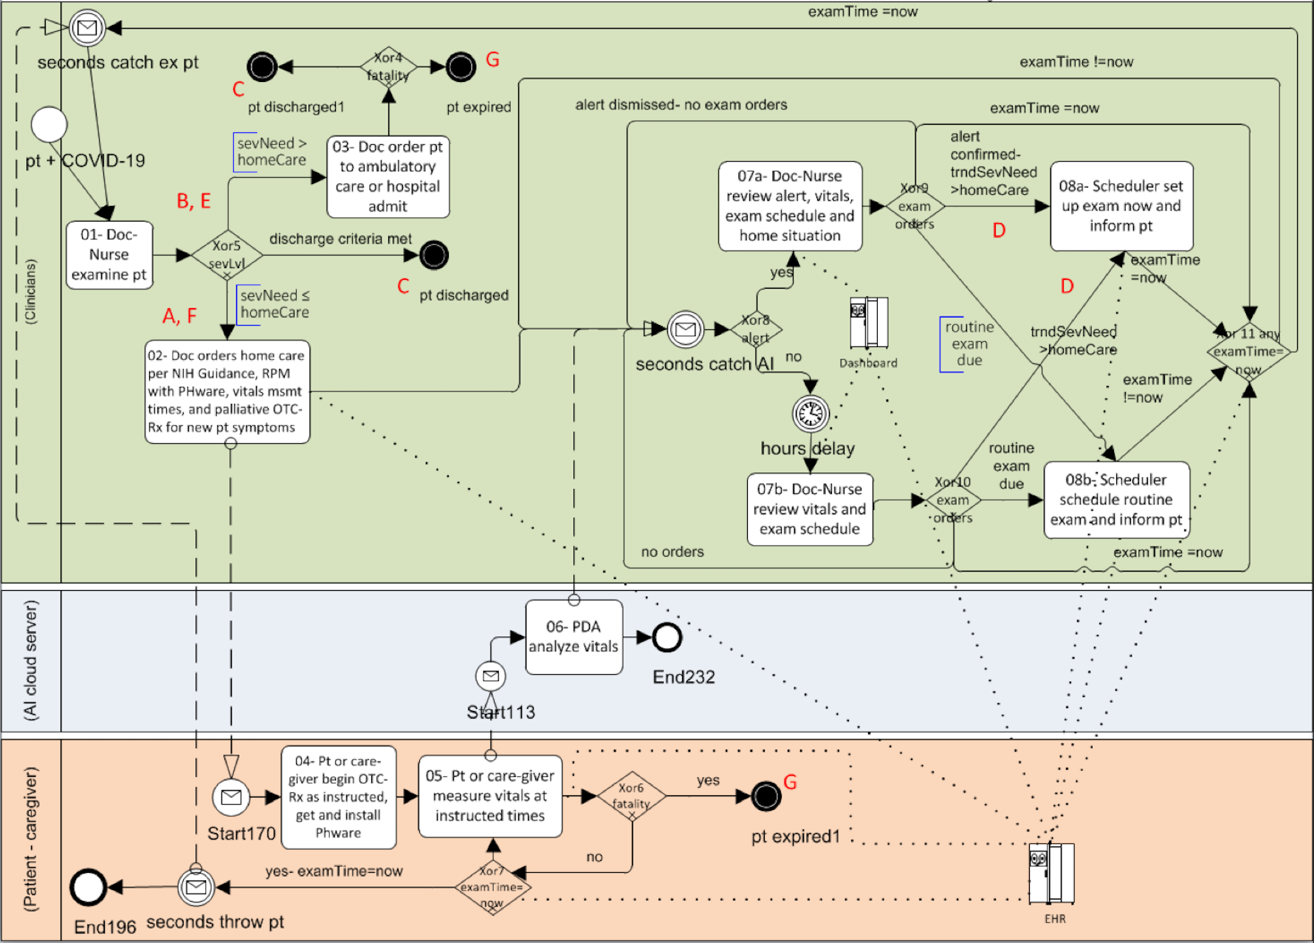
BPMN
PHware Remote Patient Monitoring

Slide 13
examTime =now
examTime =!now
alert dismissed- no exam orders
BPMN
PHware Remote Patient Monitoring
examTime =now

