Slide 1


Model Checking Functional Integration of Human Cognition and Machine Reasoning
Eric Mercer*
Brigham Young University
Provo UT, USA
Keith Butler
University of Washington
Seattle WA, USA
Ali Bahrami
Bionous LLC
Kirkland WA, USA

Slide 2
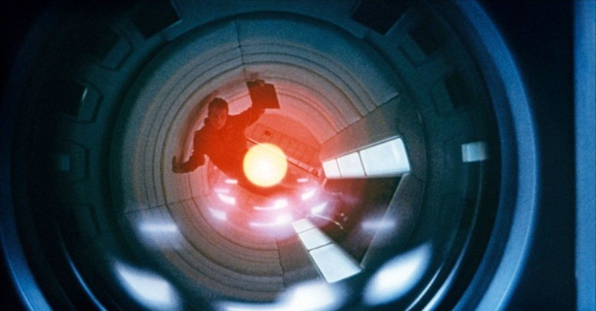
Functional integration of human cognition and machine reasoning is challenging especially where failure risks health or safety
Notes:
Human machine teaming is fast becoming ubiquitous as machine reasoning and automation is integrated into workflows.
It business, it creates a capitol risk.
It healthcare, it creates a health and safety risk.
As workflows are defined that include automation or machine reasoning, functional integration is very important.

Slide 3
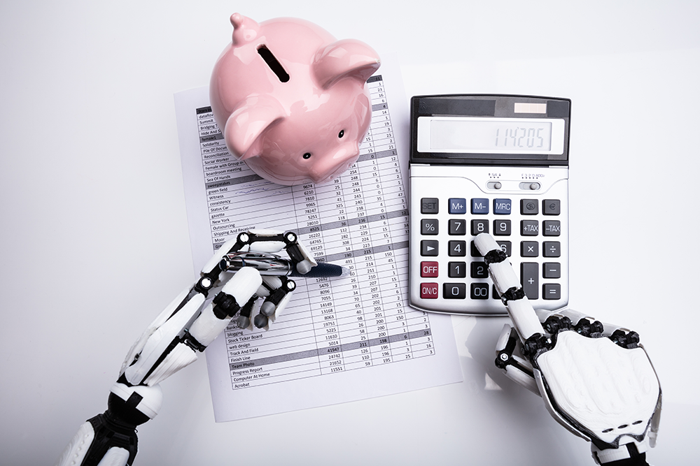
The vast difference between humans and machines challenge conventional methods of integration
Notes:
There is an inherent discontinuity in performance and ability between a human and a machine.
That goes both ways.
There are things the machine can do that the human cannot and there are things the human can do that the machine cannot.
When thinking of functional integration, these differences in ability and performance challenge traditional methods such as … ASK KEITH FOR MORE HERE.

Slide 4
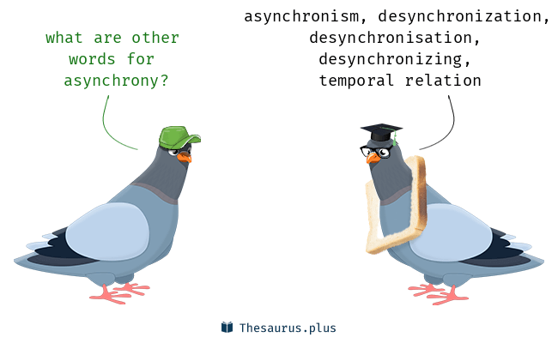
Asynchrony and distribution make manual reasoning difficult at best
Notes:
Humans are not good when it comes to reasoning about asynchronous interaction.
They don’t see emergent behavior, and they don’t see unintended consequences of synchronization (or the lack thereof).

Slide 5
Proposed Solution
What
How
Cognitive Work Problem (CWP)
Workflow Model (BPMN)
To Linear Temporal Logic (LTL)
To Process Meta Language (Promela)
Model Checking (SPIN)
Does the BPMN implements the CWP?

Slide 6
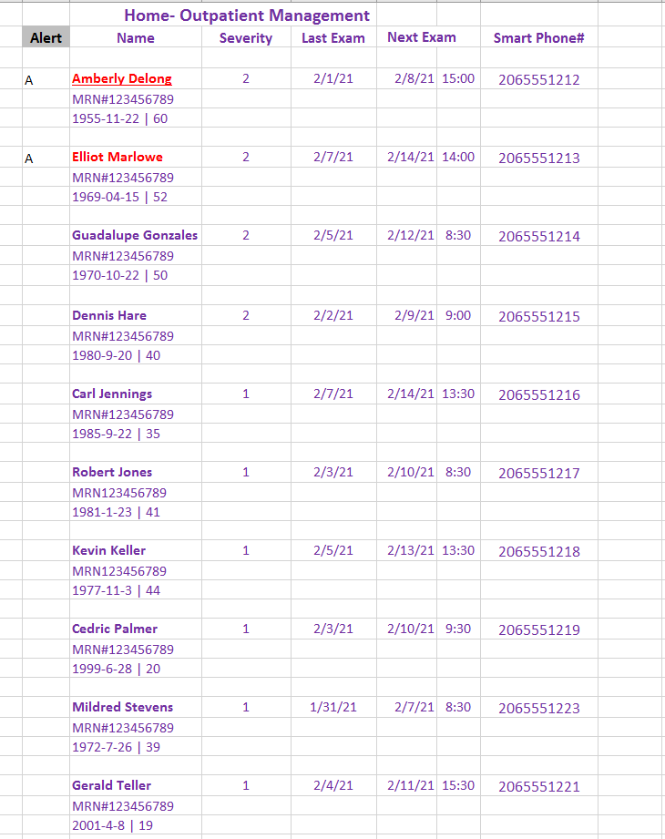
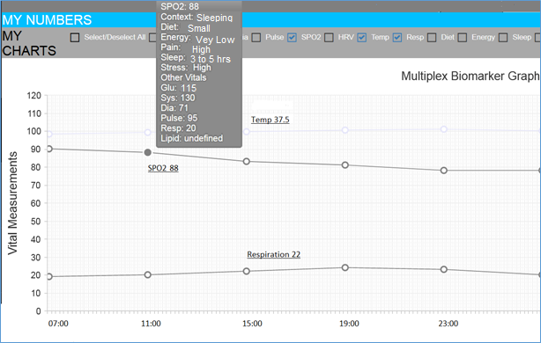
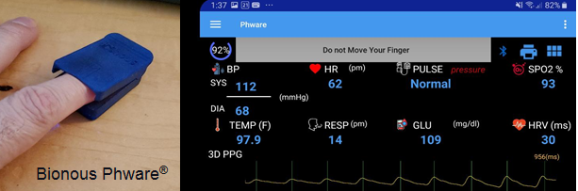
Remote Patient Monitoring

Slide 7
CWP
Remote Patient Monitoring
Notes:
Computation Independent Model
Content based on NIH Guidelines for non-hospitalized COVID patients.
Defines the state for the functional integration—see the conditions on the edges.
Finite state machine represents-
relevant states home care patients can occupy
physical events and exam findings that guard state transitions.
Graphical UML standard that allowed SME participation in design.

Slide 8
LTL for the CWP
CWP States
Define variables
Conjunct inputs
Negate outputs
Global Properties
All states covered
Reachable goals
State Properties
Reachable
Unique
Allowed edges
2 + 3(N) properties to check on BPMN

Slide 9
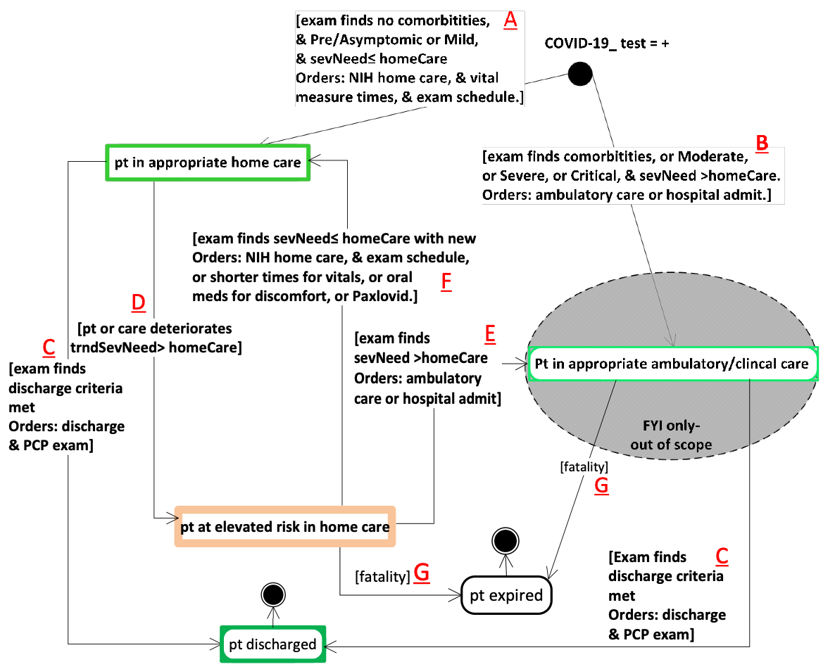
CWP State
orders (A, B, C, E, F)
sevNeed (A, B, E , F,)
homeCare (A, B, D, E, F)
trndSevNeed (D)

Slide 10
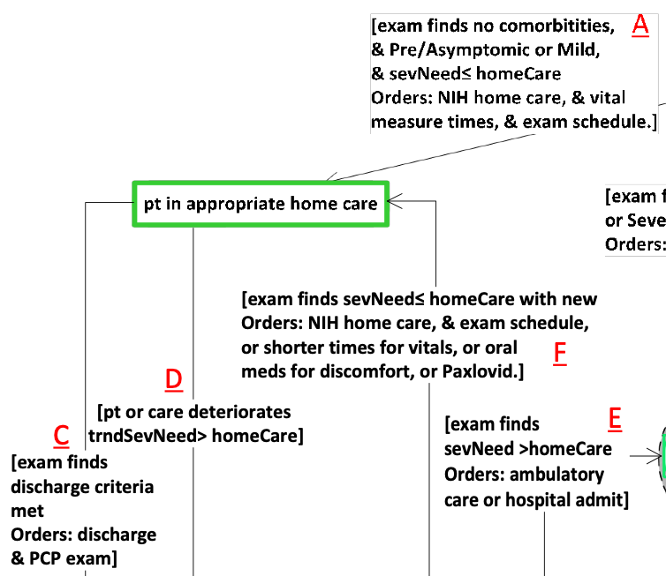
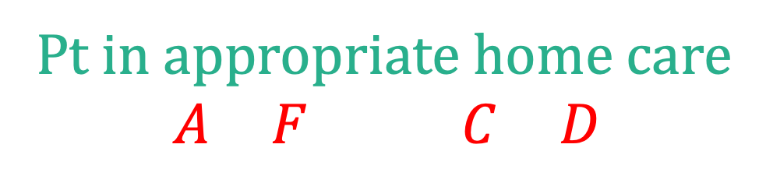
CWP States
Defined by conditions
Must satisfy input conditions and
Must not satisfy any output conditions
2
2
Pt in appropriate home care
$$\left(A∧F\right)∧¬(C∨D)$$

Slide 11






Global Properties
1
2
BPMN state covered by some CWP state
4
1
$$∨$$
2
$$∨$$
3
always
$$∨$$
4
$$∨$$
5
$$∨$$
6
3
The goal states are reachable (fair)
6
5
eventually
5
$$∨$$
6
Notes:
The “object” is the state of the BPMN claiming to implement this CWP.
That BPMN must have a mapping from it’s state to the variables that define the state of the CWP.
Every state of the BPMN must be is some state of the CWP. Always.

Slide 12










State Properties
1
2
BPMN reaches state (witness)
fair
$$⟹$$
always
$$¬$$
2
4
BPMN only in one CWP state at a time
$$¬$$
1
$$∧$$
2
$$∧¬$$
3
3
always
2
$$⟹$$
$$∧¬$$
4
$$∧¬$$
5
$$∧¬$$
6
6
Only transitions defined in CWP allowed
5
fair
$$⟹$$
always
2
$$⟹$$
2
until
3
$$∨$$
5

Slide 13
LTL for the CWP
CWP States
Conjunct inputs
Negate outputs
Global Properties
All states covered
Reachable goals
State Properties
Reachable
Unique
Allowed edges
2 + 3(6)=20 properties to check on BPMN

Slide 14
examTime =now
examTime =!now
alert dismissed- no exam orders
BPMN
PHware Remote Patient Monitoring
examTime =now

Slide 15
Promela for the BPMN
Token Semantics
Token activation
Consume & pass
Define State
Import CWP state
Add other state
Update locations
Environment (input)
Values
Weak as possible
Additional information from designer

Slide 16
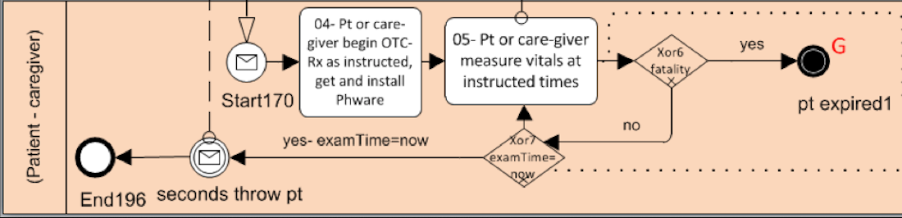
Token Activation Semantics
active proctype patientCaregiver() {
do
:: hasToken(Start170) ->
atomic {
consumeToken(Start170)
/* State and environment updates */
putToken(Task04)
}
:: hasToken(Task04) -> …
:: …
od
}
Notes:
There are no attributes on the tokens.

Slide 17
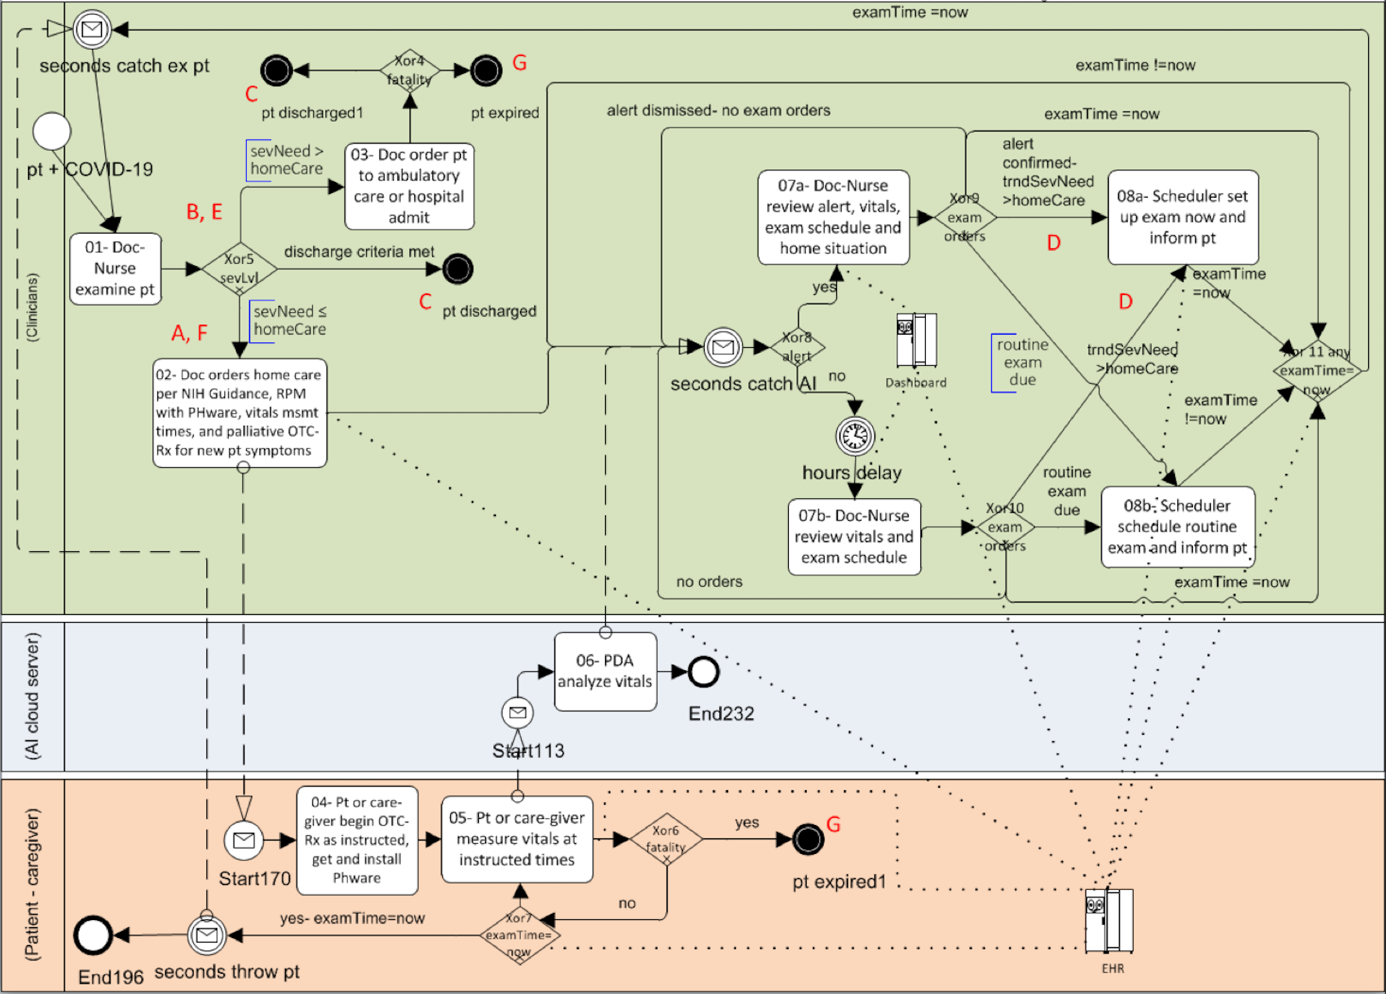
examTime
State
Import CWP state
orders
sevNeed
homeCare
trndSevNeed
alert
examTime
orders
sevNeed
homeCare
fatality
(sevNeed)
Add other variables
alert
examTime
trndSevNeed
alert
Identify updates

Slide 18
Environment
active proctype patientCaregiver() {
do
:: hasToken(task05) ->
atomic {
consumeToken(task05)
updatePatientMortality(tndSevNeed,sevNeed)
putToken(Task04)
}
:: …
od
}
Notes:
There are no attributes on the tokens.

Slide 19
Weakest Environment Possible
inline updatePatientMortality(trndSevNeed, sevNeed) {
if
:: (! isWithinHomeCare(trndSevNeed)) ->
setSeverity(sevNeed, EXPIRED)
:: (! isWithinHomeCare(sevNeed)) ->
setSeverity(sevNeed, EXPIRED)
:: true
fi
}
At Home
Hospital

Slide 20
SPIN Verification
./short-verify.sh
never claim + (alwayInAState)
State-vector 60 byte, depth reached 3654, errors: 0
never claim + (fairPathExists)
State-vector 60 byte, depth reached 84, errors: 1
Global Properties
Witness (good)
never claim + (ptInAppropriateHomeCareExists)
State-vector 60 byte, depth reached 84, errors: 1
never claim + (ptInAppropriateHomeCareMutex)
State-vector 60 byte, depth reached 3654, errors: 0
never claim + (ptInAppropriateHomeCareEdges)
State-vector 60 byte, depth reached 3654, errors: 0
Properties for one of the states
never claim + (ptInElevatedRiskHomeCareEdges)
State-vector 60 byte, depth reached 3654, errors: 0
real 1m5.452s
user 1m0.701s
sys 0m3.009s
Verification time

Slide 21
Conclusions and Future Work
Functional integration of human and machine reasoning is hard
Vast performance differences and asynchrony challenge reasoning
CWP is a adequate declarative specification of what an integrated human and machine reasoning system must accomplish
The integration itself can be defined with with workflows using BPMN
Model checking can verify a workflow against a CWP
Requires the CWP be turned into LTL and the BPMN into Promela
SPIN verifies the BPMN satisfies the CWP
Future work is to automate the process

